Slide 1
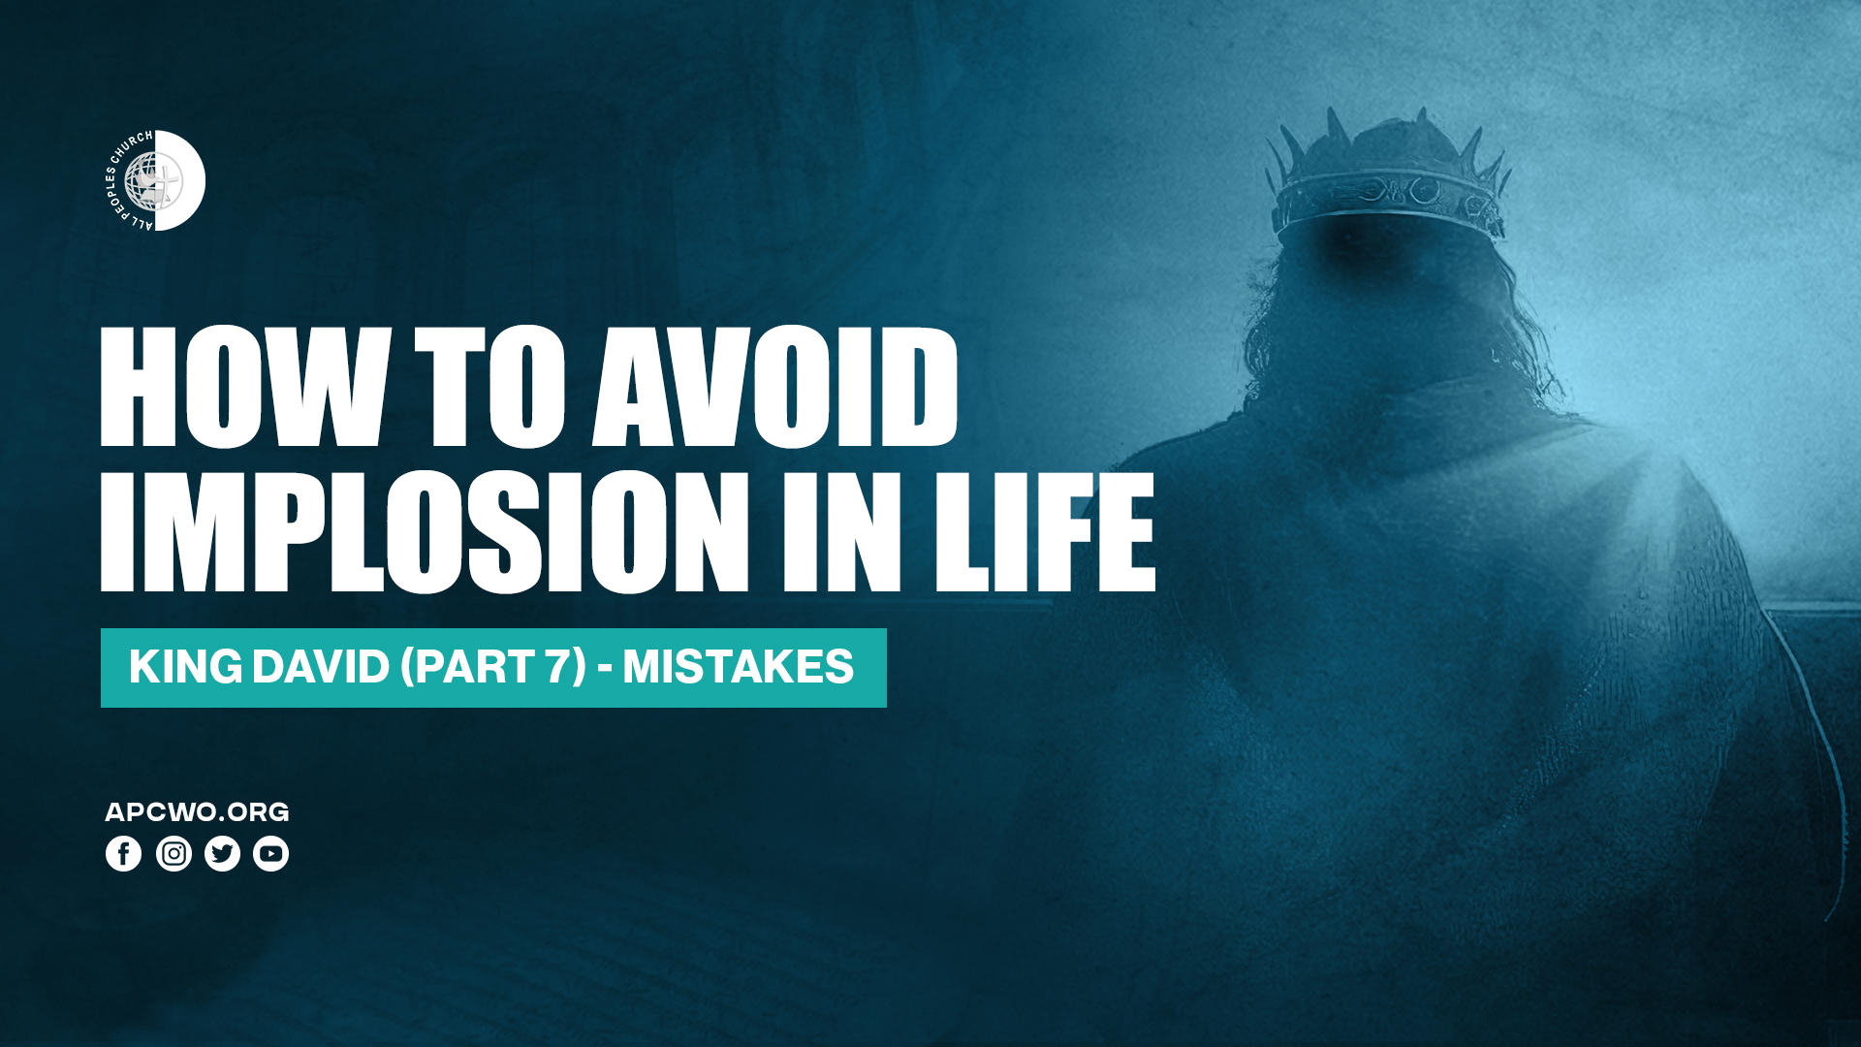

Slide 2
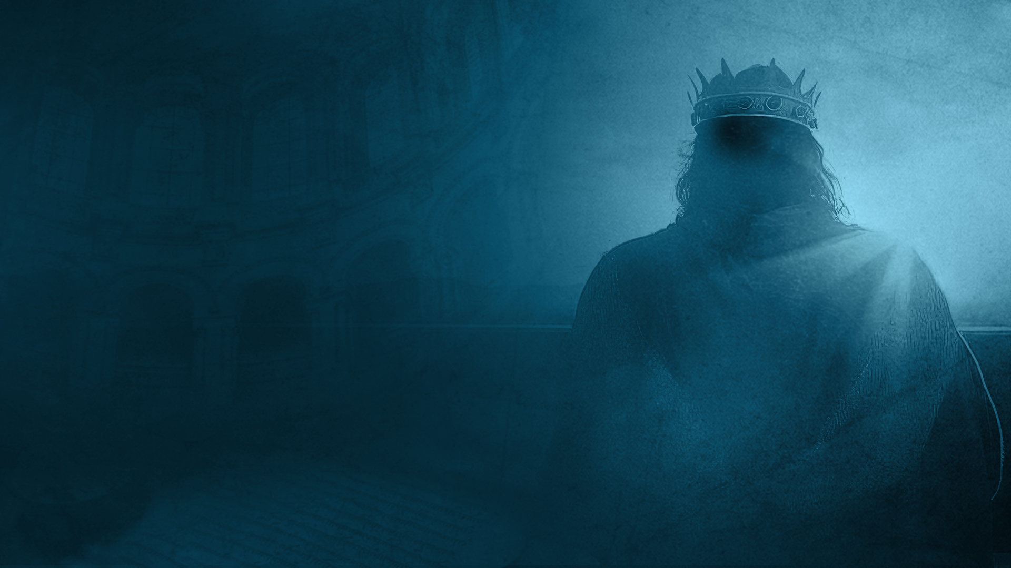
2 Samuel 11-24,
1 Chronicles 17-21

Slide 3
MISTAKES

Slide 4
Overview of this phase of David’s life:
• David and Bathsheba
(2 Samuel 11).
• Nathan’s rebuke and David’s repentance (2 Samuel 12:1-15,
Psalm 51).
• The mercy of God
(2 Samuel 12:24-31, 1 Chronicles 20).
• Family problems: Amnon, Tamar, Absalom (2 Samuel 13,14).

Slide 5
• Troubles with Absalom
(2 Samuel 15-18).
• David forgives his enemies
(2 Samuel 19).
• The rebellion of Sheba
(2 Samuel 20).
• Atonement for the land
(2 Samuel 21).
• David’s song of deliverance
(2 Samuel 22).

Slide 6
• David's mighty men
(2 Samuel 23, 1 Chronicles 11,12).
• David's census and atonement
(2 Samuel 24, 1 Chronicles 21).

Slide 7
Key insights: How to avoid implosion in life

Slide 8
STAY IN THE BATTLE. STAY IN YOUR PLACE OF ASSIGNMENT

Slide 9
2 Samuel 11:1,2
1 It happened in the spring of the year, at the time when kings go out to battle, that David sent Joab and his servants with him, and all Israel; and they destroyed the people of Ammon and besieged Rabbah. But David remained at Jerusalem.
2 Then it happened one evening that David arose from his bed and walked on the roof of the king's house. And from the roof he saw a woman bathing, and the woman was very beautiful to behold.

Slide 10
DON’T IGNORE YOUR CORE. WHEN THE CORE WEAKENS,
THE WHOLE COLLAPSES.

Slide 11
2 Samuel 13:21-23
21 But when King David heard of all these things, he was very angry.
22 And Absalom spoke to his brother Amnon neither good nor bad. For Absalom hated Amnon, because he had forced his sister Tamar.
23 And it came to pass, after two full years, that Absalom had sheepshearers in Baal Hazor, which is near Ephraim; so Absalom invited all the king's sons.

Slide 12
Never sacrifice your walk with God to maintain the appearance of success.

Slide 13
RESOLVE ISSUES AT THE FIRST INSTANT. DELAYS COULD MEAN DISASTER.

Slide 14
2 Samuel 13:32,38,39
32 Then Jonadab the son of Shimeah, David's brother, answered and said, "Let not my lord suppose they have killed all the young men, the king's sons, for only Amnon is dead. For by the command of Absalom this has been determined from the day that he forced his sister Tamar.
38 So Absalom fled and went to Geshur, and was there three years.
39 And King David longed to go to Absalom. For he had been comforted concerning Amnon, because he was dead.

Slide 15
2 Samuel 14:23,24,28,29
23 So Joab arose and went to Geshur, and brought Absalom to Jerusalem.
24 And the king said, "Let him return to his own house, but do not let him see my face." So Absalom returned to his own house, but did not see the king's face.
28 And Absalom dwelt two full years in Jerusalem, but did not see the king's face.
29 Therefore Absalom sent for Joab, to send him to the king, but he would not come to him. And when he sent again the second time, he would not come.

Slide 16
2 Samuel 14:33
So Joab went to the king and told him. And when he had called for Absalom, he came to the king and bowed himself on his face to the ground before the king. Then the king kissed Absalom.

Slide 17
Delayed action is inaction when it matters most.

Slide 18
Watch over your people.
Know their hearts.
Prevent rebellion.

Slide 19
Proverbs 27:23-27
23 Be diligent to know the state of your flocks, And attend to your herds;
24 For riches are not forever, Nor does a crown endure to all generations.
25 When the hay is removed, and the tender grass shows itself, And the herbs of the mountains are gathered in,
26 The lambs will provide your clothing, And the goats the price of a field;
27 You shall have enough goats' milk for your food, For the food of your household, And the nourishment of your maidservants.

Slide 20
GUARD YOUR VULNERABILITIES IN THE HIGHS AND LOWS.

Slide 21
1 Chronicles 21:1
Now Satan stood up against Israel, and moved David to number Israel.

Slide 22
The end of the battle does not mean the end of every danger.

Slide 23
Past victories cannot be a substitute for present obedience.

Slide 24
Yesterday's victories do not eliminate today's need for vigilance.

Slide 25
Complacency when everything seems to be going well can be dangerous.

Slide 26
The moment we begin to think we no longer need counsel is the moment we need it most.

Slide 27
The applause of friends can become more dangerous than the criticism of your enemies.

Slide 28
Guard your heart in every season, when you are winning, when you are weeping, or when you are just waiting.

Slide 29
GOD IS BIGGER THAN OUR MISTAKES. HE REALIGNS AND RESTORES.

Slide 30
The mercy of God:
Solomon was born.
Rabbah was captured.
The kingdom was retained.
A temple was built.

Slide 31
2 Chronicles 3:1
Now Solomon began to build the house of the LORD at Jerusalem on Mount Moriah, where the LORD had appeared to his father David, at the place that David had prepared on the threshing floor of Ornan the Jebusite.

Slide 32
PSALMS OF DAVID MOST LIKELY WRITTEN IN THIS PHASE:
Psalm 51
Psalm 32
Psalm 38
Psalm 39
Psalm 3

