Slide 1
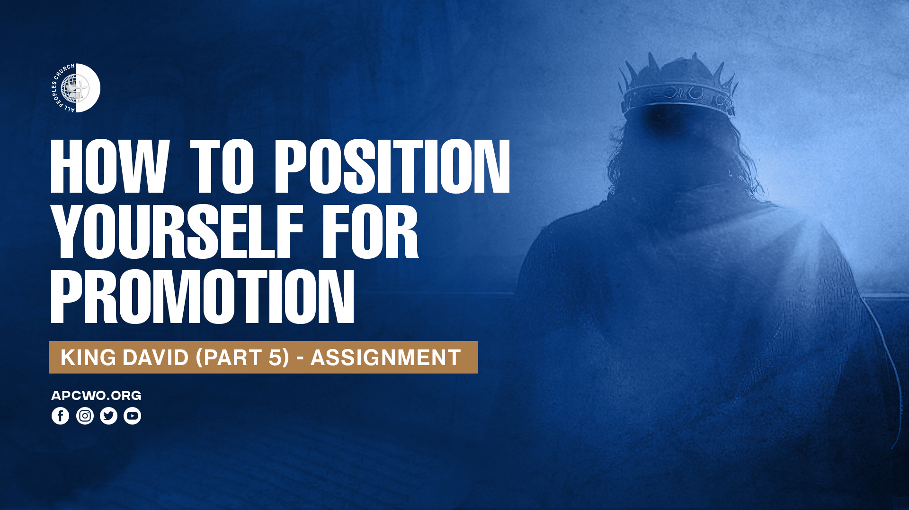

Slide 2

STEPPING INTO
LIFE’S ASSIGNMENT

Slide 3
SAUL’S DEATH,
DAVID’S RESPONSE

Slide 4
1 Samuel 31, 2 Samuel 1

Slide 5
2 Samuel 1:11,12
11 Therefore David took hold of his own clothes and tore them, and so did all the men who were with him.
12 And they mourned and wept and fasted until evening for Saul and for Jonathan his son, for the people of the LORD and for the house of Israel, because they had fallen by the sword.

Slide 6
2 Samuel 1:19,23
19 The beauty of Israel is slain on your high places! How the mighty have fallen!
23 Saul and Jonathan were beloved and pleasant in their lives, And in their death they were not divided; They were swifter than eagles, They were stronger than lions.

Slide 7
SHOULD I MOVE? WHERE?

Slide 8
2 Samuel 2:1
It happened after this that David inquired of the LORD, saying, "Shall I go up to any of the cities of Judah?" And the LORD said to him, "Go up." David said, "Where shall I go up?" And He said, "To Hebron."

Slide 9
DAVID BECOMES KING
OVER JUDAH

Slide 10
2 Samuel 2:2-4
2 So David went up there, and his two wives also, Ahinoam the Jezreelitess, and Abigail the widow of Nabal the Carmelite.
3 And David brought up the men who were with him, every man with his household. So they dwelt in the cities of Hebron.
4 Then the men of Judah came, and there they anointed David king over the house of Judah.

Slide 11
DAVID GROWS STRONGER AND STRONGER

Slide 12
2 Samuel 3:1
Now there was a long war between the house of Saul and the house of David. But David grew stronger and stronger, and the house of Saul grew weaker and weaker.

Slide 13
2 Samuel 3:36
Now all the people took note of it, and it pleased them, since whatever the king did pleased all the people.

Slide 14
Psalm 60:12
Through God we will do valiantly, For it is He who shall tread down our enemies.

Slide 15
SEVEN YEARS — AND THEN IT HAPPENED! DAVID BECOMES KING OVER ALL ISRAEL

Slide 16
2 Samuel 5:1-5
1 Then all the tribes of Israel came to David at Hebron and spoke, saying, "Indeed we are your bone and your flesh.
2 Also, in time past, when Saul was king over us, you were the one who led Israel out and brought them in; and the LORD said to you, 'You shall shepherd My people Israel, and be ruler over Israel.' "
3 Therefore all the elders of Israel came to the king at Hebron, and King David made a covenant with them at Hebron before the LORD. And they anointed David king over Israel.

Slide 17
2 Samuel 5:1-5
4 David was thirty years old when he began to reign, and he reigned forty years.
5 In Hebron he reigned over Judah seven years and six months, and in Jerusalem he reigned thirty-three years over all Israel and Judah.

Slide 18
Psalm 18
Psalm 133
Psalm 101

Slide 19
POSITIONING — RIGHT PLACE, RIGHT TIME

Slide 20
Positioning is being in the right place at the right time doing the right thing.

Slide 21
Ecclesiastes 8:5,6
5 He who keeps his command will experience nothing harmful; And a wise man's heart discerns both time and judgment,
6 Because for every matter there is a time and judgment, Though the misery of man increases greatly.

Slide 22
Ask God to show you where and how to position yourself and what you need to grow.

Slide 23
PSALMS OF DAVID IN THIS PHASE:
Psalm 18: David's deliverance from Saul and his enemies.
Psalm 60: David's military campaigns and victory over enemies east of the Jordan.
Psalm 61: David crying to God from a place of distance and dependence.
Psalm 67: prayer for God's blessing and the extension of His salvation to the nations.

Slide 24
Psalm 68: God's victorious procession and establishment of His dwelling.
Psalm 101: David's declaration concerning how he intends to govern.
Psalm 110: strongly royal/Messianic; traditionally Davidic.
Psalm 122: Jerusalem/Zion, although the exact date is uncertain.

Slide 25
Psalm 124: thanksgiving for God's deliverance.
Psalm 131: humility and quietness before God.
Psalm 133: unity among God's people.
Psalm 138: thanksgiving for God's faithfulness.

