Slide 1


Slide 2

ADVERSITY

Slide 3
AN ENEMY FOR THE WRONG REASONS

Slide 4
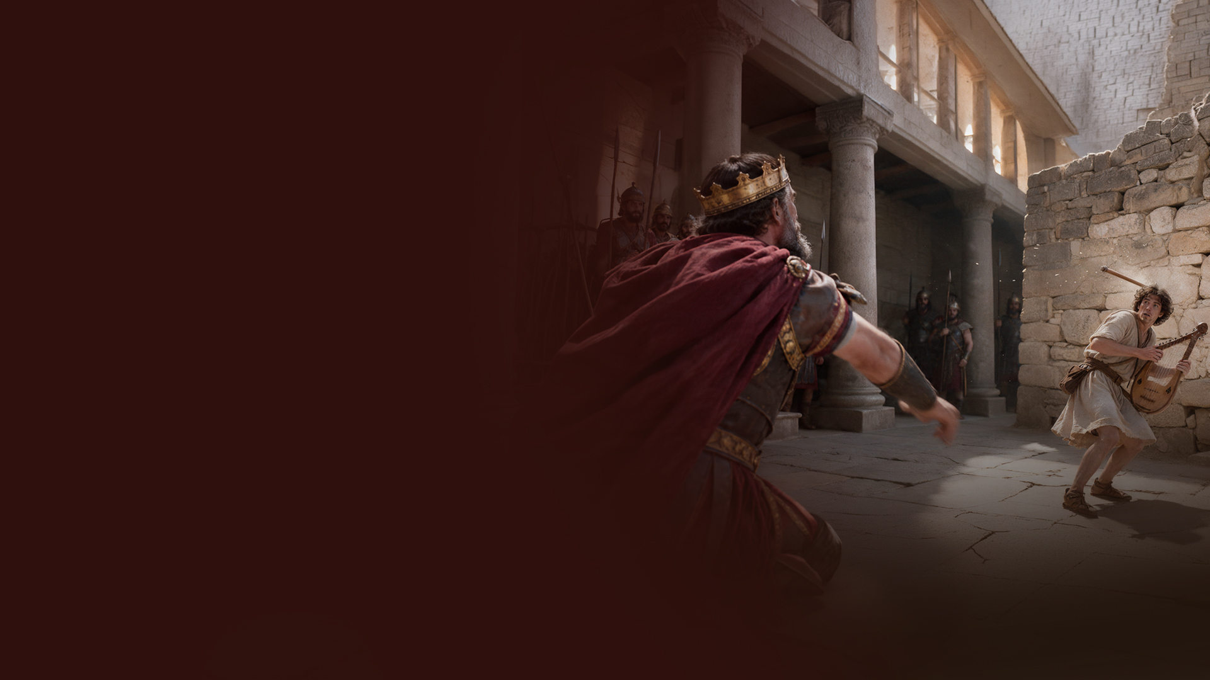
Saul’s jealousy and pursuit of David

Slide 5
1. RECOGNIZE THE PEOPLE GOD IS POSITIONING AROUND YOU

Slide 6
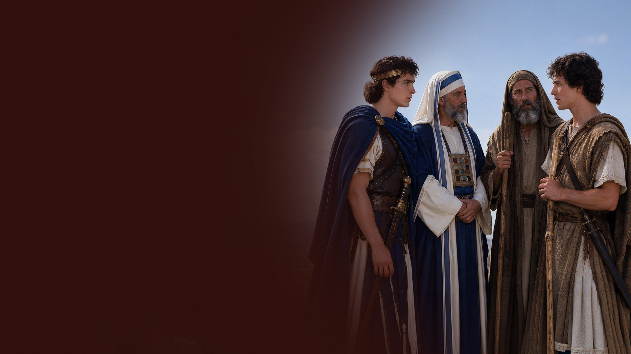
Jonathan, Abiathar the priest, prophet Gad

Slide 7
2. RECOGNIZE REMINDERS OF PAST VICTORIES

Slide 8
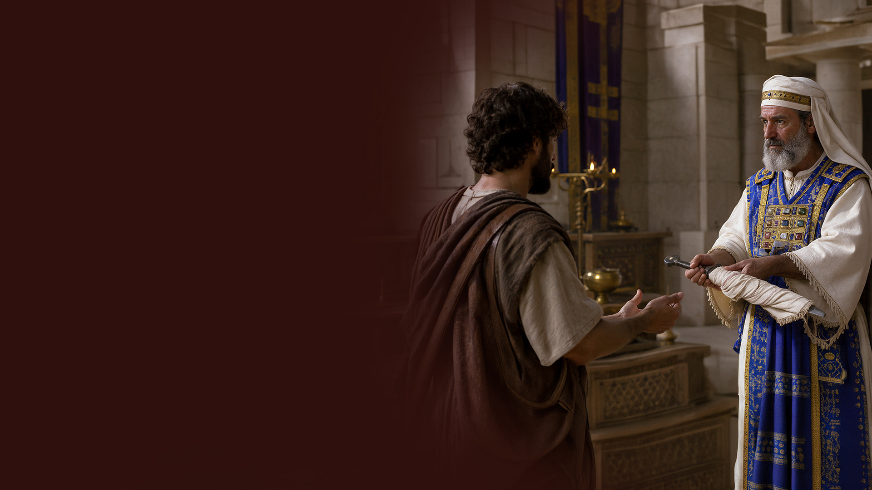
Goliath’s sword
(1 Samuel 21:9)
Reminders of the prophetic word (1 Samuel 25)

Slide 9
3. RECOGNIZE HOW GOD IS BUILDING YOUR FUTURE EVEN WHEN EVERYTHING IS BEING STRIPPED AWAY

Slide 10
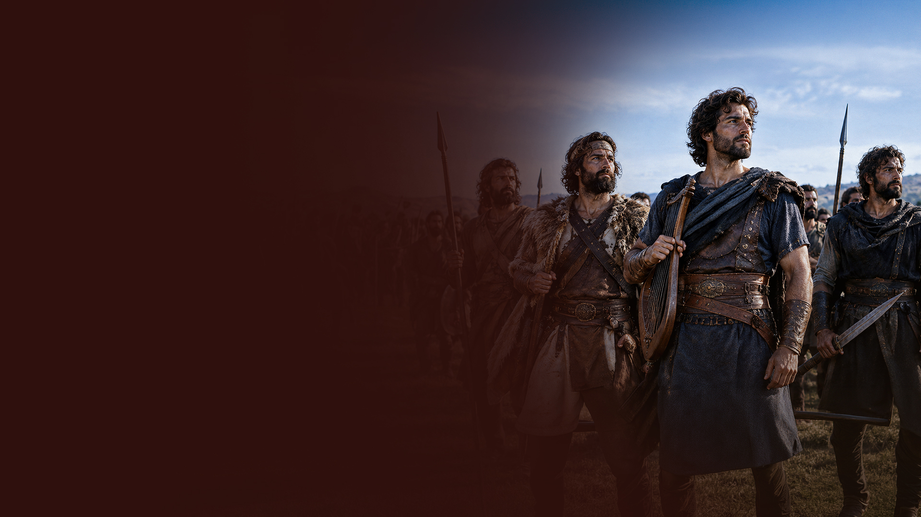
1 Samuel 22:1,2; 2 Samuel 23:8-22
The men who came to David when they were discouraged, discontented, and in debt eventually became David’s mighty men.

Slide 11
4. RECOGNIZE GOD’S PROTECTION FROM HASTY ACTION

Slide 12
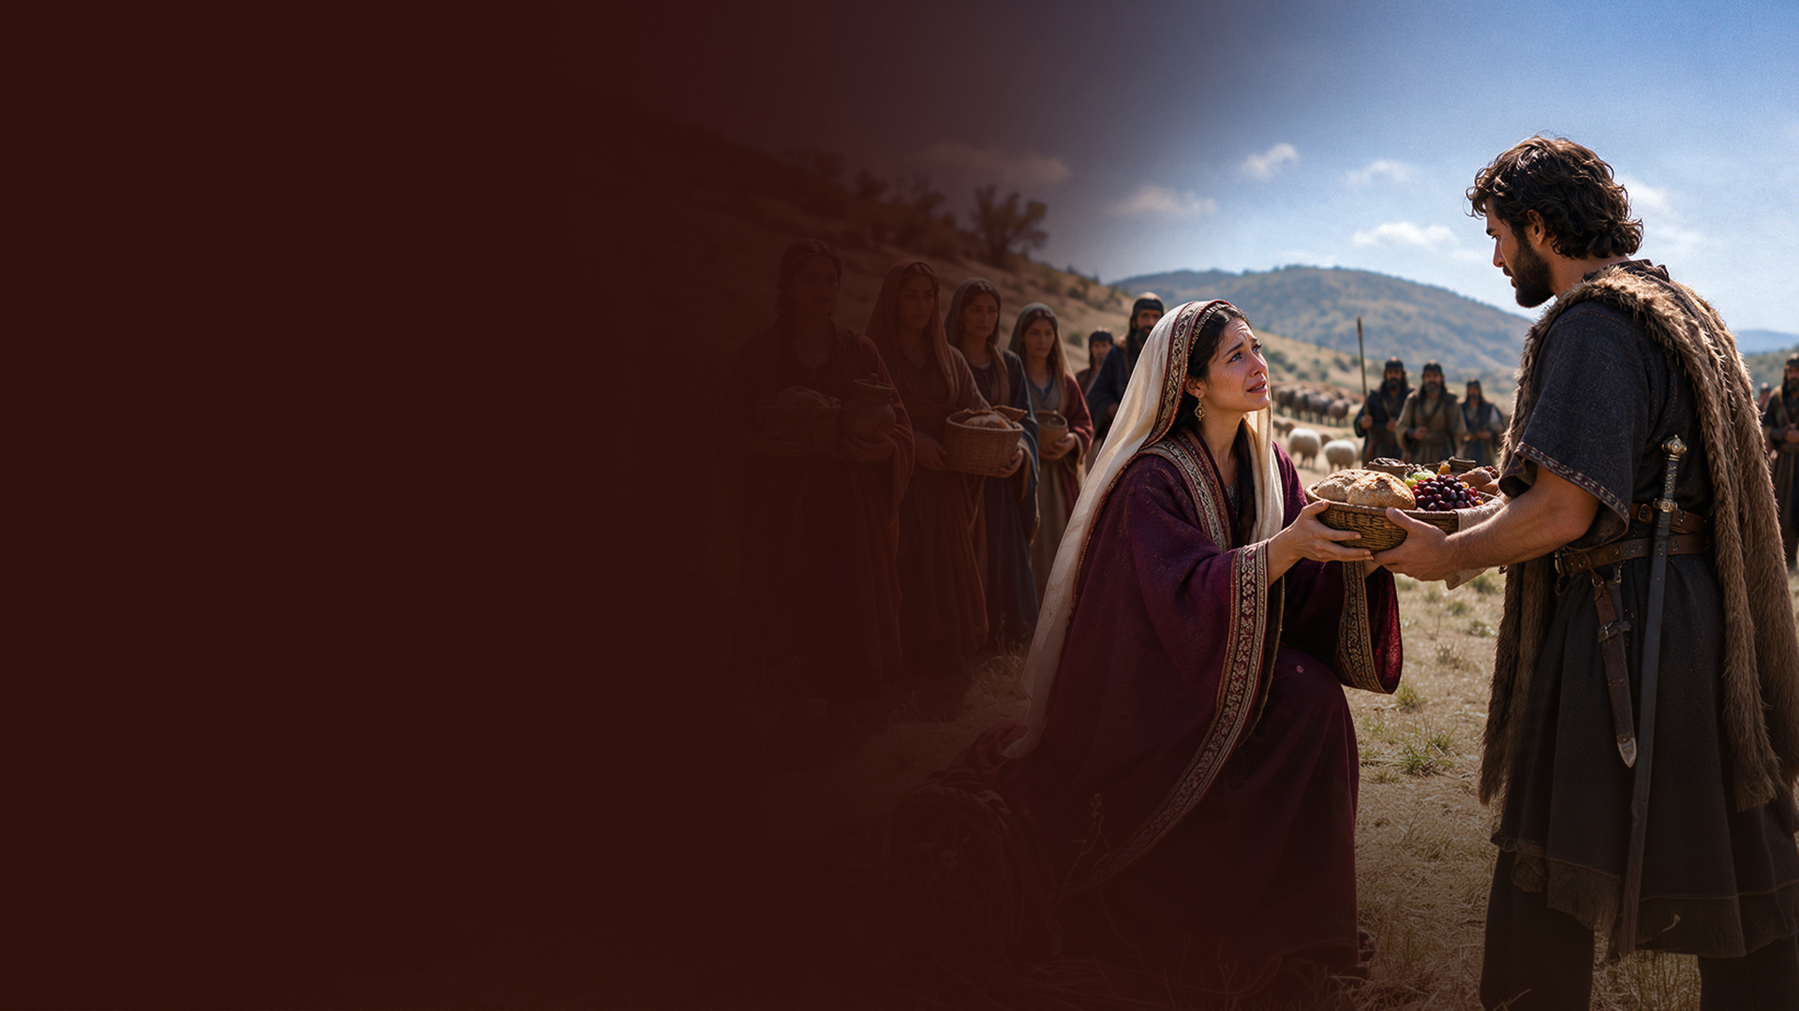
Nabal and Abigail
(1 Samuel 25)

Slide 13
5. RECOGNIZE GOD HELPING YOU RECOVER ALL AND MORE!

Slide 14
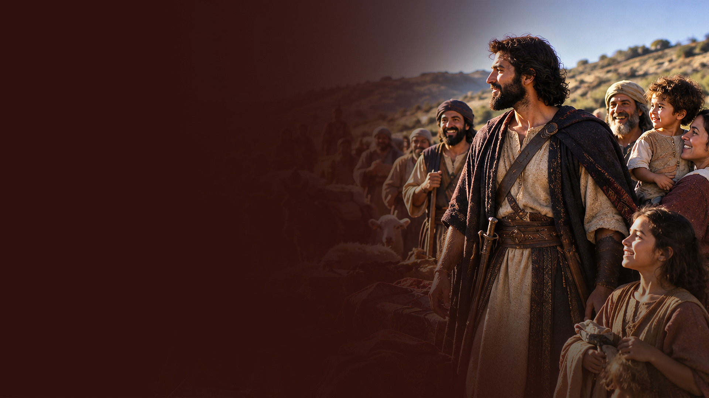
David recovered all
(1 Samuel 30:1-8,18,19)

Slide 15
THE CORE "ADVERSITY" PSALMS OF DAVID:
Psalm 7: David's persecution during Saul's reign.
Psalm 34: David's deliverance after pretending madness before Abimelech/king of Gath.
(1 Samuel 21:10-15)
Psalm 52: Doeg the Edomite informing Saul about David's visit to Ahimelech.
(1 Samuel 22:9-19)

Slide 16
Psalm 54: The Ziphites informing Saul about David. (1 Samuel 23:19)
Psalm 56: David in Gath when the Philistines seized him.
(1 Samuel 21:10,11)
Psalm 57: David fleeing from Saul into the cave. (1 Samuel 22:1 / 24:3)

Slide 17
Psalm 59: Saul sending men to watch David's house and kill him. (1 Samuel 19:11)
Psalm 63: David in the wilderness of Judah.
Psalm 142: David's prayer while in the cave of Adullam.

