Slide 1


Slide 2

1 Samuel Chapters 19-31
Covers about 10 years of David’s life: age 20-30.
A time of great adversity, but also a season of growth for David.

Slide 3

A GOOD MENTOR HELPS BUILD MOMENTUM

Slide 4
1 Samuel 19:18
So David fled and escaped, and went to Samuel at Ramah, and told him all that Saul had done to him. And he and Samuel went and stayed in Naioth.

Slide 5

KEEP GROWING EVEN IF YOU ARE JUST SURVIVING
Food from the Tabernacle
(1 Samuel 21:1-6)
Feigning insanity before the king of Gath (1 Samuel 21:12)
An army of men all discontented, distressed and in debt (1 Samuel 22:2)

Slide 6

LEARN TO HEAR GOD
Prophet Gad (1 Samuel 22:5)
David repeatedly inquired of God (1 Samuel 23:2-4,9; 30:1-6)

Slide 7
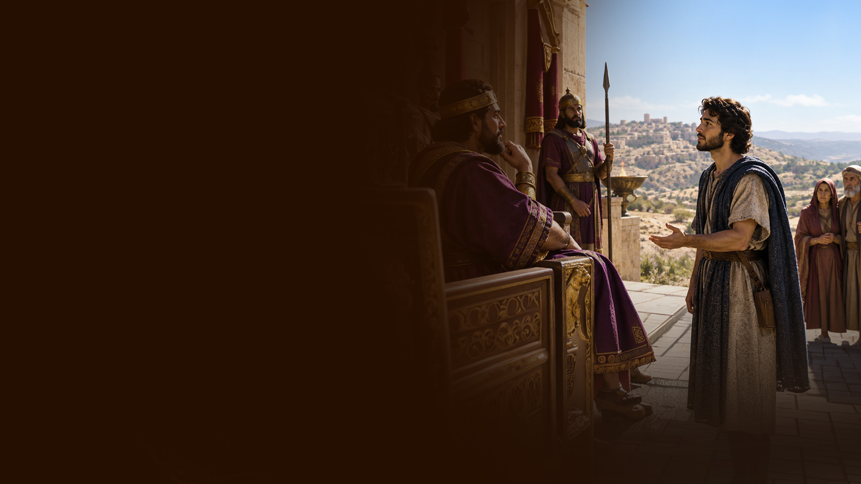
LEARN TO HONOR PEOPLE
Parents: 1 Samuel 22:3
Leaders (Saul): 1 Samuel 24:5-7;
1 Samuel 26:9-11
Team—those who went and those who stayed: 1 Samuel 30:24,25
Elders of Judah: 1 Samuel 30:26
Saul & Jonathan: 2 Samuel 1:17-27

Slide 8
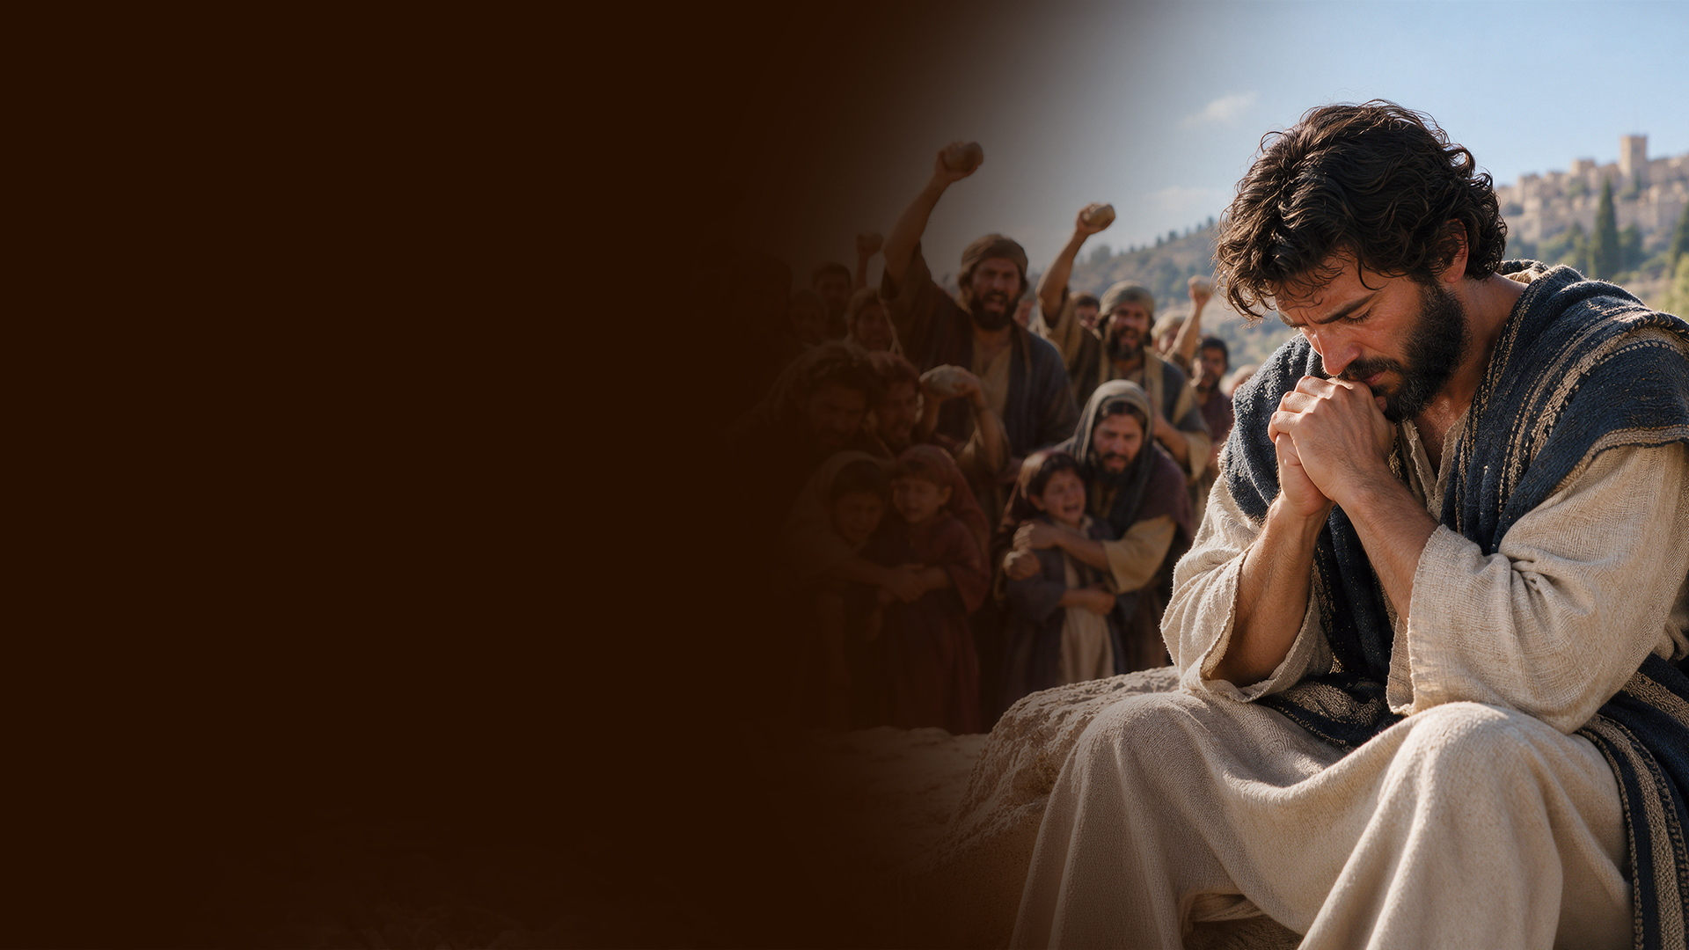
LEARN TO STRENGTHEN YOURSELF IN GOD

Slide 9
1 Samuel 30:6
Now David was greatly distressed, for the people spoke of stoning him, because the soul of all the people was grieved, every man for his sons and his daughters. But David strengthened himself in the LORD his God.

Slide 10
PSALMS MOST LIKELY WRITTEN DURING THIS PHASE:
Psalm 25: seeking God's guidance
Psalm 35: appeal against unjust opposition
Psalm 36: contrast between wickedness and God's mercy
Psalm 37: learning to wait on God

Slide 11
Psalm 40: testimony of God's faithfulness
Psalm 41: betrayal and concern for the vulnerable
Psalm 62: God alone as refuge
Psalm 65: praise for God's provision

