Slide 1


Slide 2

DAVID PLAYS THE HARP FOR SAUL

Slide 3
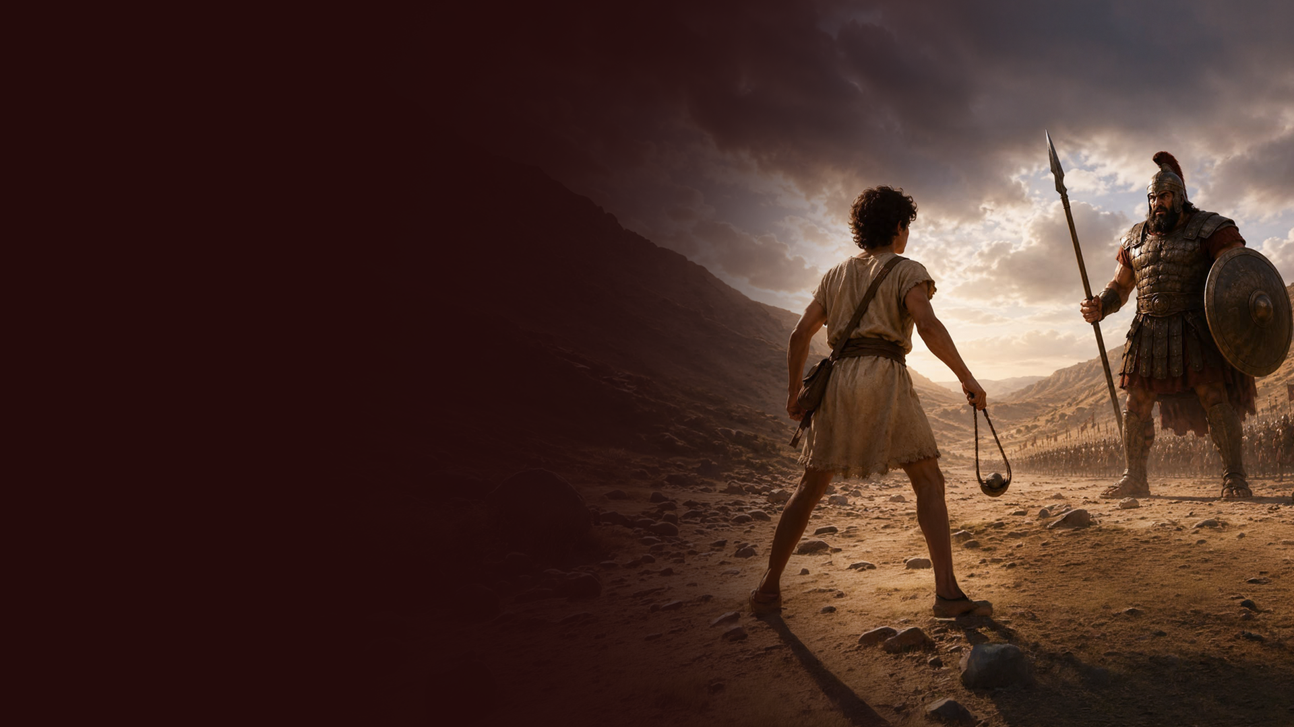
DAVID AND GOLIATH

Slide 4
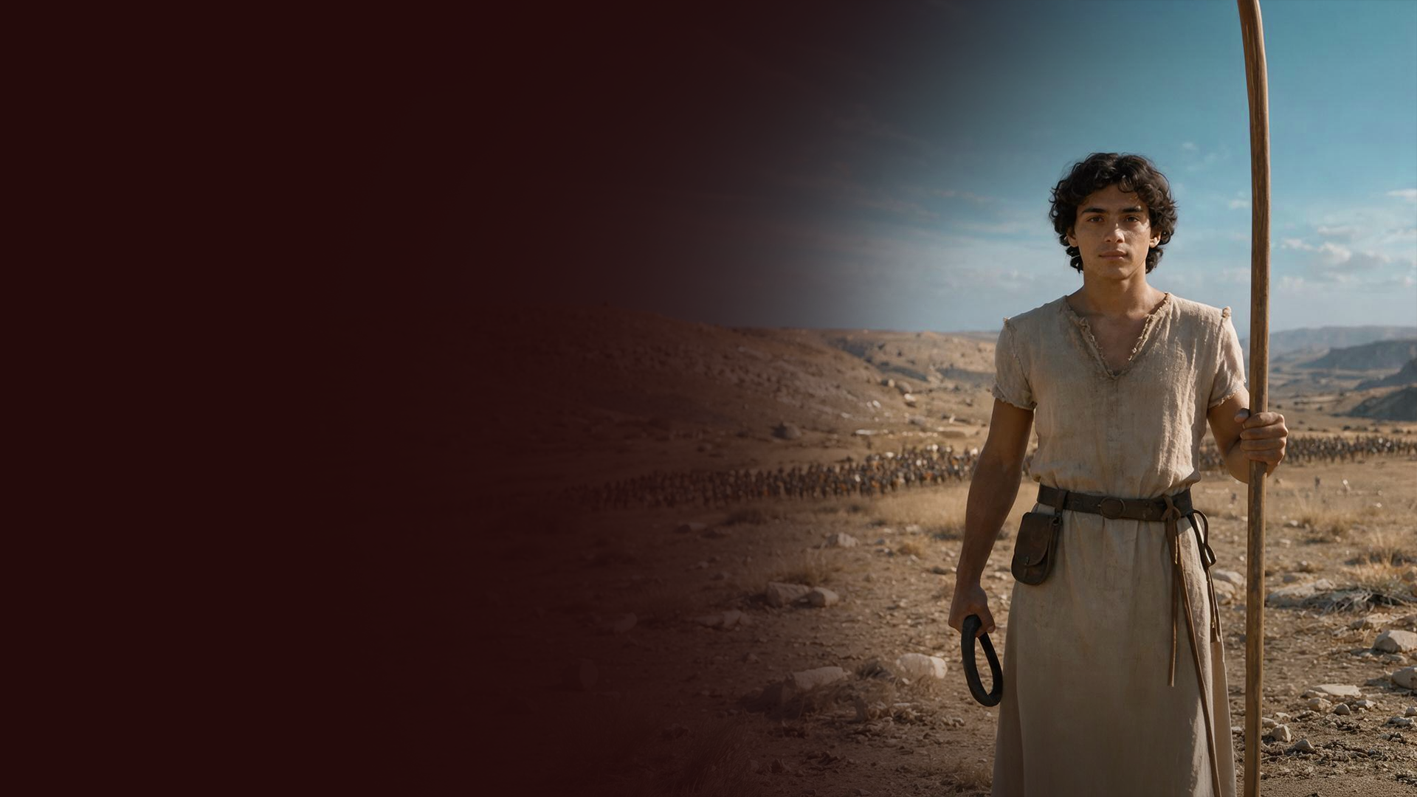
DAVID, A NATIONAL HERO

Slide 5
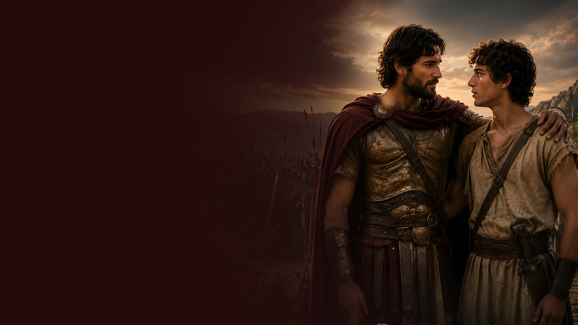
DAVID AND JONATHAN—FRIENDS

Slide 6

DAVID BEHAVED WISELY

Slide 7
1 Samuel 18:5,14,30
5 So David went out wherever Saul sent him, and behaved wisely.
14 And David behaved wisely in all his ways, and the LORD was with him.
30 Then the princes of the Philistines went out to war. And so it was, whenever they went out, that David behaved more wisely than all the servants of Saul, so that his name became highly esteemed.

Slide 8

KEY INSIGHTS

Slide 9
1. A SIMPLE TASK COULD OPEN THE DOOR TO AN UNUSUAL OPPORTUNITY

Slide 10
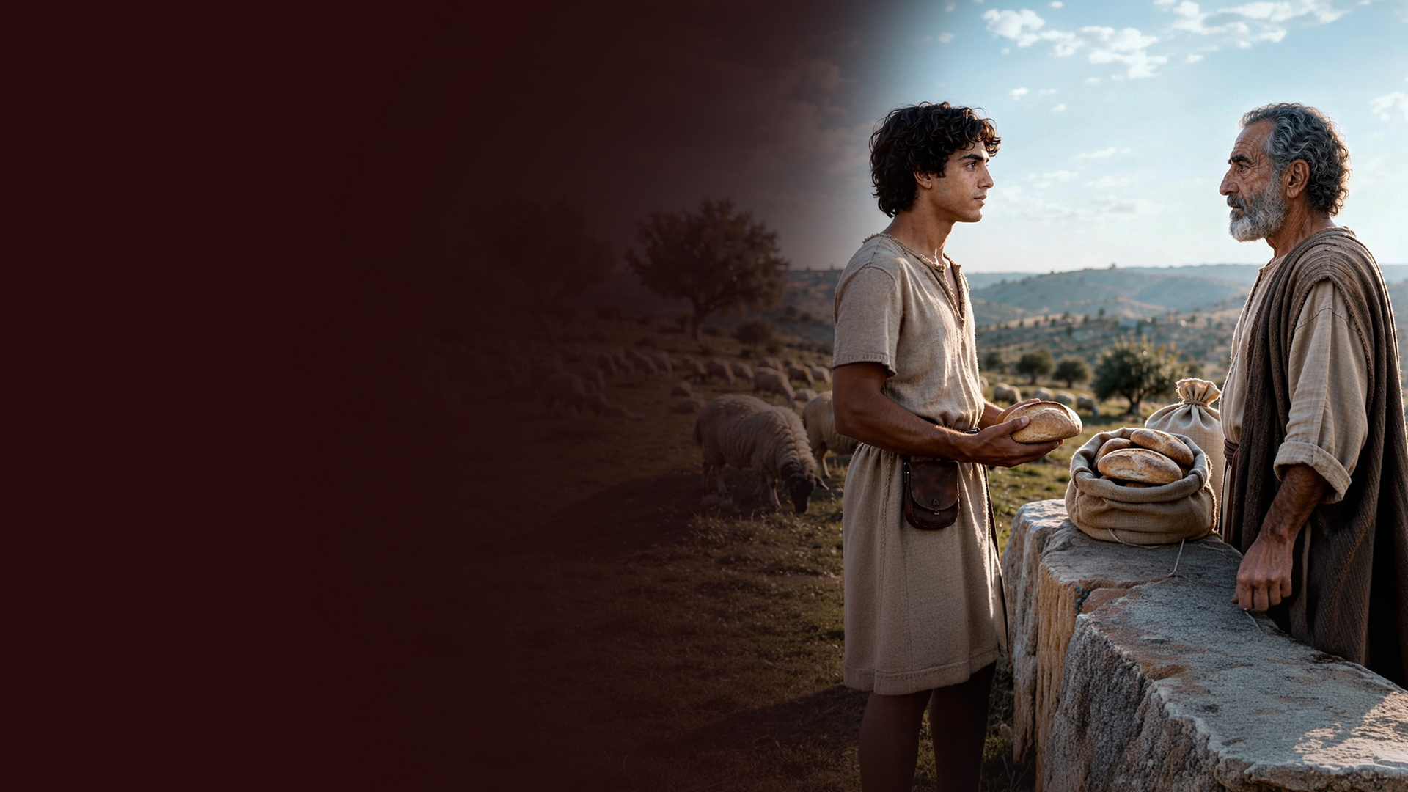
1 Samuel 17:17,18
17 Then Jesse said to his son David, "Take now for your brothers an ephah of this dried grain and these ten loaves, and run to your brothers at the camp.
18 And carry these ten cheeses to the captain of their thousand, and see how your brothers fare, and bring back news of them."

Slide 11
2. BE WILLING TO DO WHAT NO ONE ELSE IS WILLING TO DO

Slide 12
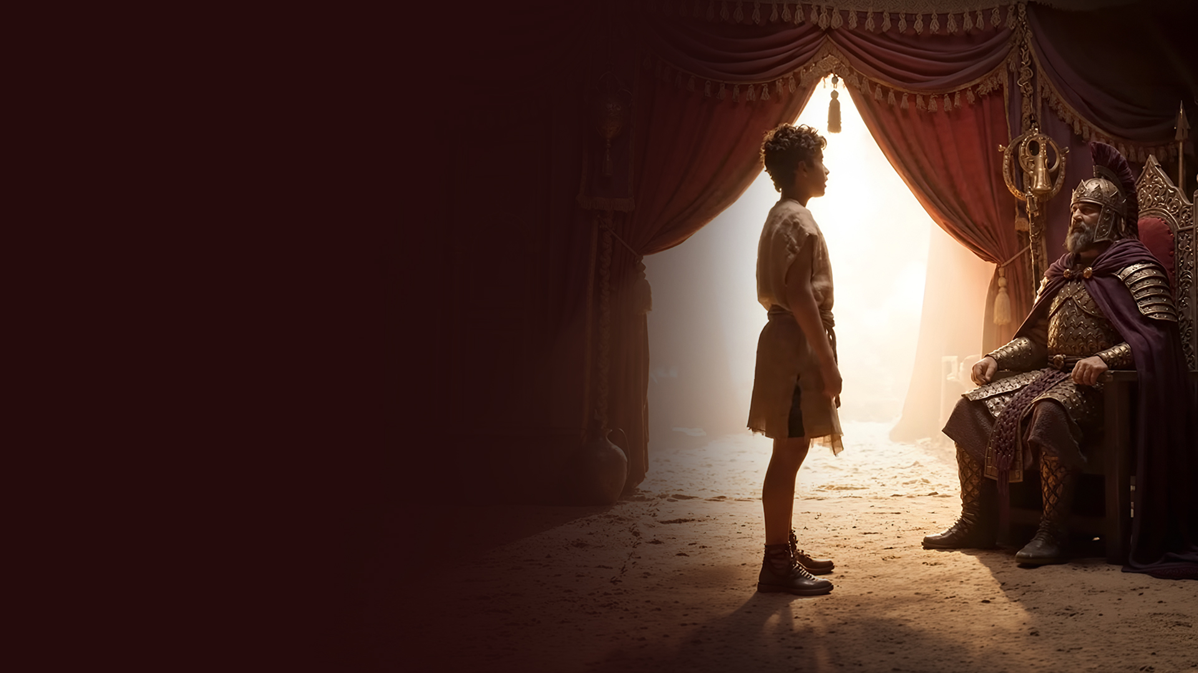
1 Samuel 17:32
Then David said to Saul, "Let no man's heart fail because of him; your servant will go and fight with this Philistine."

Slide 13
3. KILLING LIONS AND BEARS PREPARES YOU TO KILL GOLIATHS

Slide 14

1 Samuel 17:34-36
34 But David said to Saul, "Your servant used to keep his father's sheep, and when a lion or a bear came and took a lamb out of the flock,
35 I went out after it and struck it, and delivered the lamb from its mouth; and when it arose against me, I caught it by its beard, and struck and killed it.
36 Your servant has killed both lion and bear; and this uncircumcised Philistine will be like one of them, seeing he has defied the armies of the living God."

Slide 15
4. USE YOUR SLINGSHOT—WHAT GOD HAS GIVEN YOU THAT YOU HAVE PROVEN IN YOUR OWN LIFE

Slide 16

1 Samuel 17:38-40,50
38 So Saul clothed David with his armor, and he put a bronze helmet on his head; he also clothed him with a coat of mail.
39 David fastened his sword to his armor and tried to walk, for he had not tested them. And David said to Saul, "I cannot walk with these, for I have not tested them." So David took them off.

Slide 17
1 Samuel 17:38-40,50
40 Then he took his staff in his hand; and he chose for himself five smooth stones from the brook, and put them in a shepherd's bag, in a pouch which he had, and his sling was in his hand. And he drew near to the Philistine.
50 So David prevailed over the Philistine with a sling and a stone, and struck the Philistine and killed him. But there was no sword in the hand of David.

Slide 18
5. HAVE CONFIDENCE IN YOUR COVENANT WITH GOD AND THE GOD WHO KEEPS COVENANT

Slide 19
1 Samuel 17:45-47
45 Then David said to the Philistine, "You come to me with a sword, with a spear, and with a javelin. But I come to you in the name of the LORD of hosts, the God of the armies of Israel, whom you have defied.
46 This day the LORD will deliver you into my hand, and I will strike you and take your head from you. And this day I will give the carcasses of the camp of the Philistines to the birds of the air and the wild beasts of the earth, that all the earth may know that there is a God in Israel.

Slide 20
1 Samuel 17:45-47
47 Then all this assembly shall know that the LORD does not save with sword and spear; for the battle is the LORD's, and He will give you into our hands."

Slide 21
6. FAITH REQUIRES TAKING RISK AND COURAGEOUS ACTION

Slide 22

1 Samuel 17:48
So it was, when the Philistine arose and came and drew near to meet David, that David hurried and ran toward the army to meet the Philistine.

Slide 23
7. LOOK BEYOND IMMEDIATE SUCCESS

Slide 24
1 Samuel 18:5,7
5 So David went out wherever Saul sent him, and behaved wisely. And Saul set him over the men of war, and he was accepted in the sight of all the people and also in the sight of Saul's servants.
7 So the women sang as they danced, and said: "Saul has slain his thousands, And David his ten thousands."

Slide 25
8. ALWAYS WALK WISELY AND HONOR THOSE ABOVE YOU

Slide 26
1 Samuel 18:5,14,30
5 So David went out wherever Saul sent him, and behaved wisely.
14 And David behaved wisely in all his ways, and the LORD was with him.
30 Then the princes of the Philistines went out to war. And so it was, whenever they went out, that David behaved more wisely than all the servants of Saul, so that his name became highly esteemed.

Slide 27
Isaiah 33:6
Wisdom and knowledge will be the stability of your times, And the strength of salvation; The fear of the LORD is His treasure.

Slide 28
PSALMS LIKELY WRITTEN DURING THIS PHASE:
Psalm 11: Confidence in God when foundations are shaken
Psalm 15: Character of the person who dwells with God
Psalm 16: Confidence, inheritance, and devotion to God
Psalm 17: David's appeal for vindication
Psalm 20: Prayer for the king and victory

Slide 29
Psalm 21: Thanksgiving for victory and God's blessing on the king
Psalm 24: The King of glory
Psalm 26: Integrity and walking before God
Psalm 27: Courage and confidence in God's presence
Psalm 28: Prayer and thanksgiving

