Slide 1
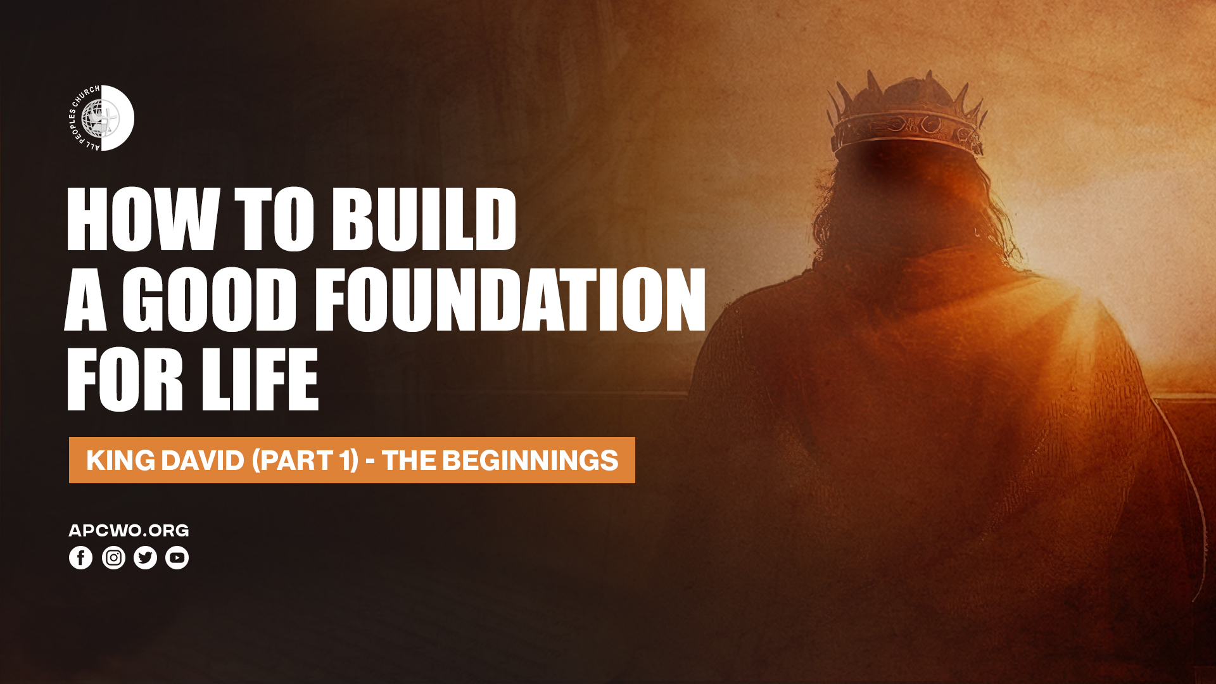

Slide 2

BACKGROUND

Slide 3
EARLY LIFE & ANOINTING

Slide 4
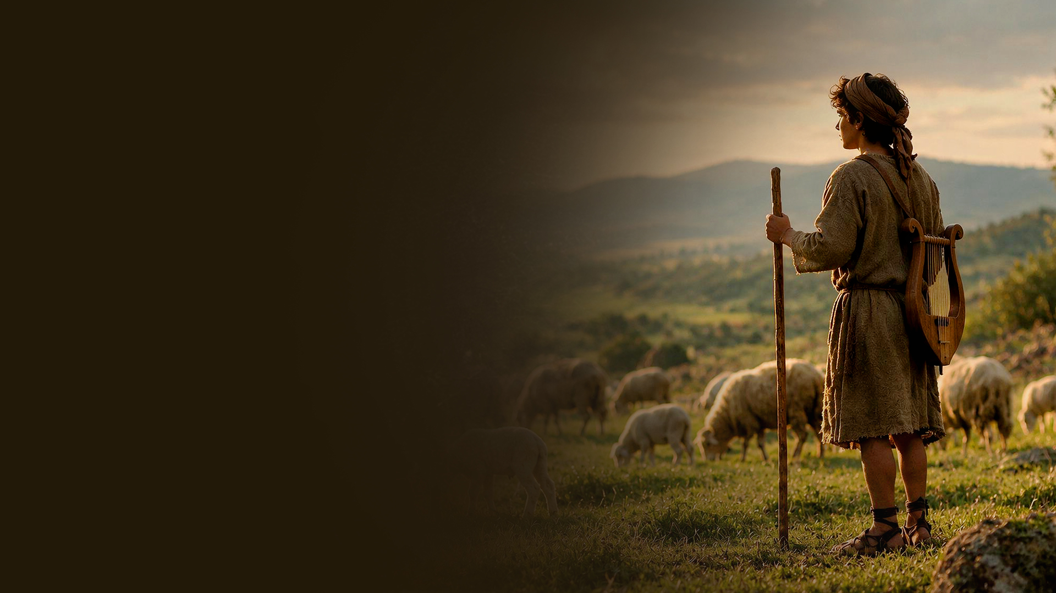
DAVID AS A SHEPHERD

Slide 5
1 Samuel 16:11
And Samuel said to Jesse, "Are all the young men here?" Then he said, "There remains yet the youngest, and there he is, keeping the sheep." And Samuel said to Jesse, "Send and bring him. For we will not sit down till he comes here."

Slide 6
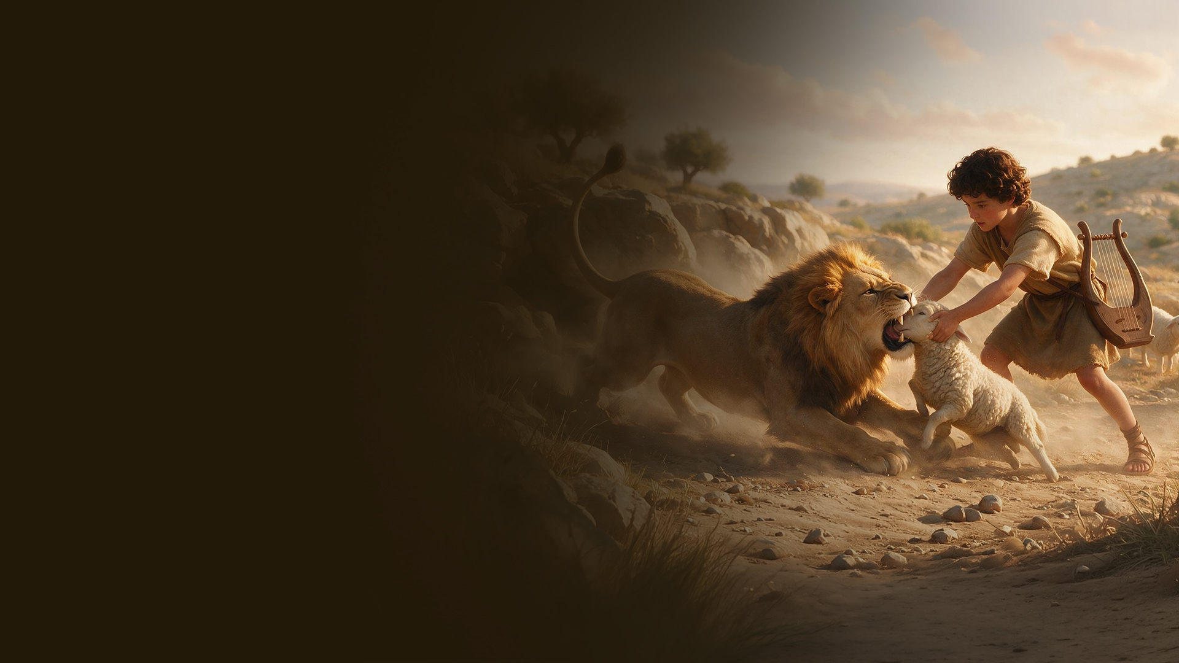
DAVID PROTECTS HIS FLOCK

Slide 7
1 Samuel 17:34-36
34 But David said to Saul, "Your servant used to keep his father's sheep, and when a lion or a bear came and took a lamb out of the flock,
35 I went out after it and struck it, and delivered the lamb from its mouth; and when it arose against me, I caught it by its beard, and struck and killed it.
36 Your servant has killed both lion and bear; and this uncircumcised Philistine will be like one of them, seeing he has defied the armies of the living God."

Slide 8
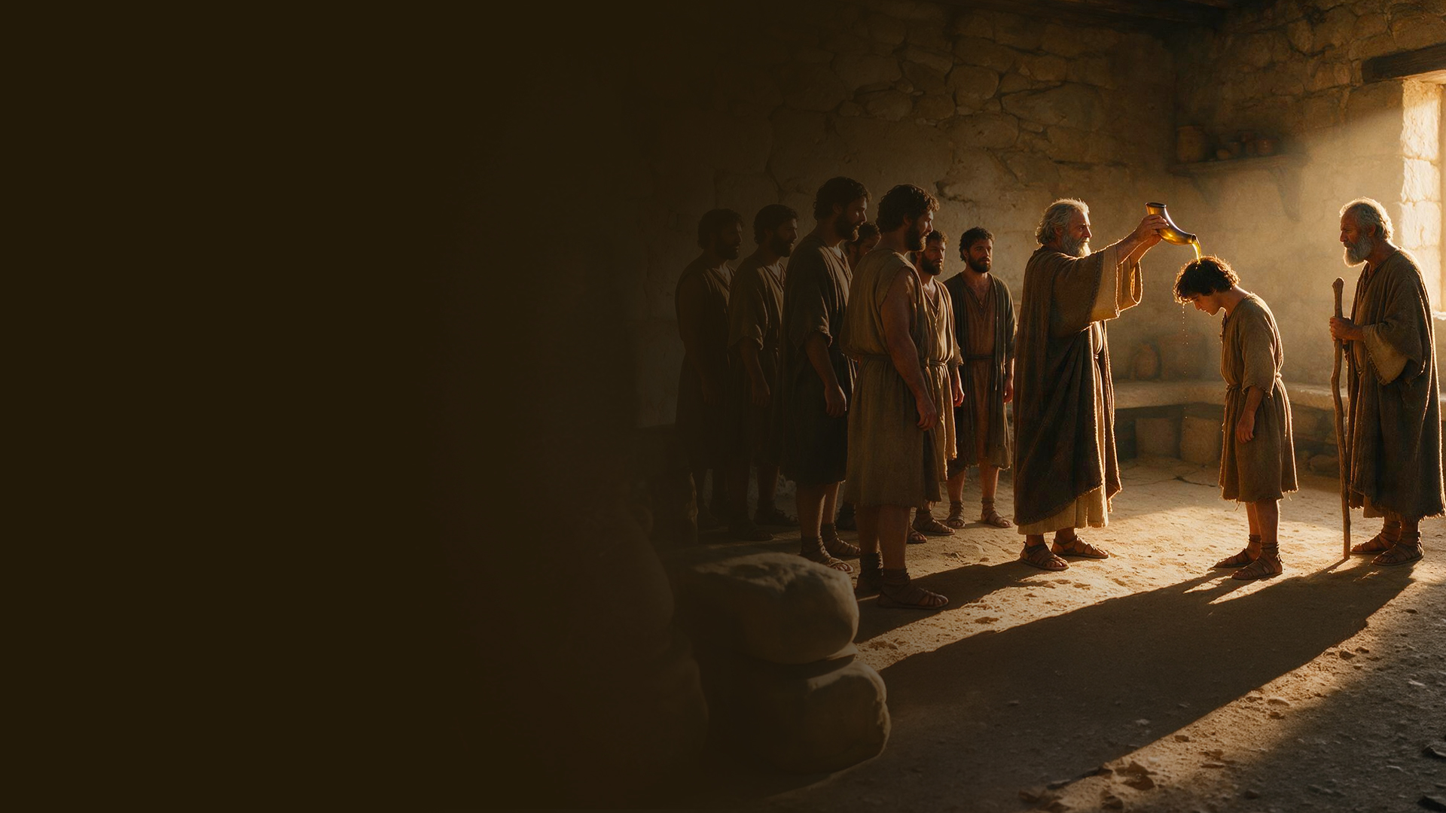
ANOINTING BY PROPHET SAMUEL

Slide 9
1 Samuel 16:1,7,12,13
1 Now the LORD said to Samuel, "How long will you mourn for Saul, seeing I have rejected him from reigning over Israel? Fill your horn with oil, and go; I am sending you to Jesse the Bethlehemite. For I have provided Myself a king among his sons."
7 But the LORD said to Samuel, "Do not look at his appearance or at his physical stature, because I have refused him. For the LORD does not see as man sees; for man looks at the outward appearance, but the LORD looks at the heart."

Slide 10
1 Samuel 16:1,7,12,13
12 So he sent and brought him in. Now he was ruddy, with bright eyes, and good-looking. And the LORD said, "Arise, anoint him; for this is the one!"
13 Then Samuel took the horn of oil and anointed him in the midst of his brothers; and the Spirit of the LORD came upon David from that day forward. So Samuel arose and went to Ramah.

Slide 11
KEY INSIGHTS

Slide 12
1. A HEART AFTER GOD

Slide 13
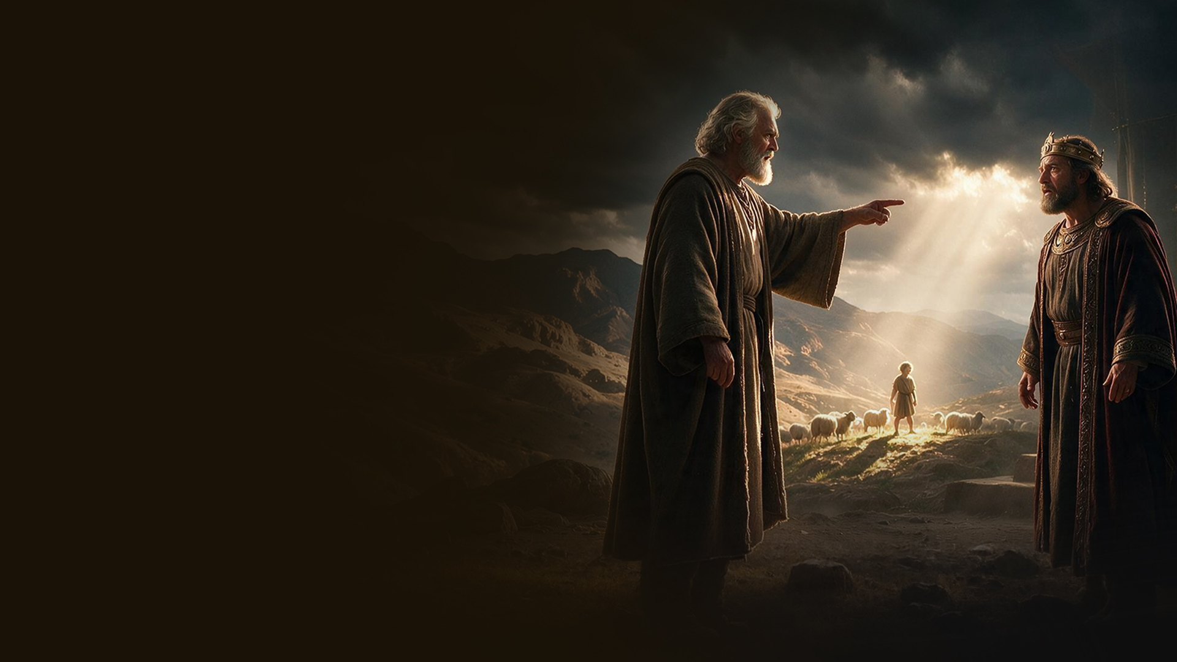
1 Samuel 13:13,14
13 And Samuel said to Saul, "You have done foolishly. You have not kept the commandment of the LORD your God, which He commanded you. For now the LORD would have established your kingdom over Israel forever.
14 But now your kingdom shall not continue. The LORD has sought for Himself a man after His own heart, and the LORD has commanded him to be commander over His people, because you have not kept what the LORD commanded you."

Slide 14
Acts 13:22
And when He had removed him, He raised up for them David as king, to whom also He gave testimony and said, 'I HAVE FOUND DAVID THE SON OF JESSE, A MAN AFTER MY OWN HEART, WHO WILL DO ALL MY WILL.'

Slide 15
A heart rooted in God is our foundation for all that is to be built in time to come.

Slide 16
2. SEEDS OF DESTINY

Slide 17
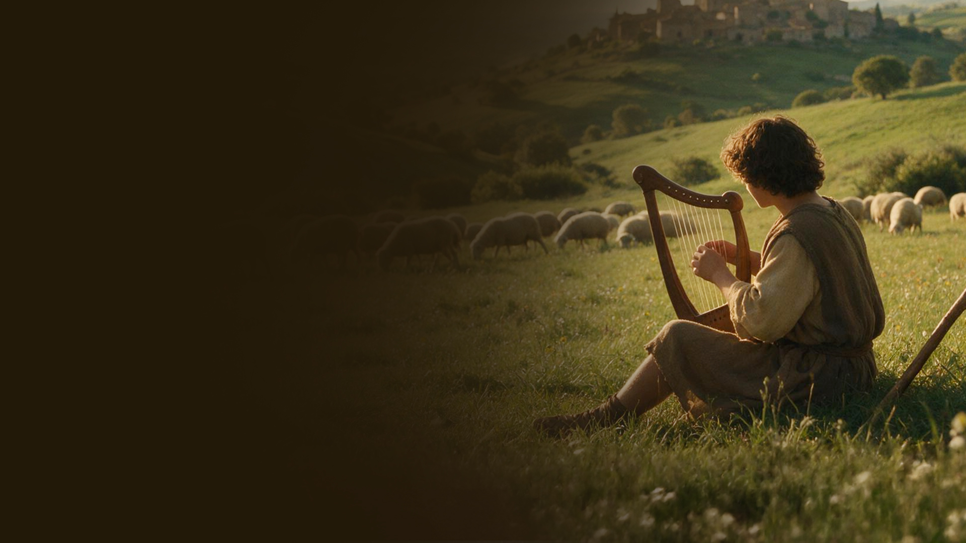
1 Samuel 16:18
Then one of the servants answered and said, "Look, I have seen a son of Jesse the Bethlehemite, who is skillful in playing, a mighty man of valor, a man of war, prudent in speech, and a handsome person; and the LORD is with him."

Slide 18
There are things God has placed in you during your early years, that are seeds for your life’s assignment.

Slide 19
3. FORMED IN OBSCURITY

Slide 20
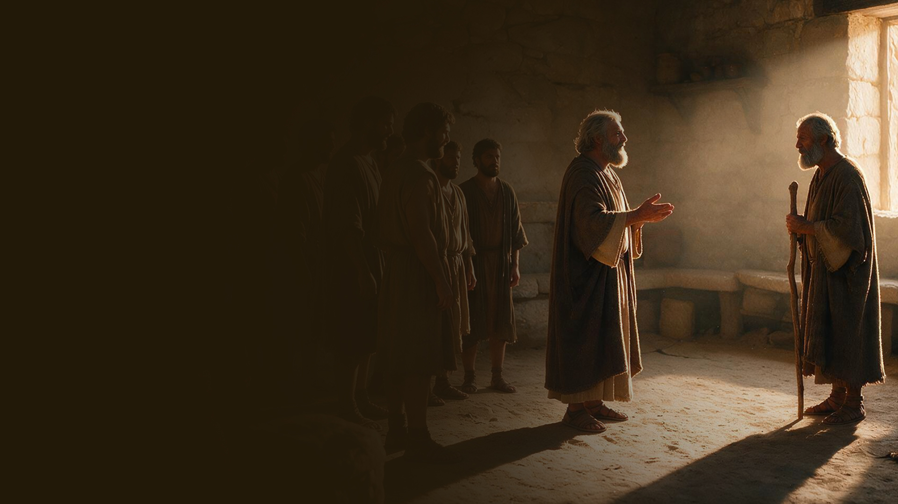
1 Samuel 16:11
And Samuel said to Jesse, "Are all the young men here?" Then he said, "There remains yet the youngest, and there he is, keeping the sheep." And Samuel said to Jesse, "Send and bring him. For we will not sit down till he comes here."

Slide 21
God prepares us in hiddenness, in obscurity.

Slide 22
The experiences and learning that take place in obscurity prepare us for the time God brings us into visibility.

Slide 23
Hiddenness formed the man before visibility revealed the man.

Slide 24
PSALMS OF DAVID

Slide 25
PSALMS MOST LIKELY WRITTEN DURING THIS PHASE:
Psalm 8: God's greatness and man's calling
Psalm 19: God's revelation through creation and His Word
Psalm 23: The LORD as Shepherd
Psalm 29: The glory and power of the LORD

