Slide 1
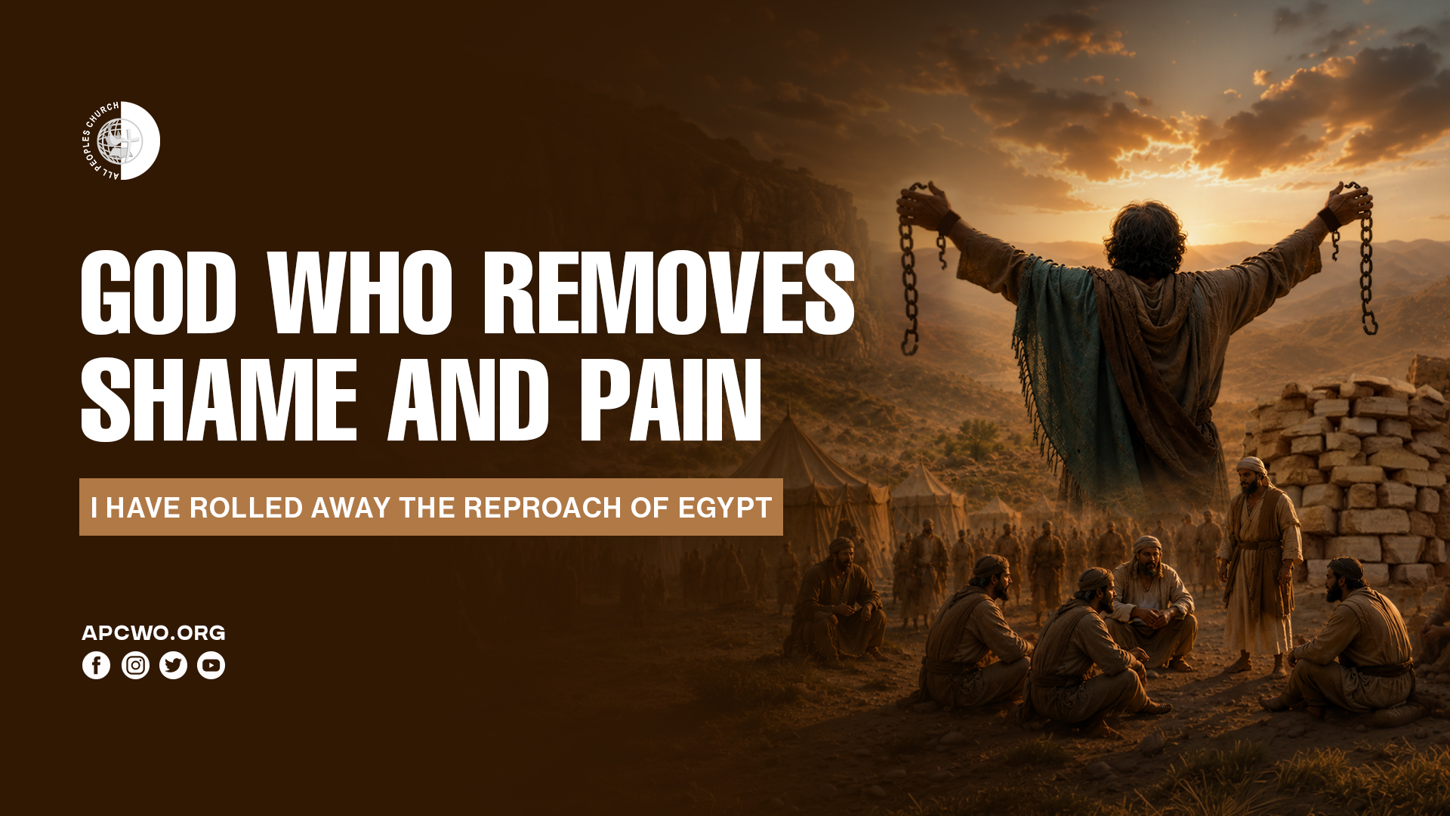

Slide 2
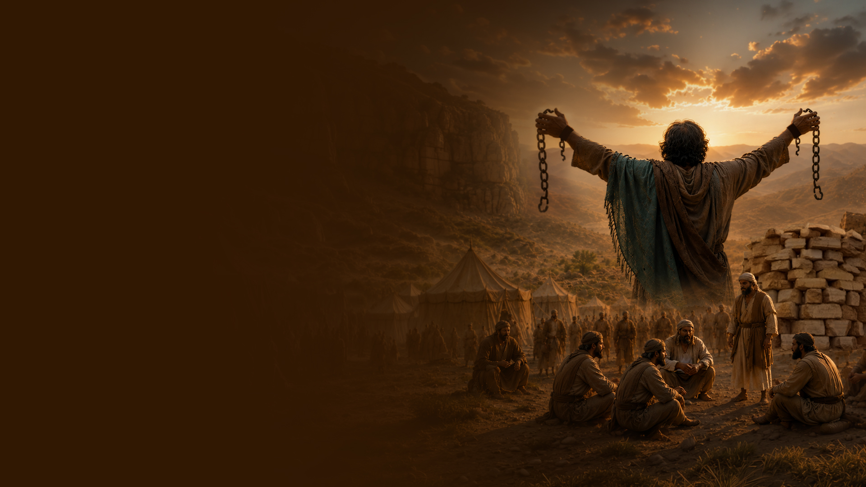
Joshua 5:8,9
8 So it was, when they had finished circumcising all the people, that they stayed in their places in the camp till they were healed.
9 Then the LORD said to Joshua, "This day I have rolled away the reproach of Egypt from you." Therefore the name of the place is called Gilgal to this day.

Slide 3
THE REPROACH OF EGYPT

Slide 4
GOD WHO REMOVES PAIN AND SHAME

Slide 5
Isaiah 29:22-24
22 Therefore thus says the LORD, who redeemed Abraham, concerning the house of Jacob: "Jacob shall not now be ashamed, Nor shall his face now grow pale;
23 But when he sees his children, The work of My hands, in his midst, They will hallow My name, And hallow the Holy One of Jacob, And fear the God of Israel.
24 These also who erred in spirit will come to understanding, And those who complained will learn doctrine."

Slide 6
Isaiah 50:6,7
6 I gave My back to those who struck Me, And My cheeks to those who plucked out the beard; I did not hide My face from shame and spitting.
7 "For the Lord GOD will help Me; Therefore I will not be disgraced; Therefore I have set My face like a flint, And I know that I will not be ashamed.

Slide 7
Isaiah 54:4
"Do not fear, for you will not be ashamed; Neither be disgraced, for you will not be put to shame; For you will forget the shame of your youth, And will not remember the reproach of your widowhood anymore.

Slide 8
Isaiah 61:7
Instead of your shame you shall have double honor, And instead of confusion they shall rejoice in their portion. Therefore in their land they shall possess double; Everlasting joy shall be theirs.

Slide 9
THIS DAY I HAVE ROLLED AWAY

Slide 10
Galatians 6:15
For in Christ Jesus neither circumcision nor uncircumcision avails anything, but a new creation.

Slide 11
Colossians 2:11,12
11 In Him you were also circumcised with the circumcision made without hands, by putting off the body of the sins of the flesh, by the circumcision of Christ,
12 buried with Him in baptism, in which you also were raised with Him through faith in the working of God, who raised Him from the dead.

Slide 12
GILGAL—THE PLACE OF PAIN AND SHAME ROLLING AWAY

Slide 13
IN HIM YOU WERE CIRCUMCISED

Slide 14
Psalm 118:22,23
22 The stone which the builders rejected Has become the chief cornerstone.
23 This was the LORD's doing; It is marvelous in our eyes.

Slide 15
Isaiah 28:16
Therefore thus says the Lord GOD: "Behold, I lay in Zion a stone for a foundation, A tried stone, a precious cornerstone, a sure foundation; Whoever believes will not act hastily.

Slide 16
Romans 8:1
There is therefore now no condemnation to those who are in Christ Jesus, who do not walk according to the flesh, but according to the Spirit.

