Slide 1
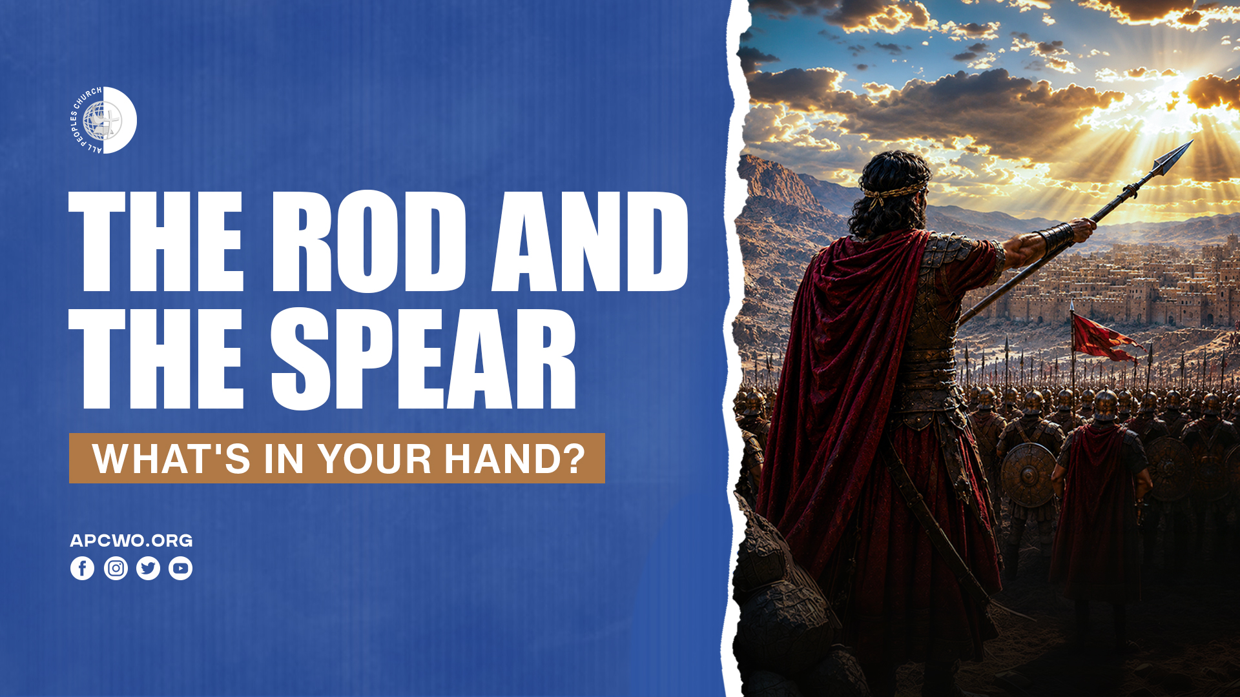

Slide 2

Exodus 8:16
So the LORD said to Moses, "Say to Aaron, 'Stretch out your rod, and strike the dust of the land, so that it may become lice throughout all the land of Egypt.' "

Slide 3

Joshua 8:18
Then the LORD said to Joshua, "Stretch out the spear that is in your hand toward Ai, for I will give it into your hand." And Joshua stretched out the spear that was in his hand toward the city.

Slide 4
1. THERE ARE NEW WAYS AND METHODS TO HOW GOD WORKS

Slide 5
1 Corinthians 12:4-6
4 There are diversities of gifts, but the same Spirit.
5 There are differences of ministries, but the same Lord.
6 And there are diversities of activities, but it is the same God who works all in all.

Slide 6
Evolution of media in the church

Slide 7
Evolution of music in the church

Slide 8
2. WHAT’S IN YOUR HAND IS ALIGNED TO YOUR ASSIGNMENT

Slide 9
Ephesians 4:7
But to each one of us grace was given according to the measure of Christ's gift.

Slide 10
Romans 12:6
Having then gifts differing according to the grace that is given to us, let us use them: if prophecy, let us prophesy in proportion to our faith;

Slide 11
3. GOD WORKS WITH YOU WHEN YOU WORK

Slide 12
1 Corinthians 3:9
For we are God's fellow workers; you are God's field, you are God's building.

Slide 13
4. DON’T LET OPPOSITION OR PAST FAILURES STOP YOU

Slide 14
5. THE ANOINTING OF THE SPIRIT MAKES ALL THE DIFFERENCE

Slide 15
Zechariah 4:6,7
6 So he answered and said to me: "This is the word of the LORD to Zerubbabel: 'Not by might nor by power, but by My Spirit,' Says the LORD of hosts.
7 'Who are you, O great mountain? Before Zerubbabel you shall become a plain! And he shall bring forth the capstone With shouts of "Grace, grace to it!" ' "

