Slide 1
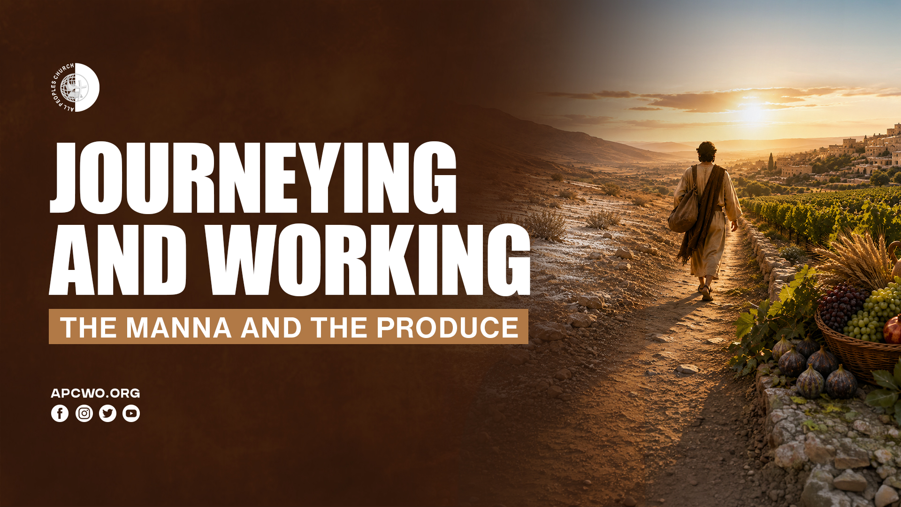

Slide 2
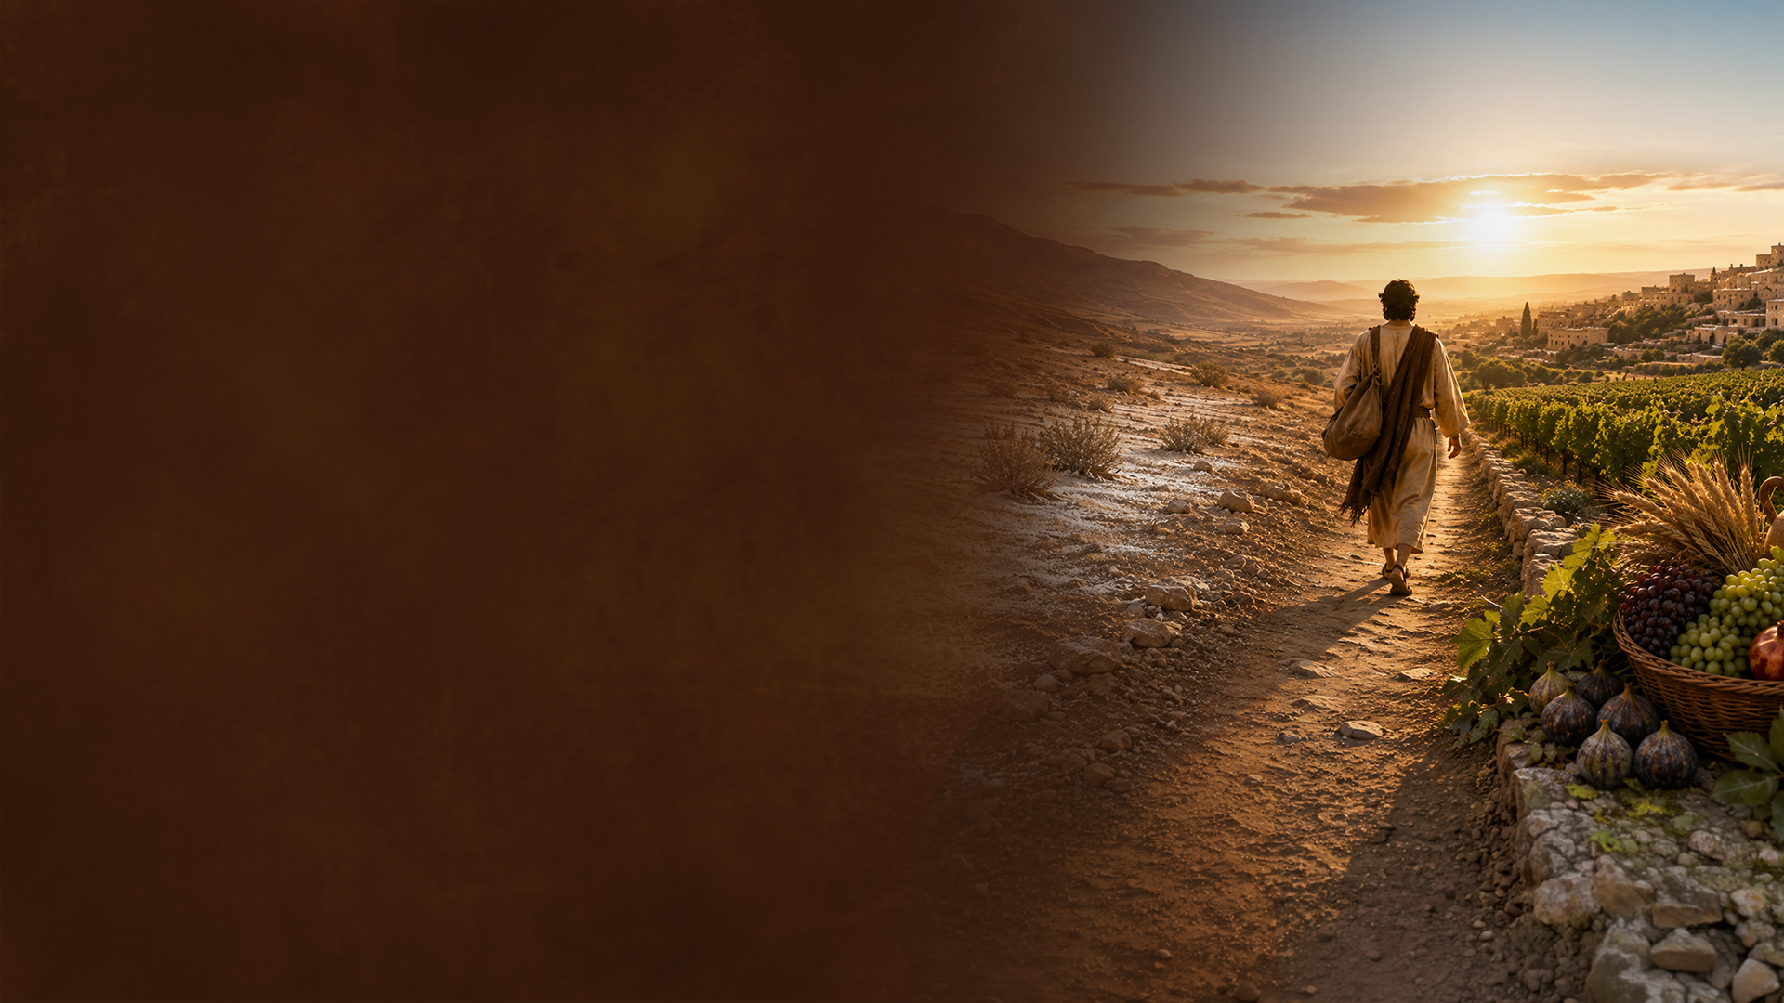
LIFE IS LIVED IN SEASONS

Slide 3
GOD ORDERS THE SEASONS OF OUR LIVES

Slide 4
Psalms 31:15
My times are in Your hand; Deliver me from the hand of my enemies, And from those who persecute me.

Slide 5
SEASONS CHANGE

Slide 6
Daniel 2:21
And He changes the times and the seasons; He removes kings and raises up kings; He gives wisdom to the wise And knowledge to those who have understanding.

Slide 7
Joshua 5:10-12
10 Now the children of Israel camped in Gilgal, and kept the Passover on the fourteenth day of the month at twilight on the plains of Jericho.
11 And they ate of the produce of the land on the day after the Passover, unleavened bread and parched grain, on the very same day.
12 Then the manna ceased on the day after they had eaten the produce of the land; and the children of Israel no longer had manna, but they ate the food of the land of Canaan that year.

Slide 8
MANNA

Slide 9
PRODUCE

Slide 10
1. THERE ARE BLESSINGS IN EVERY SEASON.

Slide 11
2. ADAPT TO YOUR CURRENT SEASON, PREPARE FOR THE NEXT.

Slide 12
3. DO NOT BE JEALOUS OF SOMEONE ELSE IN A DIFFERENT SEASON.

Slide 13
4. SEASONS CHANGE; GOD DOES NOT. HE IS STILL THE SAME.

