Slide 1
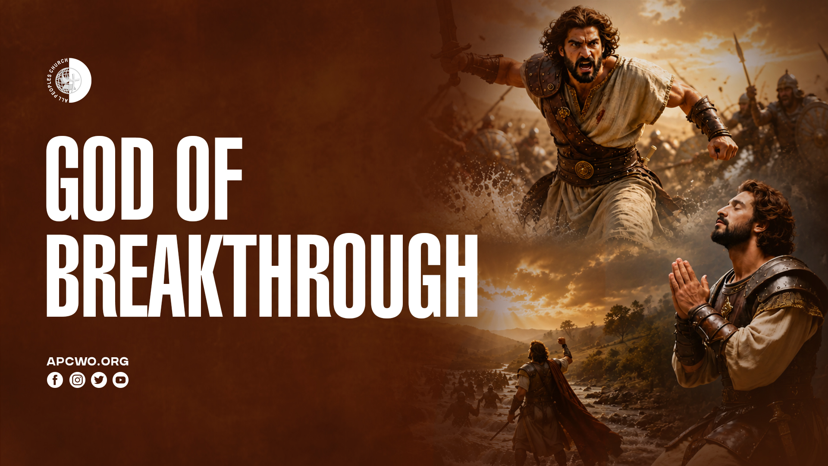

Slide 2

GOD BREAKS THROUGH

Slide 3
2 Samuel 5:17-20
17 Now when the Philistines heard that they had anointed David king over Israel, all the Philistines went up to search for David. And David heard of it and went down to the stronghold.
18 The Philistines also went and deployed themselves in the Valley of Rephaim.

Slide 4
2 Samuel 5:17-20
19 So David inquired of the Lord, saying, “Shall I go up against the Philistines? Will You deliver them into my hand?” And the Lord said to David, “Go up, for I will doubtless deliver the Philistines into your hand.”
20 So David went to Baal Perazim, and David defeated them there; and he said, “The Lord has broken through my enemies before me, like a breakthrough of water.” Therefore, he called the name of that place Baal Perazim.

Slide 5
• David took a posture of dependence in distress
• God answered him
• Active faith and obedience brought the victory
• The display of God’s divine power shattered the enemy

Slide 6
GOD BREAKS OPEN

Slide 7
Micah 2:12,13
12 “I will surely assemble all of you, O Jacob, I will surely gather the remnant of Israel; I will put them together like sheep of the fold, Like a flock in the midst of their pasture; They shall make a loud noise because of so many people.
13 The one who breaks open will come up before them; They will break out,
Pass through the gate, And go out by it;
Their king will pass before them,
With the Lord at their head.”

Slide 8
Acts 16:25,26
25 But at midnight Paul and Silas were praying and singing hymns to God, and the prisoners were listening to them.
26 Suddenly there was a great earthquake, so that the foundations of the prison were shaken; and immediately all the doors were opened and everyone’s chains were loosed.

Slide 9
GOD OF THE IMPOSSIBLE

Slide 10
Psalm 77:14
You are the God who does wonders;
You have declared Your strength among the peoples.

Slide 11
Jeremiah 32:27
“Behold, I am the Lord, the God of all flesh. Is there anything too hard for Me?

Slide 12
Luke 1:37
“For with God nothing will be impossible.”

Slide 13
Matthew 19:26
But Jesus looked at them and said to them, “With men this is impossible, but with God all things are possible.”

Slide 14
WHEN GOD BROKE THROUGH

Slide 15
1. BREAKTHROUGH IN DISTRESS

Slide 16
1 Samuel 1:15
But Hannah answered and said, “No, my lord, I am a woman of sorrowful spirit. I have drunk neither wine nor intoxicating drink, but have poured out my soul before the Lord.

Slide 17
Psalm 62:8
Trust in Him at all times, you people; Pour out your heart before Him; God is a refuge for us. Selah

Slide 18
1 Samuel 1:19,20
19 Then they rose early in the morning and worshiped before the Lord, and returned and came to their house at Ramah. And Elkanah knew Hannah his wife, and the Lord remembered her.
20 So it came to pass in the process of time that Hannah conceived and bore a son, and called his name Samuel, saying, “Because I have asked for him from the Lord.”

Slide 19
2. BREAKTHROUGH IN NEED

Slide 20
1 Kings 17:12,14
12 So she said, “As the Lord your God lives, I do not have bread, only a handful of flour in a bin, and a little oil in a jar; and see, I am gathering a couple of sticks that I may go in and prepare it for myself and my son, that we may eat it, and die.”
14 For thus says the Lord God of Israel: ‘The bin of flour shall not be used up, nor shall the jar of oil run dry, until the day the Lord sends rain on the earth.’”

Slide 21
3. BREAKTHROUGH IN FAILURE

Slide 22
John 21:3,6
3 Simon Peter said to them, “I am going fishing.” They said to him, “We are going with you also.” They went out and immediately got into the boat, and that night they caught nothing.
6 And He said to them, “Cast the net on the right side of the boat, and you will find some.” So they cast, and now they were not able to draw it in because of the multitude of fish.

Slide 23
4. BREAKING THROUGH FROM OPPRESSION

Slide 24
The Gerasene demoniac delivered (Mark 5:1-20)

Slide 25
5. BREAKTHROUGH IN HEALTH

Slide 26
The woman with the issue of blood healed (Mark 5:25-34)

Slide 27
6. BREAKTHROUGH WHILE FACING A LOSS

Slide 28
Joel 2:25
“So I will restore to you the years that the swarming locust has eaten, The crawling locust, The consuming locust, And the chewing locust, My great army which I sent among you.

Slide 29
7. BREAKTHROUGH IN DARKNESS AND DEATH

Slide 30
Mark 5:41,42
41 Then He took the child by the hand, and said to her, “Talitha, cumi,” which is translated, “Little girl, I say to you, arise.”
42 Immediately the girl arose and walked, for she was twelve years of age. And they were overcome with great amazement.

Slide 31
HOW TO RECEIVE HIS BREAKTHROUGH
1. Seek God in Prayer
(Philippians 4:6,7)
2. Demonstrate Faith (Mark 11:24)
3. Persevere (Hebrews 6:12)
4. Declare the Victory of the Cross
(Colossians 2:15)
5. Praise Him to Receive Strength
(Romans 4:20)

Slide 32
SUMMARY
• Our God is the God of Breakthrough (Baal Perazim).
• He intervenes supernaturally in human circumstances.
• He clears and opens paths that seem humanly impossible.

Slide 33
WE CAN RECEIVE DIVINE BREAKTHROUGH BY:
• Seeking God in prayer
• Exercising faith
• Persevering through trials
• Declaring the victory of the Cross
• Praising Him

