Slide 1
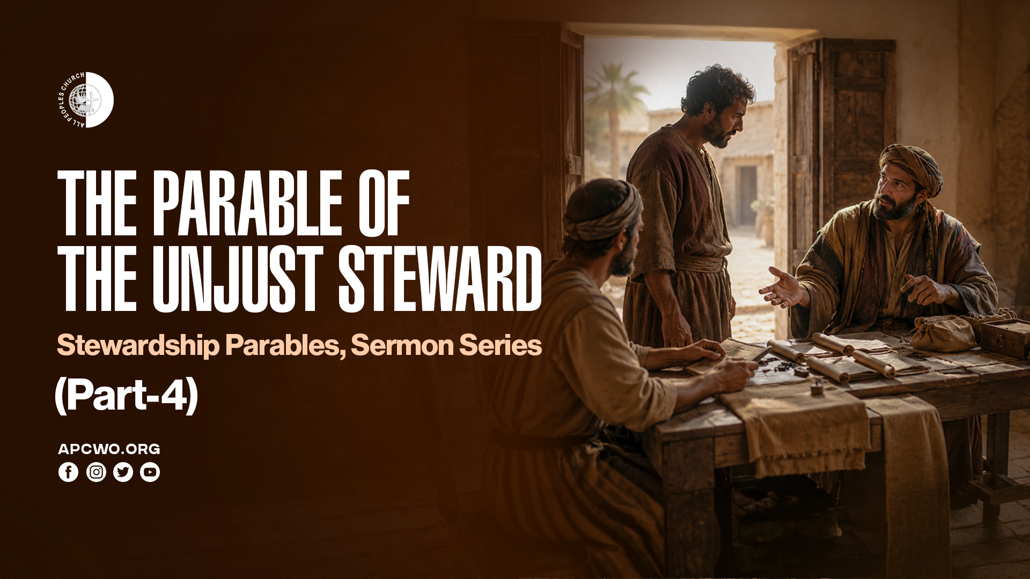

Slide 2
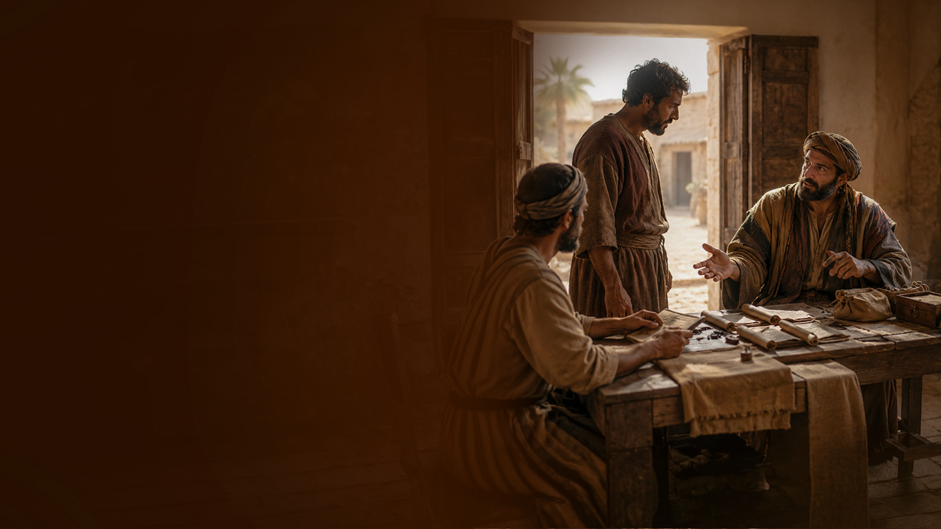
The Parable of the Unjust Steward

Slide 3
Luke 16:1-13
1 He also said to His disciples: "There was a certain rich man who had a steward, and an accusation was brought to him that this man was wasting his goods.
2 So he called him and said to him, 'What is this I hear about you? Give an account of your stewardship, for you can no longer be steward.'

Slide 4
Luke 16:1-13
3 "Then the steward said within himself, 'What shall I do? For
my master is taking the stewardship away from me. I cannot dig; I am ashamed to beg.
4 I have resolved what to do, that when I am put out of the stewardship, they may receive me into their houses.'

Slide 5
Luke 16:1-13
5 "So he called every one of
his master's debtors to him, and said to the first, 'How much do you owe my master?'
6 And he said, 'A hundred measures of oil.' So he said to him, 'Take your bill, and sit down quickly and write fifty.'

Slide 6
Luke 16:1-13
7 Then he said to another, 'And how much do you owe?' So he said, 'A hundred measures of wheat.' And he said to him, 'Take your bill, and write eighty.'
8 So the master commended the unjust steward because he had dealt shrewdly. For the sons of this world are more shrewd in their generation than the sons of light.

Slide 7
Luke 16:1-13
9 "And I say to you, make friends for yourselves by unrighteous mammon, that when you fail, they may receive you into an everlasting home.
10 He who is faithful in what is least is faithful also in much; and he who is unjust in what is least is unjust also in much.

Slide 8
Luke 16:1-13
11 Therefore if you have not been faithful in the unrighteous mammon, who will commit to your trust the true riches?
12 And if you have not been faithful in what is another man's, who will give you what is your own?

Slide 9
Luke 16:1-13
13 "No servant can serve two masters; for either he will hate the one and love the other, or else he will be loyal to the one and despise the other. You cannot serve God and mammon."

Slide 10
HE DEALT SHREWDLY

Slide 11
JESUS' MAIN POINT

Slide 12
Vs 8: "...For the sons of this world are more shrewd in their generation than the sons of light."

Slide 13
THE INTENT OF THIS STEWARDSHIP PARABLE

Slide 14
“…UNRIGHTEOUS MAMMON...” (VS 9,11,13)

Slide 15
USE MONEY TO BUILD FRIENDSHIPS

Slide 16
9 "And I say to you, make friends for yourselves by unrighteous mammon, that when you fail, they may receive you into an everlasting home.

Slide 17
"...they may receive you into an everlasting home."

Slide 18
BE FAITHFUL AND HONEST IN LITTLE THINGS

Slide 19
10 He who is faithful in what is least is faithful also in much; and he who is unjust in what is least is unjust also in much.

Slide 20
BE FAITHFUL IN MONEY

Slide 21
11 Therefore if you have not been faithful in the unrighteous mammon, who will commit to your trust the true riches?

Slide 22
BE FAITHFUL IN WHAT IS ANOTHER PERSON’S

Slide 23
12 And if you have not been faithful in what is another man's, who will give you what is your own?

Slide 24
BE FAITHFUL TO GOD—YOU CANNOT SERVE TWO MASTERS

Slide 25
13 "No servant can serve two masters; for either he will hate the one and love the other, or else he will be loyal to the one and despise the other. You cannot serve God and mammon."

Slide 26
Matthew 6:19-24
19 "Do not lay up for yourselves treasures on earth, where moth and rust destroy and where thieves break in and steal;
20 but lay up for yourselves treasures in heaven, where neither moth nor rust destroys and where thieves do not break in and steal.

Slide 27
Matthew 6:19-24
21 For where your treasure is, there your heart will be also.
22 "The lamp of the body is the eye. If therefore your eye is good, your whole body will be full of light.

Slide 28
Matthew 6:19-24
23 But if your eye is bad, your whole body will be full of darkness. If therefore the light that is in you is darkness, how great is that darkness!
24 "No one can serve two masters; for either he will hate the one and love the other, or else he will be loyal to the one and despise the other. You cannot serve God and mammon.

Slide 29
1 Timothy 6:6-10,17-19
6 Now godliness with contentment is great gain.
7 For we brought nothing into this world, and it is certain we can carry nothing out.
8 And having food and clothing, with these we shall be content.

Slide 30
1 Timothy 6:6-10,17-19
9 But those who desire to be rich fall into temptation and a snare, and into many foolish and harmful lusts which drown men in destruction and perdition.
10 For the love of money is a root of all kinds of evil, for which some have strayed from the faith in their greediness, and pierced themselves through with many sorrows.

Slide 31
1 Timothy 6:6-10,17-19
17 Command those who are rich in this present age not to be haughty, nor to trust in uncertain riches but in the living God, who gives us richly all things to enjoy.
18 Let them do good, that they be rich in good works, ready to give, willing to share,
19 storing up for themselves a good foundation for the time to come, that they may lay hold on eternal life.

Slide 32
Philippians 4:17-19
17 Not that I seek the gift, but I seek the fruit that abounds to your account.
18 Indeed I have all and abound.
I am full, having received from Epaphroditus the things sent from you, a sweet-smelling aroma, an acceptable sacrifice, well pleasing to God.
19 And my God shall supply all your need according to His riches in glory by Christ Jesus.

Slide 33
KINGDOM LAWS OF STEWARDSHIP

Slide 34
1. To whom much is given, much will be required.
(Luke 12:48)
2. To everyone who has, more will be given, and he will have abundance; but from him who does not have, even what he has will be taken away. (Matthew 25:29)

Slide 35
3. So the last will be first, and the first last. For many are called, but few chosen. (Matthew 20:16)
4. Be a wise steward in earthly matters and earthly resources, especially money. (Luke 16:9-13)

