Slide 1
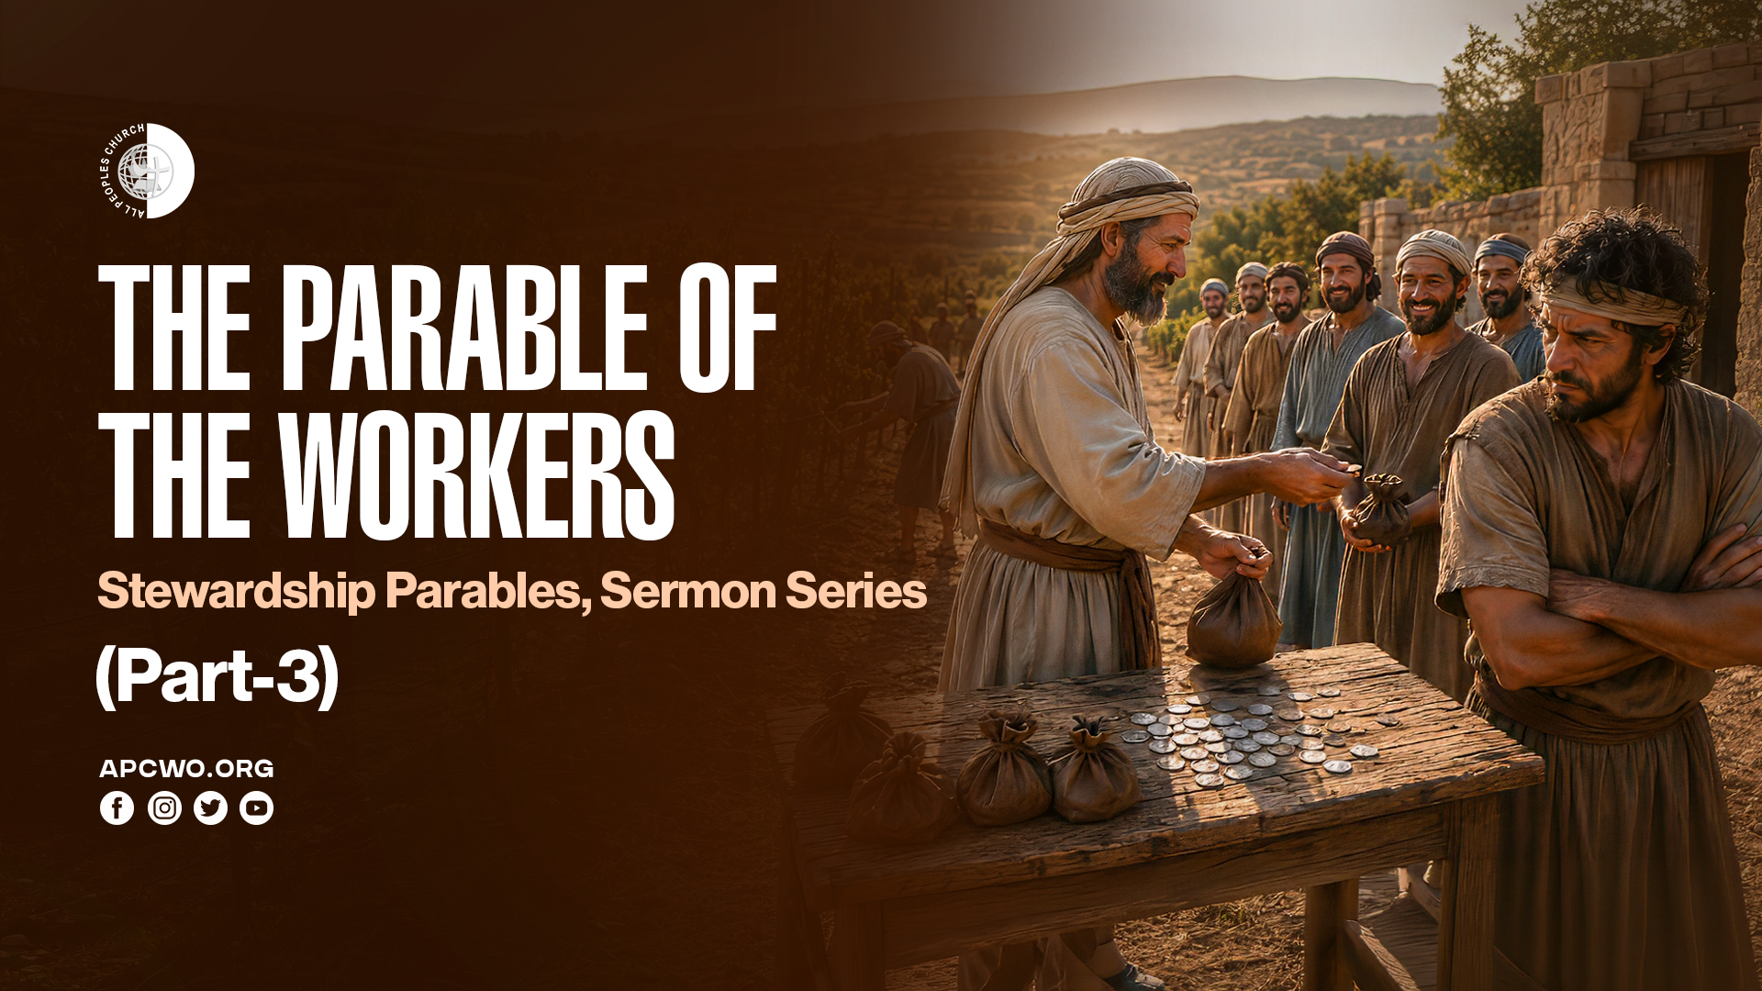

Slide 2
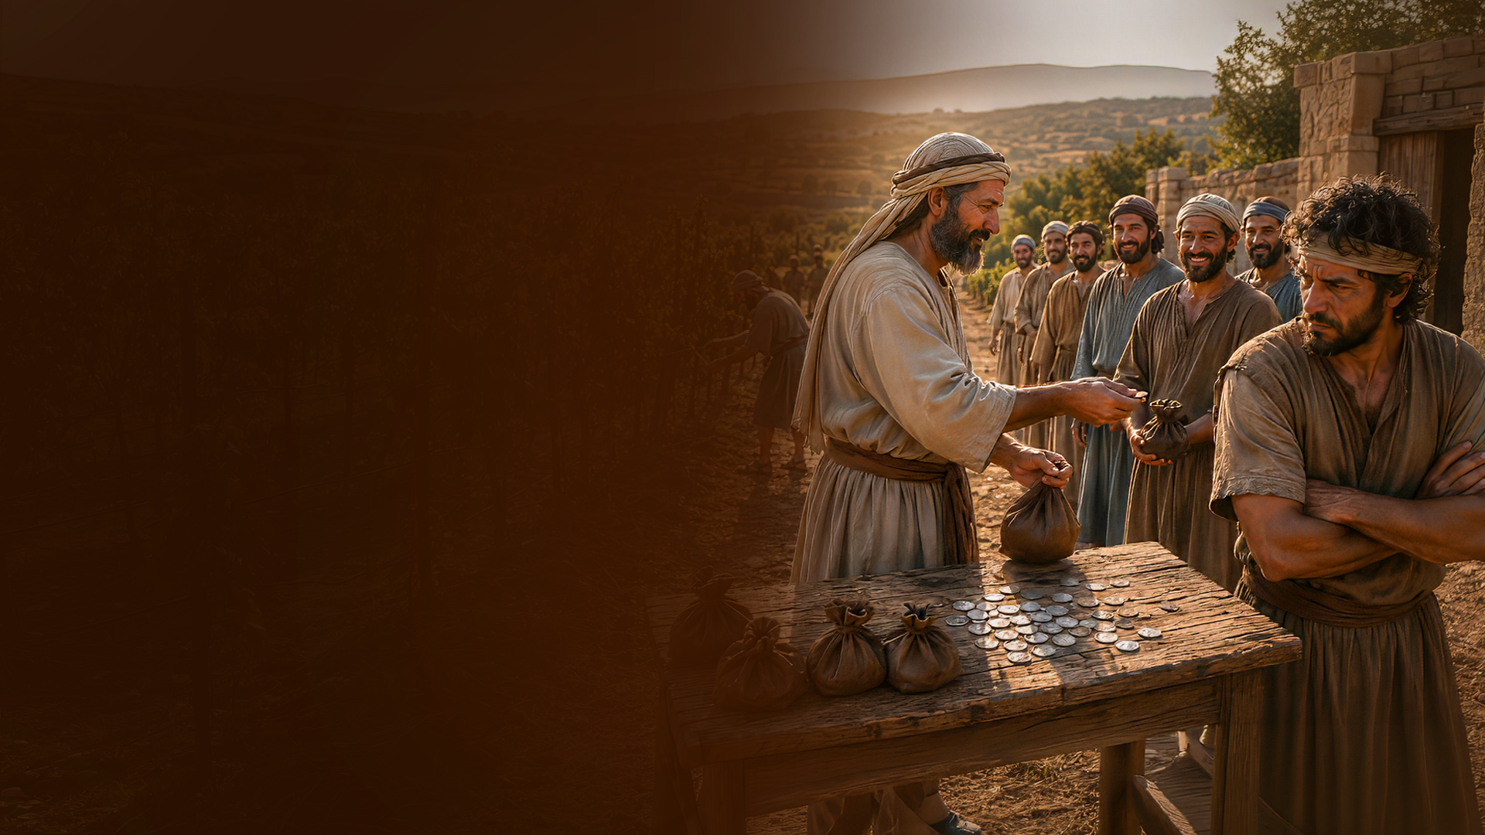
THE PARABLE OF THE WORKERS

Slide 3
Matthew 19:27-30
27 Then Peter answered and said to Him, "See, we have left all and followed You. Therefore what shall we have?"
28 So Jesus said to them, "Assuredly I say to you, that in the regeneration, when the Son of Man sits on the throne of His glory, you who have followed Me will also sit on twelve thrones, judging the twelve tribes of Israel.

Slide 4
Matthew 19:27-30
29 And everyone who has left houses or brothers or sisters or father or mother or wife or children or lands, for My name's sake, shall receive a hundredfold, and inherit eternal life.
30 But many who are first will be last, and the last first.

Slide 5
Matthew 20:1-16
1 "For the kingdom of heaven is like a landowner who went out early in the morning to hire laborers for his vineyard.
2 Now when he had agreed with the laborers for a denarius a day, he sent them into his vineyard.
3 And he went out about the third hour and saw others standing idle in the marketplace,

Slide 6
Matthew 20:1-16
4 and said to them, 'You also go into the vineyard, and whatever is right I will give you.' So they went.
5 Again he went out about the sixth and the ninth hour, and did likewise.
6 And about the eleventh hour he went out and found others standing idle, and said to them, 'Why have you been standing here idle all day?'

Slide 7
Matthew 20:1-16
7 They said to him, 'Because no one hired us.' He said to them, 'You also go into the vineyard, and whatever is right you will receive.'
8 "So when evening had come, the owner of the vineyard said to his steward, 'Call the laborers and give them their wages, beginning with the last to the first.'
9 And when those came who were hired about the eleventh hour, they each received a denarius.

Slide 8
Matthew 20:1-16
10 But when the first came, they supposed that they would receive more; and they likewise received each a denarius.
11 And when they had received it, they complained against the landowner,
12 saying, 'These last men have worked only one hour, and you made them equal to us who have borne the burden and the heat of the day.'

Slide 9
Matthew 20:1-16
13 But he answered one of them and said, 'Friend, I am doing you no wrong. Did you not agree with me for a denarius?
14 Take what is yours and go your way. I wish to give to this last man the same as to you.

Slide 10
Matthew 20:1-16
15 Is it not lawful for me to do what I wish with my own things? Or is your eye evil because I am good?'
16 So the last will be first, and the first last. For many are called, but few chosen."

Slide 11
Matthew 19:27
Then Peter answered and said to Him, "See, we have left all and followed You. Therefore what shall we have?"

Slide 12
LET’S BEGIN WITH THE END

Slide 13
Matthew 20:16
So the last will be first, and the first last. For many are called, but few chosen."

Slide 14
"FIRST" AND "LAST"

Slide 15
INSIGHT 1: GOD OVERTURNS HUMAN RANKING SYSTEMS.

Slide 16
INSIGHT 2: EVERYONE RECEIVED THE SAME, INDICATING GOD'S WAY OF WORKING.

Slide 17
THE MANY AND THE FEW

Slide 18
Matthew 20:16
So the last will be first, and the first last. For many are called, but few chosen."

Slide 19
LESSONS TO APPLY

Slide 20
2 Corinthians 10:12
For we dare not class ourselves or compare ourselves with those who commend themselves. But they, measuring themselves by themselves, and comparing themselves among themselves, are not wise.

Slide 21
Romans 14:4,12
4 Who are you to judge another's servant? To his own master he stands or falls. Indeed, he will be made to stand, for God is able to make him stand.
12 So then each of us shall give account of himself to God.

Slide 22
PETER'S QUESTION

Slide 23
Matthew 19:27
Then Peter answered and said to Him, "See, we have left all and followed You. Therefore what shall we have?"

Slide 24
A. Never compare yourself with others or other ministries

Slide 25
1 Corinthians 4:6
Now these things, brethren, I have figuratively transferred to myself and Apollos for your sakes, that you may learn in us not to think beyond what is written, that none of you may be puffed up on behalf of one against the other.

Slide 26
B. God rewards everyone as He sees best

Slide 27
Hebrews 6:10
For God is not unjust to forget your work and labor of love which you have shown toward His name, in that you have ministered to the saints, and do minister.

Slide 28
C. Keep a humble heart when you are blessed with an early start and long service

Slide 29
D. Don't think you are superior because you are rewarded quicker and same as others who have labored long

Slide 30
E. A right heart is more important than seniority or visibility

Slide 31
KINGDOM LAWS OF STEWARDSHIP

Slide 32
1. To whom much is given, much will be required.
(Luke 12:48)

Slide 33
2. To everyone who has, more will be given, and he will have abundance; but from him who does not have, even what he has will be taken away. (Matthew 25:29)

Slide 34
3. So the last will be first, and the first last. For many are called, but few chosen. (Matthew 20:16)

Slide 35
SUMMARY

Slide 36
A. Never compare yourself with others or other ministries
B. God rewards everyone as He sees best
C. Keep a humble heart when you are blessed with an early start and long service

Slide 37
D. Don't think you are superior because you are rewarded quicker and same as others who have labored long
E. A right heart is more important than seniority or visibility

