Slide 1
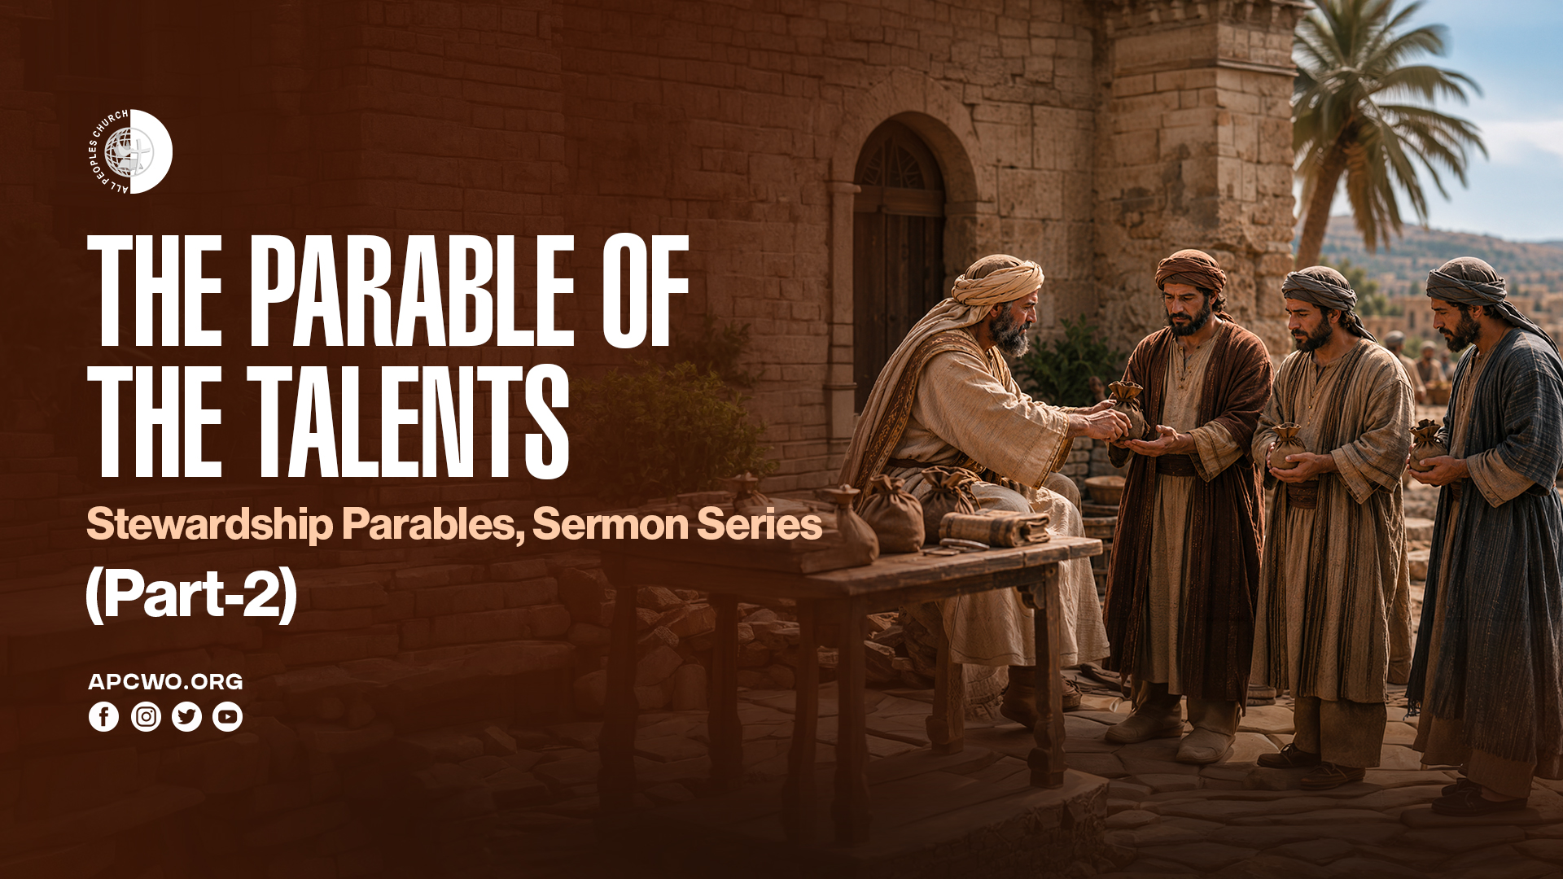

Slide 2
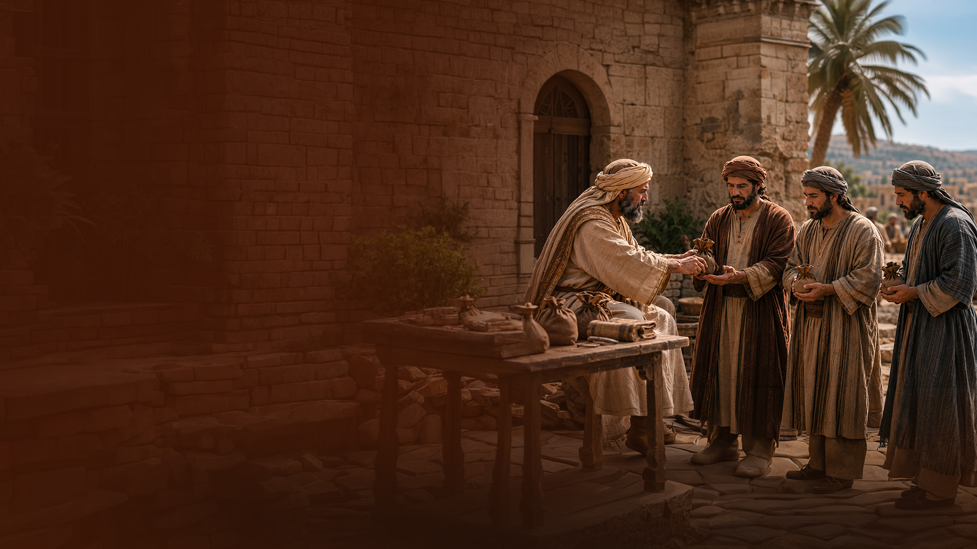
The Parable of the Talents

Slide 3
Matthew 25:14-30
(See also Luke 19:11-27)
14 "For the kingdom of heaven is like a man traveling to a far country, who called his own servants and delivered his goods to them.
15 And to one he gave five talents, to another two, and to another one, to each according to his own ability; and immediately he went on a journey.

Slide 4
Matthew 25:14-30
(See also Luke 19:11-27)
16 Then he who had received the five talents went and traded with them, and made another five talents.
17 And likewise he who had received two gained two more also.
18 But he who had received one went and dug in the ground, and hid his lord's money.

Slide 5
Matthew 25:14-30
(See also Luke 19:11-27)
19 After a long time the lord of those servants came and settled accounts with them.
20 "So he who had received five talents came and brought five other talents, saying, 'Lord, you delivered to me five talents; look, I have gained five more talents besides them.'

Slide 6
Matthew 25:14-30
(See also Luke 19:11-27)
21 His lord said to him, 'Well done, good and faithful servant; you were faithful over a few things, I will make you ruler over many things. Enter into the joy of your lord.'
22 He also who had received two talents came and said, 'Lord, you delivered to me two talents; look, I have gained two more talents besides them.'

Slide 7
Matthew 25:14-30
(See also Luke 19:11-27)
23 His lord said to him, 'Well done, good and faithful servant; you have been faithful over a few things, I will make you ruler over many things. Enter into the joy of your lord.'
24 "Then he who had received the one talent came and said, 'Lord, I knew you to be a hard man, reaping where you have not sown, and gathering where you have not scattered seed.

Slide 8
Matthew 25:14-30
(See also Luke 19:11-27)
25 And I was afraid, and went and hid your talent in the ground. Look, there you have what is yours.'
26 "But his lord answered and said to him, 'You wicked and lazy servant, you knew that I reap where I have not sown, and gather where I have not scattered seed.

Slide 9
Matthew 25:14-30
(See also Luke 19:11-27)
27 So you ought to have deposited my money with the bankers, and at my coming I would have received back my own with interest.
28 So take the talent from him, and give it to him who has ten talents.

Slide 10
Matthew 25:14-30
(See also Luke 19:11-27)
29 'For to everyone who has, more will be given, and he will have abundance; but from him who does not have, even what he has will be taken away.
30 And cast the unprofitable servant into the outer darkness. There will be weeping and gnashing of teeth.'

Slide 11
EIGHT LESSONS ON STEWARDSHIP FROM THE PARABLE OF THE TALENTS

Slide 12
1. GOD ENTRUSTS US WITH GIFTS

Slide 13
2. USE WHAT YOU HAVE BEEN GIVEN

Slide 14
3. OPERATE IN FAITH, NOT FEAR

Slide 15
4. GOD WANTS US TO GROW

Slide 16
5. INVEST TO BE PROFITABLE

Slide 17
6. BE FAITHFUL AND
PROFITABLE

Slide 18
7. EVERYONE WILL BE HELD ACCOUNTABLE

Slide 19
8. FAITHFULNESS AND PROFITABILITY ARE REWARDED WITH INCREASE

Slide 20
KINGDOM LAW OF
STEWARDSHIP

Slide 21
1. To whom much is given, much will be required
(Luke 12:48)

Slide 22
2. To everyone who has, more will be given, and he will have abundance
(Matthew 25:29)

