Slide 1
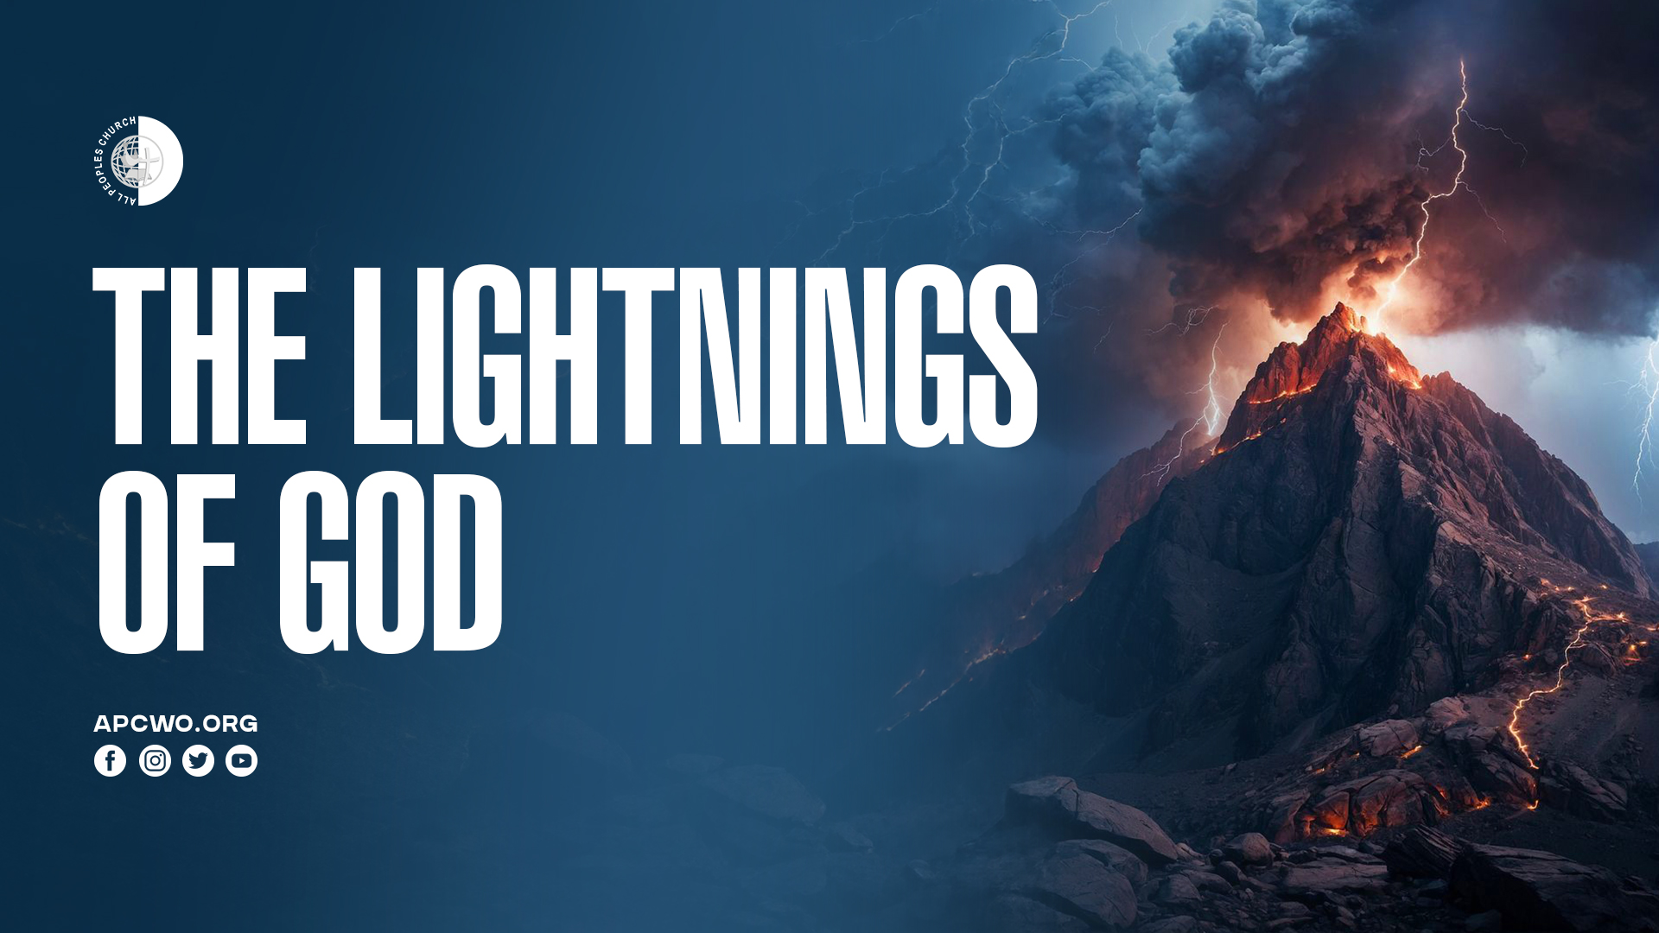

Slide 2
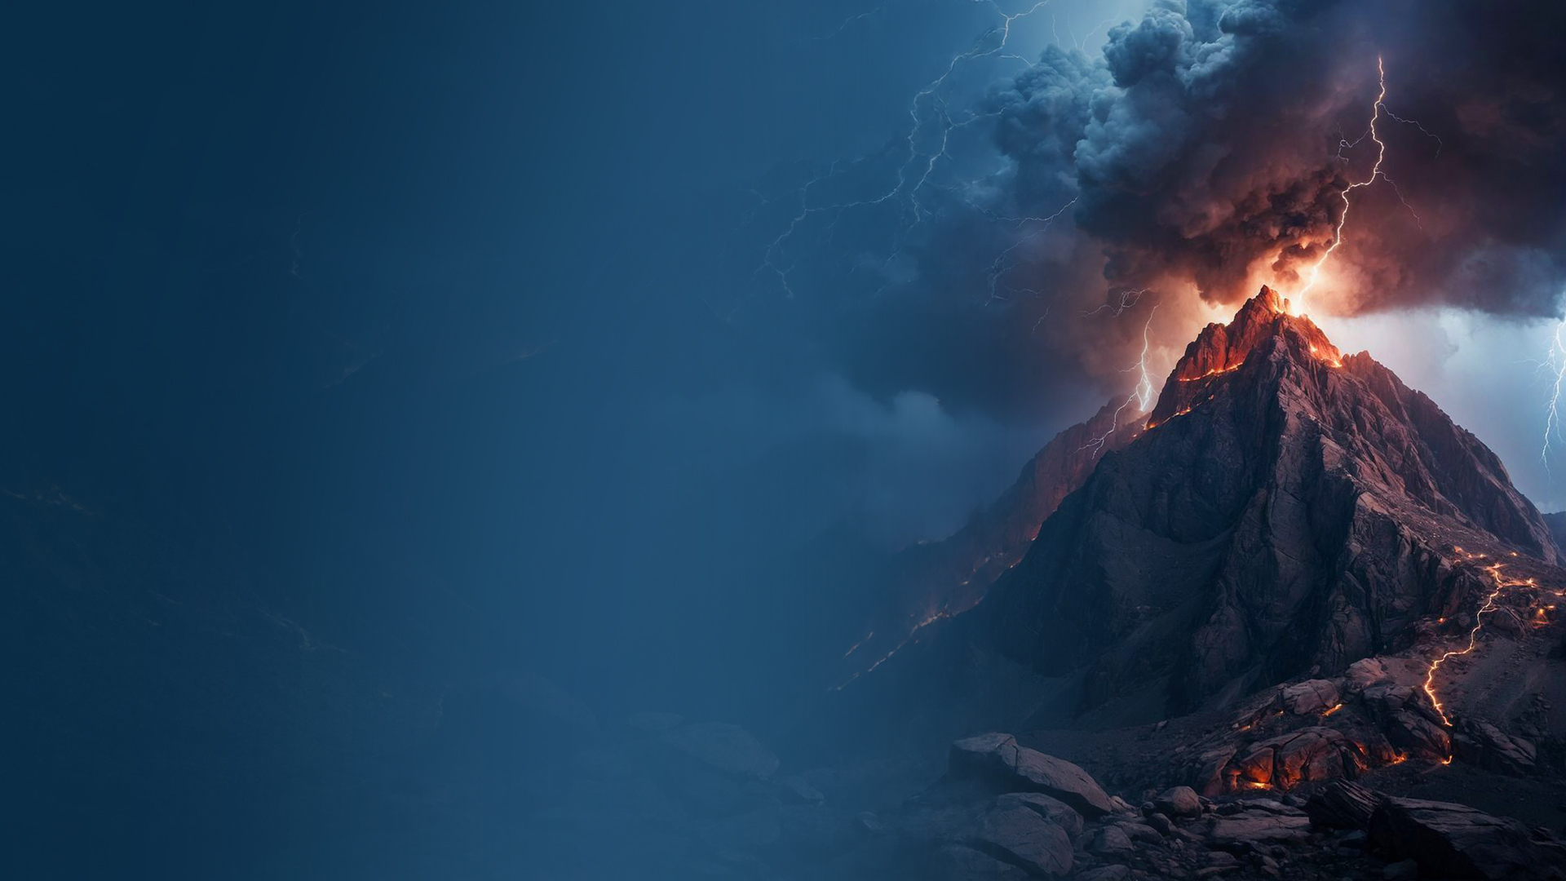
HEAVENLY COUNTENANCE LIKE LIGHTNING

Slide 3
Daniel 10:5,6
5 I lifted my eyes and looked, and behold, a certain man clothed in linen, whose waist was girded with gold of Uphaz!
6 His body was like beryl, his face like the appearance of lightning, his eyes like torches of fire, his arms and feet like burnished bronze in color, and the sound of his words like the voice of a multitude.

Slide 4
Matthew 28:1-4
1 Now after the Sabbath, as the first day of the week began to dawn, Mary Magdalene and the other Mary came to see the tomb.
2 And behold, there was a great earthquake; for an angel of the Lord descended from heaven, and came and rolled back the stone from the door, and sat on it.
3 His countenance was like lightning, and his clothing as white as snow.
4 And the guards shook for fear of him, and became like dead men.

Slide 5
THE LIGHTNING OF HIS PRESENCE

Slide 6
Exodus 20:18-21
18 Now all the people witnessed the thunderings, the lightning flashes, the sound of the trumpet, and the mountain smoking; and when the people saw it, they trembled and stood afar off.
19 Then they said to Moses, "You speak with us, and we will hear; but let not God speak with us, lest we die."

Slide 7
Exodus 20:18-21
20 And Moses said to the people, "Do not fear; for God has come to test you, and that His fear may be before you, so that you may not sin."
21 So the people stood afar off, but Moses drew near the thick darkness where God was.

Slide 8
FROM HIS THRONE PROCEED LIGHTNINGS

Slide 9
Revelation 4:5
And from the throne proceeded lightnings, thunderings, and voices. Seven lamps of fire were burning before the throne, which are the seven Spirits of God.

Slide 10
LIGHTNING FLASHING FROM HIS HAND

Slide 11
Habakkuk 3:1-4
1 A prayer of Habakkuk the prophet, on Shigionoth.
2 O LORD, I have heard Your speech and was afraid; O LORD, revive Your work in the midst of the years! In the midst of the years make it known; In wrath remember mercy.

Slide 12
Habakkuk 3:1-4
3 God came from Teman, The Holy One from Mount Paran. Selah. His glory covered the heavens, And the earth was full of His praise.
4 His brightness was like the light; He had rays flashing from His hand, And there His power was hidden.

Slide 13
THE LORD'S DELIVERANCE COMES LIKE LIGHTNING

Slide 14
2 Samuel 22:14,15
14 "The LORD thundered from heaven, And the Most High uttered His voice.
15 He sent out arrows and scattered them; Lightning bolts, and He vanquished them.

Slide 15
Zechariah 9:14-16
14 Then the LORD will be seen over them, And His arrow will go forth like lightning. The Lord GOD will blow the trumpet, And go with whirlwinds from the south.
15 The LORD of hosts will defend them; They shall devour and subdue with slingstones. They shall drink and roar as if with wine; They shall be filled with blood like basins, Like the corners of the altar.

Slide 16
Zechariah 9:14-16
16 The LORD their God will save them in that day, As the flock of His people. For they shall be like the jewels of a crown, Lifted like a banner over His land—

Slide 17
ENCOUNTERING THE LIGHTNINGS OF GOD

Slide 18
Acts 9:1-6
1 Then Saul, still breathing threats and murder against the disciples of the Lord, went to the high priest
2 and asked letters from him to the synagogues of Damascus, so that if he found any who were of the Way, whether men or women, he might bring them bound to Jerusalem.
3 As he journeyed he came near Damascus, and suddenly a light shone around him from heaven.

Slide 19
Acts 9:1-6
4 Then he fell to the ground, and heard a voice saying to him, "Saul, Saul, why are you persecuting Me?"
5 And he said, "Who are You, Lord?" Then the Lord said, "I am Jesus, whom you are persecuting. It is hard for you to kick against the goads."
6 So he, trembling and astonished, said, "Lord, what do You want me to do?" Then the Lord said to him, "Arise and go into the city, and you will be told what you must do."

Slide 20
HIS COMING IS LIKE LIGHTNING

Slide 21
Matthew 24:27 (Luke 17:24)
For as the lightning comes from the east and flashes to the west, so also will the coming of the Son of Man be.

