Slide 1
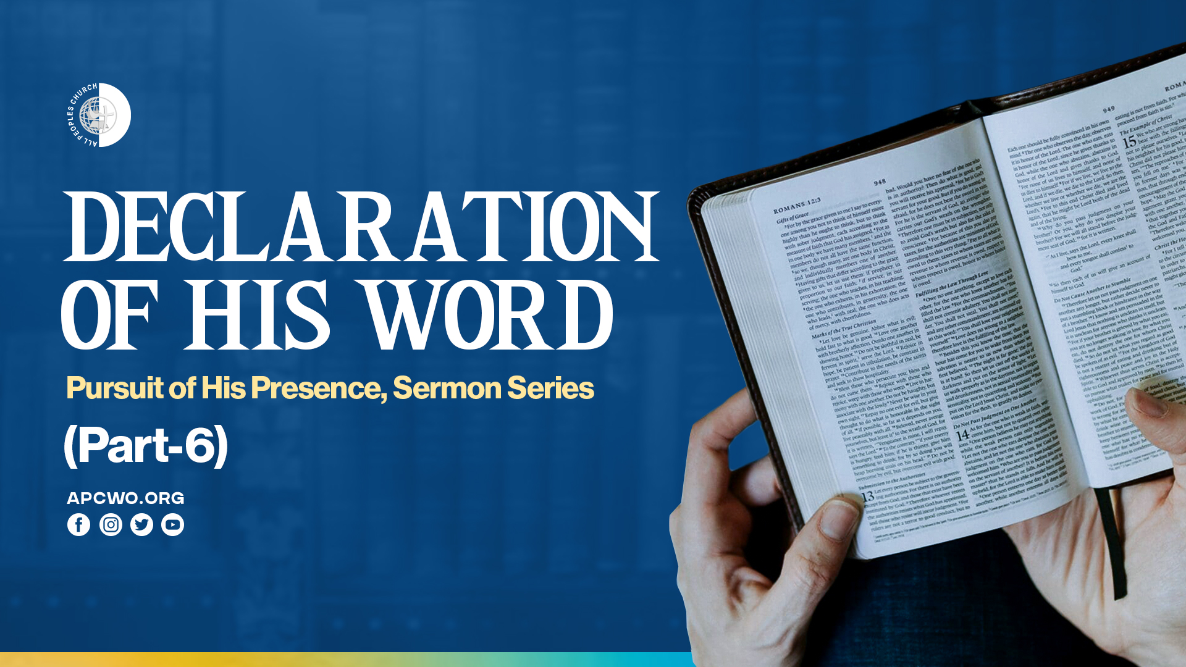

Slide 2

WE MUST BE IN AGREEMENT WITH GOD IF WE ARE TO WALK WITH HIM

Slide 3
Amos 3:1-3
1 Hear this word that the LORD has spoken against you, O children of Israel, against the whole family which I brought up from the land of Egypt, saying:
2 "You only have I known of all the families of the earth; Therefore I will punish you for all your iniquities."
3 Can two walk together, unless they are agreed?

Slide 4
THE IMPORTANCE OF OUR WORDS TO HIS PRESENCE

Slide 5
Psalm 19:13,14
13 Keep back Your servant also from presumptuous sins; Let them not have dominion over me. Then I shall be blameless, And I shall be innocent of great transgression.
14 Let the words of my mouth and the meditation of my heart Be acceptable in Your sight, O LORD, my strength and my Redeemer.

Slide 6
Malachi 3:13-18
13 "Your words have been harsh against Me," Says the LORD, Yet you say, 'What have we spoken against You?'
14 You have said, 'It is useless to serve God; What profit is it that we have kept His ordinance, And that we have walked as mourners Before the LORD of hosts?
15 So now we call the proud blessed, For those who do wickedness are raised up; They even tempt God and go free.' "

Slide 7
Malachi 3:13-18
16 Then those who feared the LORD spoke to one another, And the LORD listened and heard them; So a book of remembrance was written before Him For those who fear the LORD And who meditate on His name.
17 "They shall be Mine," says the LORD of hosts, "On the day that I make them My jewels. And I will spare them As a man spares his own son who serves him."

Slide 8
Malachi 3:13-18
18 Then you shall again discern Between the righteous and the wicked, Between one who serves God And one who does not serve Him.

Slide 9
DECLARE WHO GOD IS AND HIS PROMISES

Slide 10
Psalm 18:2
The LORD is my rock and my fortress and my deliverer; My God, my strength, in whom I will trust; My shield and the horn of my salvation, my stronghold.

Slide 11
Psalm 23:1
The LORD is my shepherd; I shall not want.

Slide 12
Psalm 27:1
The LORD is my light and my salvation; Whom shall I fear? The LORD is the strength of my life; Of whom shall I be afraid?

Slide 13
Psalm 28:7
The LORD is my strength and my shield; My heart trusted in Him, and I am helped; Therefore my heart greatly rejoices, And with my song I will praise Him.

Slide 14
Psalm 91:2
I will say of the LORD, "He is my refuge and my fortress; My God, in Him I will trust."

Slide 15
Psalm 118:14
The LORD is my strength and song, And He has become my salvation.

Slide 16
Hebrews 13:5,6
5 Let your conduct be without covetousness; be content with such things as you have. For He Himself has said, "I WILL NEVER LEAVE YOU NOR FORSAKE YOU."
6 So we may boldly say: "THE LORD IS MY HELPER; I WILL NOT FEAR. WHAT CAN MAN DO TO ME?"

Slide 17
DECLARING WHO GOD IS AND HIS PROMISES, LEADS US TO ENCOUNTERING GOD

Slide 18
EXAMPLES IN SCRIPTURE

