Slide 1
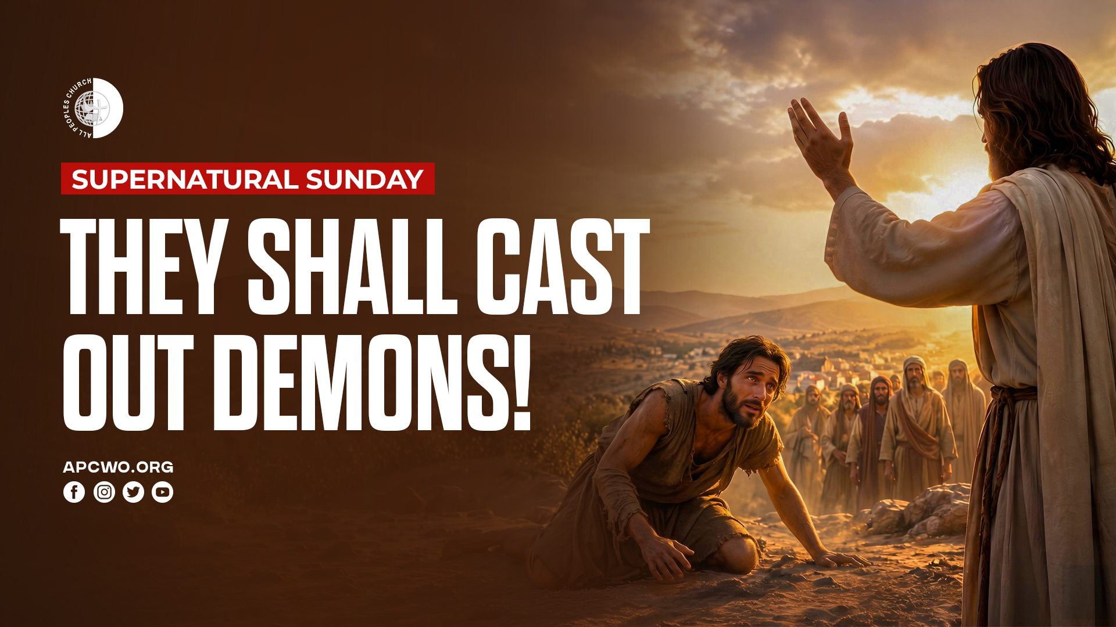

Slide 2
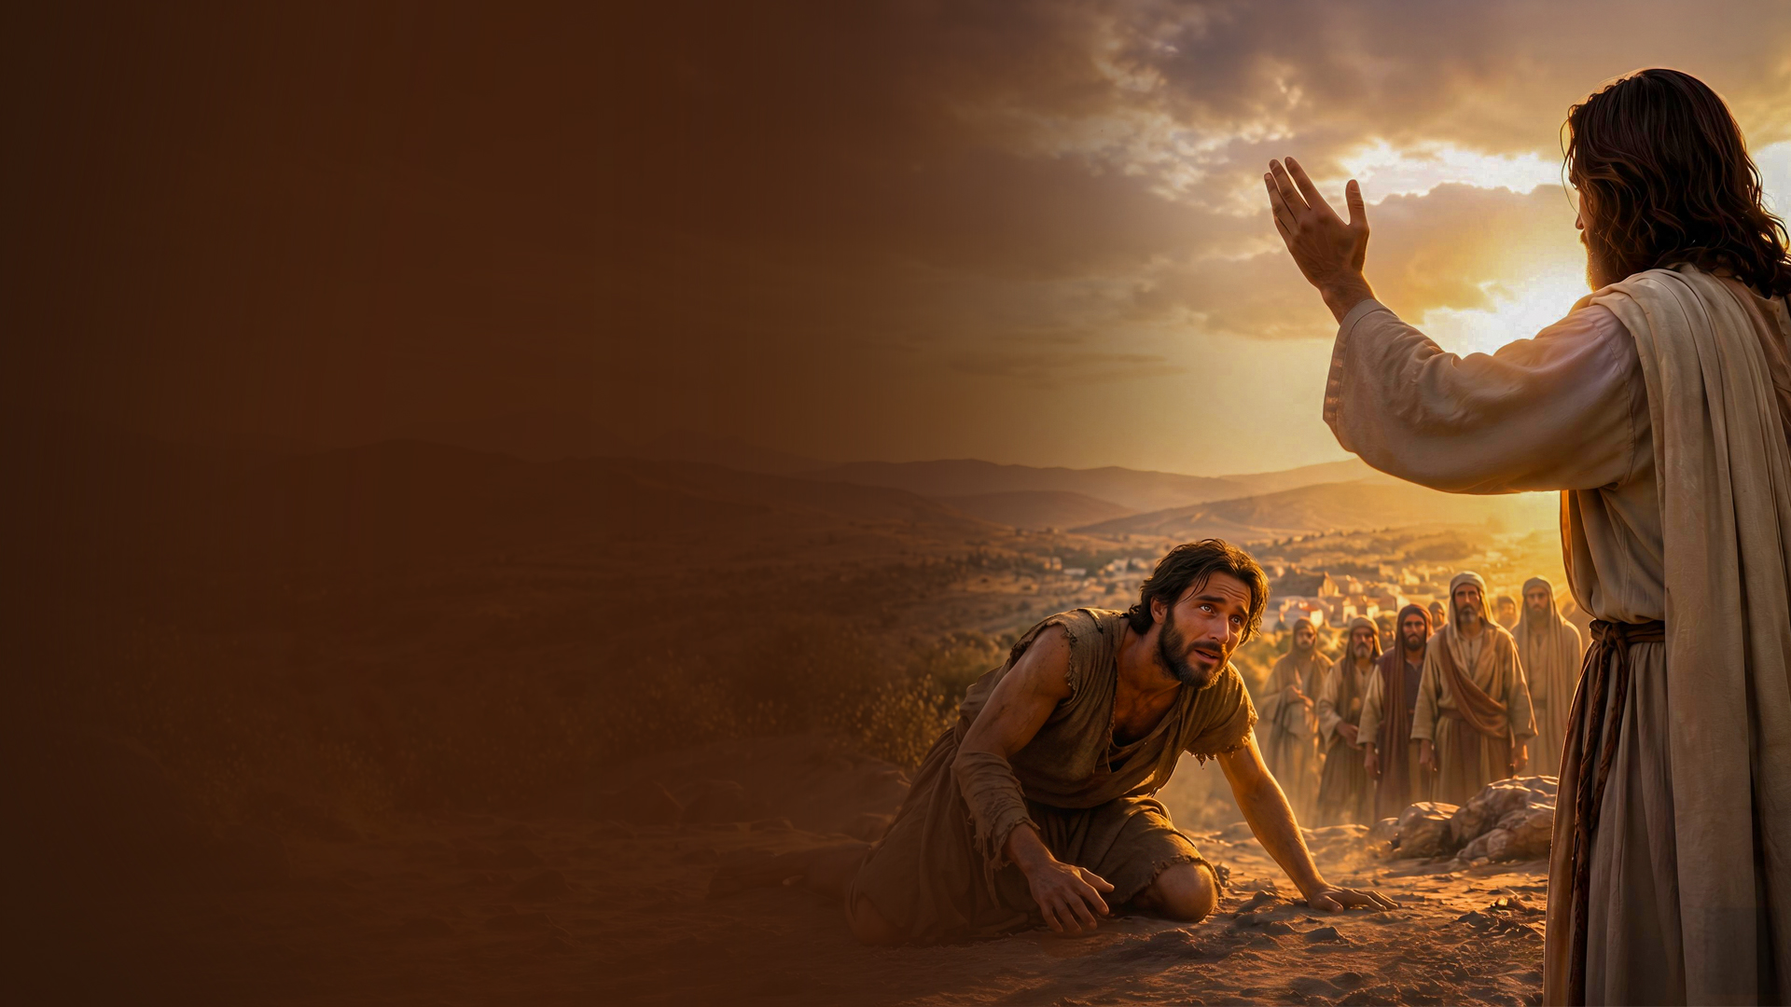
CONFLICT IN THE SPIRITUAL REALM

Slide 3
Ephesians 6:12
For we do not wrestle against flesh and blood, but against principalities, against powers, against the rulers of the darkness of this age, against spiritual hosts of wickedness in the heavenly places.

Slide 4
DEMONIC ACTIVITY

Slide 5
Steal, kill, destroy
(John 10:10)

Slide 6
Sickness (Acts 10:38)

Slide 7
Heaviness (Isaiah 61:3)

Slide 8
Situations (Job 1 & 2)

Slide 9
Hindrances
(2 Corinthians 12:7;
1 Thessalonians 2:18)

Slide 10
AUTHORITY TO CAST OUT DEMONS

Slide 11
Mark 16:17,18
17 And these signs will follow those who believe: In My name they will cast out demons; they will speak with new tongues;
18 they will take up serpents; and if they drink anything deadly, it will by no means hurt them; they will lay hands on the sick, and they will recover.

Slide 12
AUTHORITY TO BIND AND LOOSE

Slide 13
Matthew 12:28,29
28 But if I cast out demons by the Spirit of God, surely the kingdom of God has come upon you.
29 Or how can one enter a strong man's house and plunder his goods, unless he first binds the strong man? And then he will plunder his house.

Slide 14
Matthew 16:16-19
16 Simon Peter answered and said, "You are the Christ, the Son of the living God."
17 Jesus answered and said to him, "Blessed are you, Simon Bar-Jonah, for flesh and blood has not revealed this to you, but My Father who is in heaven.

Slide 15
Matthew 16:16-19
18 And I also say to you that you are Peter, and on this rock I will build My church, and the gates of Hades shall not prevail against it.
19 And I will give you the keys of the kingdom of heaven, and whatever you bind on earth will be bound in heaven, and whatever you loose on earth will be loosed in heaven."

Slide 16
EXERCISING AUTHORITY OVER DEMONIC ACTIVITY

