Slide 1
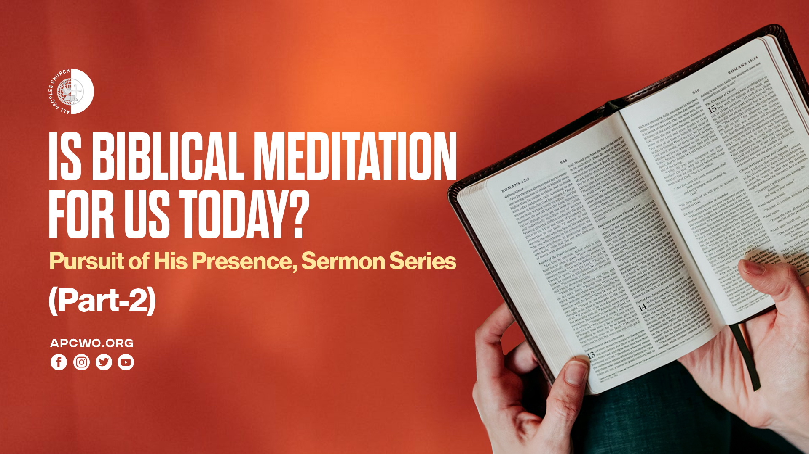

Slide 2

MEDITATION – IN BOTH TESTAMENTS

Slide 3
Philippians 4:8
Finally, brethren, whatever things are true, whatever things are noble, whatever things are just, whatever things are pure, whatever things are lovely, whatever things are of good report, if there is any virtue and if there is anything praiseworthy—meditate on these things.

Slide 4
1 Timothy 4:15
Meditate on these things; give yourself entirely to them, that your progress may be evident to all.

Slide 5
Luke 2:19
But Mary kept all these things and pondered them in her heart.

Slide 6
ENCOUNTERING AND COMMUNING WITH GOD THROUGH BIBLICAL MEDITATION

Slide 7
Psalm 63:1-6
1 O God, You are my God; Early will I seek You; My soul thirsts for You; My flesh longs for You In a dry and thirsty land Where there is no water.
2 So I have looked for You in the sanctuary, To see Your power and Your glory.
3 Because Your lovingkindness is better than life, My lips shall praise You.

Slide 8
Psalm 63:1-6
4 Thus I will bless You while I live; I will lift up my hands in Your name.
5 My soul shall be satisfied as with marrow and fatness, And my mouth shall praise You with joyful lips.
6 When I remember You on my bed, I meditate on You in the night watches.

Slide 9
BIBLICAL MEDITATION

Slide 10
WAYS TO PRACTICE BIBLICAL MEDITATION

Slide 11
1. SCRIPTURE REPETITION THROUGHOUT THE DAY
Choose one verse in the morning and quietly repeat it throughout the day.

Slide 12
2. MEDITATIVE JOURNALING
After reading Scripture, write your reflections as a journal entry or conversationally with God.

Slide 13
3. SCRIPTURE MEMORIZATION WITH REFLECTION
Memorization becomes meditation when believers deeply ponder what they memorize.

Slide 14
4. MEDITATING DURING DAILY WORK
Biblical meditation does not require isolation. It can happen while cooking, driving, coding, walking, exercising, doing housework.

Slide 15
5. WORD MEDITATION BEFORE SLEEP
The Psalms repeatedly mention meditating at night
(Psalm 63:6).

Slide 16
COMMUNAL MEDITATION

Slide 17
MAJOR DIFFERENCES BETWEEN BIBLICAL MEDITATION AND SOME MODERN IDEAS

