Slide 1
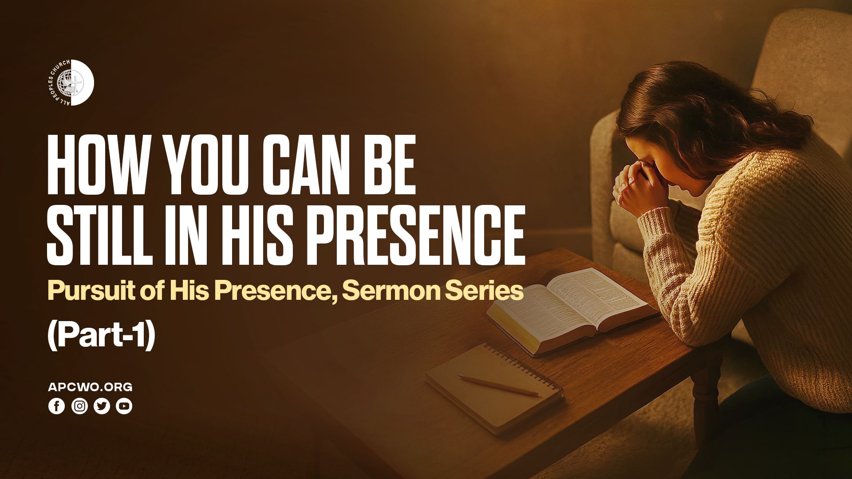

Slide 2
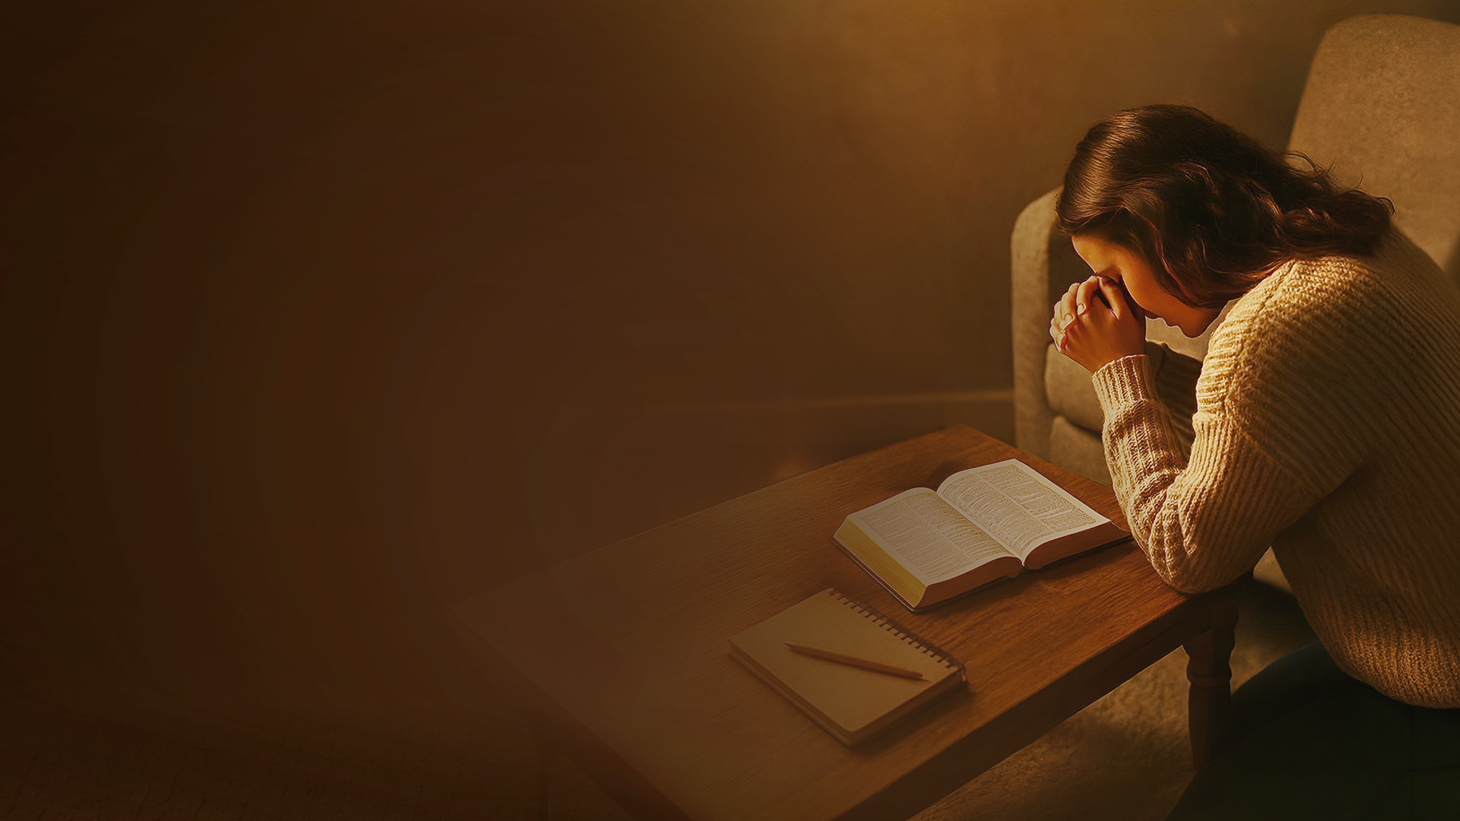
BEING STILL

Slide 3
Psalm 46:10,11
10 Be still, and know that I am God; I will be exalted among the nations, I will be exalted in the earth!
11 The LORD of hosts is with us; The God of Jacob is our refuge. Selah

Slide 4
GOD IS WITH US.
GOD IS OUR REFUGE.

Slide 5
SELAH

Slide 6
STILLNESS AND SILENCE

Slide 7
Zechariah 2:13
Be silent, all flesh, before the LORD, for He is aroused from His holy habitation!"

Slide 8
Habakkuk 2:20
"But the LORD is in His holy temple. Let all the earth keep silence before Him."

Slide 9
QUIETNESS AND CONFIDENCE

Slide 10
Isaiah 30:15
For thus says the Lord GOD, the Holy One of Israel: "In returning and rest you shall be saved; In quietness and confidence shall be your strength." But you would not,

Slide 11
THE HINDRANCES WE FACE

Slide 12
THEY THAT WAIT

Slide 13
Isaiah 40:27-31
27 Why do you say, O Jacob, And speak, O Israel: "My way is hidden from the LORD, And my just claim is passed over by my God"?
28 Have you not known? Have you not heard? The everlasting God, the LORD, The Creator of the ends of the earth, Neither faints nor is weary. His understanding is unsearchable.
29 He gives power to the weak, And to those who have no might He increases strength.

Slide 14
Isaiah 40:27-31
30 Even the youths shall faint and be weary, And the young men shall utterly fall,
31 But those who wait on the LORD Shall renew their strength; They shall mount up with wings like eagles, They shall run and not be weary, They shall walk and not faint.

Slide 15
Isaiah 64:1-4
1 Oh, that You would rend the heavens! That You would come down! That the mountains might shake at Your presence—
2 As fire burns brushwood, As fire causes water to boil—To make Your name known to Your adversaries, That the nations may tremble at Your presence!

Slide 16
Isaiah 64:1-4
3 When You did awesome things for which we did not look, You came down, The mountains shook at Your presence.
4 For since the beginning of the world Men have not heard nor perceived by the ear, Nor has the eye seen any God besides You, Who acts for the one who waits for Him.

Slide 17
Stillness is an expression of our waiting on Him and waiting for Him.

Slide 18
PRACTICING QUIETNESS AND STILLNESS IN HIS PRESENCE

Slide 19
PRACTICING QUIETNESS AND STILLNESS IN DAILY WORK

