Slide 1
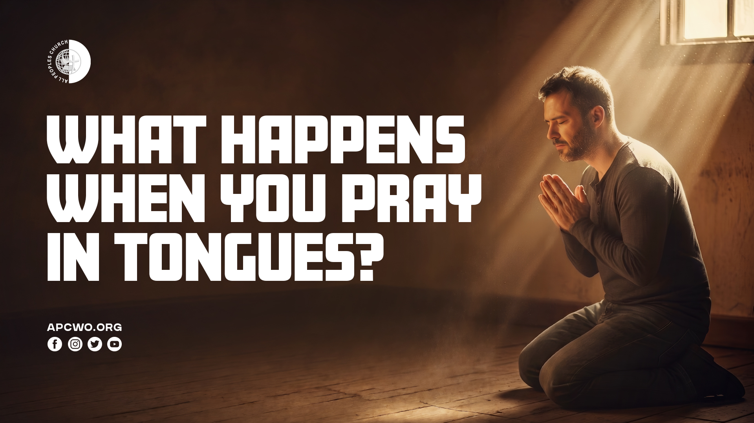

Slide 2

PERSONAL TESTIMONY

Slide 3
WHY PRAY IN TONGUES?

Slide 4
Tongues – an opportunity to partner with God in prayer.

Slide 5
IS PRAYING IN TONGUES FOR TODAY?

Slide 6
1. Jesus is still the Baptizer
in the Holy Spirit
(Matthew 3:11, Acts 1:5, Acts 2:1-4)

Slide 7
2. Jesus said those who believed in Him will speak in new tongues (Mark 16:17,18)

Slide 8
3. The promise of the Holy Spirit is still for us today
(Acts 2:38,39)

Slide 9
4. The Holy Spirit is still at work in the Church and expresses Himself through His gifts
(1 Corinthians 12:7-11)

Slide 10
5. Believers are encouraged to desire spiritual gifts and to speak in tongues
(1 Corinthians 14:1,39)

Slide 11
WHAT HAPPENS WHEN YOU PRAY IN TONGUES?

Slide 12
1. Praying beyond boundaries

Slide 13
1 Corinthians 14:2,14,15
2 For he who speaks in a tongue does not speak to men but to God, for no one understands him; however, in the spirit he speaks mysteries.
14 For if I pray in a tongue, my spirit prays, but my understanding is unfruitful.
15 What is the conclusion then? I will pray with the spirit, and I will also pray with the understanding. I will sing with the spirit, and I will also sing with the understanding.

Slide 14
2. Personal edification

Slide 15
1 Corinthians 14:4
He who speaks in a tongue edifies himself, but he who prophesies edifies the church.

Slide 16
Jude 1:20,21
20 But you, beloved, building yourselves up on your most holy faith, praying in the Holy Spirit,
21 keep yourselves in the love of God, looking for the mercy of our Lord Jesus Christ unto eternal life.

Slide 17
3. Personal unveiling of mysteries – receiving the mind of God

Slide 18
1 Corinthians 14:2
For he who speaks in a tongue does not speak to men but to God, for no one understands him; however, in the spirit he speaks mysteries.

Slide 19
1 Corinthians 2:9,10
9 But as it is written: "EYE HAS NOT SEEN, NOR EAR HEARD, NOR HAVE ENTERED INTO THE HEART OF MAN THE THINGS WHICH GOD HAS PREPARED FOR THOSE WHO LOVE HIM."
10 But God has revealed them to us through His Spirit. For the Spirit searches all things, yes, the deep things of God.

Slide 20
4. Personal refreshing and renewal

Slide 21
Isaiah 28:11,12 (1 Corinthians 14:21)
11 For with stammering lips and another tongue He will speak to this people,
12 To whom He said, "This is the rest with which You may cause the weary to rest," And, "This is the refreshing"; Yet they would not hear.

Slide 22
5. Deep intercession empowered by the Spirit

Slide 23
Romans 8:26,27
26 Likewise the Spirit also helps in our weaknesses. For we do not know what we should pray for as we ought, but the Spirit Himself makes intercession for us with groanings which cannot be uttered.
27 Now He who searches the hearts knows what the mind of the Spirit is, because He makes intercession for the saints according to the will of God.

Slide 24
6. Overcoming our weaknesses

Slide 25
7. Always aligned to the will of God

Slide 26
8. Staying in the love of God

Slide 27
Jude 1:20,21
20 But you, beloved, building yourselves up on your most holy faith, praying in the Holy Spirit,
21 keep yourselves in the love of God, looking for the mercy of our Lord Jesus Christ unto eternal life.

Slide 28
9. A means for prophecy

Slide 29
1 Corinthians 14:5,13
5 I wish you all spoke with tongues, but even more that you prophesied; for he who prophesies is greater than he who speaks with tongues, unless indeed he interprets, that the church may receive edification.
13 Therefore let him who speaks in a tongue pray that he may interpret.

Slide 30
IS PRAYING IN TONGUES AVAILABLE FOR ALL BELIEVERS?

Slide 31
PRAY A LOT IN TONGUES

Slide 32
1 Corinthians 14:18
I thank my God I speak with tongues more than you all;

