Slide 1


Slide 2
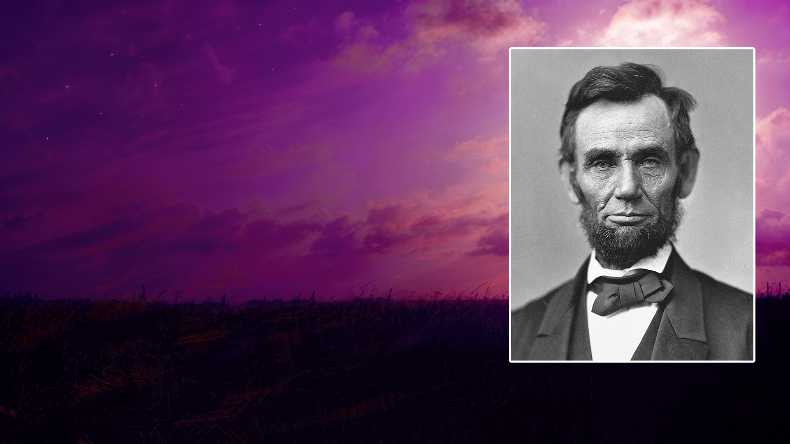
EMANCIPATION PROCLAMATION

Slide 3
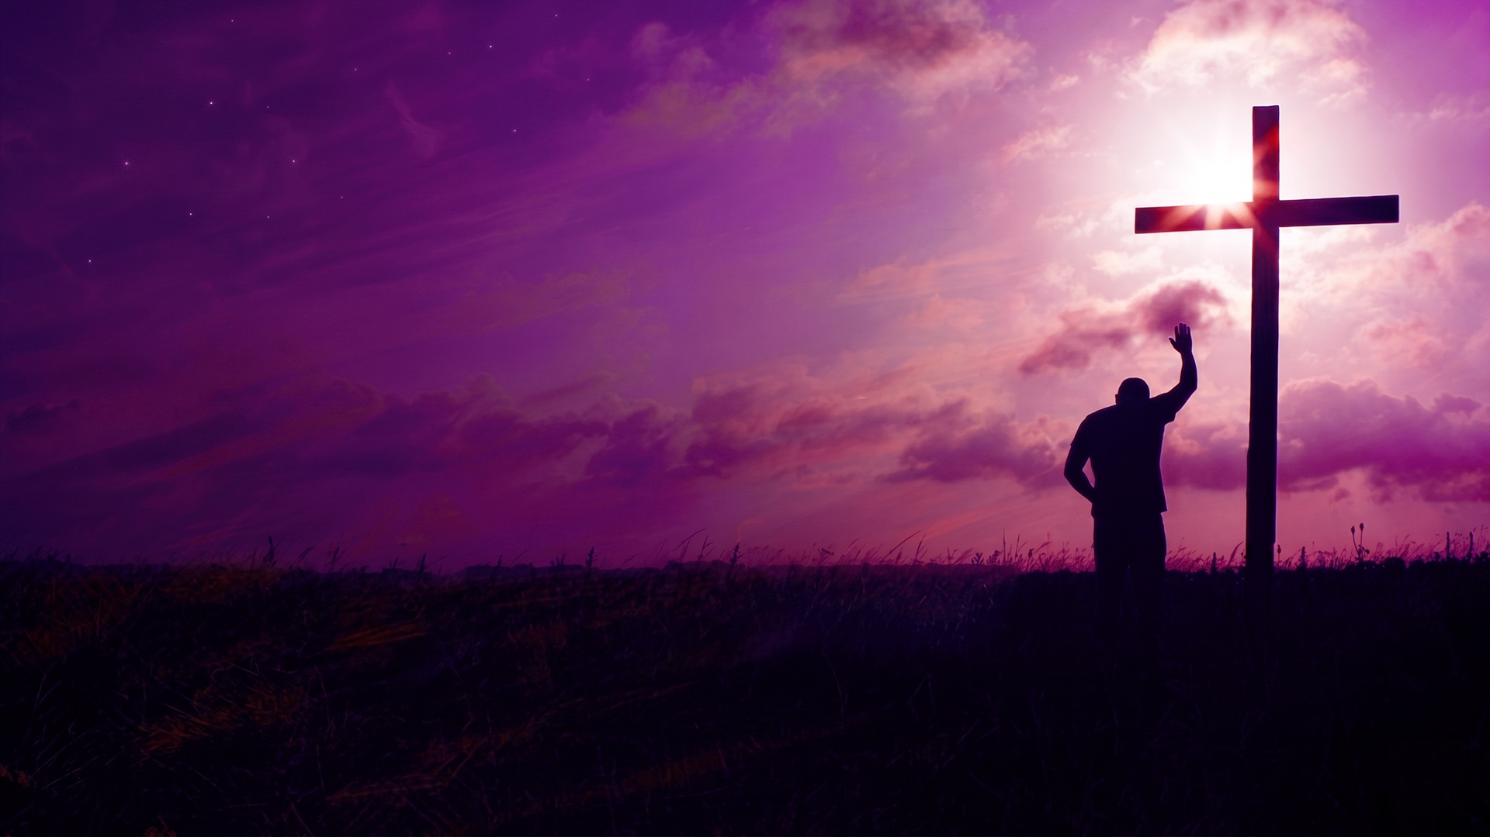
DELAYED FREEDOM

Slide 4
THE REDEMPTION PARALLEL

Slide 5
LIBERATION OF PRISONERS

Slide 6
THE REDEMPTION PARALLEL

Slide 7
A LACK OF KNOWLEDGE

Slide 8
Hosea 4:6
My people are destroyed for lack of knowledge…

Slide 9
Isaiah 5:13
Therefore my people have gone into captivity, Because they have no knowledge...

Slide 10
WE HAVE BEEN REDEEMED

Slide 11
Colossians 1:13,14
13 He has delivered us from the power of darkness and conveyed us into the kingdom of the Son of His love,
14 in whom we have redemption through His blood, the forgiveness of sins.

Slide 12
BELIEVE IN OUR REDEEMER AND THE REDEMPTION HE HAS PROVIDED

Slide 13
Luke 4:18,19
18 "THE SPIRIT OF THE LORD IS UPON ME, BECAUSE HE HAS ANOINTED ME TO PREACH THE GOSPEL TO THE POOR; HE HAS SENT ME TO HEAL THE BROKENHEARTED, TO PROCLAIM LIBERTY TO THE CAPTIVES AND RECOVERY OF SIGHT TO THE BLIND, TO SET AT LIBERTY THOSE WHO ARE OPPRESSED;
19 TO PROCLAIM THE ACCEPTABLE YEAR OF THE LORD."

Slide 14
Hebrews 9:12
Not with the blood of goats and calves, but with His own blood He entered the Most Holy Place once for all, having obtained eternal redemption.

Slide 15
EMBRACING REDEMPTION REALITIES

Slide 16
1 Corinthians 6:20
For you were bought at a price; therefore glorify God in your body and in your spirit, which are God's.

Slide 17
LET THE REDEEMED OF THE LORD SAY SO!

Slide 18
Psalm 107:2
Let the redeemed of the LORD say so, Whom He has redeemed from the hand of the enemy,

Slide 19
Revelation 12:11
And they overcame him by the blood of the Lamb and by the word of their testimony, and they did not love their lives to the death.

Slide 20
STAND IN YOUR REDEMPTION RIGHTS

