Slide 1
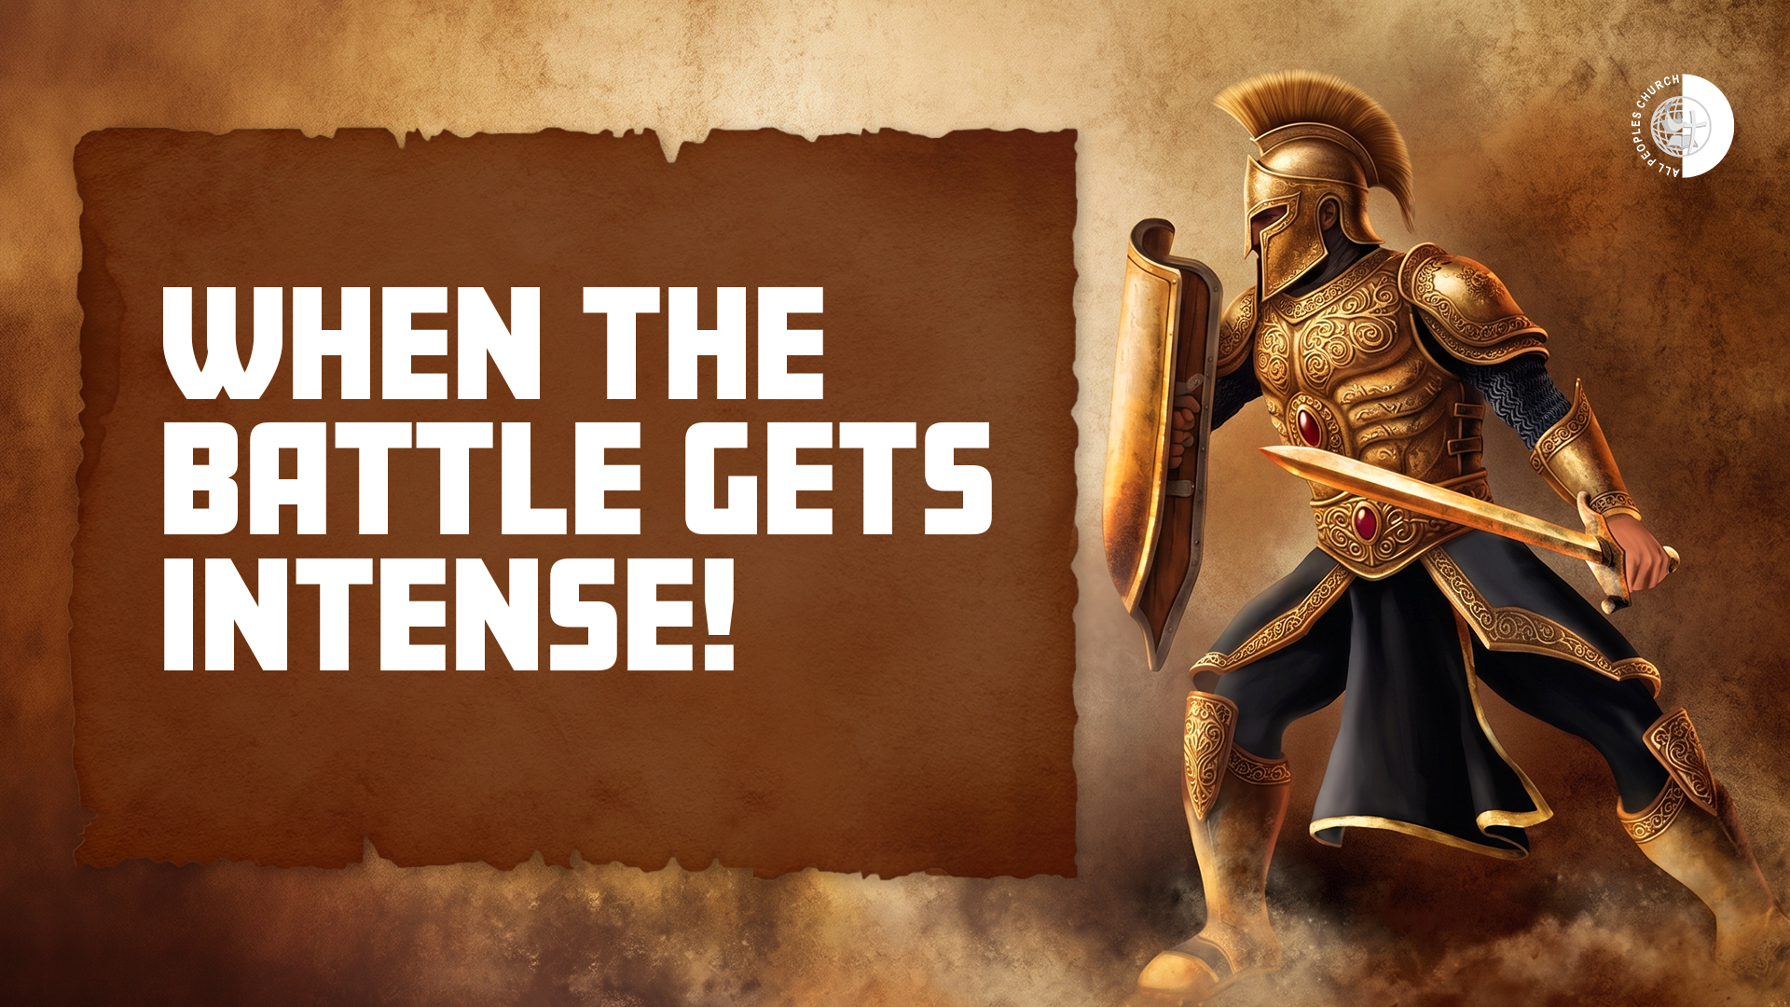

Slide 2
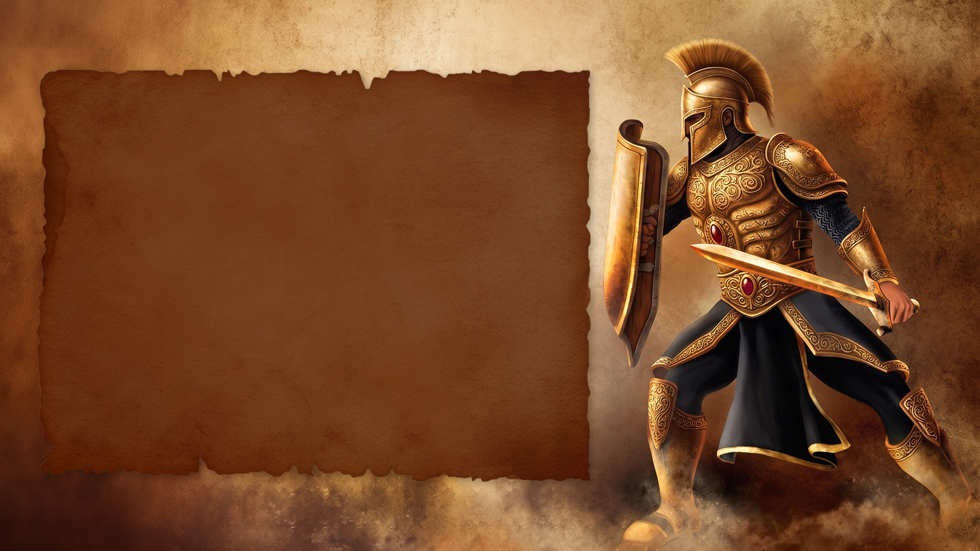
Ephesians 6:10-18
10 Finally, my brethren, be strong in the Lord and in the power of His might.
11 Put on the whole armor of God, that you may be able to stand against the wiles of the devil.

Slide 3
Ephesians 6:10-18
12 For we do not wrestle against flesh and blood, but against principalities, against powers, against the rulers of
the darkness of this age, against
spiritual hosts of wickedness in the heavenly places.
13 Therefore take up the whole armor
of God, that you may be able to withstand in the evil day, and having done all, to stand.

Slide 4
Ephesians 6:10-18
14 Stand therefore, having girded your waist with truth, having put on the breastplate of righteousness,
15 and having shod your feet with the preparation of the gospel of peace;

Slide 5
Ephesians 6:10-18
16 above all, taking the shield of faith with which you will be able to quench all the fiery darts of the wicked one.
17 And take the helmet of salvation, and the sword of the Spirit, which is the word of God;

Slide 6
Ephesians 6:10-18
18 praying always with all prayer and supplication in the Spirit, being watchful to this end with all perseverance and supplication for all the saints—

Slide 7
WE ARE IN SPIRITUAL CONFLICT

Slide 8
THE ENEMY COMES TO STEAL, KILL AND DESTROY

Slide 9
THE SCHEMES, THE EVIL DAY AND ALL THE FIERY DARTS

Slide 10
BE STRONG IN THE LORD

Slide 11
USE YOUR FULL ARMOR

Slide 12
KEEP STANDING

Slide 13
WRESTLE

Slide 14
QUENCH FIERY DARTS

Slide 15
ATTACK

Slide 16
Keep focused on His Word
Keep speaking His Word
Keep quenching every
fiery dart
Keep praising
Surround yourself with
good people
Stay vigilant

