Slide 1


Slide 2

THE LORD JESUS – OUR EXAMPLE, OUR ROLE MODEL

Slide 3
1 Corinthians 15:45-49
45 And so it is written, "The First Man Adam Became A Living Being." The last Adam became a life-giving spirit.
46 However, the spiritual is not first, but the natural, and afterward the spiritual.
47 The first man was of the earth, made of dust; the second Man is the Lord from heaven.

Slide 4
1 Corinthians 15:45-49
48 As was the man of dust, so also are those who are made of dust; and as is the heavenly Man, so also are those who are heavenly.
49 And as we have borne the image of the man of dust, we shall also bear the image of the heavenly Man.

Slide 5
Hebrews 10:5,7,9
5 Therefore, when He came into the world, He said: "Sacrifice And Offering You Did Not Desire, But A Body You Have Prepared For Me.
7 Then I Said, 'Behold, I Have Come—In The Volume Of The Book It Is Written Of Me—To Do Your Will, O God.' "
9 then He said, "Behold, I Have Come To Do Your Will, O God." He takes away the first that He may establish the second.

Slide 6
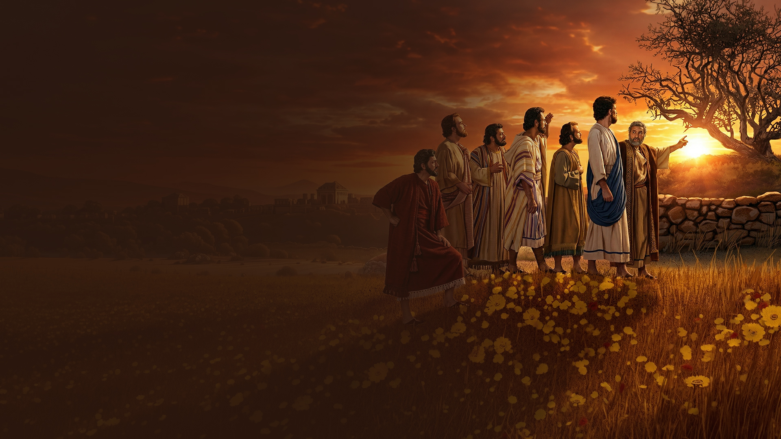
WHAT DID JESUS TEACH?

Slide 7
Mark 11:12-14,20-26
12 Now the next day, when they had come out from Bethany, He was hungry.
13 And seeing from afar a fig tree having leaves, He went to see if perhaps He would find something on it. When He came to it, He found nothing but leaves, for it was not the season for figs.
14 In response Jesus said to it, "Let no one eat fruit from you ever again." And His disciples heard it.

Slide 8
Mark 11:12-14,20-26
20 Now in the morning, as they passed by, they saw the fig tree dried up from the roots.
21 And Peter, remembering, said to Him, "Rabbi, look! The fig tree which You cursed has withered away."
22 So Jesus answered and said to them, "Have faith in God.

Slide 9
Mark 11:12-14,20-26
23 For assuredly, I say to you, whoever says to this mountain, 'Be removed and be cast into the sea,' and does not doubt in his heart, but believes that those things he says will be done, he will have whatever he says.
24 Therefore I say to you, whatever things you ask when you pray, believe that you receive them, and you will have them.

Slide 10
Mark 11:12-14,20-26
25 "And whenever you stand praying, if you have anything against anyone, forgive him, that your Father in heaven may also forgive you your trespasses.
26 But if you do not forgive, neither will your Father in heaven forgive your trespasses."

Slide 11
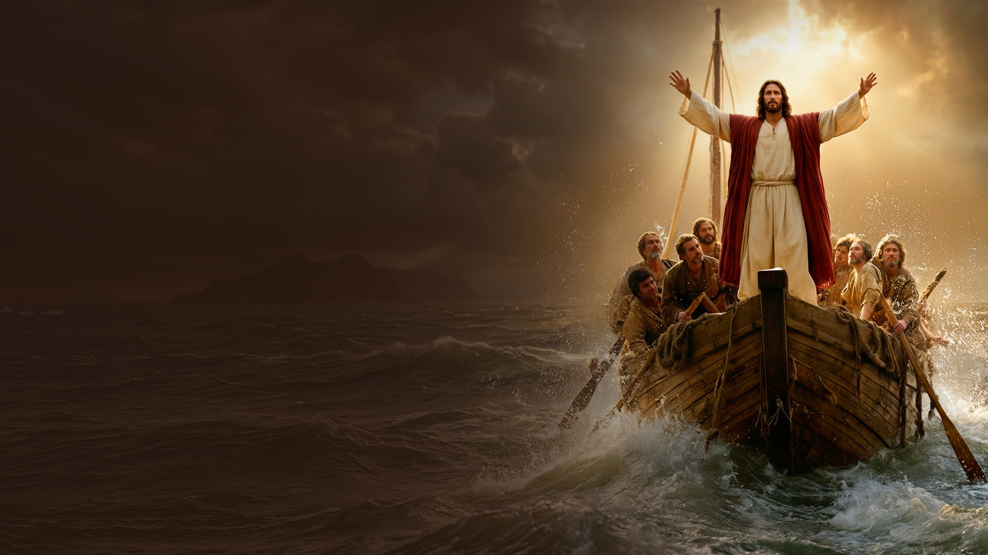
WHAT DID JESUS DO?

Slide 12
Mark 4:35-41
35 On the same day, when evening had come, He said to them, "Let us cross over to the other side."
36 Now when they had left the multitude, they took Him along in the boat as He was. And other little boats were also with Him.
37 And a great windstorm arose, and the waves beat into the boat, so that it was already filling.

Slide 13
Mark 4:35-41
38 But He was in the stern, asleep on a pillow. And they awoke Him and said to Him, "Teacher, do You not care that we are perishing?"
39 Then He arose and rebuked the wind, and said to the sea, "Peace, be still!" And the wind ceased and there was a great calm.

Slide 14
Mark 4:35-41
40 But He said to them, "Why are you so fearful? How is it that you have no faith?"
41 And they feared exceedingly, and said to one another, "Who can this be, that even the wind and the sea obey Him!"

Slide 15
WHEN YOU FACE MOUNTAINS AND STORMS BRING YOUR FAITH IN GOD TO BEAR ON THE SITUATION

Slide 16
Have faith in God.

Slide 17
Speak to the mountain, the wind and the waves.

Slide 18
Pray and believe the work is done.

Slide 19
Keep your heart clean before God.

