Slide 1
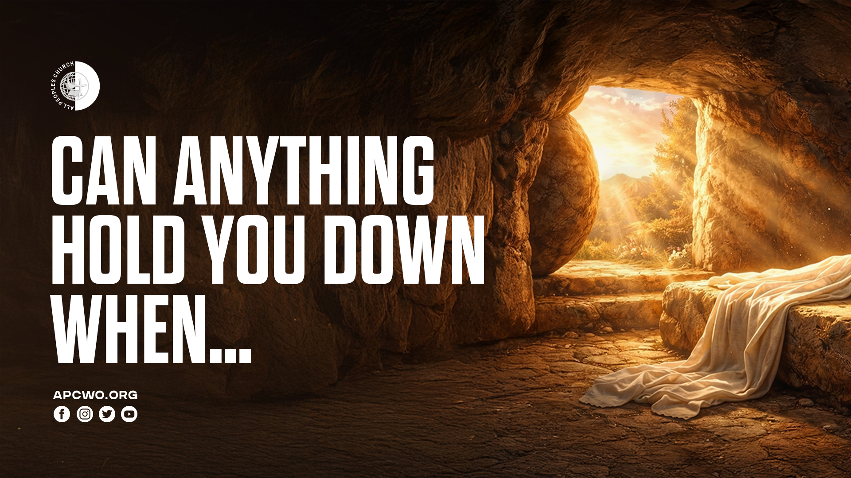

Slide 2
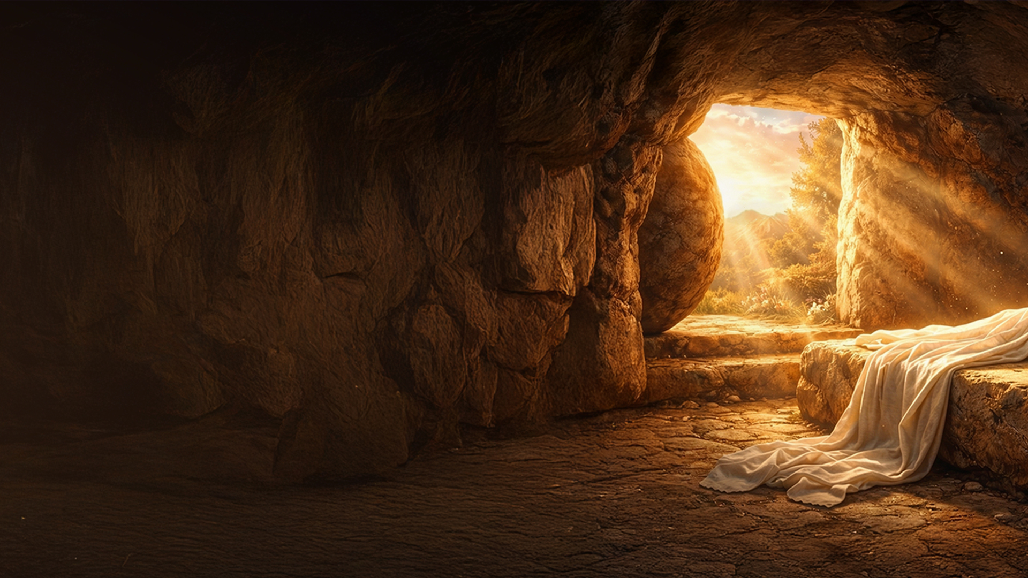
WHEN JESUS AROSE…

Slide 3
Mark 16:1-6
1 Now when the Sabbath was past, Mary Magdalene, Mary the mother of James, and Salome bought spices, that they might come and anoint Him.
2 Very early in the morning, on the first day of the week, they came to the tomb when the sun had risen.
3 And they said among themselves, "Who will roll away the stone from the door of the tomb for us?"

Slide 4
Mark 16:1-6
4 But when they looked up, they saw that the stone had been rolled away—for it was very large.
5 And entering the tomb, they saw a young man clothed in a long white robe sitting on the right side; and they were alarmed.
6 But he said to them, "Do not be alarmed. You seek Jesus of Nazareth, who was crucified. He is risen! He is not here. See the place where they laid Him.

Slide 5
WHEN CHRIST WAS RAISED UP…WE WERE RAISED UP

Slide 6
THE POWER OF HIS RESURRECTION IN US

Slide 7
1. THROUGH THE POWER OF HIS RESURRECTION IN US GOD CAUSES US TO LIVE A NEW LIFE

Slide 8
Romans 6:4
Therefore we were buried with Him through baptism into death, that just as Christ was raised from the dead by the glory of the Father, even so we also should walk in newness of life.

Slide 9
2. THROUGH THE POWER OF HIS RESURRECTION IN US GOD WORKS BEYOND WHAT WE CAN ASK OR IMAGINE

Slide 10
Ephesians 1:15-21
15 Therefore I also, after I heard of your faith in the Lord Jesus and your love for all the saints,
16 do not cease to give thanks for you, making mention of you in my prayers:
17 that the God of our Lord Jesus Christ, the Father of glory, may give to you the spirit of wisdom and revelation in the knowledge of Him,

Slide 11
Ephesians 1:15-21
18 the eyes of your understanding being enlightened; that you may know what is the hope of His calling, what are the riches of the glory of His inheritance in the saints,
19 and what is the exceeding greatness of His power toward us who believe, according to the working of His mighty power

Slide 12
Ephesians 1:15-21
20 which He worked in Christ when He raised Him from the dead and seated Him at His right hand in the heavenly places,
21 far above all principality and power and might and dominion, and every name that is named, not only in this age but also in that which is to come.

Slide 13
Ephesians 3:20,21
20 Now to Him who is able to do exceedingly abundantly above all that we ask or think, according to the power that works in us,
21 to Him be glory in the church by Christ Jesus to all generations, forever and ever. Amen.

Slide 14
3. THROUGH THE POWER OF HIS RESURRECTION IN US GOD GIVES LIFE TO OUR BODIES

Slide 15
Romans 8:11
But if the Spirit of Him who raised Jesus from the dead dwells in you, He who raised Christ from the dead will also give life to your mortal bodies through His Spirit who dwells in you.

Slide 16
4. THROUGH THE POWER OF HIS RESURRECTION IN US WE ENDURE

Slide 17
Philippians 3:10,11
10 that I may know Him and the power of His resurrection, and the fellowship of His sufferings, being conformed to His death,
11 if, by any means, I may attain to the resurrection from the dead.

Slide 18
5. THROUGH THE POWER OF HIS RESURRECTION IN US WE WILL RECEIVE GLORIFIED BODIES

Slide 19
Philippians 3:20,21
20 For our citizenship is in heaven, from which we also eagerly wait for the Savior, the Lord Jesus Christ,
21 who will transform our lowly body that it may be conformed to His glorious body, according to the working by which He is able even to subdue all things to Himself.

Slide 20
CAN ANYTHING HOLD YOU DOWN WHEN…
…HIS RESURRECTION POWER IS AT WORK IN YOU?

