Slide 1


Slide 2
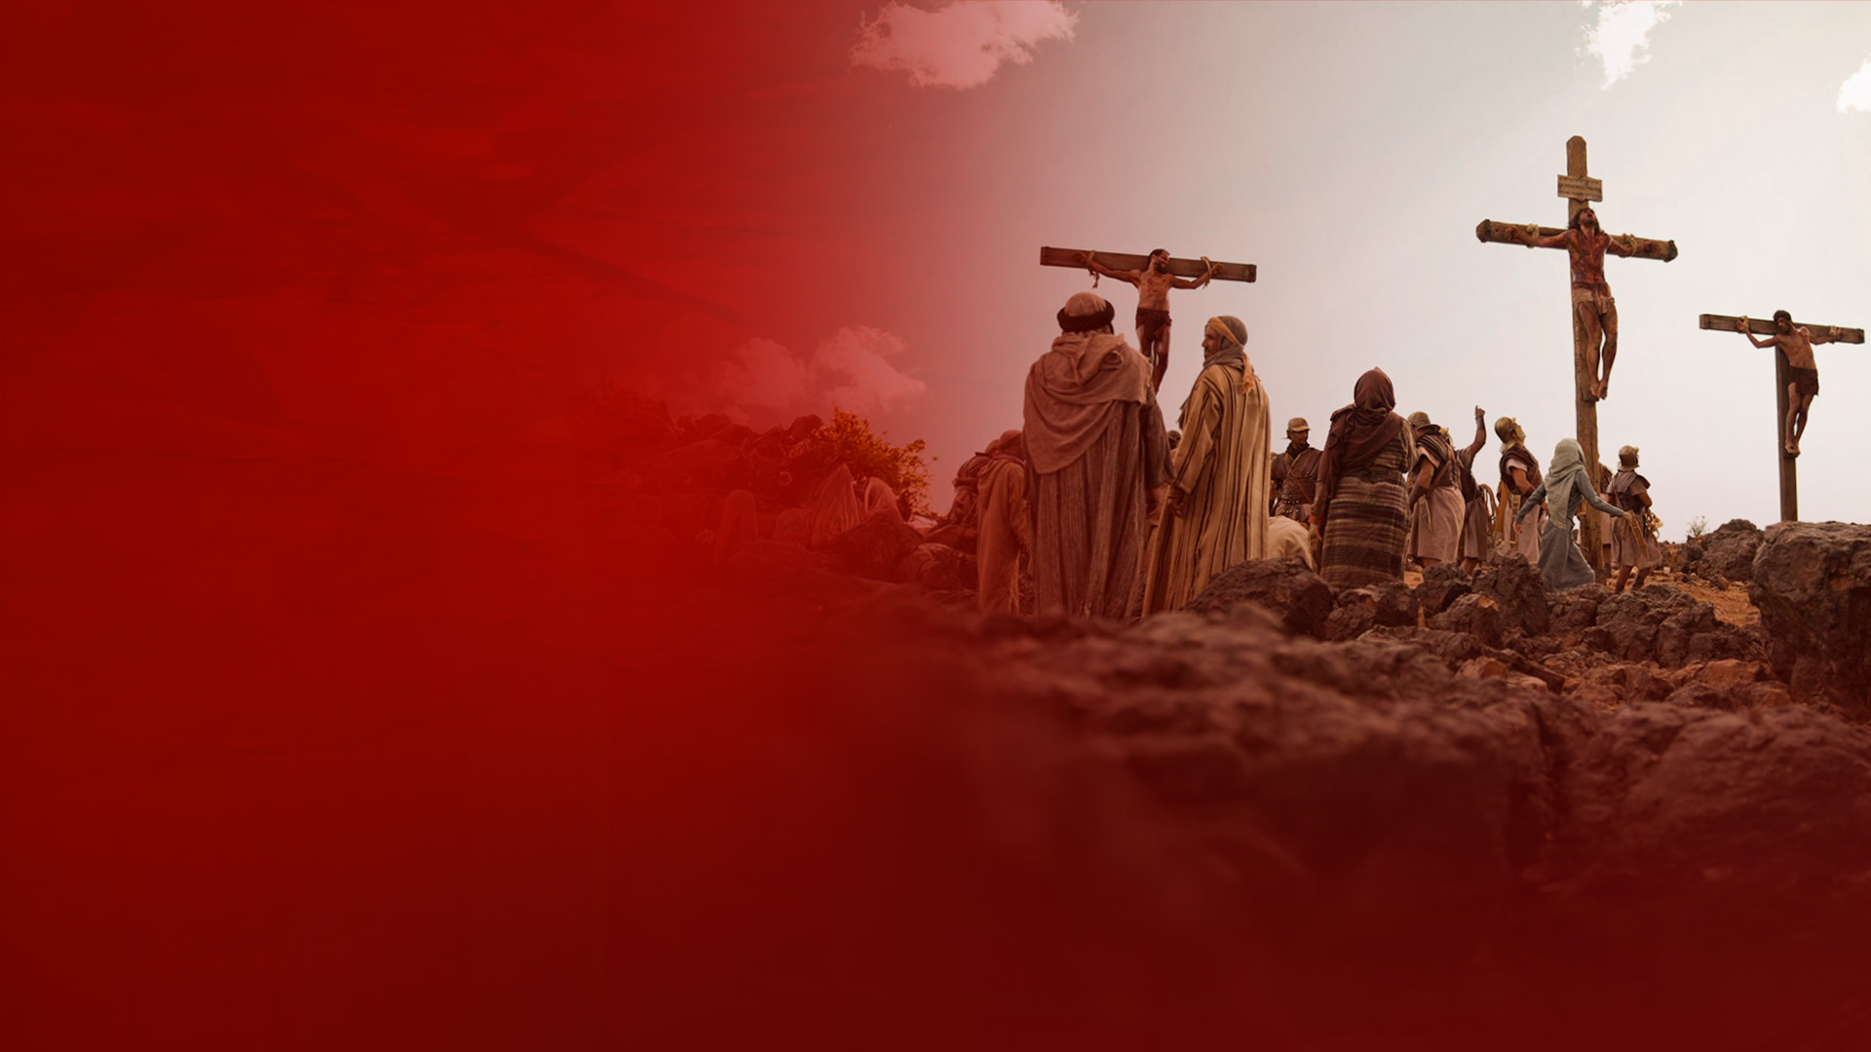
"FATHER, FORGIVE THEM, FOR THEY DO NOT KNOW WHAT THEY DO.”
(LUKE 23:34)

Slide 3
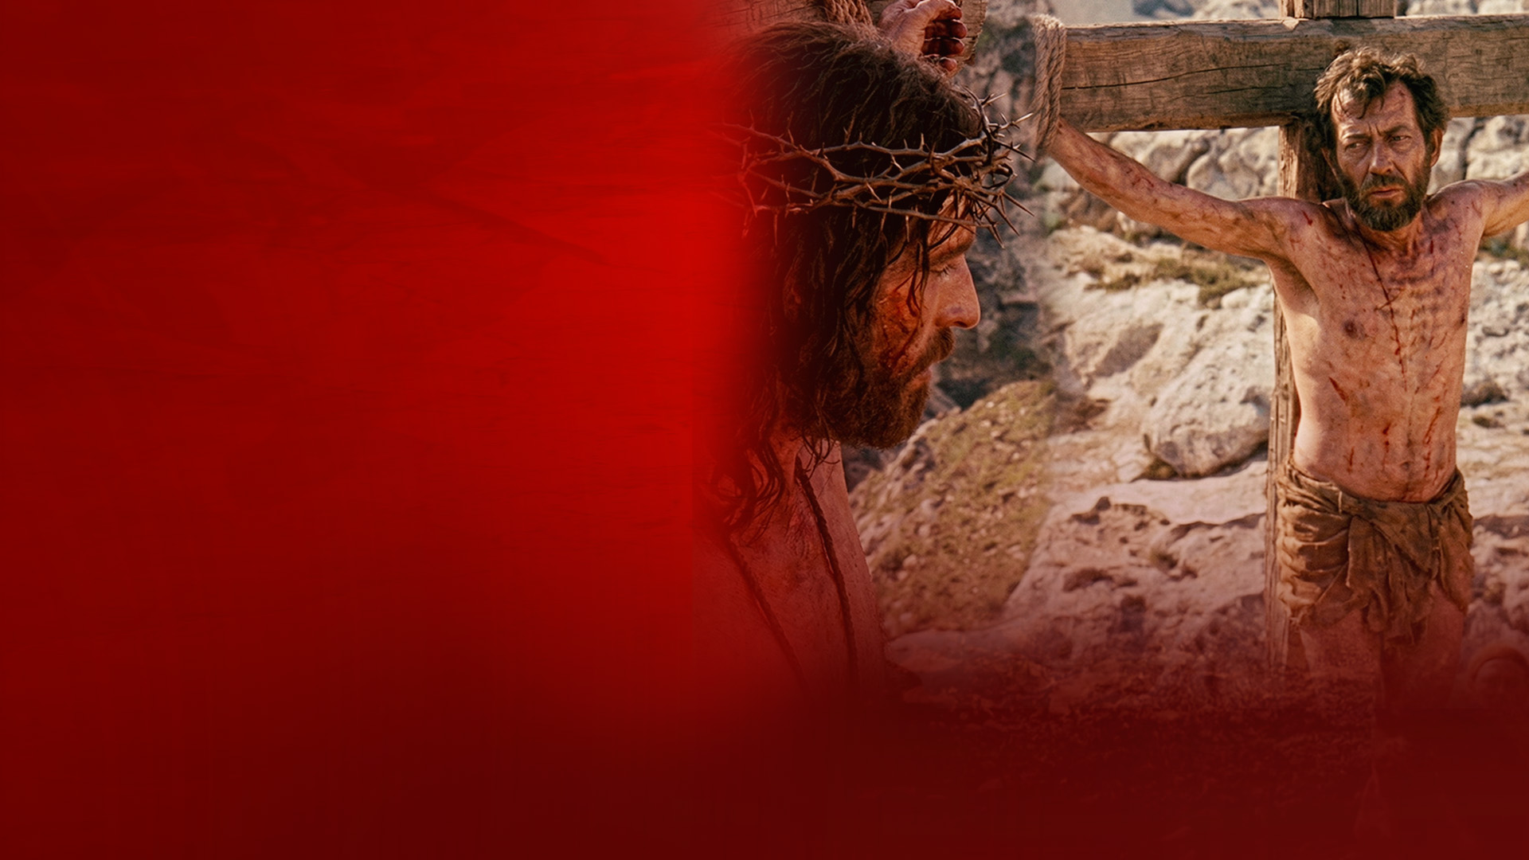
"TODAY YOU WILL BE WITH ME IN PARADISE." (LUKE 23:43)

Slide 4
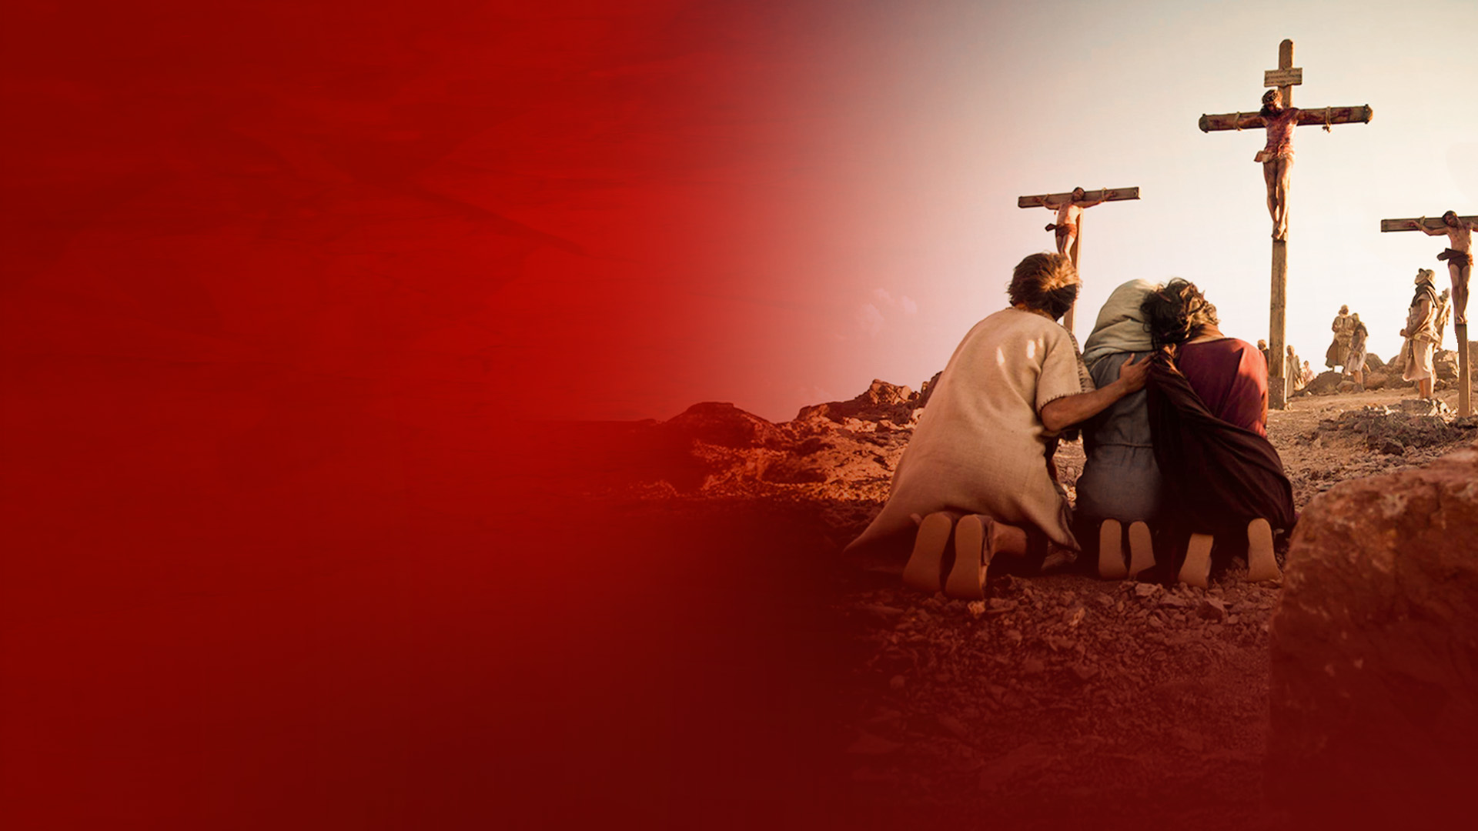
"WOMAN, THIS IS YOUR SON... THIS IS YOUR MOTHER."
(JOHN 19:26,27)

Slide 5

"MY GOD, MY GOD, WHY HAVE YOU FORSAKEN ME?" (MATTHEW 27:46)

Slide 6

"I THIRST!"
(JOHN 19:28)

Slide 7

"IT IS FINISHED!"
(JOHN 19:30)

Slide 8
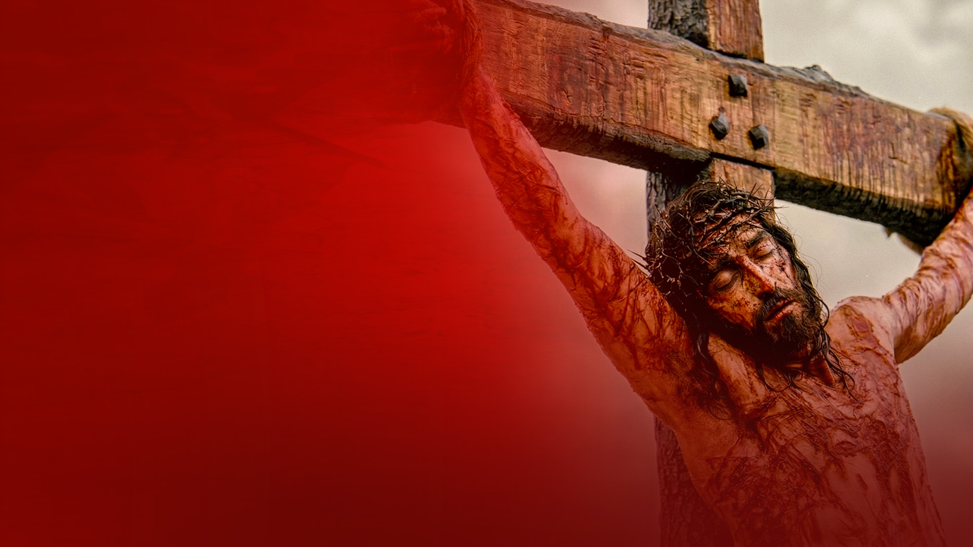
"FATHER, INTO YOUR HANDS I COMMEND MY SPIRIT."
(LUKE 23:46)

