Slide 1


Slide 2

FAITH IS EXPECTATION!

Slide 3
Hebrews 11:1
Now faith is the substance of things hoped for, the evidence of things not seen.

Slide 4
GREAT FAITH HAS GREAT EXPECTATION!

Slide 5
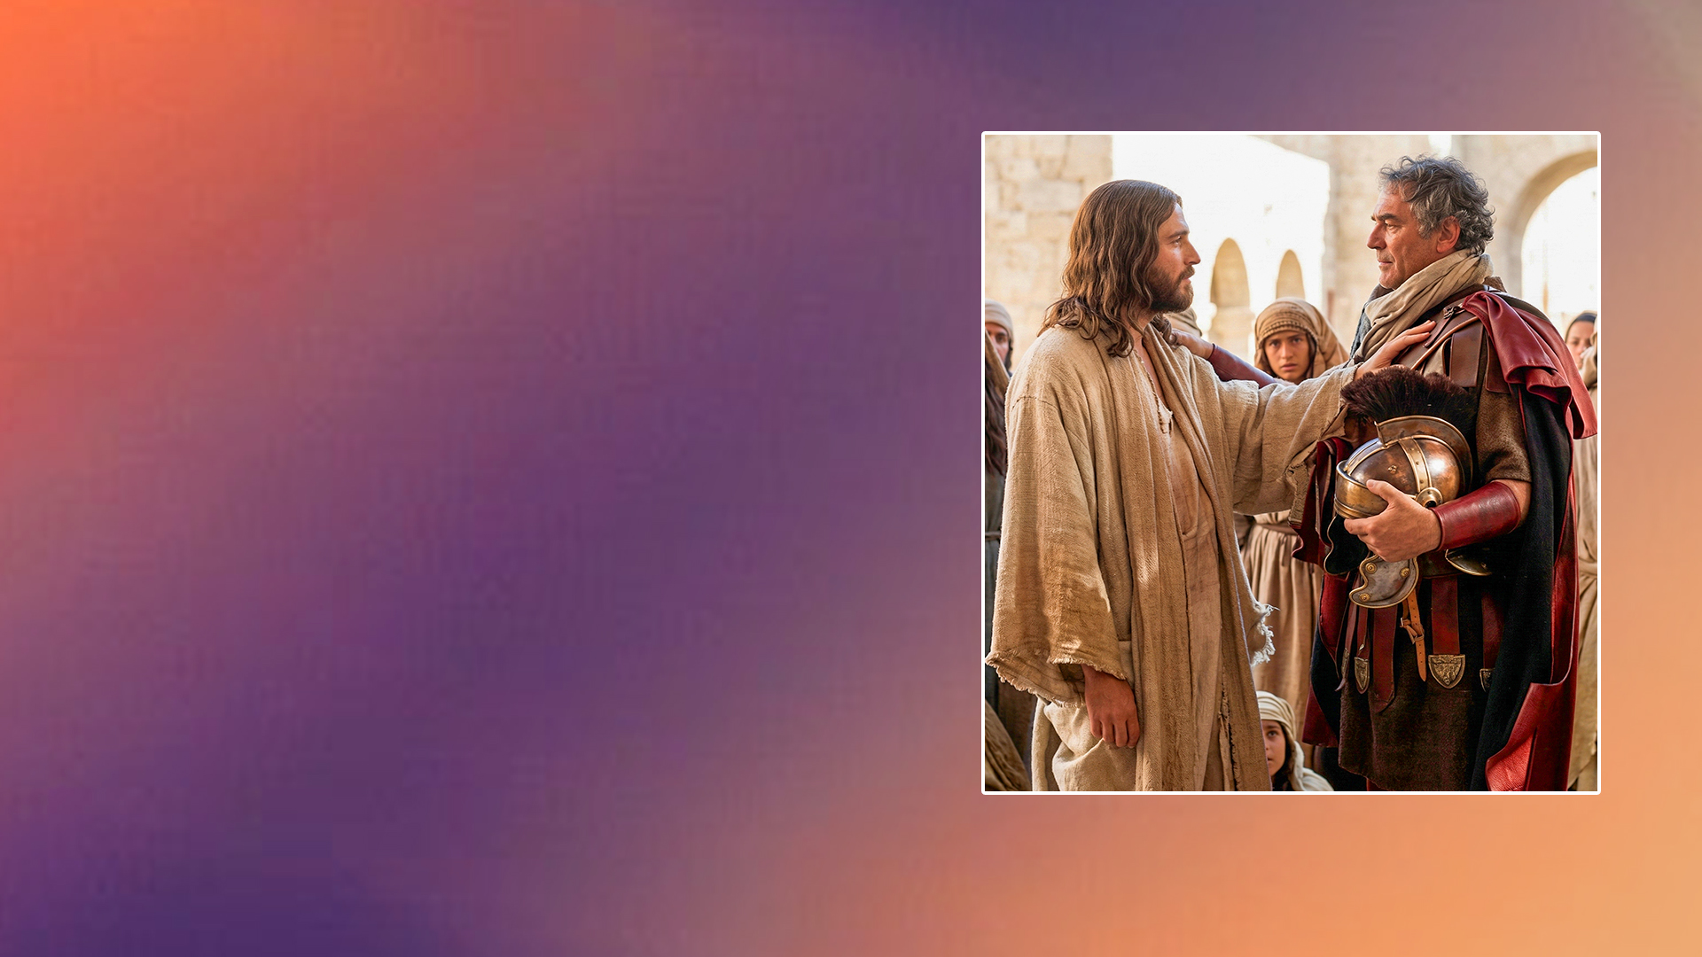
The Roman Centurion

Slide 6
Matthew 8:8,10
8 The centurion answered and said, "Lord, I am not worthy that You should come under my roof. But only speak a word, and my servant will be healed.
10 When Jesus heard it, He marveled, and said to those who followed, "Assuredly, I say to you, I have not found such great faith, not even in Israel!

Slide 7

The Canaanite Woman

Slide 8
Matthew 15:28
Then Jesus answered and said to her, "O woman, great is your faith! Let it be to you as you desire." And her daughter was healed from that very hour.

Slide 9
IS IT WRONG TO EXPECT MIRACLES, SIGNS AND WONDERS?

Slide 10
John 4:48
Then Jesus said to him, "Unless you people see signs and wonders, you will by no means believe."

Slide 11
Matthew 12:38,39
(see also Matthew 16:1-4)
38 Then some of the scribes and Pharisees answered, saying, "Teacher, we want to see a sign from You."
39 But He answered and said to them, "An evil and adulterous generation seeks after a sign, and no sign will be given to it except the sign of the prophet Jonah.

Slide 12
When people came to Jesus asking for a miracle for Jesus to “prove Himself,” Jesus pointed to His death and resurrection. For those who came to Jesus in faith, asking for a miracle to meet their need, He worked a miracle!

Slide 13
WHY DO WE NOT EXPECT MIRACLES?

Slide 14
Mark 9:23,24
23 Jesus said to him, "If you can believe, all things are possible to him who believes."
24 Immediately the father of the child cried out and said with tears, "Lord, I believe; help my unbelief!"

Slide 15
INCREASE YOUR EXPECTATION FOR YOUR MIRACLE!

Slide 16
BASE YOUR EXPECTATION ON WHO GOD IS AND WHAT HE HAS PROMISED.

Slide 17
EXPECT YOUR MIRACLE!

