Slide 1


Slide 2

THE JESUS OF THE BIBLE IS THE JESUS OF TODAY!

Slide 3
Hebrews 13:8
Jesus Christ is the same yesterday, today, and forever.

Slide 4
Matthew 4:23-25
23 And Jesus went about all Galilee, teaching in their synagogues, preaching the gospel of the kingdom, and healing all kinds of sickness and all kinds of disease among the people.
24 Then His fame went throughout all Syria; and they brought to Him all sick people who were afflicted with various diseases and torments, and those who were demon-possessed, epileptics, and paralytics; and He healed them.

Slide 5
Matthew 4:23-25
25 Great multitudes followed Him—from Galilee, and from Decapolis, Jerusalem, Judea, and beyond the Jordan.

Slide 6
Matthew 9:35,36
35 Then Jesus went about all the cities and villages, teaching in their synagogues, preaching the gospel of the kingdom, and healing every sickness and every disease among the people.
36 But when He saw the multitudes, He was moved with compassion for them, because they were weary and scattered, like sheep having no shepherd.

Slide 7
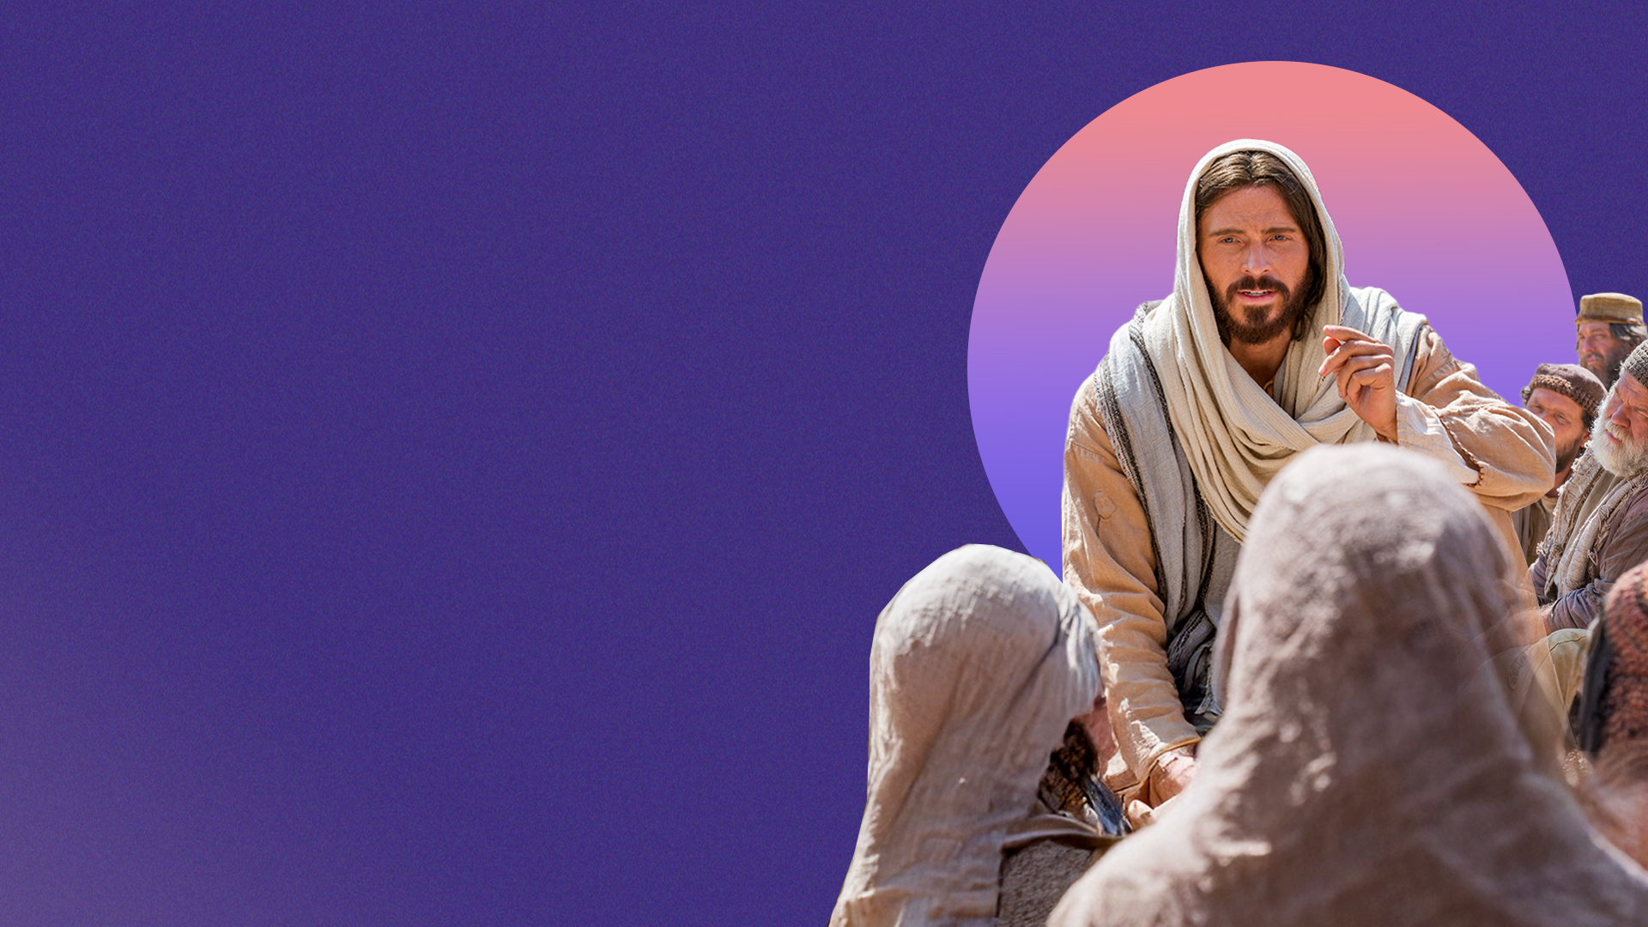
1. THE JESUS OF THE BIBLE PREACHED THE GOOD NEWS OF THE KINGDOM

Slide 8
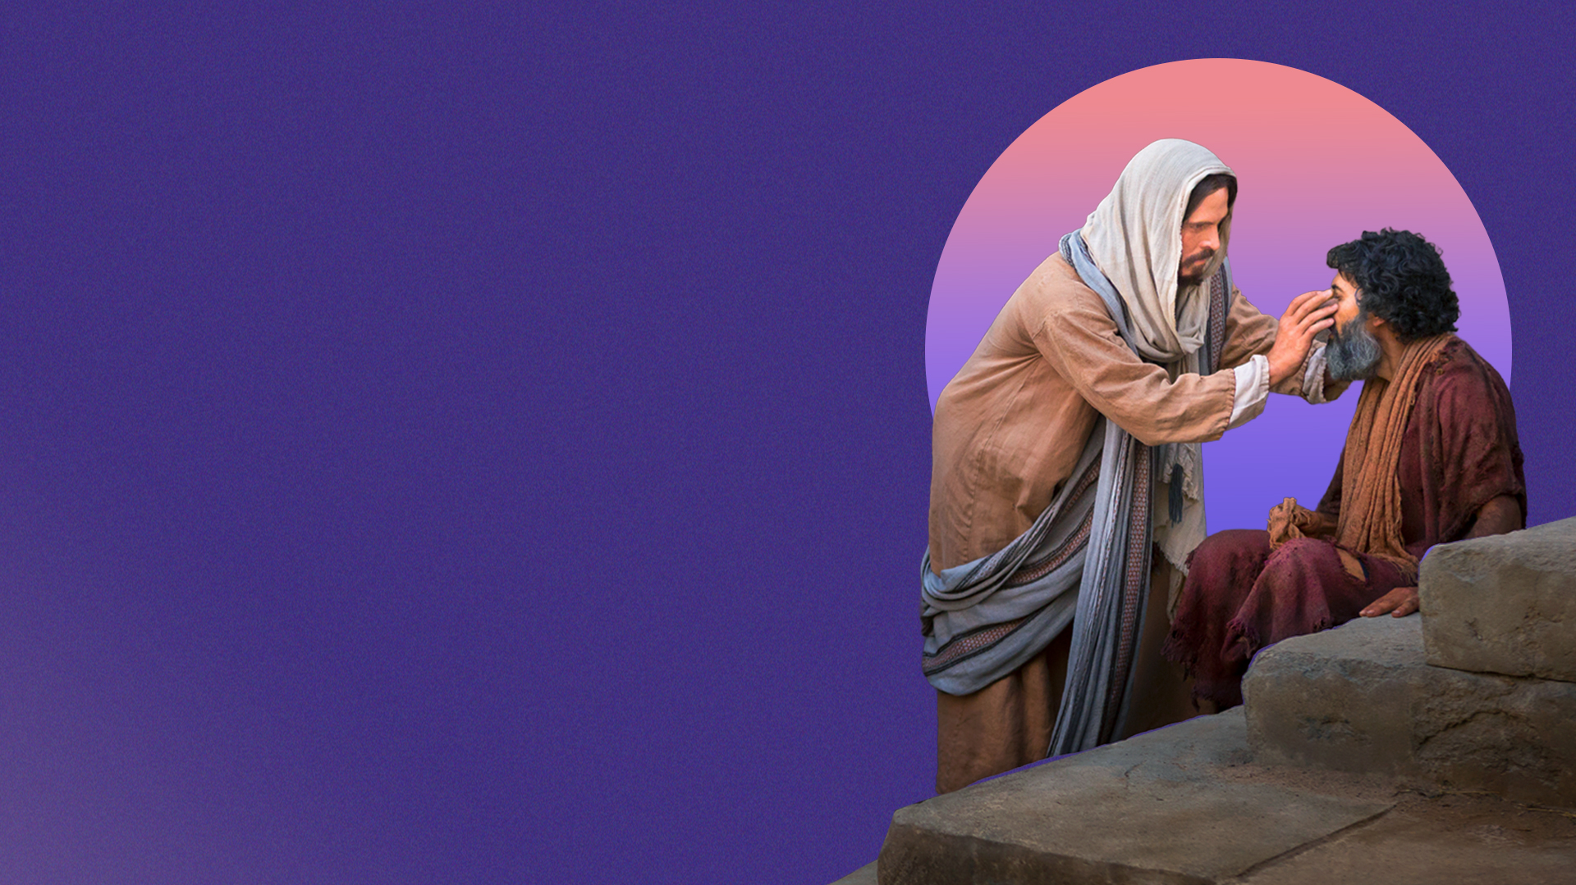
2. THE JESUS OF THE BIBLE HEALED ALL/EVERY SICKNESS AND DISEASE

Slide 9
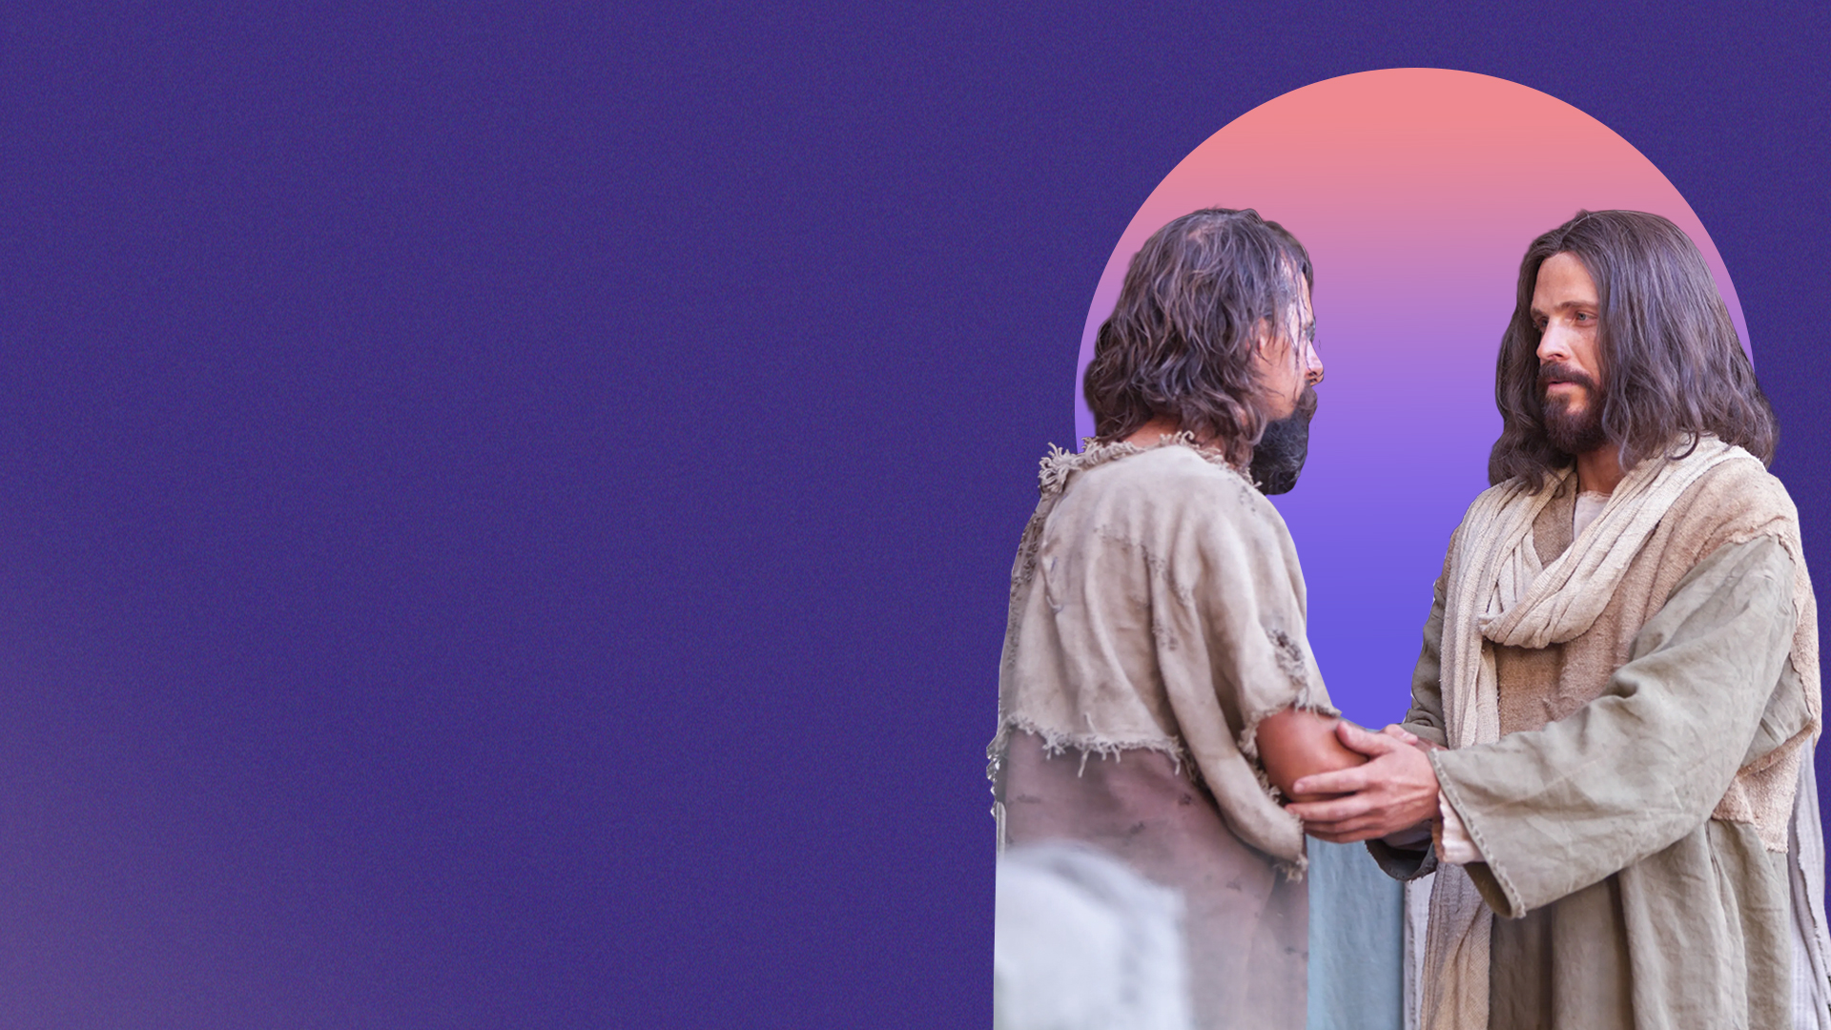
3. THE JESUS OF THE BIBLE SET PEOPLE FREE FROM DEMONS

Slide 10
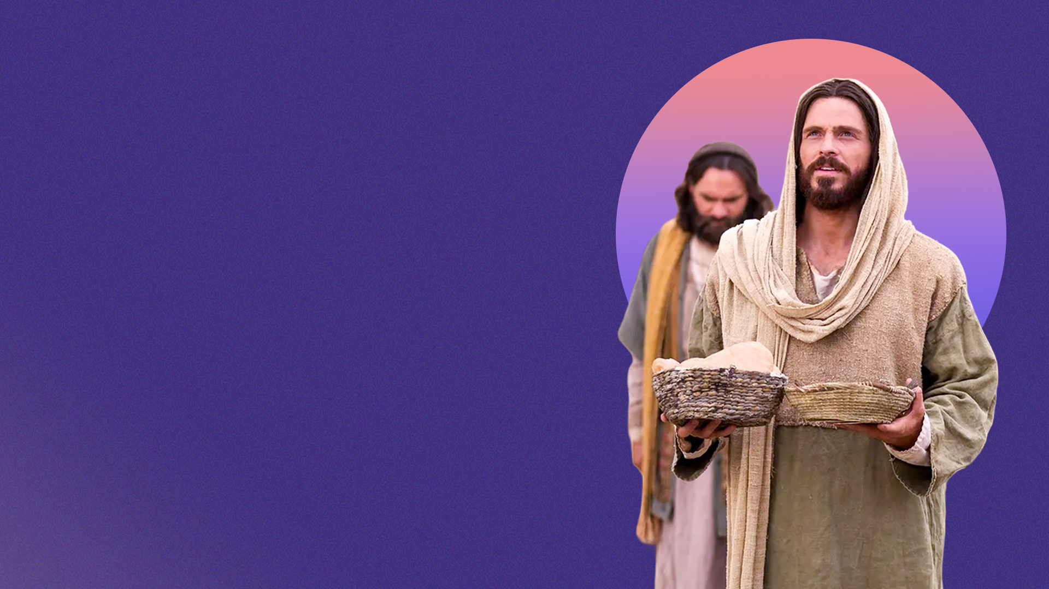
4. THE JESUS OF THE BIBLE WAS MOVED WITH COMPASSION FOR THE PEOPLE

Slide 11
THE JESUS OF THE BIBLE IS THE JESUS OF TODAY!

