Slide 1

QUICK REVIEW:

Slide 2


Slide 3
1. MARCH FORWARD! STEP INTO THE PLANS AND PURPOSES OF GOD.

Slide 4
Blend the spiritual and
the practical

Slide 5
2. MARCH FORWARD! PUSH AGAINST BARRIERS THAT HINDER YOU.

Slide 6
Get God’s strategies to advance

Slide 7
Be strategic

Slide 8
3. MARCH FORWARD! DON’T TURN BACK. DON’T RETREAT. DON’T ACCEPT DEFEAT.

Slide 9
When you face a setback – reflect, relearn, reorganize, retry – with divine wisdom

Slide 10
Expect God’s supernatural favor and orchestration

Slide 11


Slide 12


Slide 13
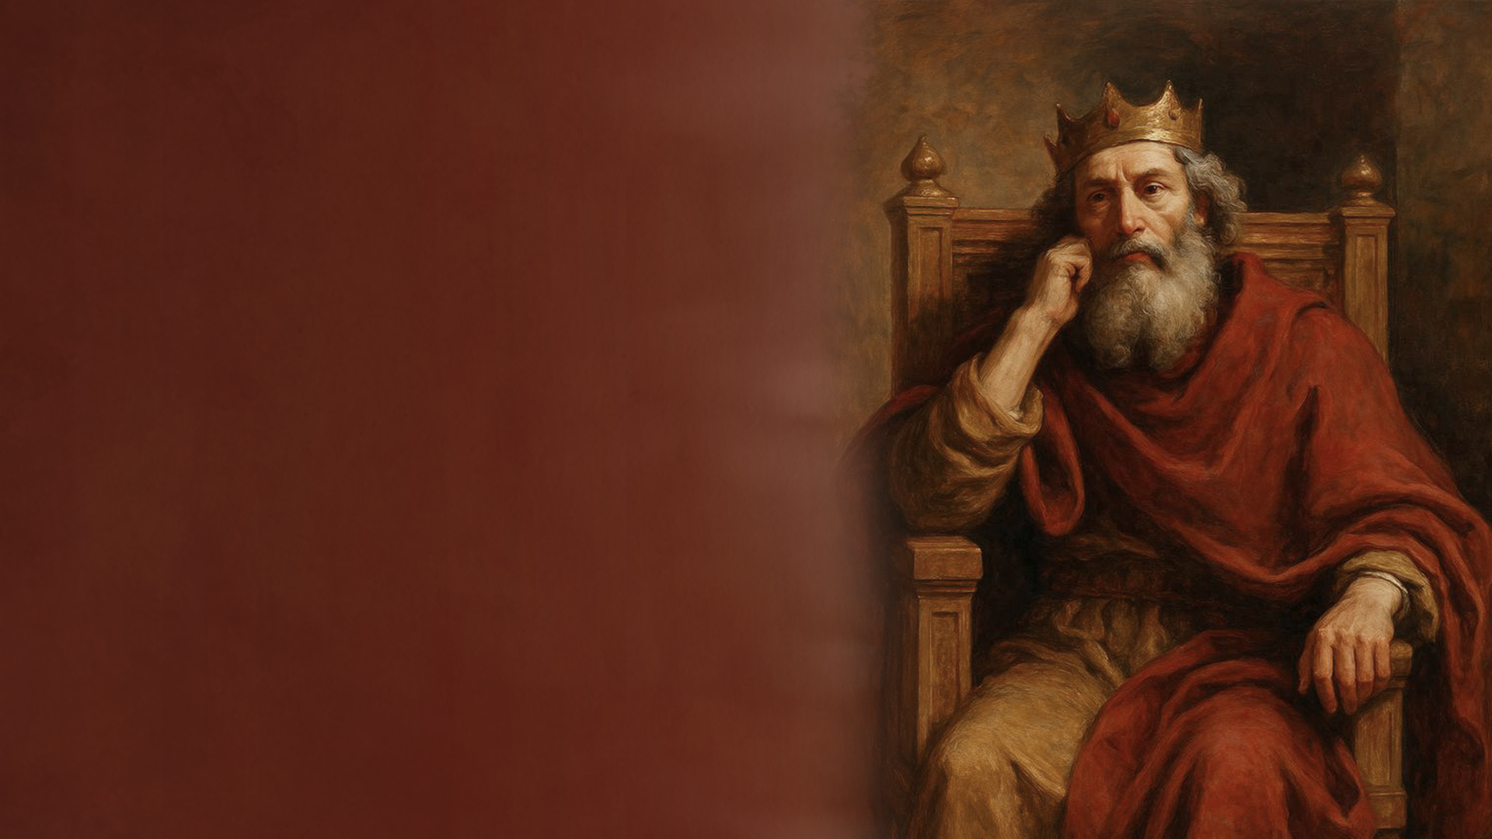
King Solomon reigned
about 970-931 BC.

Slide 14

Scribes during Hezekiah king of Judah about 715-686 BC.

Slide 15

1. Wisdom = "to be skillful"
Wisdom is skill in godly living that is rooted in the fear of God.

Slide 16
2. Understanding = "to separate, distinguish"
Understanding is seeing clearly what is really going on.

Slide 17
3. Prudence = "to be shrewd, crafty"
Prudence is wise foresight and strategic thinking.

Slide 18
4. Knowledge = "to know by experience"
Knowledge is truth internalized through relationship and experience.

Slide 19
5. Discretion = "to plan, devise"
Discretion is disciplined thinking that guards conduct.

Slide 20
Wisdom, understanding, prudence, knowledge and discernment form a moral–spiritual skill set for living well before God. Together these produce a mature, God-shaped mind and life.

Slide 21
FOCUS AREAS
Proverbs on Wisdom
Proverbs on Relationships
Proverbs on Family
Proverbs on Purity
Proverbs on Discipline
Proverbs on Work
Proverbs on Leadership
Proverbs on Prudence

Slide 22
PLEASE KEEP YOUR BIBLE OPEN

Slide 23
TODAY: PROVERBS ON WISDOM

Slide 24
Proverbs 1:5,7
Proverbs 1:20-33
Proverbs 2:1-22
Proverbs 3:13-24

Slide 25
Proverbs 4:1-13
Proverbs 7:1-5
Proverbs 8:1-36
Proverbs 9:1-12

Slide 26
Proverbs 10:8,13,14,19
Proverbs 11:29
Proverbs 12:15
Proverbs 13:20

Slide 27
Proverbs 14:35
Proverbs 15:2,7
Proverbs 17:2,10
Proverbs 21:22
Proverbs 24:5

Slide 28
Proverbs 30:24-28

Slide 29
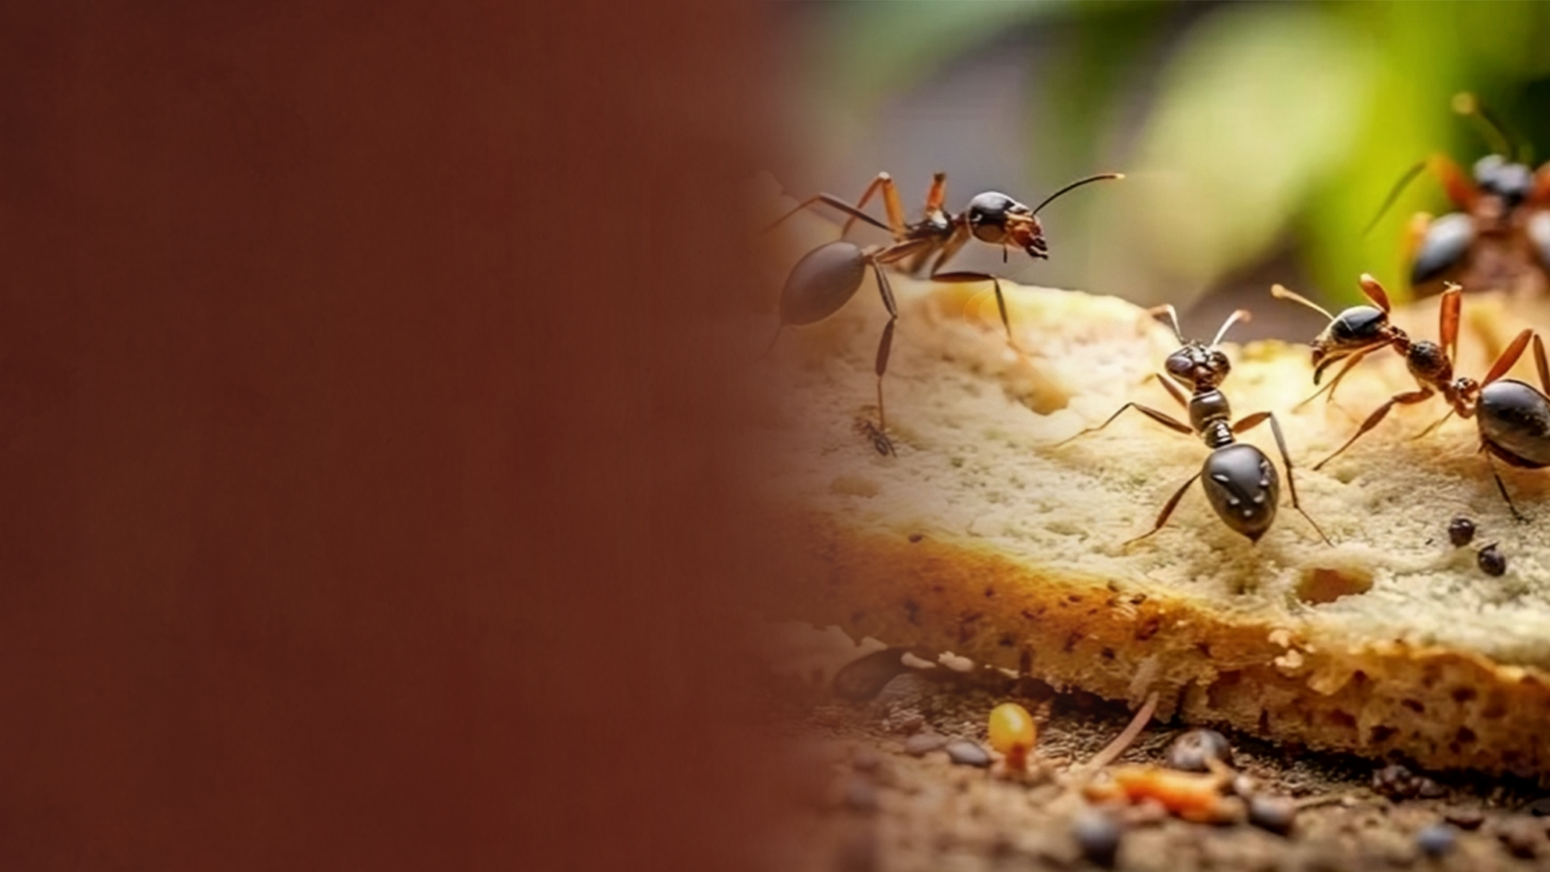
Ants illustrate foresight.

Slide 30
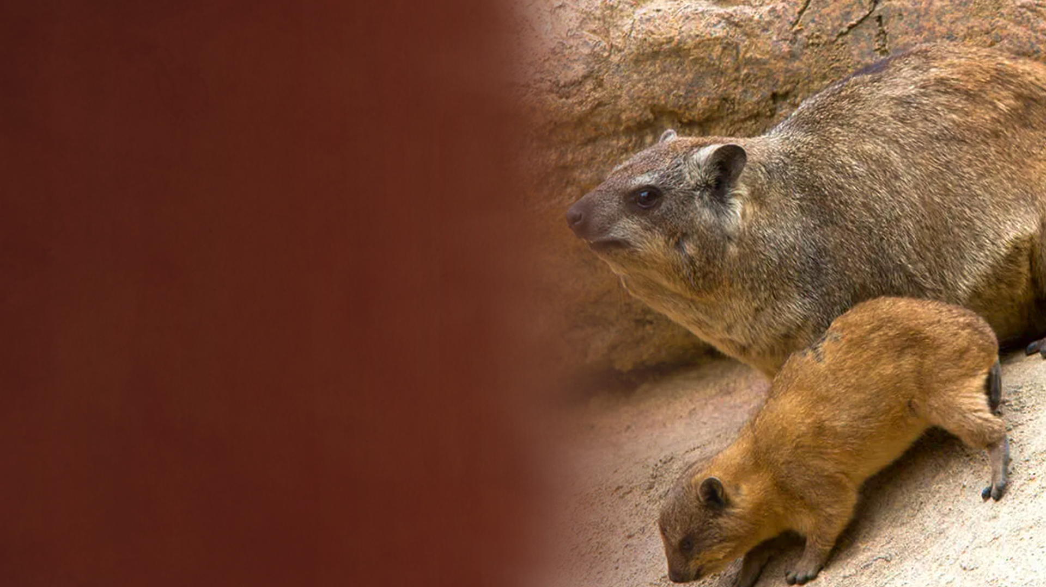
Rock badgers illustrate understanding.

Slide 31

Locusts illustrate self-governing cooperation.

Slide 32

Spider illustrates skill that brings influence in places of power.

