Slide 1
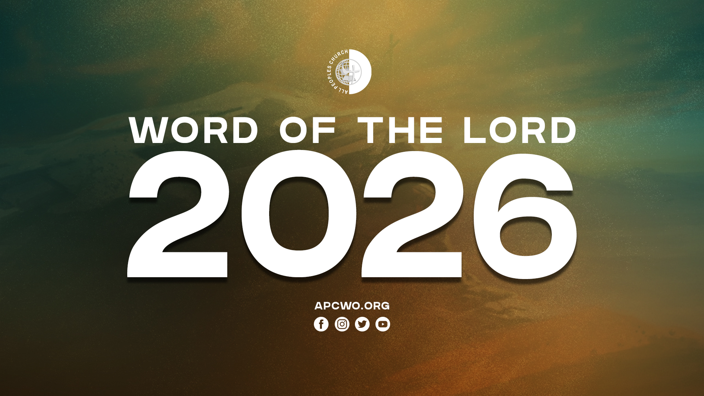

Slide 2
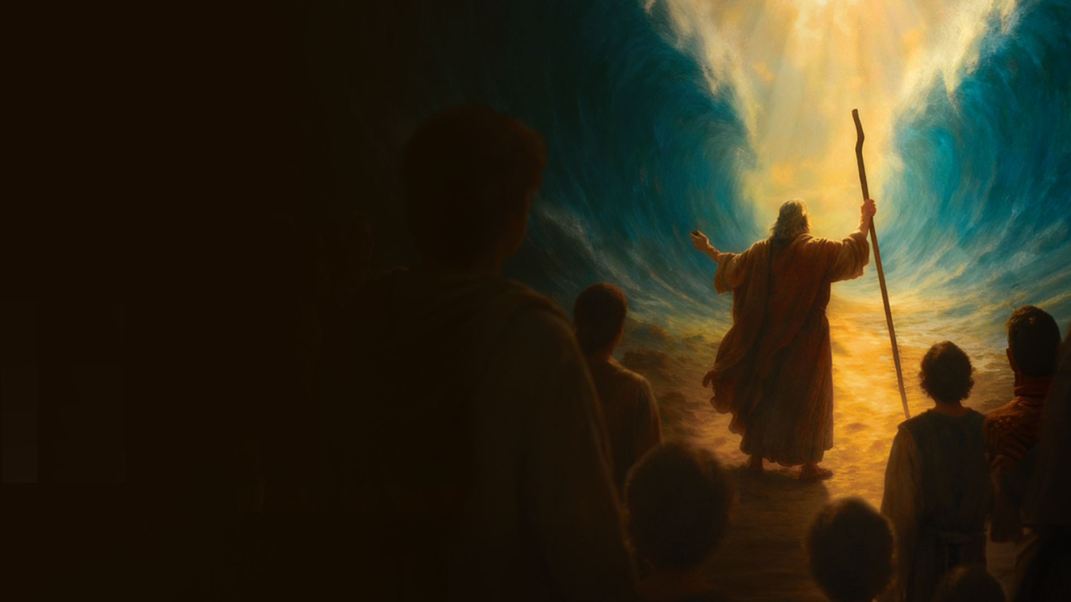
Exodus 14:15,16
15 And the LORD said to Moses, "Why do you cry to Me? Tell the children of Israel to go forward.
16 But lift up your rod, and stretch out your hand over the sea and divide it. And the children of Israel shall go on dry ground through the midst of the sea.

Slide 3
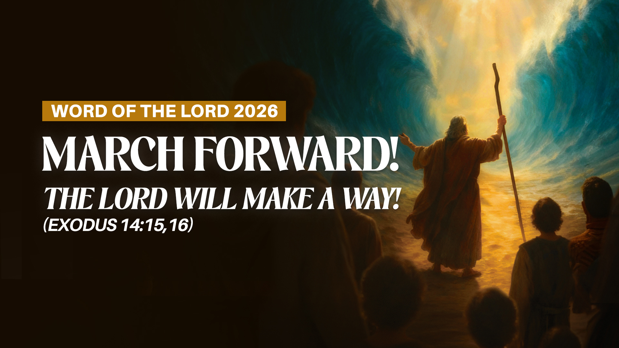

Slide 4
Seas will be parted.
Crooked paths will be made straight.
Mountains will be made low.
Valleys will be lifted.
Rough places will be made smooth.
Iron gates will be opened.

Slide 5
Isaiah 40:3-5
3 The voice of one crying in the wilderness: "Prepare the way of the LORD; Make straight in the desert A highway for our God.
4 Every valley shall be exalted And every mountain and hill brought low; The crooked places shall be made straight And the rough places smooth;
5 The glory of the LORD shall be revealed, And all flesh shall see it together; For the mouth of the LORD has spoken.”

Slide 6
Isaiah 45:1-3
1 "Thus says the LORD to His anointed, To Cyrus, whose right hand I have held—To subdue nations before him And loose the armor of kings, To open before him the double doors, So that the gates will not be shut:
2 'I will go before you And make the crooked places straight; I will break in pieces the gates of bronze And cut the bars of iron.

Slide 7
Isaiah 45:1-3
3 I will give you the treasures of darkness And hidden riches of secret places, That you may know that I, the LORD, Who call you by your name, Am the God of Israel.

Slide 8
1. MARCH FORWARD! STEP INTO THE PLANS AND PURPOSES OF GOD.

Slide 9
Blend the spiritual and
the practical

Slide 10
2. MARCH FORWARD! PUSH AGAINST BARRIERS THAT HINDER YOU.

Slide 11
Get God’s strategies to advance

Slide 12
Be strategic

Slide 13
3. MARCH FORWARD! DON’T TURN BACK. DON’T RETREAT. DON’T ACCEPT DEFEAT.

Slide 14
When you face a setback – reflect, relearn, reorganize, retry – with divine wisdom.

Slide 15
Expect God’s supernatural favor and orchestration

Slide 16
Revelation 3:8
I know your works. See, I have set before you an open door, and no one can shut it; for you have a little strength, have kept My word, and have not denied My name.

