Slide 1


Slide 2
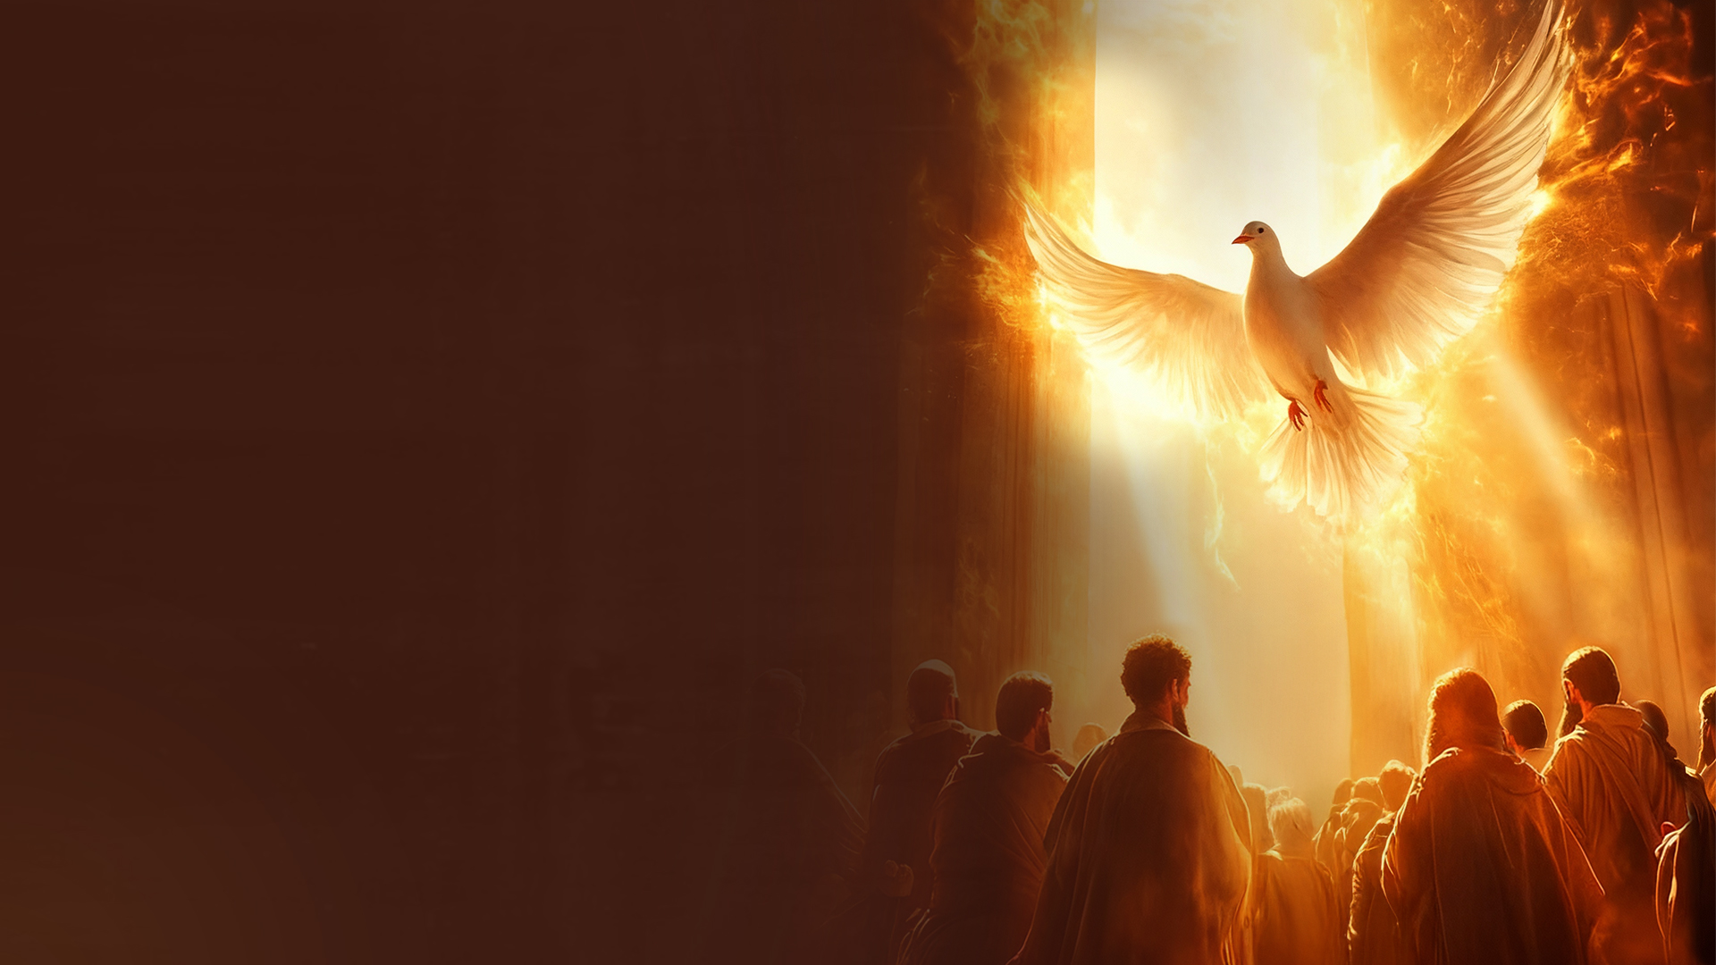
Ephesians 5:25-27
25 Husbands, love your wives, just as Christ also loved the church and gave Himself for her,
26 that He might sanctify and cleanse her with the washing of water by the word,
27 that He might present her to Himself a glorious church, not having spot or wrinkle or any such thing, but that she should be holy and without blemish.

Slide 3
Church – Both Glorious and Holy

Slide 4
Colossians 1:21,22
21 ...He has reconciled
22 in the body of His flesh through death, to present you holy, and blameless, and above reproach in His sight—

Slide 5
2 Corinthians 11:2
For I am jealous for you with godly jealousy. For I have betrothed you to one husband, that I may present you as a chaste virgin to Christ.

Slide 6
God is Preparing the Church
• By His Word
• By His Holy Spirit

Slide 7
Glorious Church

Slide 8
Endoxos (Greek)
in glory, splendid or noble – glorious, gorgeous, or honorable
Doxa (Greek)
dignity, glory (-ious), honor, praise, worship
Ekklesia (Greek)
A calling out or called-out ones

Slide 9
Jesus, our Example
Jesus is the expression of God's glory.

Slide 10
John 1:14
And the Word became flesh and dwelt among us, and we beheld His glory, the glory as of the only begotten of the Father, full of grace and truth.

Slide 11
We are called to walk in His
steps (1 John 2:6).
Jesus walked in sonship glory
(John 17:5).
Sonship glory is available to the
believer (John 17:22).

Slide 12
Display of Glory Through Jesus
• Grace (character, virtue) and Truth
(integrity, purity, holiness, light,
wisdom) – John 1:14
• Healings, Miracles, Supernatural
– John 2:11

Slide 13
God Wants to Fill His Church With Glory

Slide 14
Exodus 29:43
And there I will meet with the children of Israel, and the tabernacle shall be sanctified by My glory.

Slide 15
Haggai 2:7-9
7 ‘and I will shake all nations, and they shall come to the Desire of All Nations, and I will fill this temple with glory,’ says the LORD of hosts.
8 ‘The silver is Mine, and the gold is Mine,’ says the LORD of hosts.
9 ‘The glory of this latter temple shall be greater than the former,’ says the LORD of hosts. ‘And in this place I will give peace,’ says the LORD of hosts.”

Slide 16
God Wants to Display His Glory Through the Church

Slide 17
Isaiah 60:1,2
1 Arise, shine, for your light has come, and the glory of the LORD rises upon you.
2 For behold, the darkness shall cover the earth, and deep darkness the people; but the LORD will arise over you, and His glory will be seen upon you.

Slide 18
Numbers 14:20,21
20 Then the LORD said: “I have pardoned, according to your word; 21 but truly, as I live, all the earth shall be filled with the glory of the LORD—”

Slide 19
What Does it Mean to Display the Glory of God as a Church?

Slide 20
Example of the early Church:
1. The community walked in holy awe of God (Acts 2:43; Acts 5:5,11).
2. There was no tolerance for sin and unrighteousness (Acts 5:1-11; Acts 8:18-24).
3. Demonstration of the Supernatural power of God
(Acts 3; Acts 16; Acts 19)

Slide 21
4. Unity (Acts 4:32)
5. Generosity (Acts 4:34)
6. Divine deliverance
(Acts 4; Acts 12)
7. Multiplication (Acts 2:47)

Slide 22
What can we expect in our midst?

Slide 23
We can expect what God did in the early Church and much more.

Slide 24
Ephesians 4:11-13
11 And He Himself gave some to be apostles, some prophets, some evangelists, and some pastors and teachers,
12 for the equipping of the saints for the work of ministry, for the edifying of the body of Christ,
13 till we all come to the unity of the faith and of the knowledge of the Son of God, to a perfect man, to the measure of the stature of the fullness of Christ;

Slide 25
1. Unity of the faith
2. Precise and correct knowledge of the Son of God
3. Maturity to Christlikeness

Slide 26
4. Manifestation of the glory of God in tangible ways (Exodus 13:21; Isaiah 40:5)
5. Greater works (John 14:12)
6. Church manifesting the gifts of the Holy Spirit
(1 Corinthians 12)

Slide 27
7. Greater expression of wisdom, knowledge, and understanding in various spheres (Isaiah 11:2)
8. Greater expression of love and compassion by the Church (Matthew 14:14)

Slide 28
How do we prepare ourselves?

Slide 29
1. Grow in the word (1 Peter 2:2)
2. Grow in faith – believe to see the glory (John 11:40)
3. Grow in power – faith and power release mighty signs and wonders (Acts 6:8)

Slide 30
4. Grow in compassion – love causes faith and power to be effective (Galatians 5:6)
5. Grow in prayer and intercession – intercession causes the birth of new things (Isaiah 66:8)

Slide 31
ARISE AS A GLORIOUS CHURCH

