Slide 1


Slide 2

JESUS' TEACHING ON FAITH
IN RELATION TO HEALING

Slide 3
YOUR FAITH

Slide 4
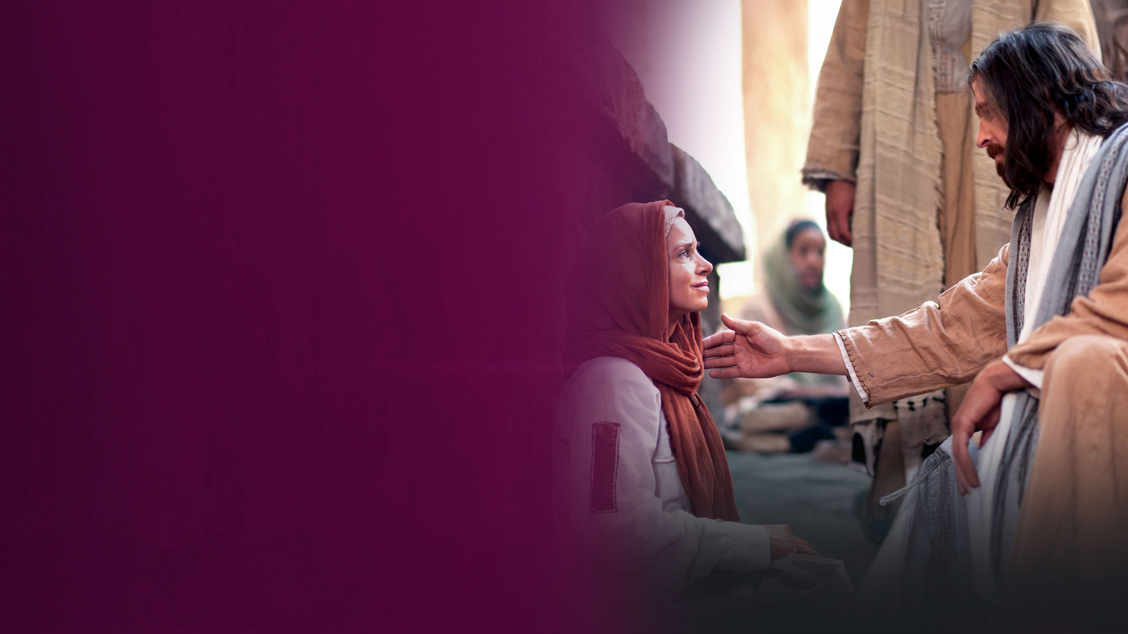
The woman with the issue of blood

Slide 5
Matthew 9:22
(Mark 5:34; Luke 8:48)
But Jesus turned around, and when He saw her He said, "Be of good cheer, daughter; your faith has made you well." And the woman was made well from that hour.

Slide 6
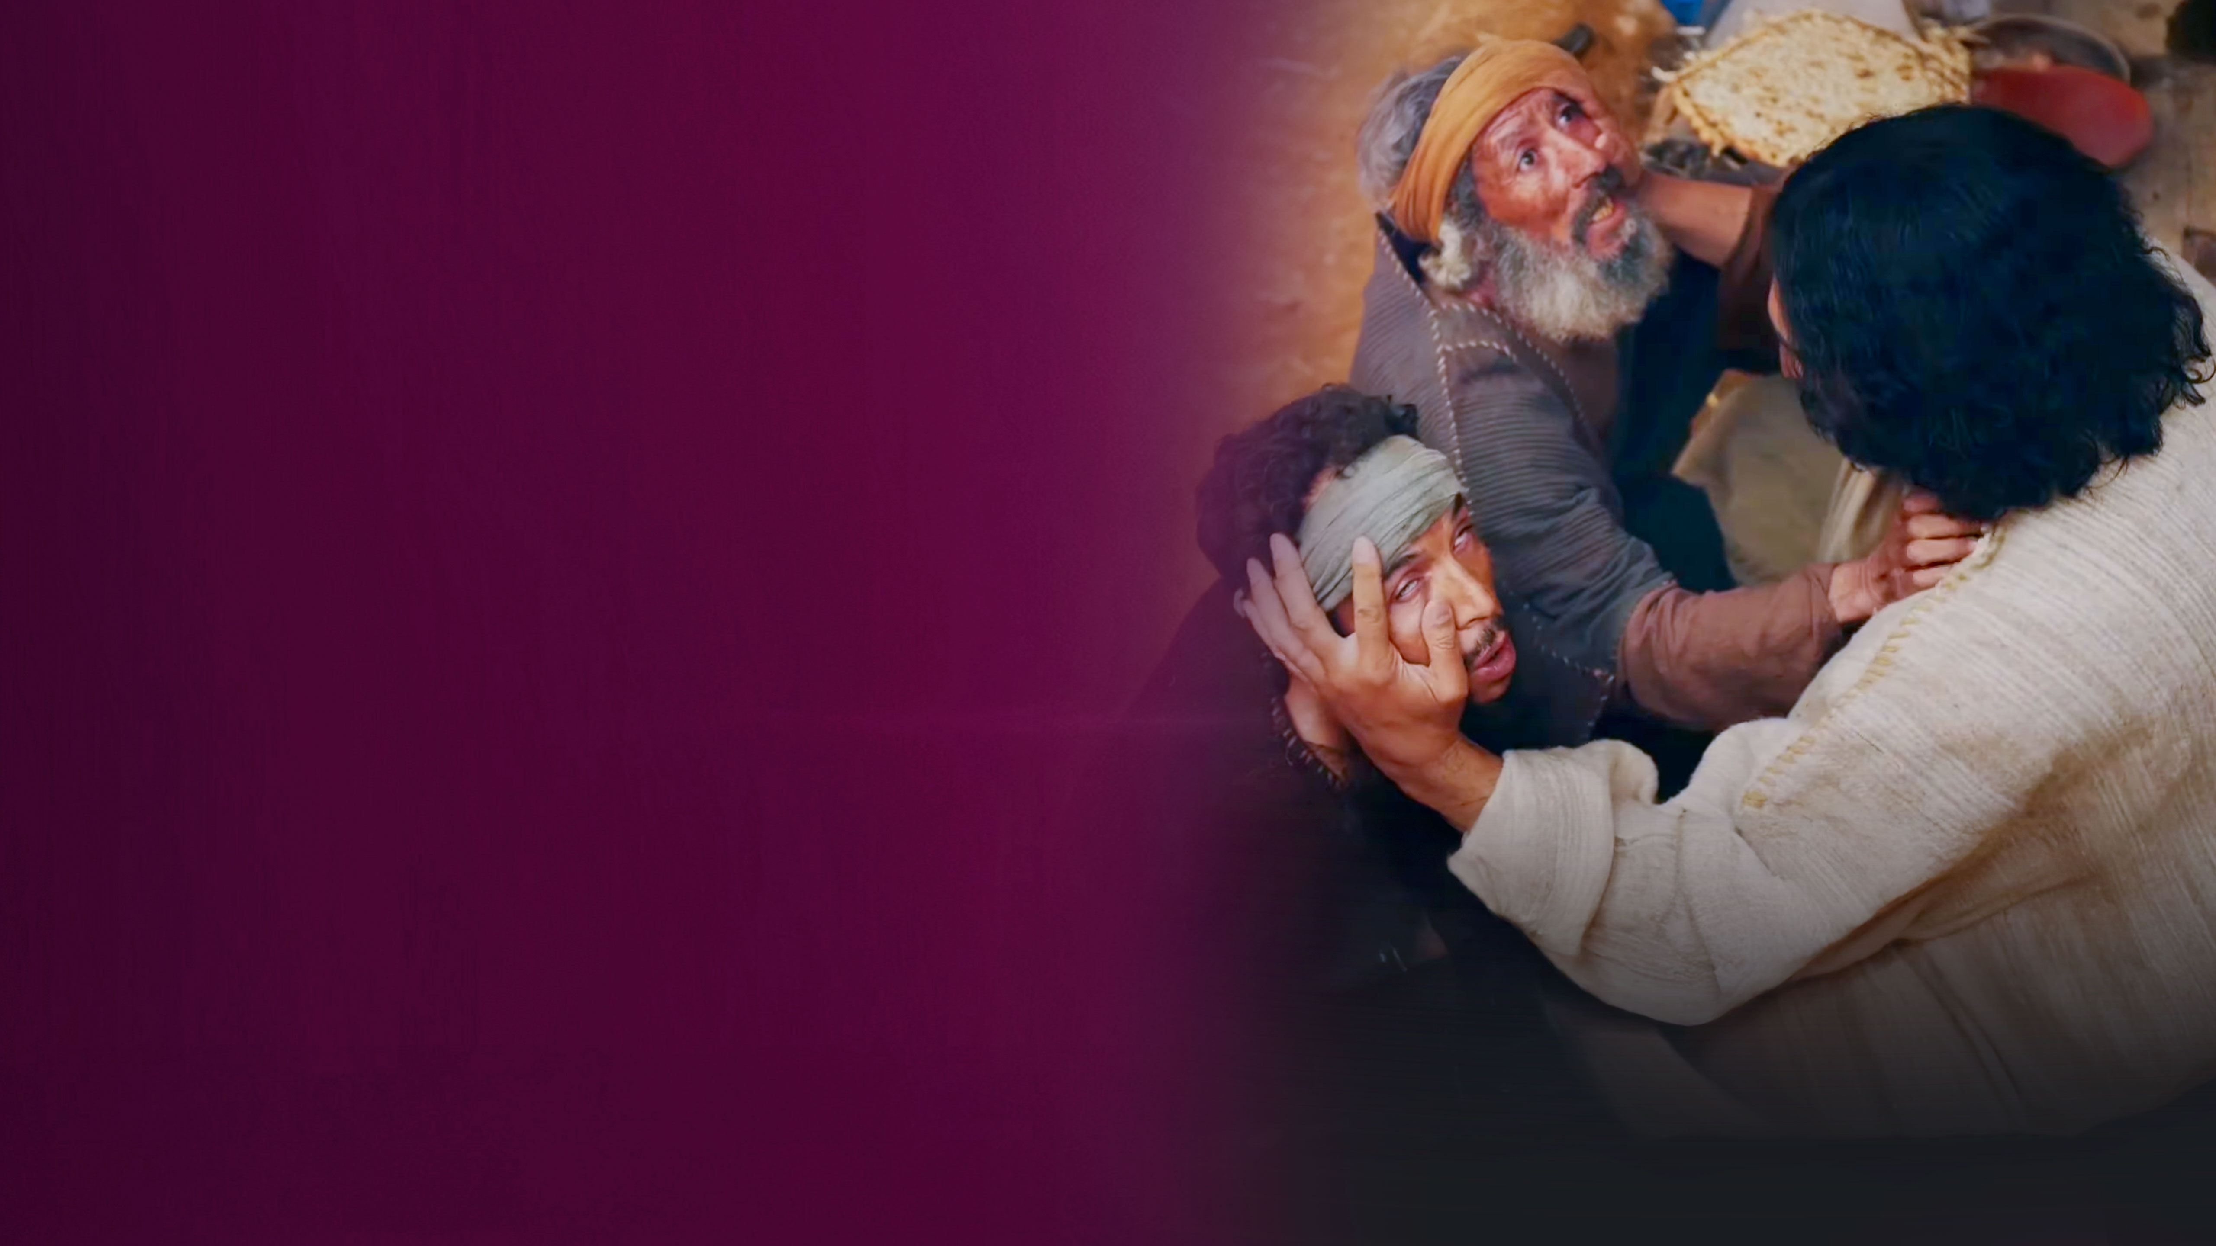
Two blind men

Slide 7
Matthew 9:29
Then He touched their eyes, saying, "According to your faith let it be to you."

Slide 8
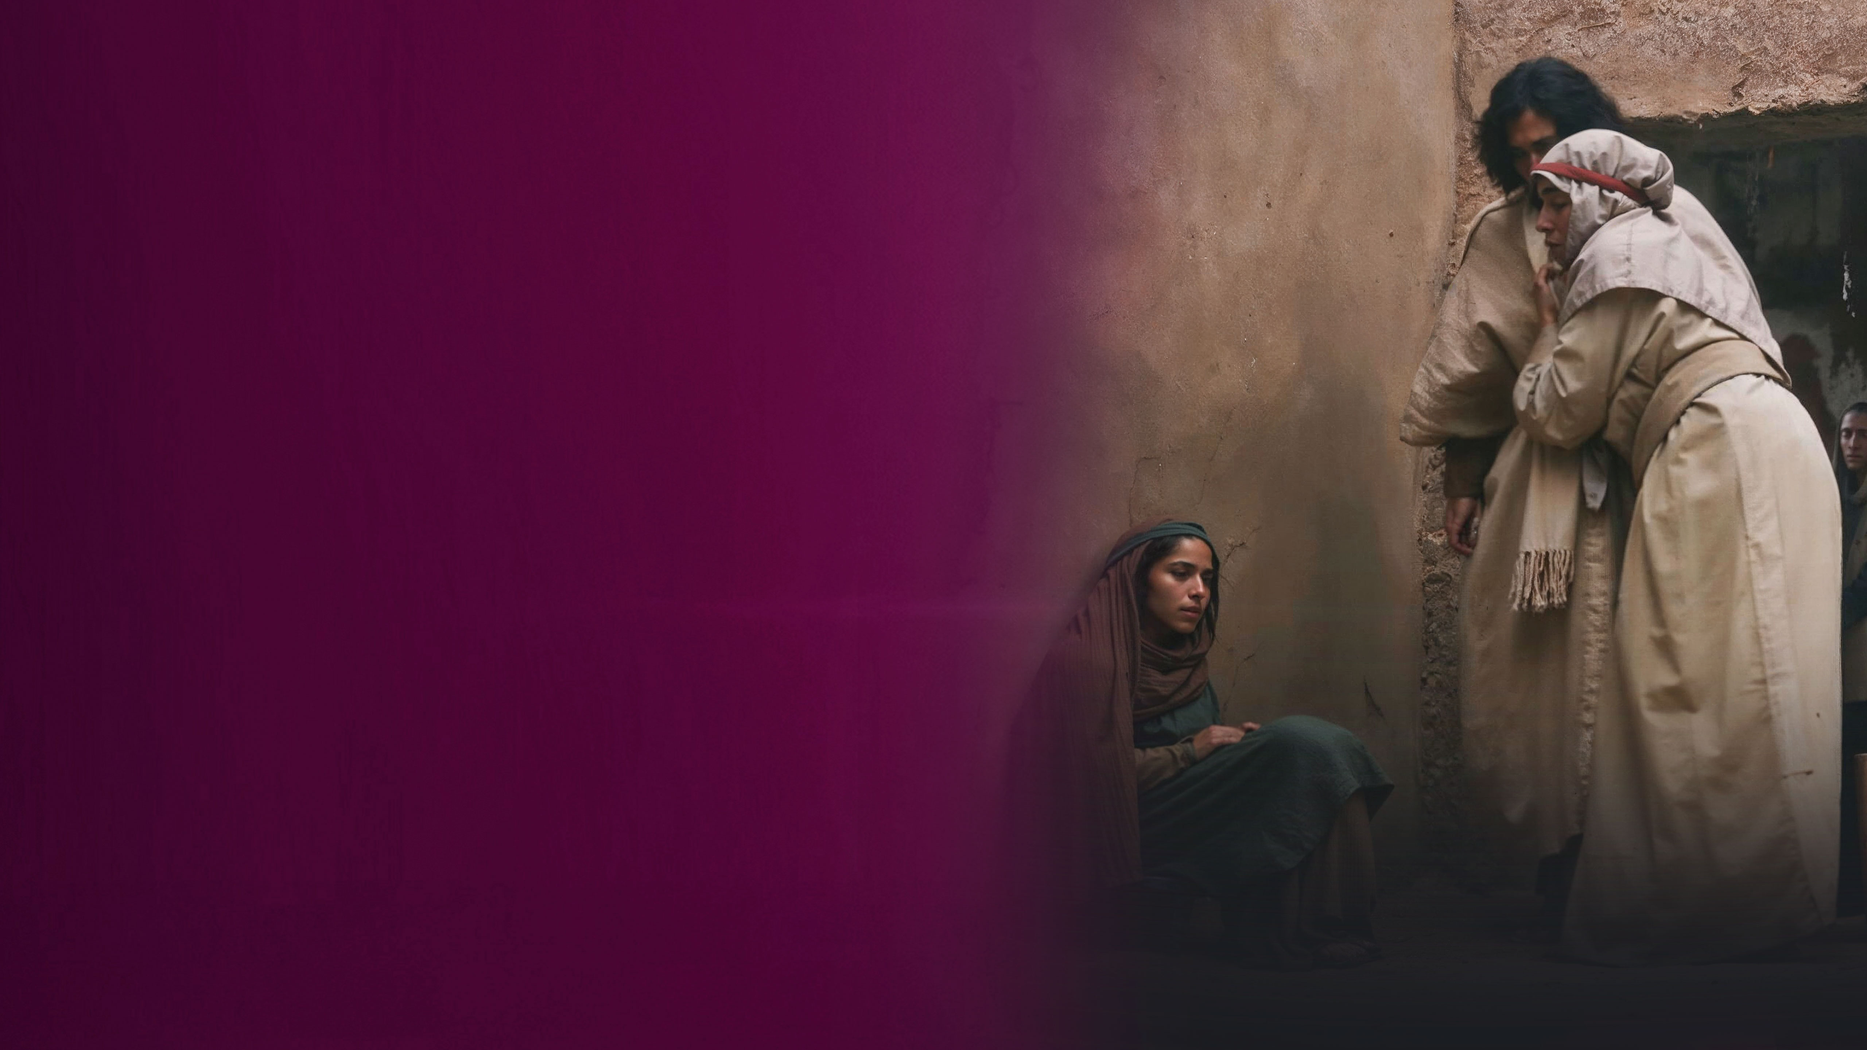
The Canaanite Woman

Slide 9
Matthew 15:28
Then Jesus answered and said to her, "O woman, great is your faith! Let it be to you as you desire." And her daughter was healed from that very hour.

Slide 10
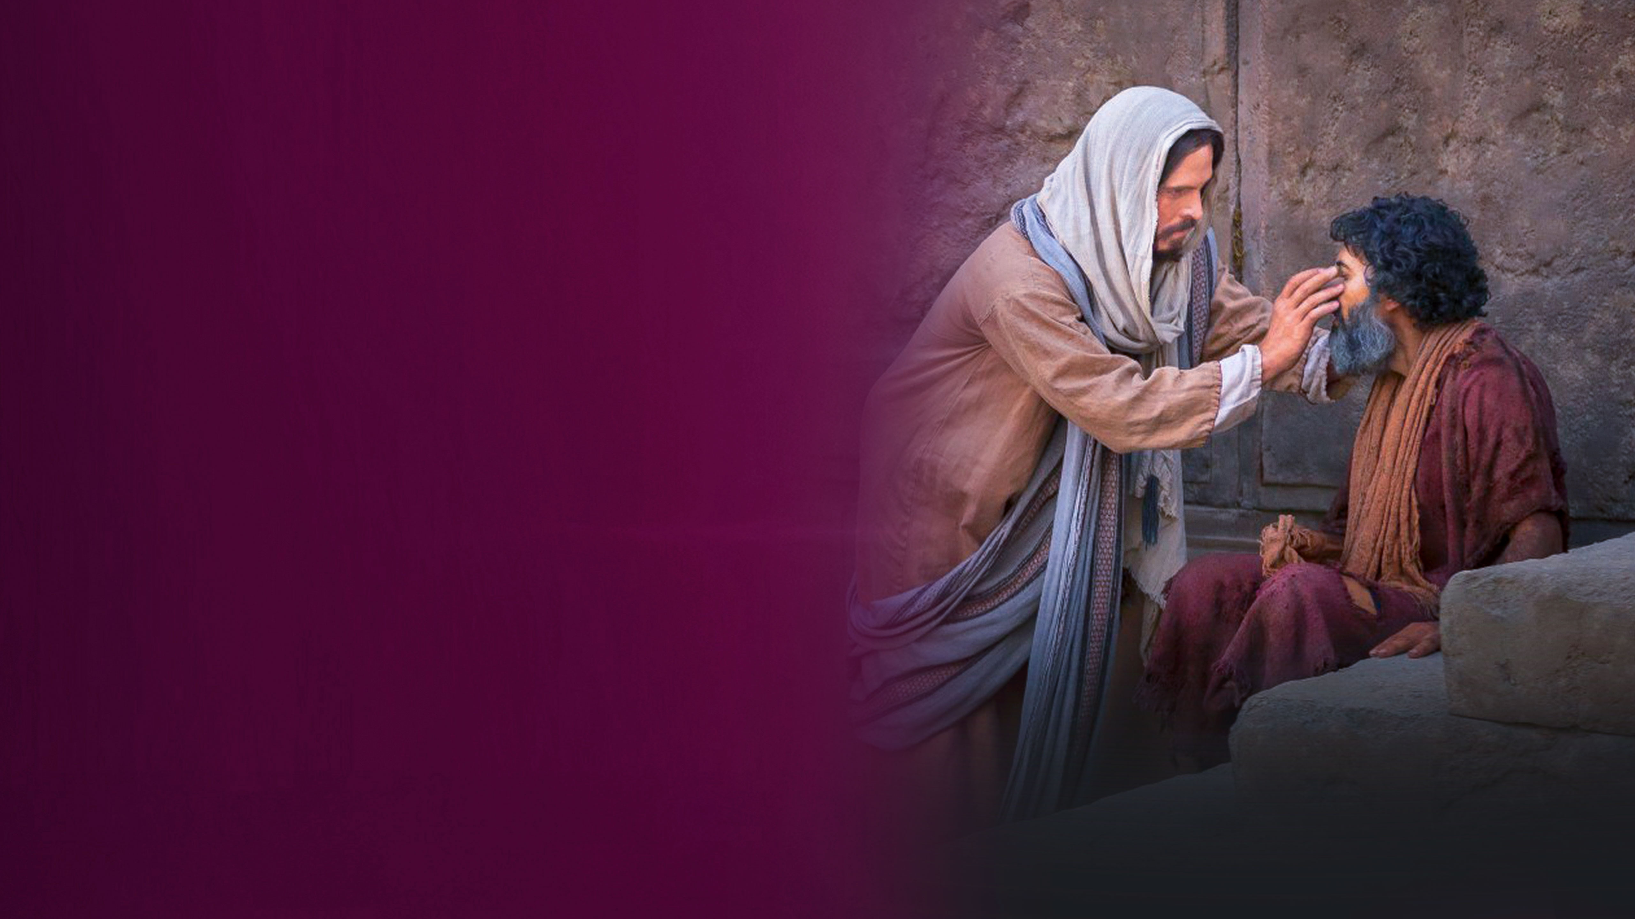
Blind Bartimaeus

Slide 11
Mark 10:52 (Luke 18:42)
Then Jesus said to him, "Go your way; your faith has made you well." And immediately he received his sight and followed Jesus on the road.

Slide 12
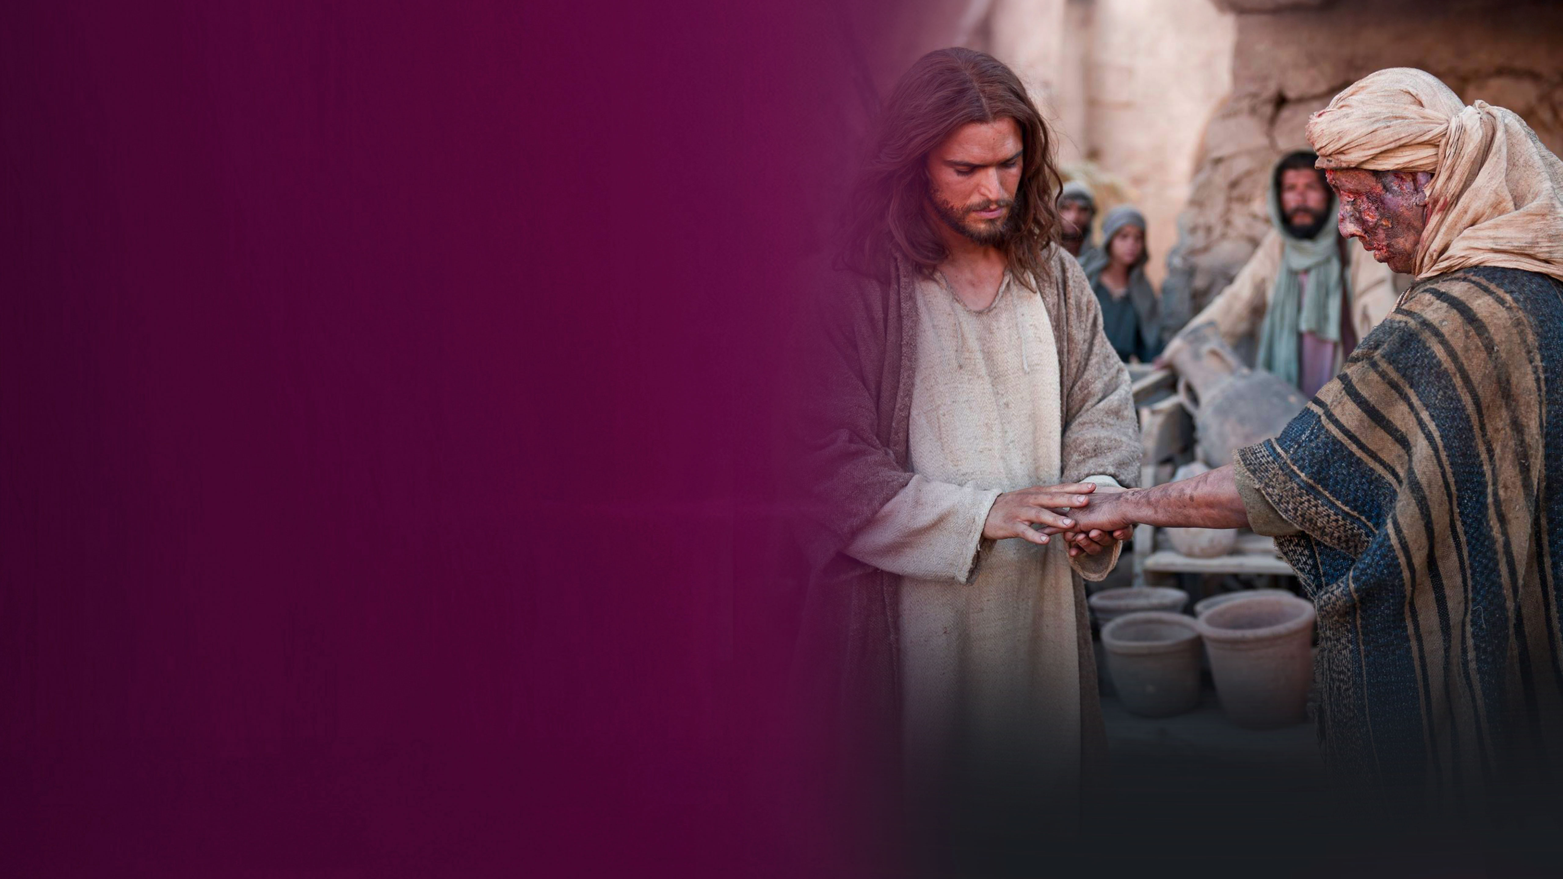
One of the Ten Lepers

Slide 13
Luke 17:19
And He said to him, "Arise, go your way. Your faith has made you well."

Slide 14
ACT YOUR FAITH

Slide 15
MINISTER IN FAITH

Slide 16
Matthew 17:19-21
19 Then the disciples came to Jesus privately and said, "Why could we not cast it out?"
20 So Jesus said to them, "Because of your unbelief; for assuredly, I say to you, if you have faith as a mustard seed, you will say to this mountain, 'Move from here to there,' and it will move; and nothing will be impossible for you.
21 However, this kind does not go out except by prayer and fasting."

Slide 17
TIMING FOR MIRACLES, HEALING AND DELIVERANCE IN JESUS’ MINISTRY

Slide 18
2 Corinthians 6:1,2
1 We then, as workers together with Him also plead with you not to receive the grace of God in vain.
2 For He says: "IN AN ACCEPTABLE TIME I HAVE HEARD YOU, AND IN THE DAY OF SALVATION I HAVE HELPED YOU." Behold, now is the accepted time; behold, now is the day of salvation.

Slide 19
WHAT MUST WE DO TO WORK THE WORKS OF GOD?

Slide 20
John 6:28,29
28 Then they said to Him, "What shall we do, that we may work the works of God?"
29 Jesus answered and said to them, "This is the work of God, that you believe in Him whom He sent."

Slide 21
THE PRAYER OF FAITH

Slide 22
James 5:14,15
14 Is anyone among you sick? Let him call for the elders of the church, and let them pray over him, anointing him with oil in the name of the Lord.
15 And the prayer of faith will save the sick, and the Lord will raise him up. And if he has committed sins, he will be forgiven.

Slide 23
WE RECEIVE DIVINE HEALING TODAY THE SAME WAY – BY FAITH

Slide 24
A FEW QUESTIONS

