Slide 1


Slide 2


Slide 3


Slide 4

THE HOLY SPIRIT IN CREATION

Slide 5
Genesis 1:1,2
1 In the beginning God created the heavens and the earth.
2 The earth was without form, and void; and darkness was on the face of the deep. And the Spirit of God was hovering over the face of the waters.

Slide 6
Job 33:4
The Spirit of God has made me, And the breath of the Almighty gives me life.

Slide 7
THE SPIRIT OF LIFE

Slide 8
Romans 8:2,11
2 For the law of the Spirit of life in Christ Jesus has made me free from the law of sin and death.
11 But if the Spirit of Him who raised Jesus from the dead dwells in you, He who raised Christ from the dead will also give life to your mortal bodies through His Spirit who dwells in you.

Slide 9
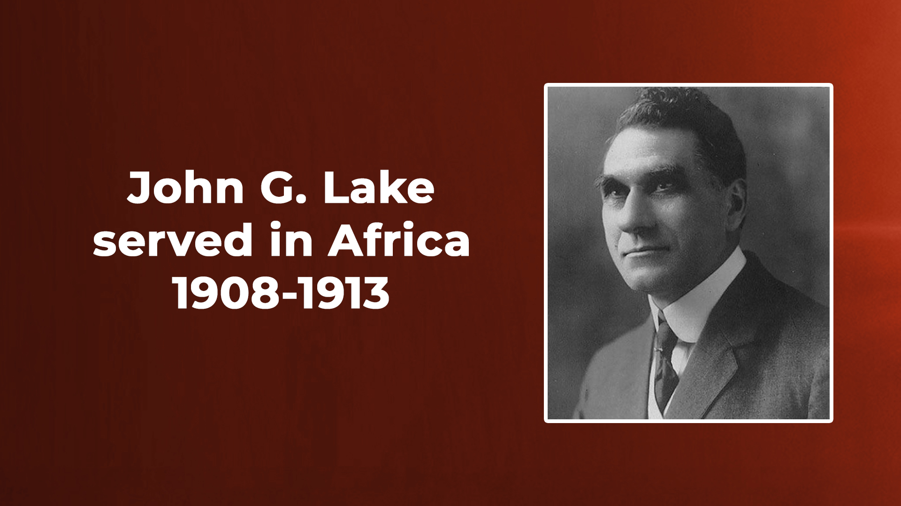

Slide 10
THE LIFE OF JESUS MANIFESTED IN OUR BODIES

Slide 11
2 Corinthians 4:10,11
10 always carrying about in the body the dying of the Lord Jesus, that the life of Jesus also may be manifested in our body.
11 For we who live are always delivered to death for Jesus' sake, that the life of Jesus also may be manifested in our mortal flesh.

Slide 12
THE ANOINTING DESTROYS YOKES AND REMOVES BURDENS

Slide 13
Isaiah 10:27
It shall come to pass in that day That his burden will be taken away from your shoulder, And his yoke from your neck, And the yoke will be destroyed because of the anointing oil.

Slide 14
THE HOLY SPIRIT IN THE MINISTRY OF JESUS

Slide 15
GIFTS OF HEALINGS AND WORKINGS OF MIRACLES

