Slide 1
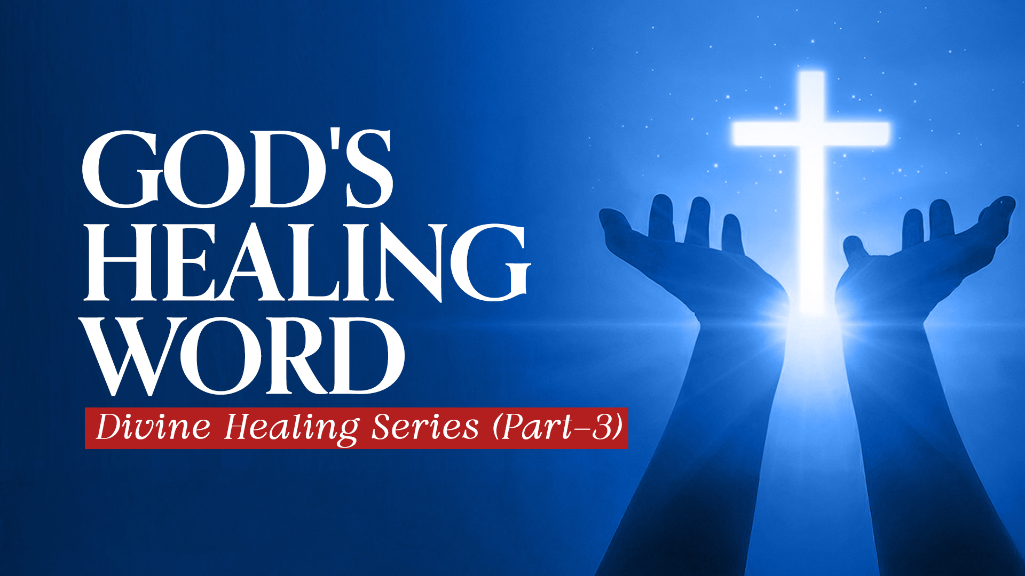

Slide 2
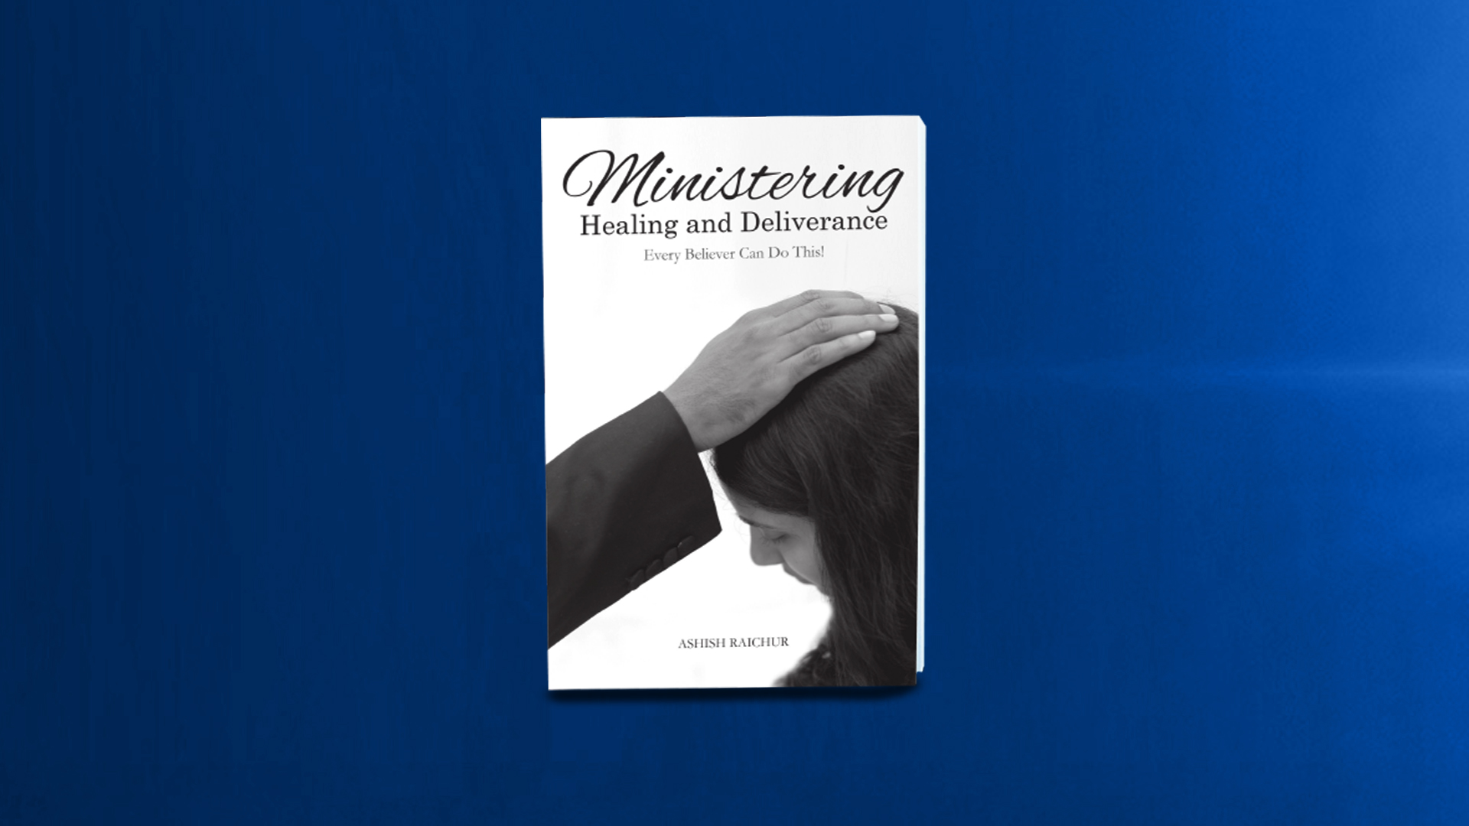

Slide 3
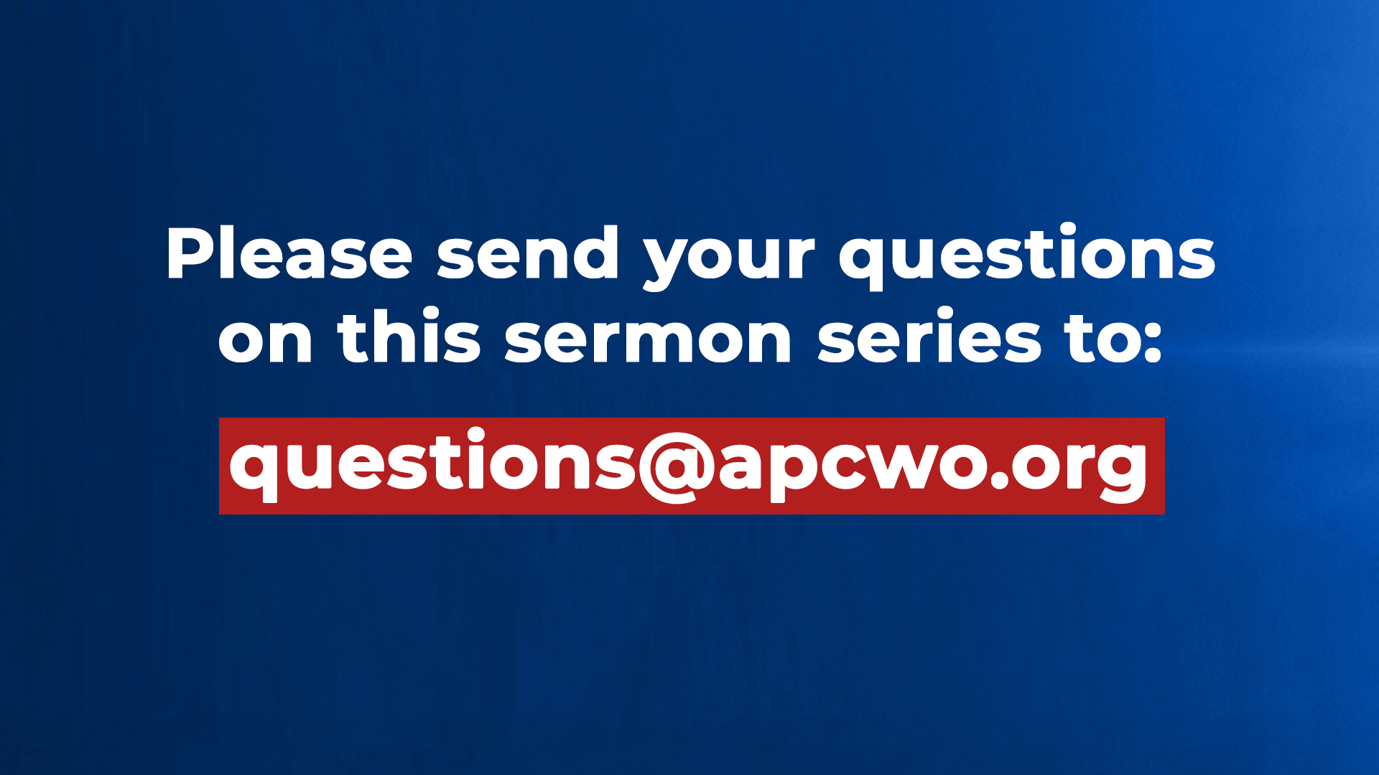

Slide 4

Proverbs 4:20-22
20 My son, give attention to my words; Incline your ear to my sayings.
21 Do not let them depart from your eyes; Keep them in the midst of your heart;
22 For they are life to those who find them, And health to all their flesh.

Slide 5
Psalm 107:20
He sent His word and healed them, And delivered them from their destructions.

Slide 6
Psalm 119:49,50
49 Remember the word to Your servant, Upon which You have caused me to hope.
50 This is my comfort in my affliction, For Your word has given me life.

Slide 7
Hebrews 4:12
For the word of God is living and powerful, and sharper than any two-edged sword, piercing even to the division of soul and spirit, and of joints and marrow, and is a discerner of the thoughts and intents of the heart.

Slide 8
IN JESUS’ MINISTRY

Slide 9
Matthew 9:35
Then Jesus went about all the cities and villages, teaching in their synagogues, preaching the gospel of the kingdom, and healing every sickness and every disease among the people.

Slide 10
Luke 5:15 (also Luke 6:19)
However, the report went around concerning Him all the more; and great multitudes came together to hear, and to be healed by Him of their infirmities.

Slide 11
Luke 5:17
Now it happened on a certain day, as He was teaching, that there were Pharisees and teachers of the law sitting by, who had come out of every town of Galilee, Judea, and Jerusalem. And the power of the Lord was present to heal them.

Slide 12
1. BELIEVE THE WORD

Slide 13
Hebrews 4:2
For indeed the gospel was preached to us as well as to them; but the word which they heard did not profit them, not being mixed with faith in those who heard it.

Slide 14
1 Thessalonians 2:13
For this reason we also thank God without ceasing, because when you received the word of God which you heard from us, you welcomed it not as the word of men, but as it is in truth, the word of God, which also effectively works in you who believe.

Slide 15
2. SPEAK THE WORD

Slide 16
Deuteronomy 30:11-20
11 "For this commandment which I command you today is not too mysterious for you, nor is it far off.
12 It is not in heaven, that you should say, 'Who will ascend into heaven for us and bring it to us, that we may hear it and do it?'
13 Nor is it beyond the sea, that you should say, 'Who will go over the sea for us and bring it to us, that we may hear it and do it?'

Slide 17
Deuteronomy 30:11-20
14 But the word is very near you, in your mouth and in your heart, that you may do it.
15 "See, I have set before you today life and good, death and evil,
16 in that I command you today to love the LORD your God, to walk in His ways, and to keep His commandments, His statutes, and His judgments, that you may live and multiply; and the LORD your God will bless you in the land which you go to possess.

Slide 18
Deuteronomy 30:11-20
17 But if your heart turns away so that you do not hear, and are drawn away, and worship other gods and serve them,
18 I announce to you today that you shall surely perish; you shall not prolong your days in the land which you cross over the Jordan to go in and possess.

Slide 19
Deuteronomy 30:11-20
19 I call heaven and earth as witnesses today against you, that I have set before you life and death, blessing and cursing; therefore choose life, that both you and your descendants may live;
20 that you may love the LORD your God, that you may obey His voice, and that you may cling to Him, for He is your life and the length of your days; and that you may dwell in the land which the LORD swore to your fathers, to Abraham, Isaac, and Jacob, to give them."

Slide 20
3. USE THE SWORD OF THE SPIRIT

Slide 21
Ephesians 6:17
And take the helmet of salvation, and the sword of the Spirit, which is the word of God;

