Slide 1
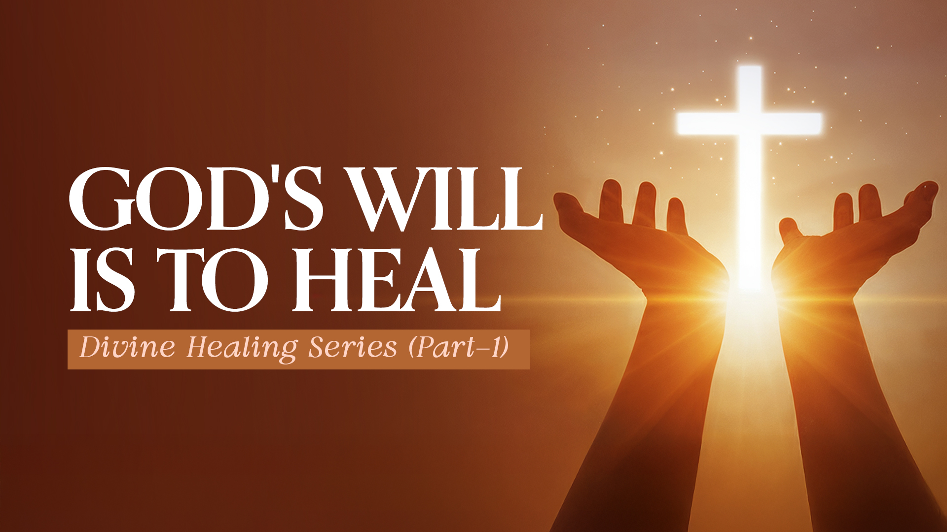

Slide 2

1. HIS NATURE

Slide 3
His nature is revealed through His name and His covenant.

Slide 4
His Covenant

Slide 5
Exodus 15:26
and said, "If you diligently heed the voice of the LORD your God and do what is right in His sight, give ear to His commandments and keep all His statutes, I will put none of the diseases on you which I have brought on the Egyptians. For I am the LORD who heals you."

Slide 6
Mark 16:17,18
17 And these signs will follow those who believe: In My name they will cast out demons; they will speak with new tongues;
18 they will take up serpents; and if they drink anything deadly, it will by no means hurt them; they will lay hands on the sick, and they will recover.”

Slide 7
2. HIS PROMISES

Slide 8
Exodus 23:25,26
25 "So you shall serve the LORD your God, and He will bless your bread and your water. And I will take sickness away from the midst of you.
26 No one shall suffer miscarriage or be barren in your land; I will fulfill the number of your days.

Slide 9
Psalm 103:1-5
1 A Psalm Of David. Bless the LORD, O my soul; And all that is within me, bless His holy name!
2 Bless the LORD, O my soul, And forget not all His benefits:
3 Who forgives all your iniquities, Who heals all your diseases,

Slide 10
Psalm 103:1-5
4 Who redeems your life from destruction, Who crowns you with lovingkindness and tender mercies,
5 Who satisfies your mouth with good things, So that your youth is renewed like the eagle's.

Slide 11
Proverbs 3:7,8
7 Do not be wise in your own eyes; Fear the LORD and depart from evil.
8 It will be health to your flesh, And strength to your bones.

Slide 12
3. HIS WORKS

Slide 13
Psalm 107:20
He sent His word and healed them, And delivered them from their destructions.

Slide 14
Proverbs 4:20-22
20 My son, give attention to my words; Incline your ear to my sayings.
21 Do not let them depart from your eyes; Keep them in the midst of your heart;
22 For they are life to those who find them, And health to all their flesh.

Slide 15
Acts 10:38
how God anointed Jesus of Nazareth with the Holy Spirit and with power, who went about doing good and healing all who were oppressed by the devil, for God was with Him.

Slide 16
Romans 8:11
But if the Spirit of Him who raised Jesus from the dead dwells in you, He who raised Christ from the dead will also give life to your mortal bodies through His Spirit who dwells in you.

Slide 17
4. HIS SON

Slide 18
Matthew 12:15
But when Jesus knew it, He withdrew from there. And great multitudes followed Him, and He healed them all.

Slide 19
Luke 6:19
And the whole multitude sought to touch Him, for power went out from Him and healed them all.

Slide 20
5. HIS PROVISION OF REDEMPTION

Slide 21
Isaiah 53:4,5
4 Surely He has borne our griefs (sickness) And carried our sorrows (pains); Yet we esteemed Him stricken, Smitten by God, and afflicted.
5 But He was wounded for our transgressions, He was bruised for our iniquities; The chastisement for our peace was upon Him, And by His stripes we are healed.

Slide 22
Matthew 8:16,17
16 When evening had come, they brought to Him many who were demon-possessed. And He cast out the spirits with a word, and healed all who were sick,
17 that it might be fulfilled which was spoken by Isaiah the prophet, saying: "HE HIMSELF TOOK OUR INFIRMITIES AND BORE OUR SICKNESSES."

