Slide 1
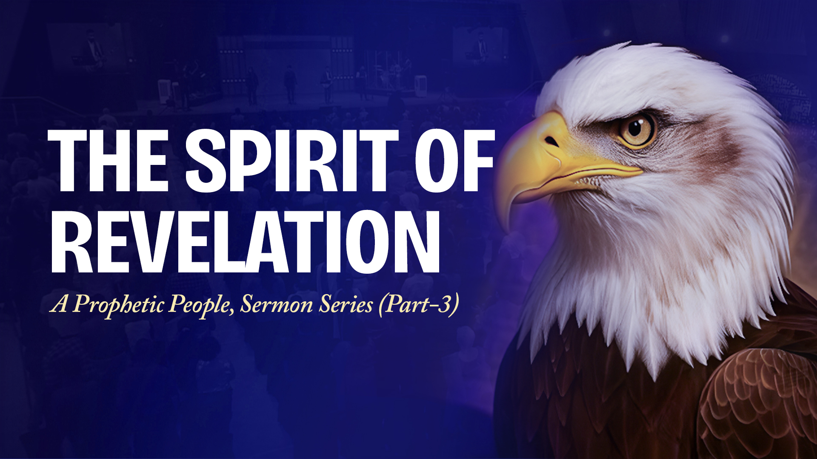

Slide 2

1. THE SPIRIT OF REVELATION BRINGS ENLIGHTENING OR SPIRITUAL UNDERSTANDING

Slide 3
Ephesians 1:15-20
15 Therefore I also, after I heard of your faith in the Lord Jesus and your love for all the saints,
16 do not cease to give thanks for you, making mention of you in my prayers:
17 that the God of our Lord Jesus Christ, the Father of glory, may give to you the spirit of wisdom and revelation in the knowledge of Him,

Slide 4
Ephesians 1:15-20
18 the eyes of your understanding being enlightened; that you may know what is the hope of His calling, what are the riches of the glory of His inheritance in the saints,
19 and what is the exceeding greatness of His power toward us who believe, according to the working of His mighty power
20 which He worked in Christ when He raised Him from the dead and seated Him at His right hand in the heavenly places,

Slide 5
Know His Person (“know Him”)
Know His Purpose
Know His Provision
(His inheritance for His people)
Know His Power

Slide 6
2. THE SPIRIT OF REVELATION BRINGS AN UNDERSTANDING OF THE MYSTERIES OF THE KINGDOM

Slide 7
Matthew 13:10-13
10 And the disciples came and said to Him, "Why do You speak to them in parables?"
11 He answered and said to them, "Because it has been given to you to know the mysteries of the kingdom of heaven, but to them it has not been given.

Slide 8
Matthew 13:10-13
12 For whoever has, to him more will be given, and he will have abundance; but whoever does not have, even what he has will be taken away from him.
13 Therefore I speak to them in parables, because seeing they do not see, and hearing they do not hear, nor do they understand.

Slide 9
3. THE SPIRIT OF REVELATION EXPRESSED THROUGH REVELATORY GIFTS OF THE SPIRIT IMPACTS PEOPLE’S LIVES

Slide 10
1 Corinthians 12:7-11
7 But the manifestation of the Spirit is given to each one for the profit of all:
8 for to one is given the word of wisdom through the Spirit, to another the word of knowledge through the same Spirit,
9 to another faith by the same Spirit, to another gifts of healings by the same Spirit,

Slide 11
1 Corinthians 12:7-11
10 to another the working of miracles, to another prophecy, to another discerning of spirits, to another different kinds of tongues, to another the interpretation of tongues.
11 But one and the same Spirit works all these things, distributing to each one individually as He wills.

Slide 12
3A. Gift of the word of knowledge –
unveiling past or present events
3B. Gift of the word of wisdom –
unveiling of God’s plan and
purposes
3C. Gift of prophecy – unveiling of
coming events
3D. Gift of discerning of spirits –
unveiling of the unseen realm,
either the hearts of people or the
spirit realm

Slide 13
RECEIVING FROM THE SPIRIT OF REVELATION

Slide 14
A. Listen to the Spirit in your spirit

Slide 15
B. Sharpen your spiritual faculties

Slide 16
Matthew 13:15
FOR THE HEARTS OF THIS PEOPLE HAVE GROWN DULL. THEIR EARS ARE HARD OF HEARING, AND THEIR EYES THEY HAVE CLOSED, LEST THEY SHOULD SEE WITH THEIR EYES AND HEAR WITH THEIR EARS, LEST THEY SHOULD UNDERSTAND WITH THEIR HEARTS AND TURN, SO THAT I SHOULD HEAL THEM.'

Slide 17
Hebrews 5:11,14
11 of whom we have much to say, and hard to explain, since you have become dull of hearing.
14 But solid food belongs to those who are of full age, that is, those who by reason of use have their senses exercised to discern both good and evil.

Slide 18
C. Follow His instructions

