Slide 1
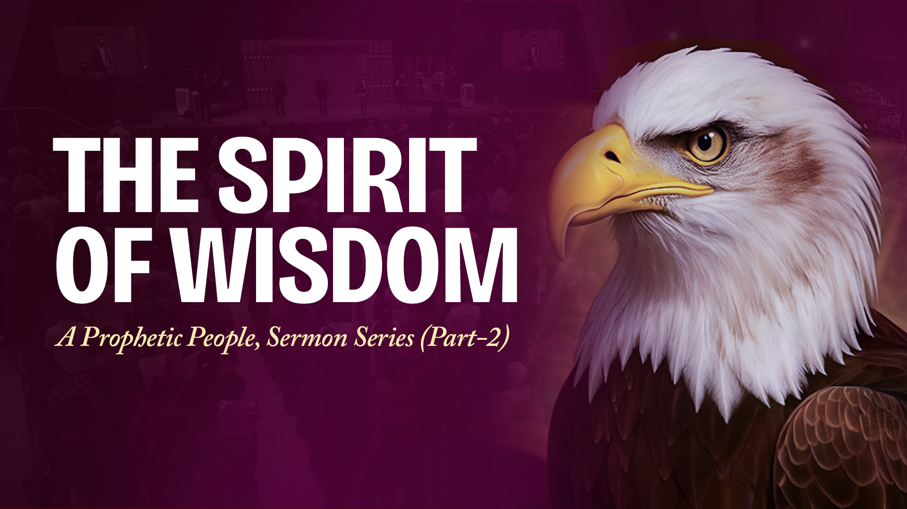

Slide 2
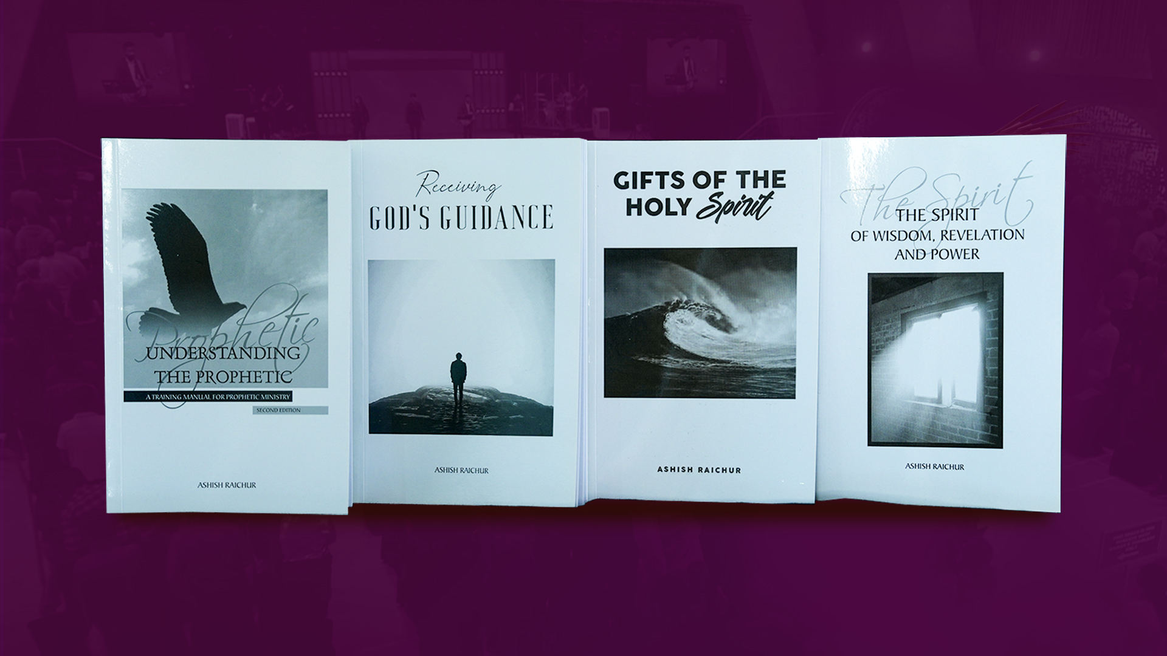

Slide 3

TODAY: THE SPIRIT OF WISDOM

Slide 4
The prophetic is bringing expressions of the Spirit of wisdom in everyday life, in our homes, families, workplaces, communities, nations, in all spheres so that the glory of God is revealed and His Kingdom is advanced here on earth.

Slide 5
Isaiah 11:2
The Spirit of the LORD shall rest upon Him, The Spirit of wisdom and understanding, The Spirit of counsel and might, The Spirit of knowledge and of the fear of the LORD.

Slide 6
Exodus 28:3-8
3 So you shall speak to all who are GIFTED artisans, whom I have filled with the SPIRIT OF WISDOM, that they may make Aaron's garments, to consecrate him, that he may minister to Me as priest.
4 And these are the garments which they shall make: a breastplate, an ephod, a robe, a SKILLFULLY woven tunic, a turban, and a sash. So they shall make holy garments for Aaron your brother and his sons, that he may minister to Me as priest.

Slide 7
Exodus 28:3-8
5 "They shall take the gold, blue, purple, and scarlet thread, and the fine linen,
6 and they shall make the ephod of gold, blue, purple, and scarlet thread, and fine woven linen, ARTISTICALLY worked.

Slide 8
Exodus 28:3-8
7 It shall have two shoulder straps joined at its two edges, and so it shall be joined together.
8 And the INTRICATELY woven band of the ephod, which is on it, shall be of the same workmanship, made of gold, blue, purple, and scarlet thread, and fine woven linen.

Slide 9
Prophetic expressions of the Spirit of wisdom make us:
Gifted (vs 3),
Skillful (vs 4),
Creative (vs 6) and
Ingenious (vs 8).

Slide 10
Exodus 31:3,4,6
3 And I have filled him with the Spirit of God, in wisdom, in understanding, in knowledge, and in all manner of workmanship,
4 to design artistic works, to work in gold, in silver, in bronze,
6 "And I, indeed I, have appointed with him Aholiab the son of Ahisamach, of the tribe of Dan; and I have put wisdom in the hearts of all the gifted artisans, that they may make all that
I have commanded you:

Slide 11
God anoints us with the Spirit of wisdom to carry out Kingdom purposes!

Slide 12
Prophetic expressions of the Spirit of wisdom enable us to carry out Kingdom purposes!

Slide 13
Exodus 35:10,20,21,26
10 'All who are gifted artisans among you shall come and make all that the LORD has commanded:
20 And all the congregation of the children of Israel departed from the presence of Moses.

Slide 14
Exodus 35:10,20,21,26
21 Then everyone came whose heart was stirred, and everyone whose spirit was willing, and they brought the LORD's offering for the work of the tabernacle of meeting, for all its service, and for the holy garments.
26 And all the women whose hearts stirred with wisdom spun yarn of goats' hair.

Slide 15
Prophetic expressions of the Spirit of wisdom involves diligent work to execute what God desires to be established.

Slide 16
Exodus 35:31,34
31 and He has filled him with the Spirit of God, in wisdom and understanding, in knowledge and all manner of workmanship,
34 "And He has put in his heart the ability to teach, in him and Aholiab the son of Ahisamach, of the tribe of Dan.

Slide 17
Prophetic expressions of the Spirit of wisdom empowers us to impart, equip and nurture skill in others.

Slide 18
Deuteronomy 34:9
Now Joshua the son of Nun was full of the spirit of wisdom, for Moses had laid his hands on him; so the children of Israel heeded him, and did as the LORD had commanded Moses.

Slide 19
Prophetic expressions of the Spirit of wisdom empowers us for leadership.

Slide 20
1 Chronicles 28:12,19
12 and the plans for all that he had by the Spirit, of the courts of the house of the LORD, of all the chambers all around, of the treasuries of the house of God, and of the treasuries for the dedicated things;
19 "All this," said David, "the LORD made me understand in writing, by His hand upon me, all the works of these plans."

Slide 21
Prophetic expressions of the Spirit of wisdom empowers us beyond our natural abilities, competencies or skills.

Slide 22
Daniel 5:12,14
12 Inasmuch as an excellent spirit, knowledge, understanding, interpreting dreams, solving riddles, and explaining enigmas were found in this Daniel, whom the king named Belteshazzar, now let Daniel be called, and he will give the interpretation."
14 I have heard of you, that the Spirit of God is in you, and that light and understanding and excellent wisdom are found in you.

Slide 23
Prophetic expressions of the Spirit of wisdom impacts and influences kings, leaders, places of power and seats of authority.

Slide 24
IN TODAY'S WORLD

Slide 25
Proverbs 8:12-21
Prudence, Knowledge, Inventions
Counsel, Understanding
Leadership
Wealth, Profitability
Righteousness, Justice

Slide 26
Psalm 90:16,17
16 Let Your work appear to Your servants, And Your glory to their children.
17 And let the beauty of the LORD our God be upon us, And establish the work of our hands for us; Yes, establish the work of our hands.

Slide 27
Proverbs 22:29
Do you see a man who excels in his work? He will stand before kings; He will not stand before unknown men.

Slide 28
Ecclesiastes 9:16,18; 10:10
Wisdom is better than strength
Wisdom is better than weapons of war
Wisdom brings success

Slide 29
The prophetic is bringing expressions of the Spirit of Wisdom in everyday life, in our homes, families, workplaces, communities, nations, in all spheres so that the glory of God is revealed and His Kingdom is advanced here on earth.

