Slide 1
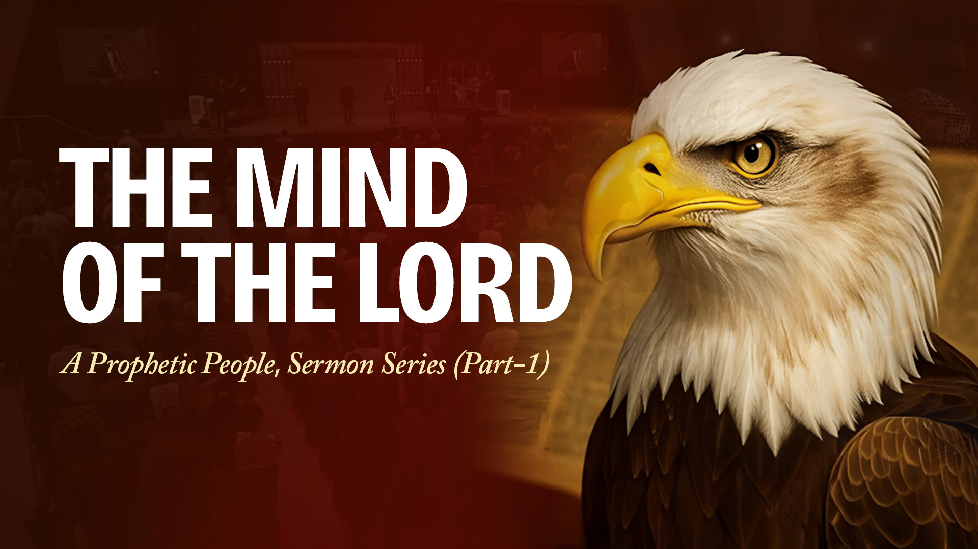

Slide 2


Slide 3

GOD DESIRES FOR ALL OF US TO BE PROPHETIC

Slide 4
Numbers 11:29
Then Moses said to him, "Are you zealous for my sake? Oh, that all the LORD's people were prophets and that the LORD would put His Spirit upon them!"

Slide 5
1 Corinthians 14:1-3,31,39
1 Pursue love, and desire spiritual gifts, but especially that you may prophesy.
2 For he who speaks in a tongue does not speak to men but to God, for no one understands him; however, in the spirit he speaks mysteries.
3 But he who prophesies speaks edification and exhortation and comfort to men.

Slide 6
1 Corinthians 14:1-3,31,39
31 For you can all prophesy one by one, that all may learn and all may be encouraged.
39 Therefore, brethren, desire earnestly to prophesy, and do not forbid to speak with tongues.

Slide 7
TO BE PROPHETIC IS TO KNOW AND UNDERSTAND THE MIND OF THE LORD, HIS WAYS AND THOUGHTS, SO THAT WE CAN THINK, ACT AND SPEAK ALIGNED TO HIM, ALL THE TIME.

Slide 8
GOD REVEALS HIS SECRETS

Slide 9
Psalm 25:14
The secret of the LORD is with those who fear Him, And He will show them His covenant.

Slide 10
Proverbs 3:32
For the perverse person is an abomination to the LORD, But His secret counsel is with the upright.

Slide 11
Isaiah 42:9
Behold, the former things have come to pass, And new things I declare; Before they spring forth I tell you of them."

Slide 12
Isaiah 46:10
Declaring the end from the beginning, And from ancient times things that are not yet done, Saying, 'My counsel shall stand, And I will do all My pleasure,'

Slide 13
Jeremiah 33:3
'Call to Me, and I will answer you, and show you great and mighty things, which you do not know.'

Slide 14
Daniel 2:22,28-30
22 He reveals deep and secret things; He knows what is in the darkness, And light dwells with Him.
28 But there is a God in heaven who reveals secrets, and He has made known to King Nebuchadnezzar what will be in the latter days. Your dream, and the visions of your head upon your bed, were these:

Slide 15
Daniel 2:22,28-30
29 As for you, O king, thoughts came to your mind while on your bed, about what would come to pass after this; and He who reveals secrets has made known to you what will be.
30 But as for me, this secret has not been revealed to me because I have more wisdom than anyone living, but for our sakes who make known the interpretation to the king, and that you may know the thoughts of your heart.

Slide 16
Amos 3:7
Surely the Lord GOD does nothing, Unless He reveals His secret to His servants the prophets.

Slide 17
THE SPIRIT REVEALS AND UNVEILS

Slide 18
John 10:27
My sheep hear My voice, and I know them, and they follow Me.

Slide 19
John 16:13-15
13 However, when He, the Spirit of truth, has come, He will guide you into all truth; for He will not speak on His own authority, but whatever He hears He will speak; and He will tell you things to come.
14 He will glorify Me, for He will take of what is Mine and declare it to you.
15 All things that the Father has are Mine. Therefore I said that He will take of Mine and declare it to you.

Slide 20
1 Corinthians 2:9-16
9 But as it is written: "EYE HAS NOT SEEN, NOR EAR HEARD, NOR HAVE ENTERED INTO THE HEART OF MAN THE THINGS WHICH GOD HAS PREPARED FOR THOSE WHO LOVE HIM."
10 But God has revealed them to us through His Spirit. For the Spirit searches all things, yes, the deep things of God.
11 For what man knows the things of a man except the spirit of the man which is in him? Even so no one knows the things of God except the Spirit of God.

Slide 21
1 Corinthians 2:9-16
12 Now we have received, not the spirit of the world, but the Spirit who is from God, that we might know the things that have been freely given to us by God.
13 These things we also speak, not in words which man's wisdom teaches but which the Holy Spirit teaches, comparing spiritual things with spiritual.
14 But the natural man does not receive the things of the Spirit of God, for they are foolishness to him; nor can he know them, because they are spiritually discerned.

Slide 22
1 Corinthians 2:9-16
15 But he who is spiritual judges all things, yet he himself is rightly judged by no one.
16 For "WHO HAS KNOWN THE MIND OF THE LORD THAT HE MAY INSTRUCT HIM?" But we have the mind of Christ.

Slide 23
STAND BEFORE THE LORD

Slide 24
Jeremiah 23:18,22
18 For who has stood in the counsel of the LORD, And has perceived and heard His word? Who has marked His word and heard it?
22 But if they had stood in My counsel, And had caused My people to hear My words, Then they would have turned them from their evil way And from the evil of their doings.

Slide 25
Habakkuk 2:1,2
1 I will stand my watch And set myself on the rampart, And watch to see what He will say to me, And what I will answer when I am corrected.
2 Then the LORD answered me and said: "Write the vision And make it plain on tablets, That he may run who reads it.

Slide 26
THE HOLY SPIRIT SPEAKS TO OUR SPIRITS

Slide 27
Job 32:8
But there is a spirit in man, And the breath of the Almighty gives him understanding.

Slide 28
Romans 8:16
The Spirit Himself bears witness with our spirit that we are children of God,

Slide 29
WHY DO WE NEED THE MIND OF THE LORD?
• Make decisions
• Plan for the future
• Bring God's word in season to people
• Bring godly counsel to people
• Bring solutions to problems
• Create, invent, design
• Forecast, predict, prepare
• … several more

