Slide 1
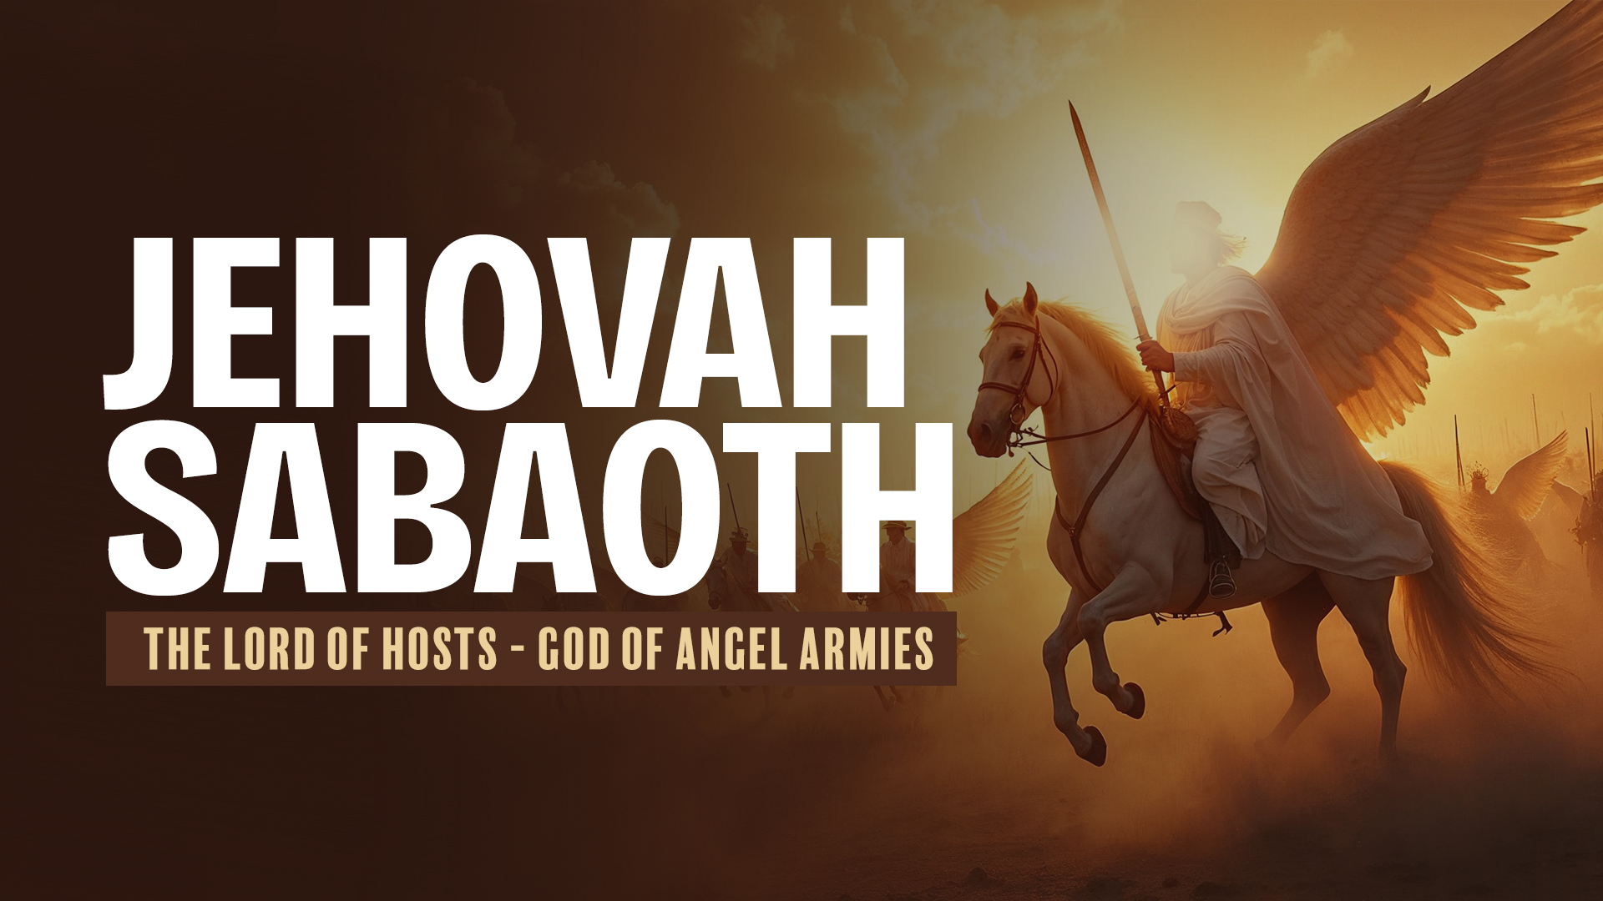

Slide 2
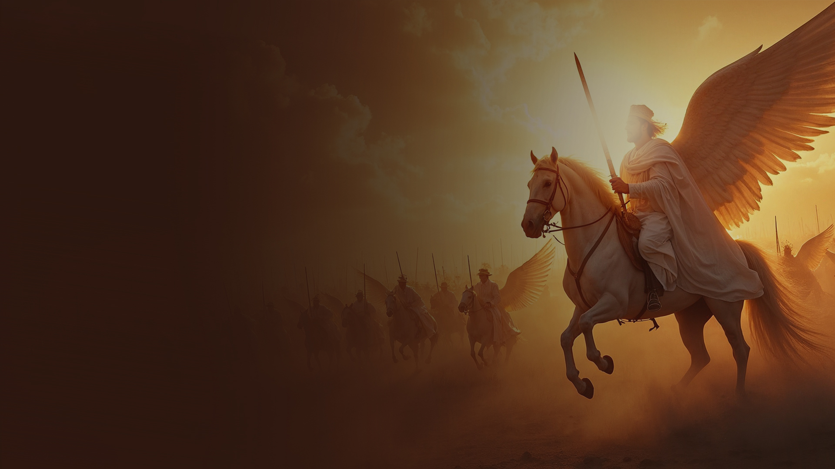
SPIRITUAL WARFARE

Slide 3
Ephesians 6:12
For we do not wrestle against flesh and blood, but against principalities, against powers, against the rulers of the darkness of this age, against spiritual hosts of wickedness in the heavenly places.

Slide 4
THE LORD IS A WARRIOR

Slide 5
Exodus 15:3
The LORD is a man of war; The LORD is His name.

Slide 6
Isaiah 42:13
The LORD shall go forth like a mighty man; He shall stir up His zeal like a man of war. He shall cry out, yes, shout aloud; He shall prevail against His enemies.

Slide 7
Malachi 3:6
For I am the LORD, I do not change;

Slide 8
Revelation 19:11-16
11 Now I saw heaven opened, and behold, a white horse. And He who sat on him was called Faithful and True, and in righteousness He judges and makes war.
12 His eyes were like a flame of fire, and on His head were many crowns. He had a name written that no one knew except Himself.
13 He was clothed with a robe dipped in blood, and His name is called The Word of God.

Slide 9
Revelation 19:11-16
14 And the armies in heaven, clothed in fine linen, white and clean, followed Him on white horses.
15 Now out of His mouth goes a sharp sword, that with it He should strike the nations. And He Himself will rule them with a rod of iron. He Himself treads the winepress of the fierceness and wrath of Almighty God.
16 And He has on His robe and on His thigh a name written: KING OF KINGS AND LORD OF LORDS.

Slide 10
JEHOVAH SABAOTH - THE LORD
OF HOSTS
GOD OF ANGEL ARMIES

Slide 11
Psalm 24:8,10
8 Who is this King of glory? The LORD strong and mighty, The LORD mighty in battle.
10 Who is this King of glory? The LORD of hosts, He is the King of glory. Selah

Slide 12
1 Samuel 17:45
Then David said to the Philistine, “You come to me with a sword, with a spear, and with a javelin. But I come to you in the name of the LORD of hosts, the God of the armies of Israel, whom you have defied.

Slide 13
GOD’S HEAVENLY HOSTS

Slide 14
Psalm 68:17
The chariots of God are twenty thousand, Even thousands of thousands; The LORD is among them as in Sinai, in the Holy Place.

Slide 15
Psalm 103:20,21
20 Bless the LORD, you His angels, Who excel in strength, who do His word, Heeding the voice of His word.
21 Bless the LORD, all you His hosts, You ministers of His, who do His pleasure.

Slide 16
THE OLD TESTAMENT EXPERIENCE OF THE LORD OF HOSTS—A BRIEF SUMMARY

Slide 17
The Lord of hosts was the Director of military operations.
He would direct His people against specific targets.
He would provide the specific time to advance into war.
He would provide the specific direction/strategy for action.

Slide 18
He would provide the call to engage in war.
When He led the operations, the army was assured of victory beforehand.
It was by His power that victory was assured.

Slide 19
Receiving Strategies and Tactics (Joshua 6)

Slide 20
The Lord fought for Israel.
He helped them conquer enemies greater and mightier than themselves.
He provided divine intervention for total obedience and for those devoted to Him.

Slide 21
HOW IS THIS RELEVANT FOR US TODAY?

Slide 22
1. HIS NATURE REPRODUCED IN US

Slide 23
2. HE STILL FIGHTS FOR US

Slide 24
Isaiah 41:10-13
10 Fear not, for I am with you; Be not dismayed, for I am your God. I will strengthen you, Yes, I will help you, I will uphold you with My righteous right hand.'
11 "Behold, all those who were incensed against you Shall be ashamed and disgraced; They shall be as nothing, And those who strive with you shall perish.

Slide 25
Isaiah 41:10-13
12 You shall seek them and not find them—Those who contended with you. Those who war against you Shall be as nothing, As a nonexistent thing.
13 For I, the LORD your God, will hold your right hand, Saying to you, 'Fear not, I will help you.'

Slide 26
Isaiah 49:25
But thus says the LORD: "Even the captives of the mighty shall be taken away, And the prey of the terrible be delivered; For I will contend with him who contends with you, And I will save your children.

Slide 27
Isaiah 54:17
No weapon formed against you shall prosper, And every tongue which rises against you in judgment You shall condemn. This is the heritage of the servants of the LORD, And their righteousness is from Me," Says the LORD.

Slide 28
3. WE ENGAGE AS SOLDIERS—PEOPLE WITH THE WARRIOR NATURE OF
OUR GOD

Slide 29
1 Timothy 6:12
Fight the good fight of faith.

Slide 30
4. WE USE SPIRITUAL WEAPONS FOR A SPIRITUAL BATTLE

Slide 31
2 Corinthians 10:4,5
4 For the weapons of our warfare are not carnal but mighty in God for pulling down strongholds,
5 casting down arguments and every high thing that exalts itself against the knowledge of God, bringing every thought into captivity to the obedience of Christ,

Slide 32
SPIRITUAL BATTLES ARE WON BY SPIRITUAL MEANS
THE NATURAL IS AFFECTED BY THE SPIRITUAL

Slide 33
5. HE ALWAYS CAUSES US TO TRIUMPH

Slide 34
2 Corinthians 2:14
Now thanks be to God who always leads us in triumph in Christ, and through us diffuses the fragrance of His knowledge in every place.

Slide 35
GOD OUR BANNER—GOD OUR VICTORY

Slide 36
Exodus 17:15
And Moses built an altar and called its name, The-LORD-Is-My-Banner;

Slide 37
GOD OF BREAKTHROUGH

Slide 38
Micah 2:13
The one who breaks open will come up before them; They will break out, Pass through the gate, And go out by it; Their king will pass before them, With the LORD at their head.

Slide 39
Micah 2:13 (ERV)
The "One Who Breaks Through Walls" will push through and walk to the front of his people. They will break through the gates and leave that city. They will leave with their king marching before them— with the LORD at the front of his people.

