Slide 1
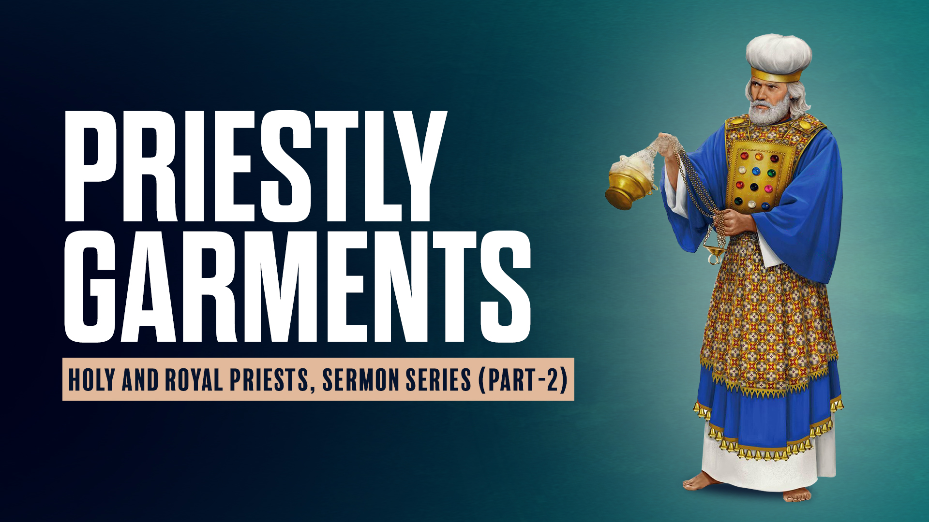

Slide 2

HOLY AND ROYAL PRIESTS

Slide 3
1 Peter 2:5,9
5 you also, as living stones, are being built up a spiritual house, a holy priesthood, to offer up spiritual sacrifices acceptable to God through Jesus Christ.
9 But you are a chosen generation, a royal priesthood, a holy nation, His own special people, that you may proclaim the praises of Him who called you out of darkness into His marvelous light;

Slide 4

Revelation 1:5,6
5 and from Jesus Christ, the faithful witness, the firstborn from the dead, and the ruler over the kings of the earth. To Him who loved us and washed us from our sins in His own blood,
6 and has made us kings and priests to His God and Father, to Him be glory and dominion forever and ever. Amen.

Slide 5
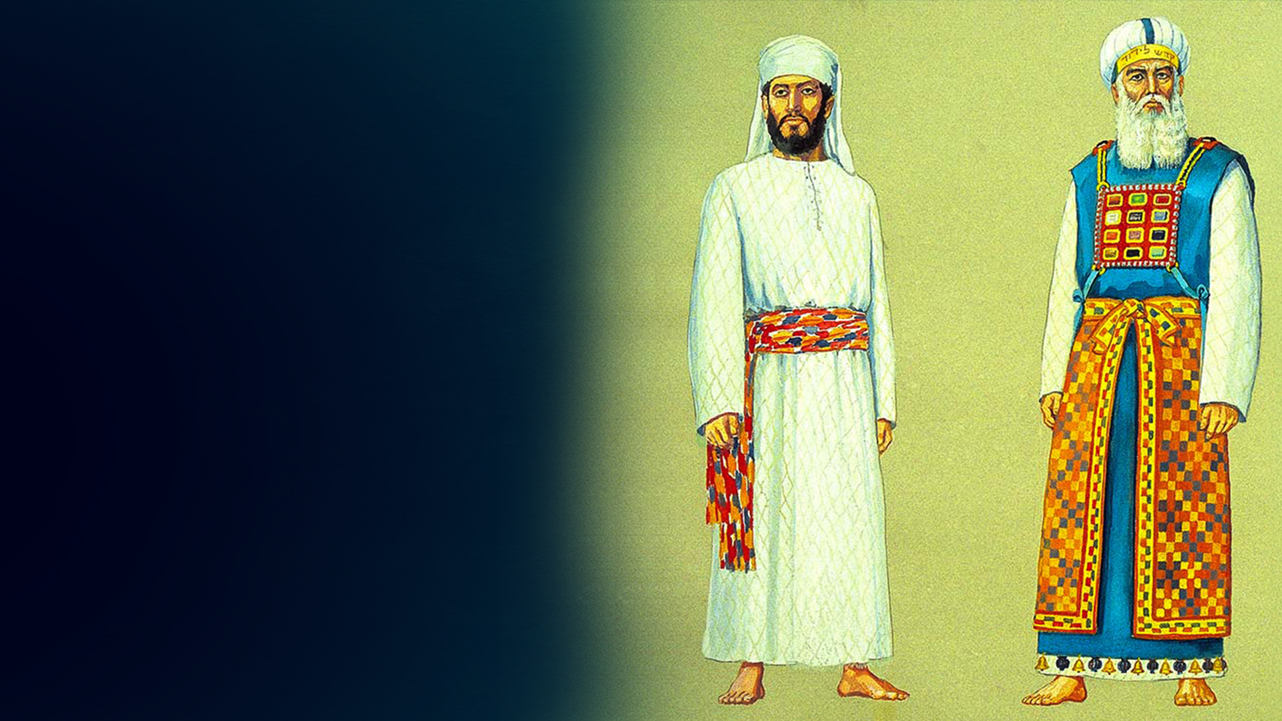
PRIESTLY GARMENTS - FOR GLORY AND FOR BEAUTY

Slide 6
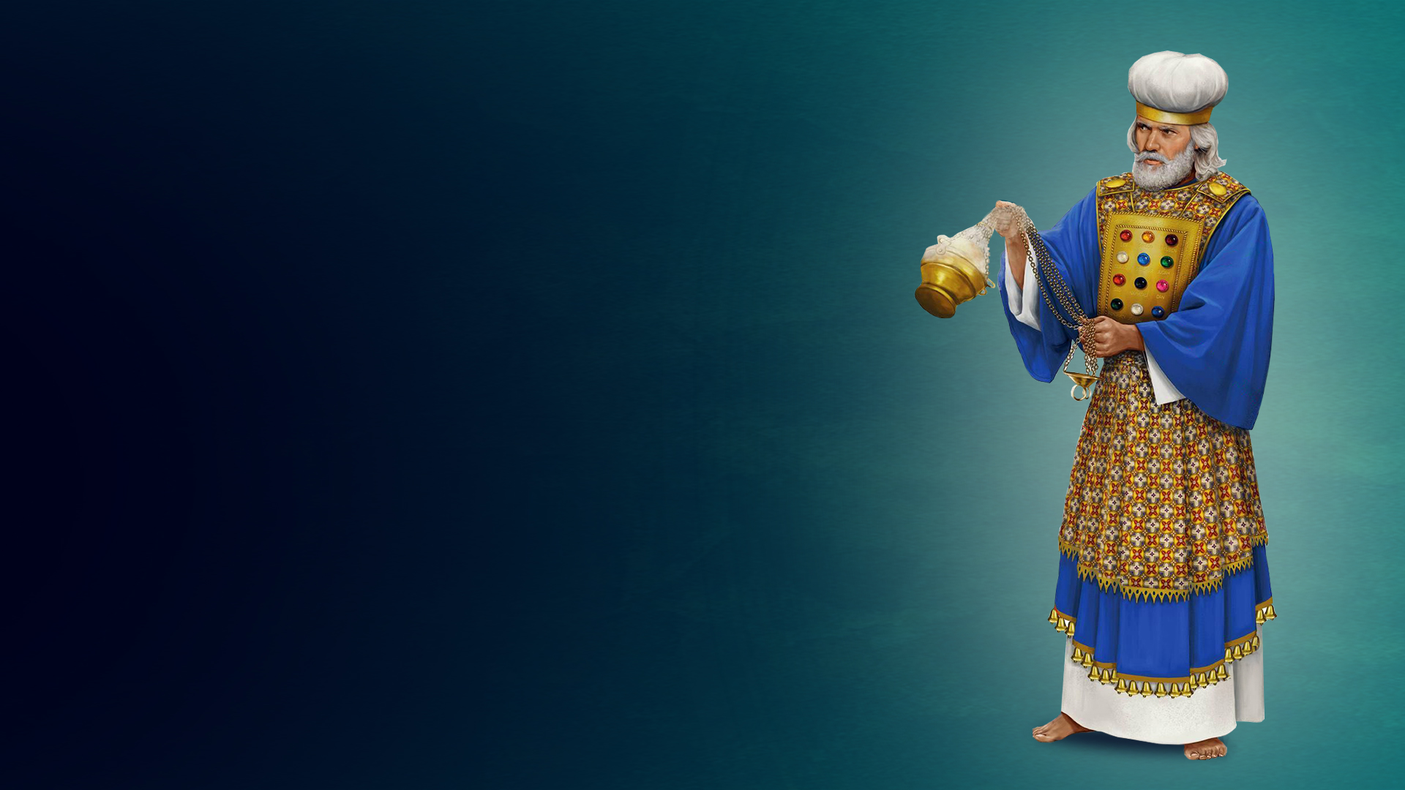
Exodus 28:2
And you shall make holy garments for Aaron your brother, for glory and for beauty.

Slide 7
OVERVIEW

Slide 8
Leviticus 8:7-9
7 And he put the tunic on him, girded him with the sash, clothed him with the robe, and put the ephod on him; and he girded him with the intricately woven band of the ephod, and with it tied the ephod on him.
8 Then he put the breastplate on him, and he put the Urim and the Thummim in the breastplate.
9 And he put the turban on his head. Also on the turban, on its front, he put the golden plate, the holy crown, as the LORD had commanded Moses.

Slide 9
1. Linen Inner Garments
2. The Linen Tunic
3. The Inner Sash / Girdle
4. The Blue Robe
5. The Ephod and its Girdles
6. The Breastplate
7. The Urim and the Thummim
8. The Turban
9. The Golden Plate – The Holy Crown

Slide 10
1. LINEN INNER GARMENTS (EXODUS 28:42)

Slide 11
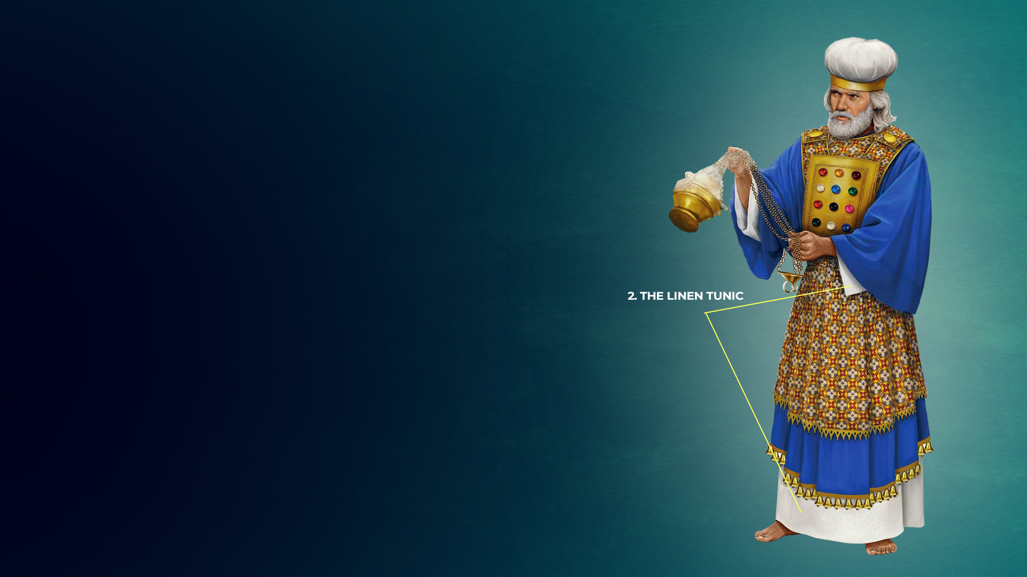
2. THE LINEN TUNIC
(EXODUS 28:39-42; LEVITICUS 8:7)

Slide 12
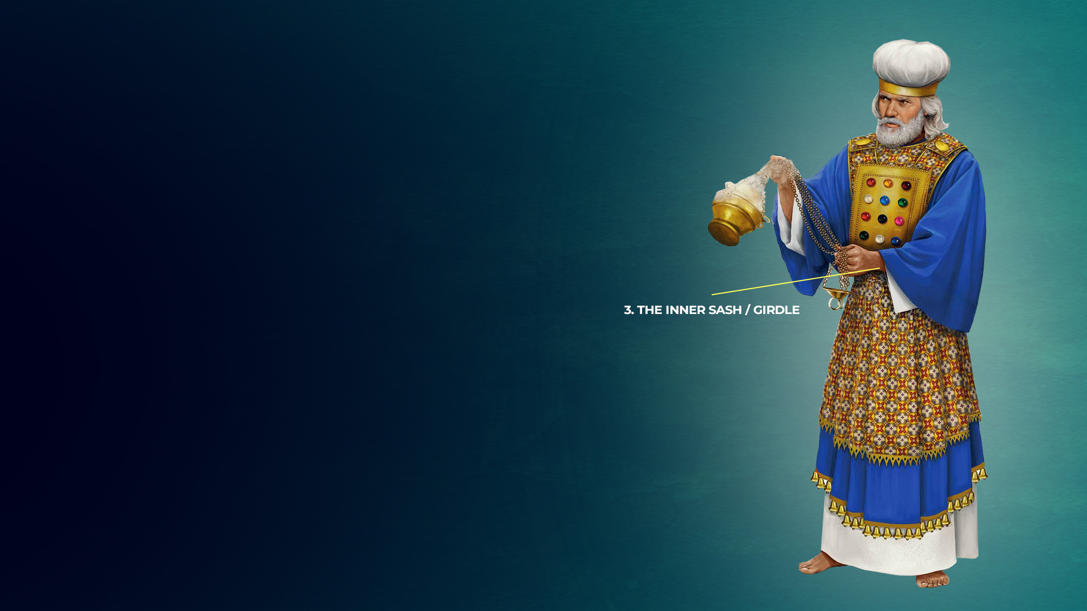
3. THE INNER SASH / GIRDLE (EXODUS 28:39-42;
LEVITICUS 8:7)

Slide 13
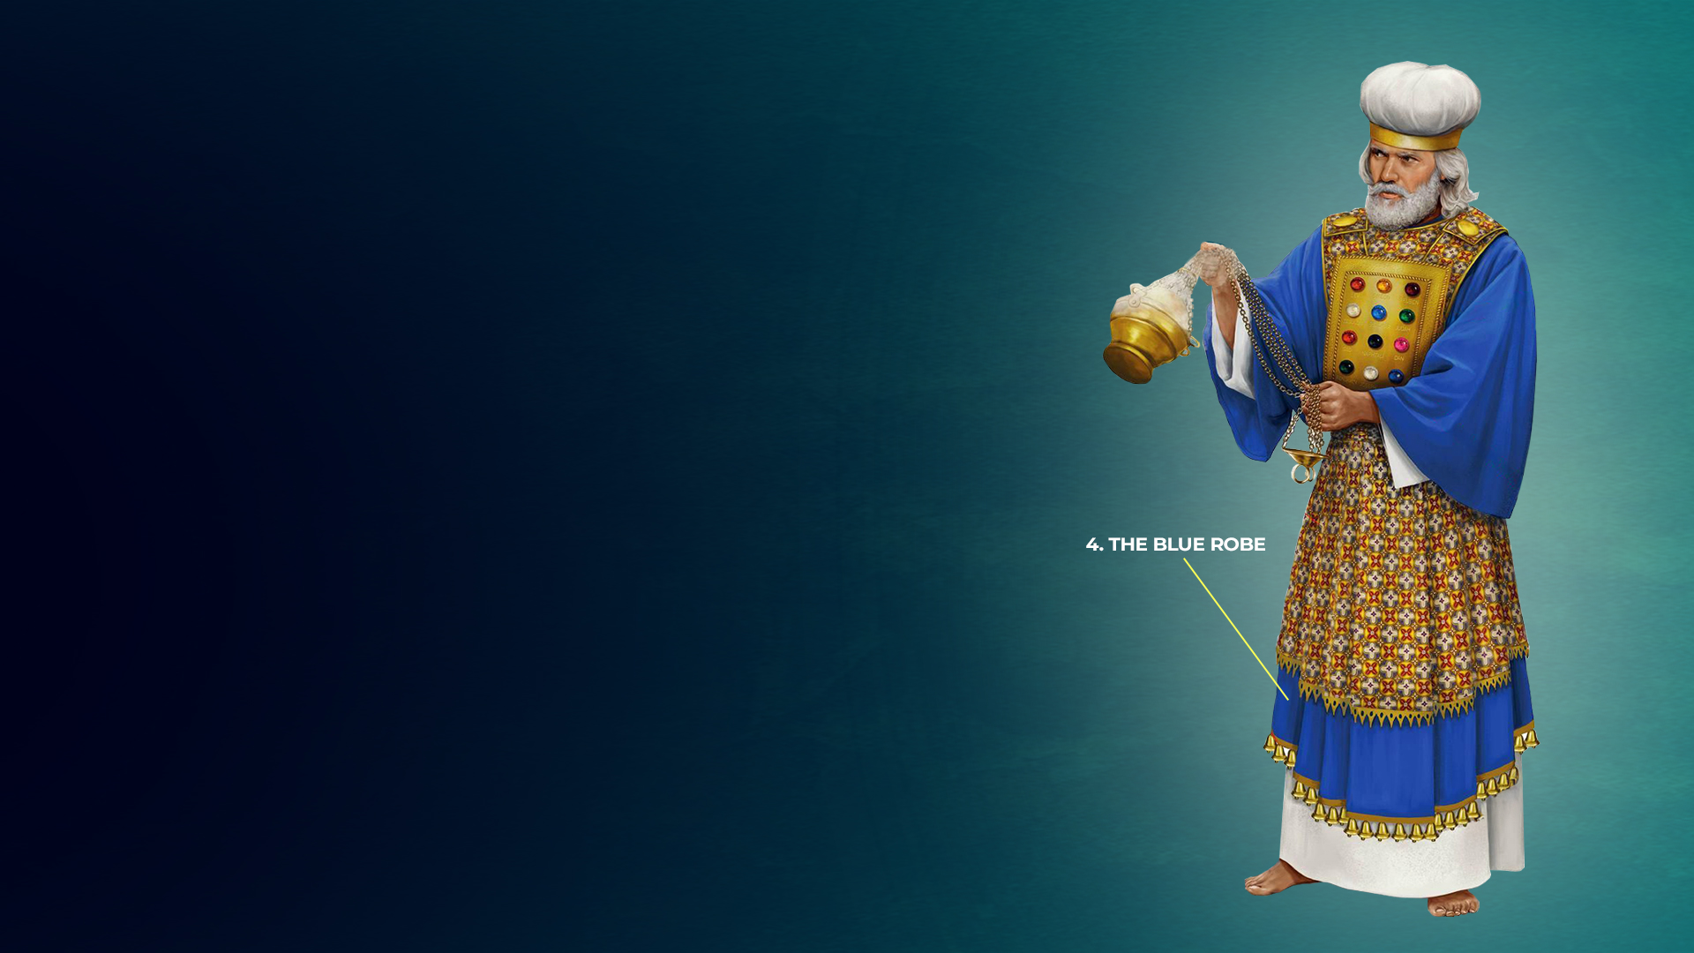
4. THE BLUE ROBE
(EXODUS 28:31–35; LEVITICUS 8:7)

Slide 14
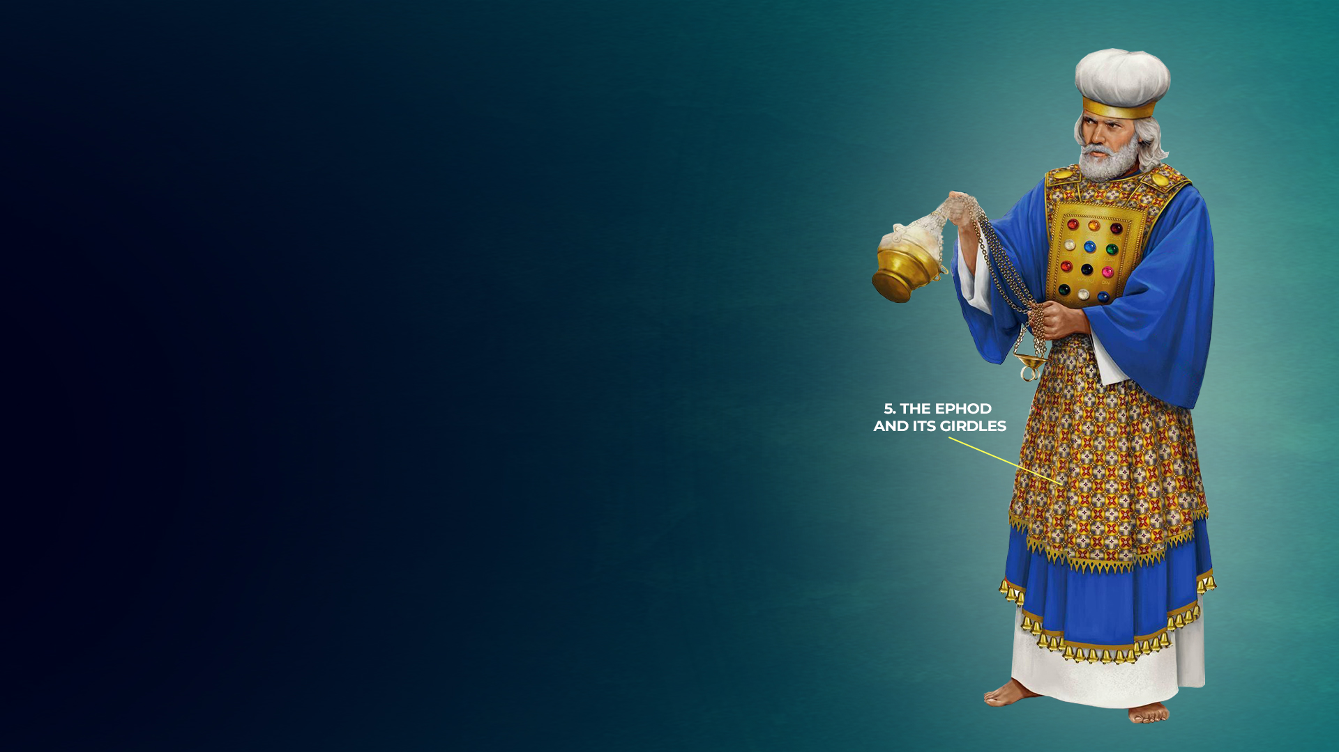
5. THE EPHOD AND ITS GIRDLES (EXODUS 28:6–14; LEVITICUS 8:7)

Slide 15
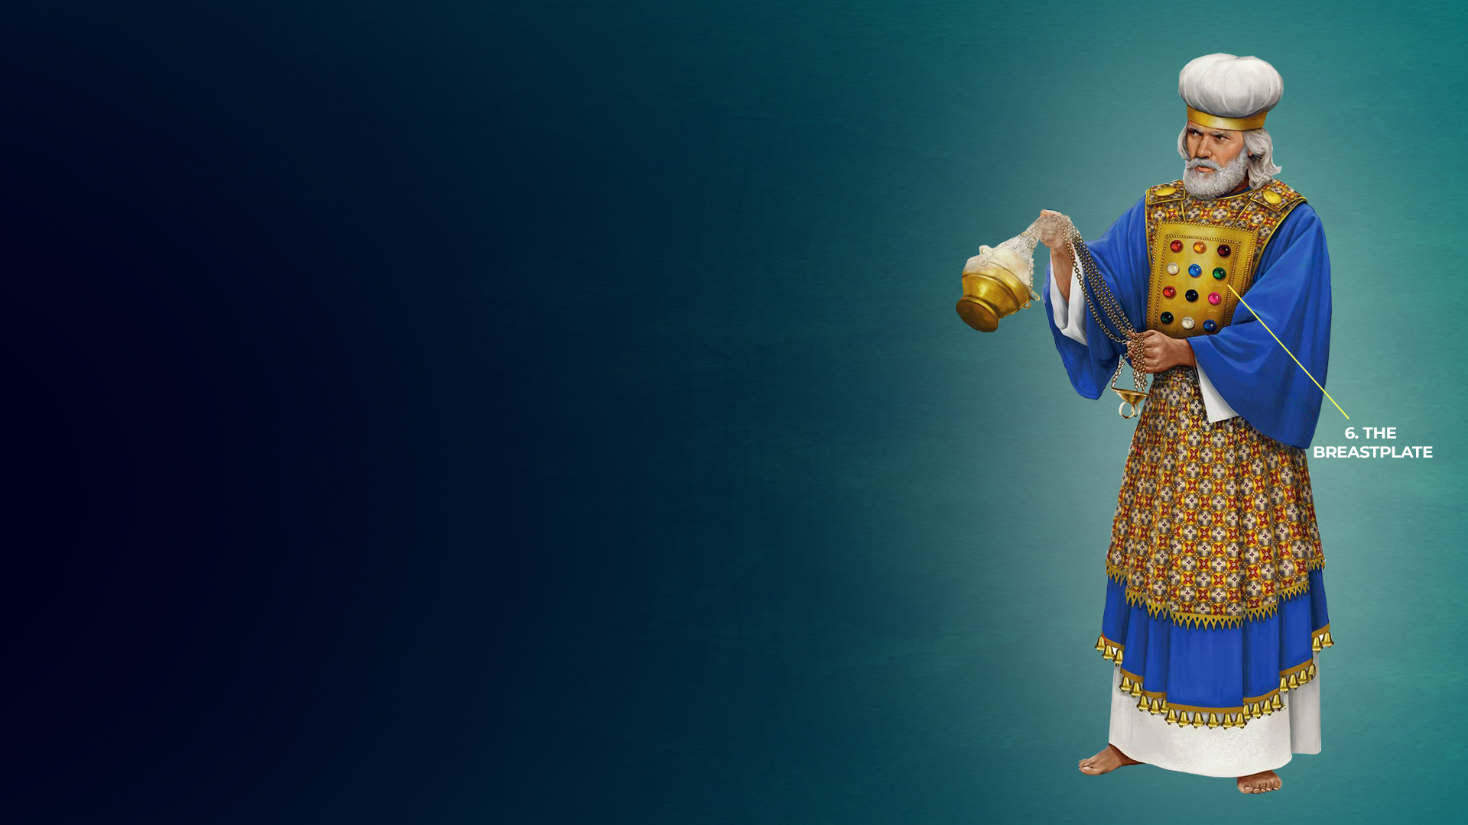
6. THE BREASTPLATE
(EXODUS 28:15–30; LEVITICUS 8:8)

Slide 16
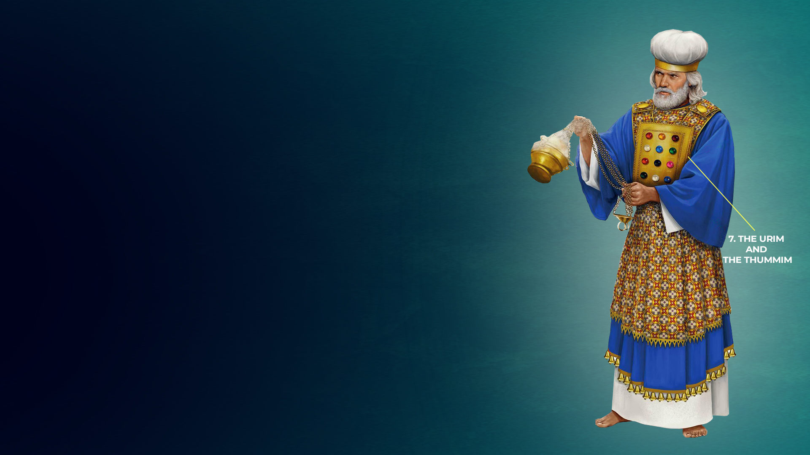
7. THE URIM AND THE THUMMIM (EXODUS 28:30)

Slide 17
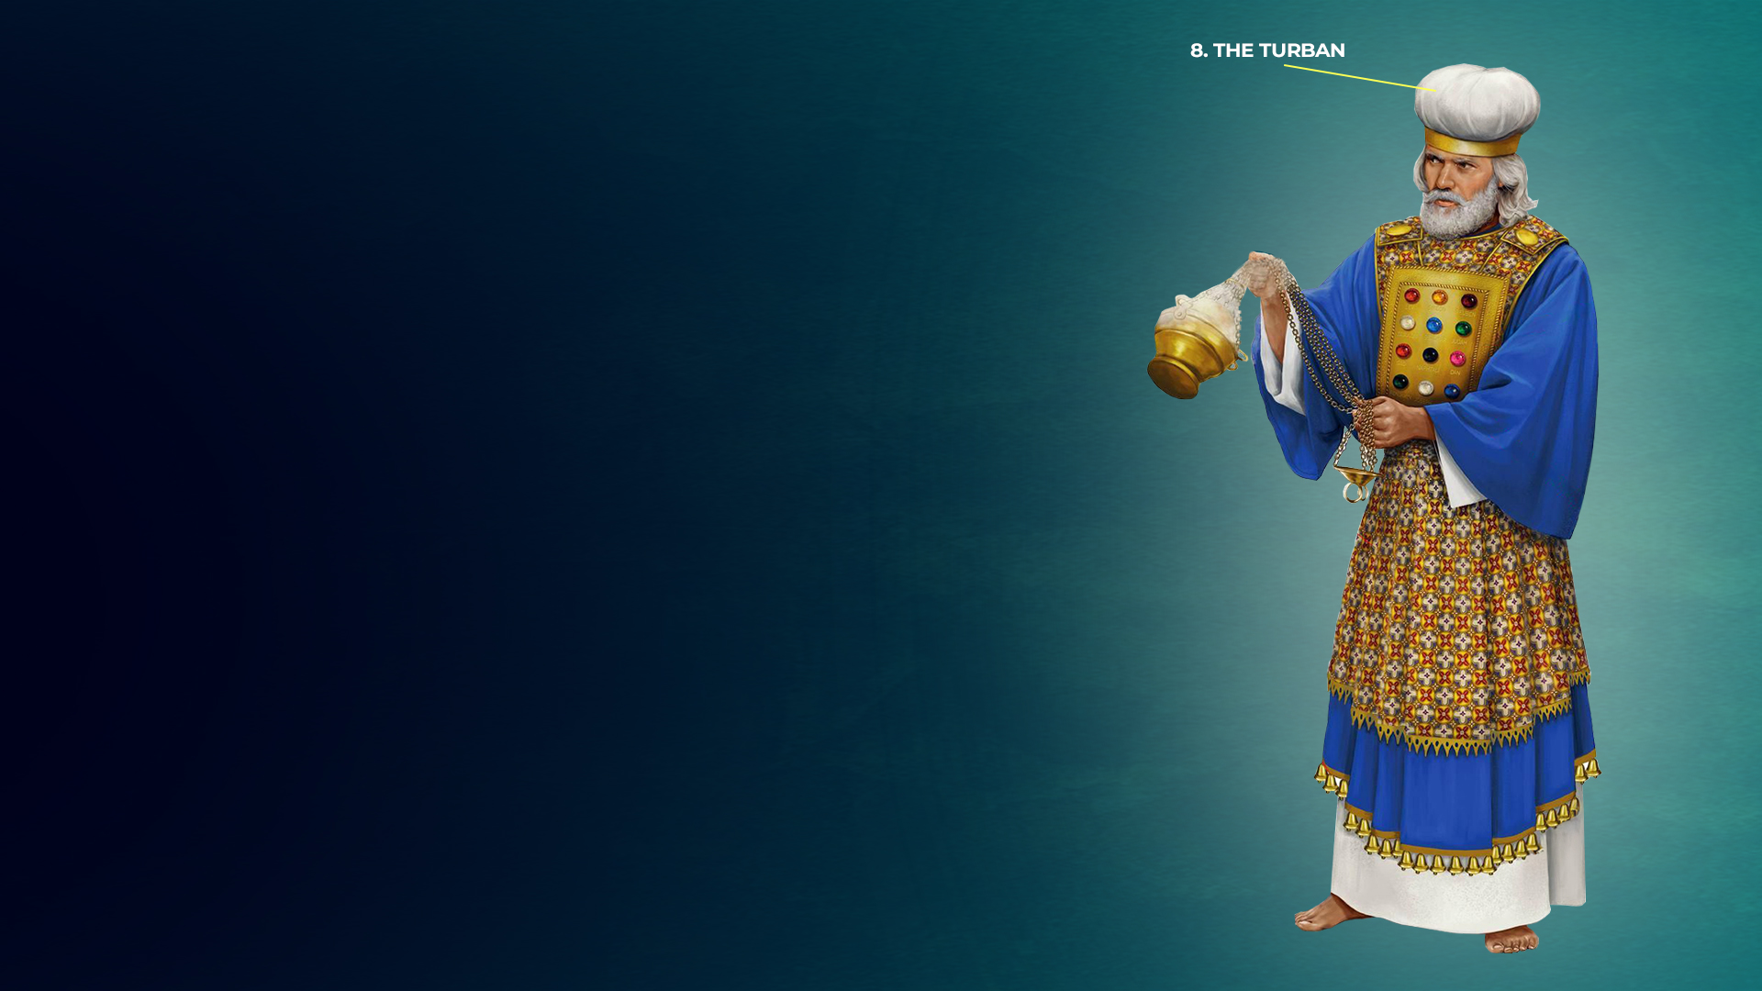
8. THE TURBAN
(EXODUS 28:36–39; LEVITICUS 8:9)

Slide 18
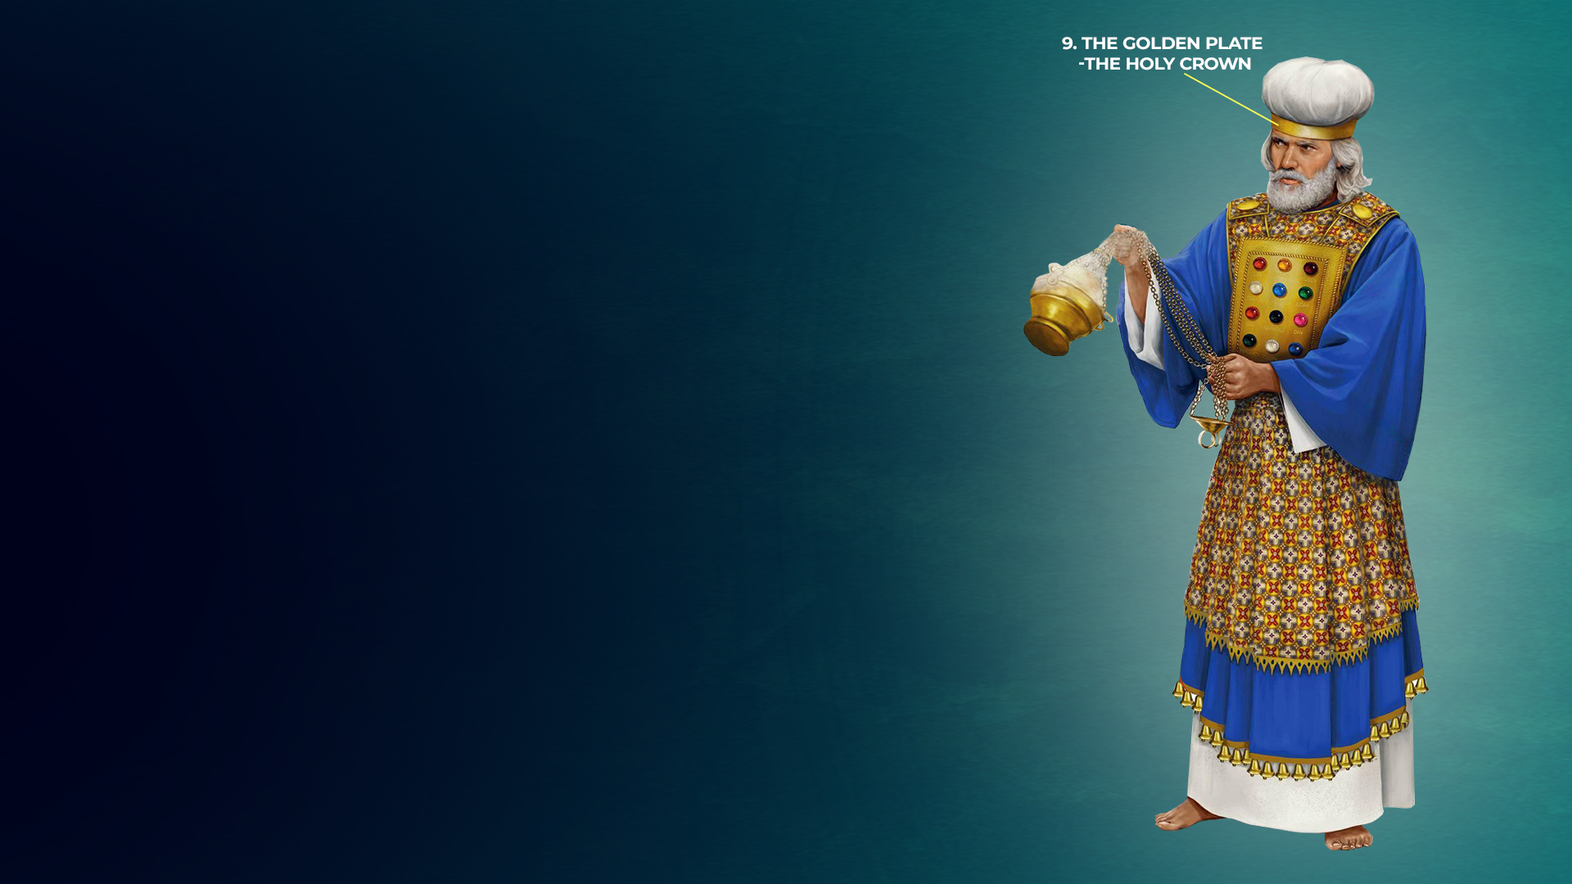
9. THE GOLDEN PLATE – THE HOLY CROWN (EXODUS 28:36–38; EXODUS 29:6; LEVITICUS 8:9)

Slide 19
AS NEW TESTAMENT PRIESTS – OUR PRIESTLY GARMENTS AND ROLE

