Slide 1
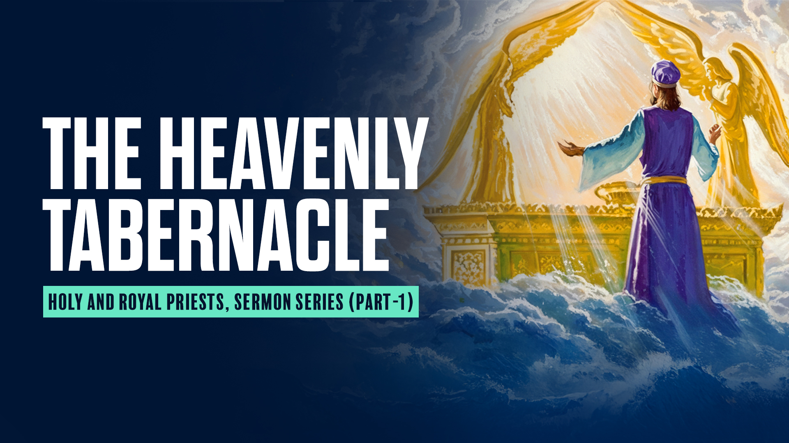

Slide 2
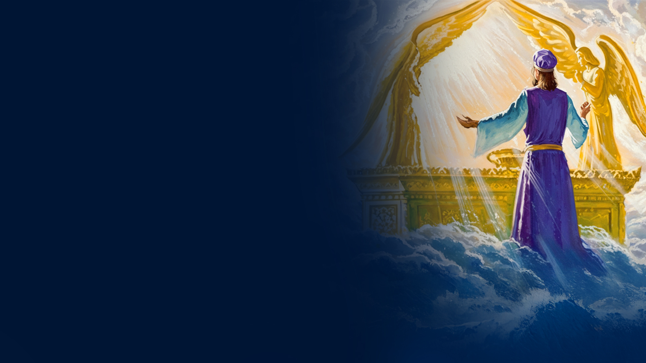
TRUE HEAVENLY TABERNACLE

Slide 3
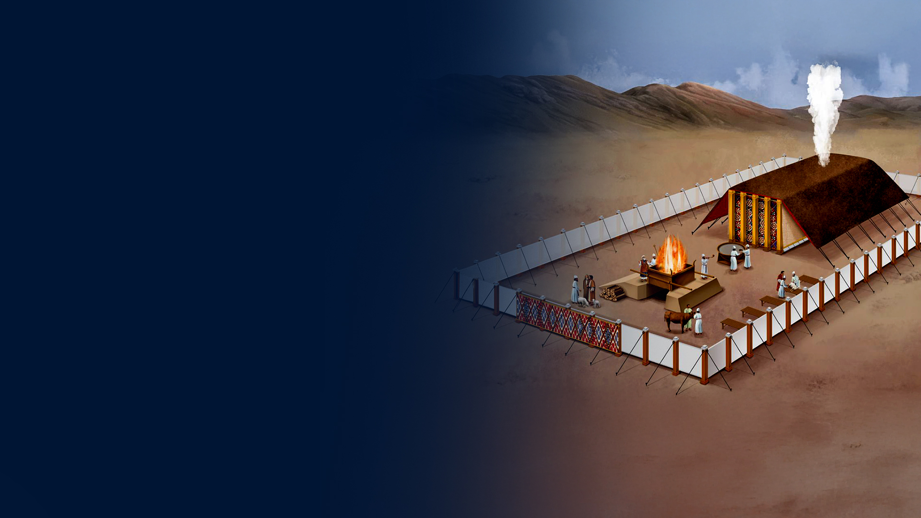
Exodus 25:9,40
9 According to all that I show you, that is, the pattern of the tabernacle and the pattern of all its furnishings, just so you shall make it.
40 And see to it that you make them according to the pattern which was shown you on the mountain.

Slide 4
Exodus 26:30
And you shall raise up the tabernacle according to its pattern which you were shown on the mountain.

Slide 5
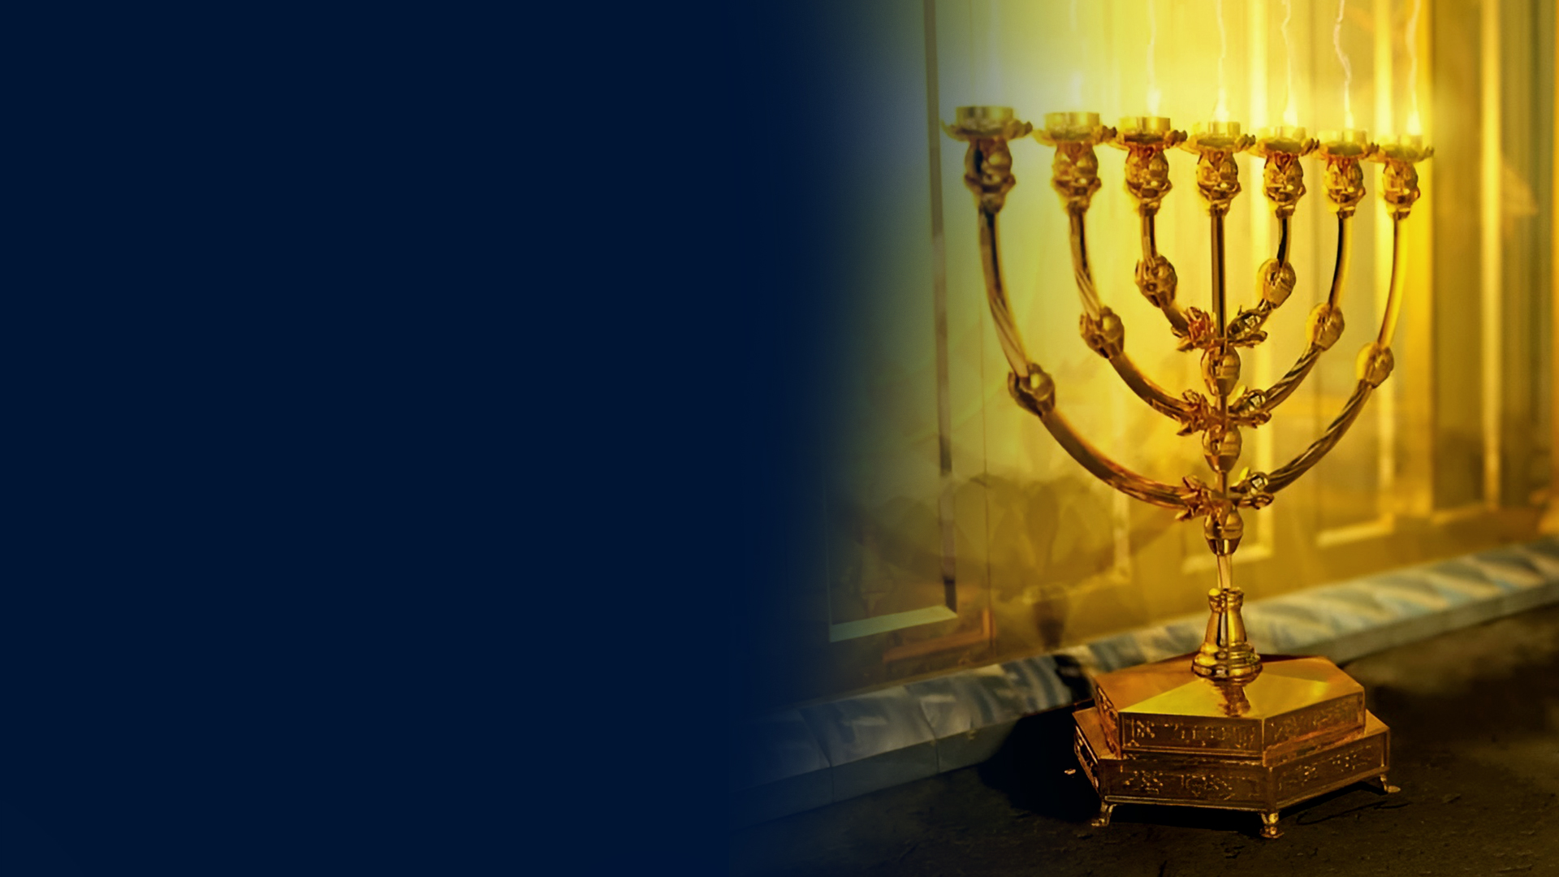
Numbers 8:4
Now this workmanship of the lampstand was hammered gold; from its shaft to its flowers it was hammered work. According to the pattern which the LORD had shown Moses, so he made the lampstand.

Slide 6
Hebrews 8:1-5
1 Now this is the main point of the things we are saying: We have such a High Priest, who is seated at the right hand of the throne of the Majesty in the heavens,
2 a Minister of the sanctuary and of the true tabernacle which the Lord erected, and not man.
3 For every high priest is appointed to offer both gifts and sacrifices. Therefore it is necessary that this One also have something to offer.

Slide 7
Hebrews 8:1-5
4 For if He were on earth, He would not be a priest, since there are priests who offer the gifts according to the law;
5 who serve the copy and shadow of the heavenly things, as Moses was divinely instructed when he was about to make the tabernacle. For He said, "SEE THAT YOU MAKE ALL THINGS ACCORDING TO THE PATTERN SHOWN YOU ON THE MOUNTAIN."

Slide 8
Hebrews 10:19-22
19 Therefore, brethren, having boldness to enter the Holiest by the blood of Jesus,
20 by a new and living way which He consecrated for us, through the veil, that is, His flesh,

Slide 9
Hebrews 10:19-22
21 and having a High Priest over the house of God,
22 let us draw near with a true heart in full assurance of faith, having our hearts sprinkled from an evil conscience and our bodies washed with pure water.

Slide 10
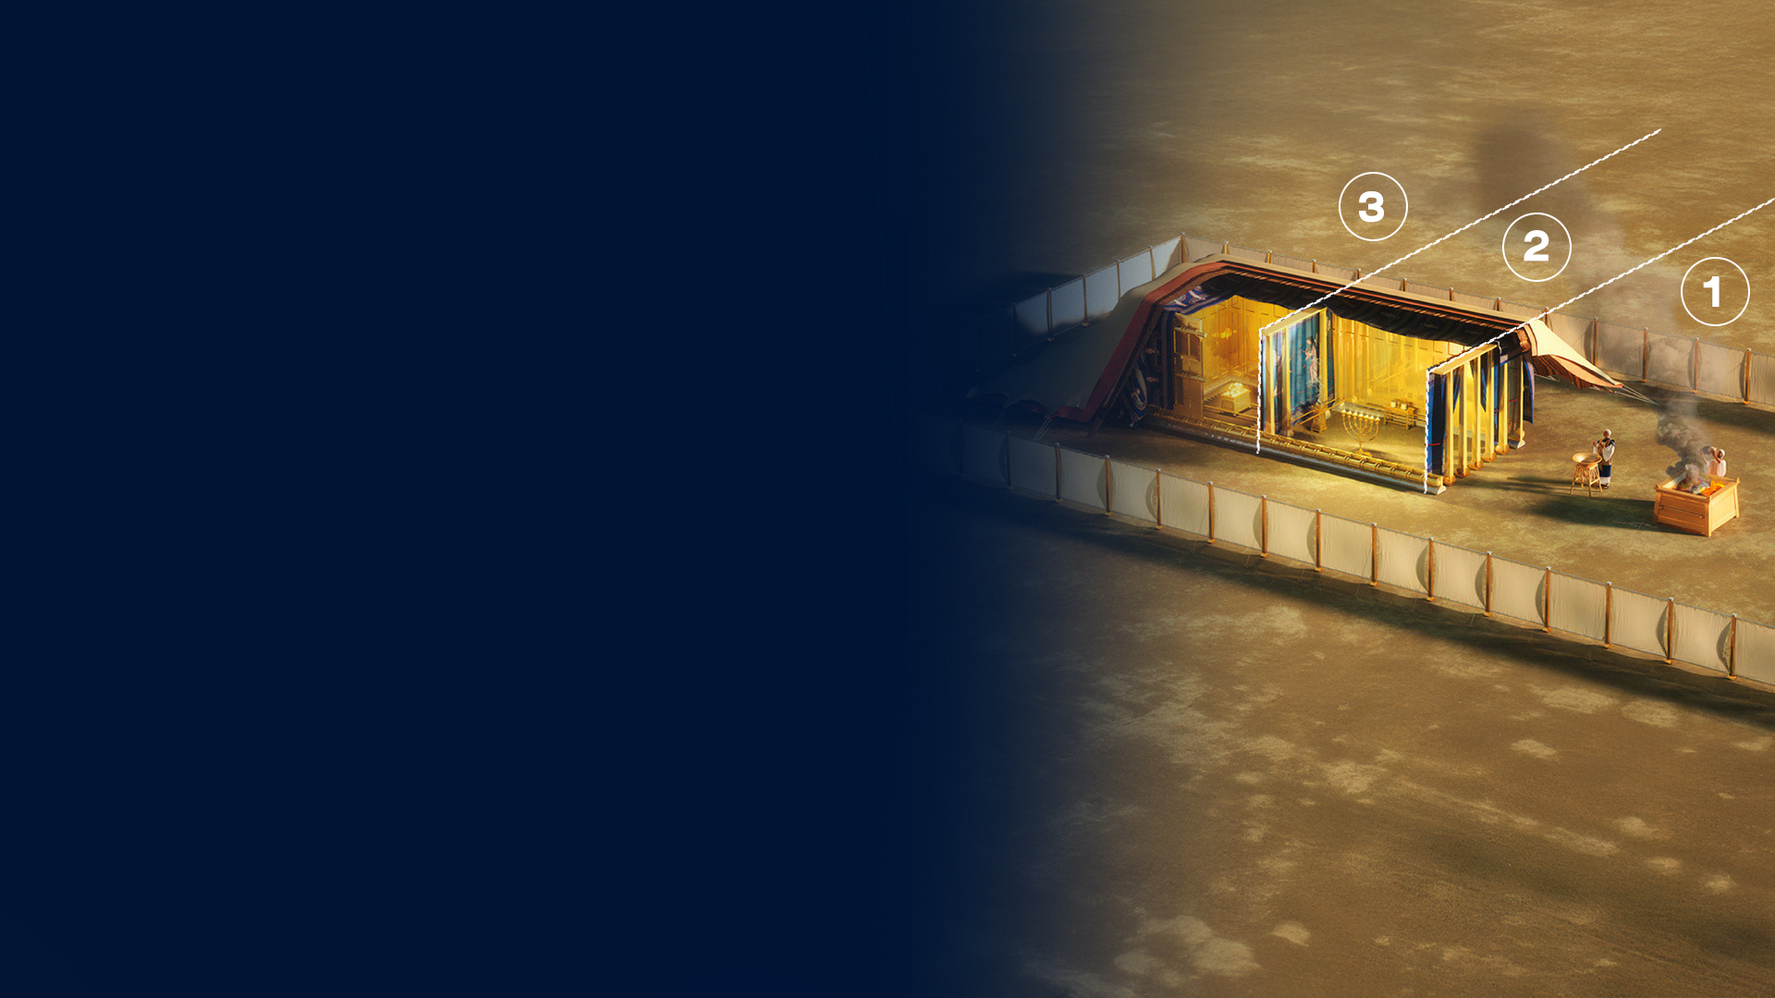
OVERVIEW OF THE TABERNACLE STRUCTURE
1. Outer Court
2. Holy Place
3. Most Holy Place
(Holy of Holies)

Slide 11
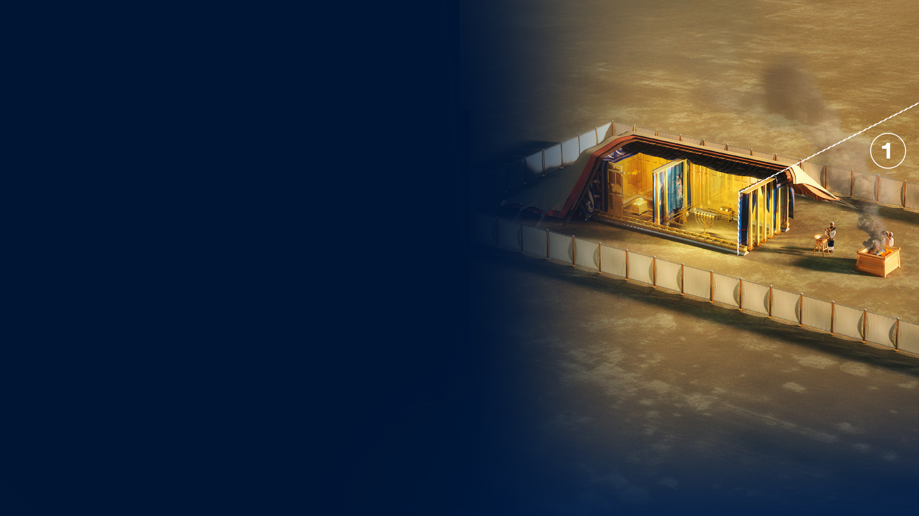
1. OUTER COURT

Slide 12
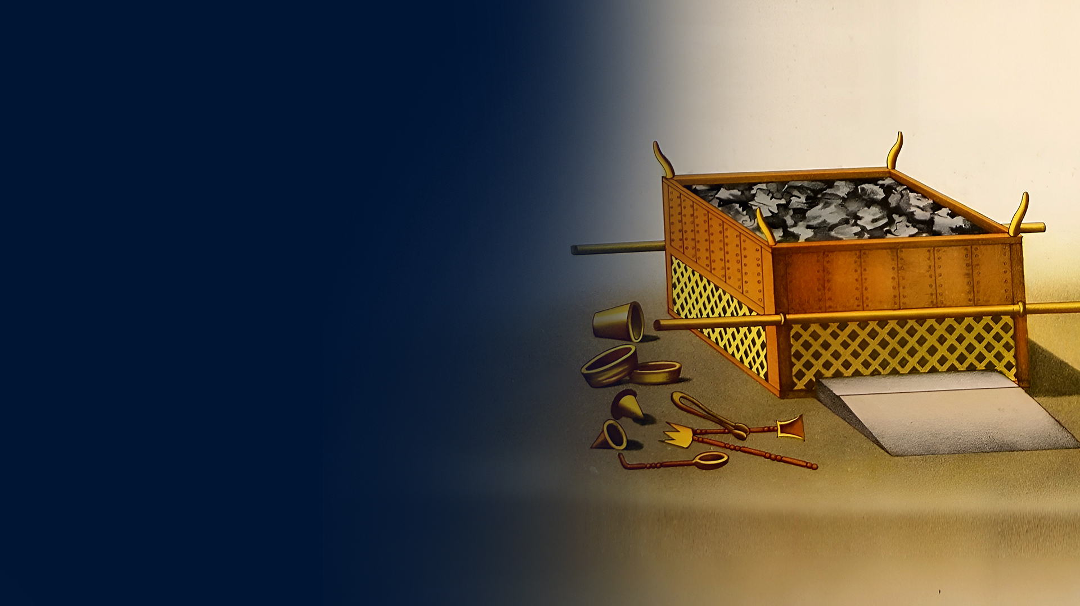
BRONZE ALTAR OF SACRIFICE (EXODUS 27:1–8)

Slide 13
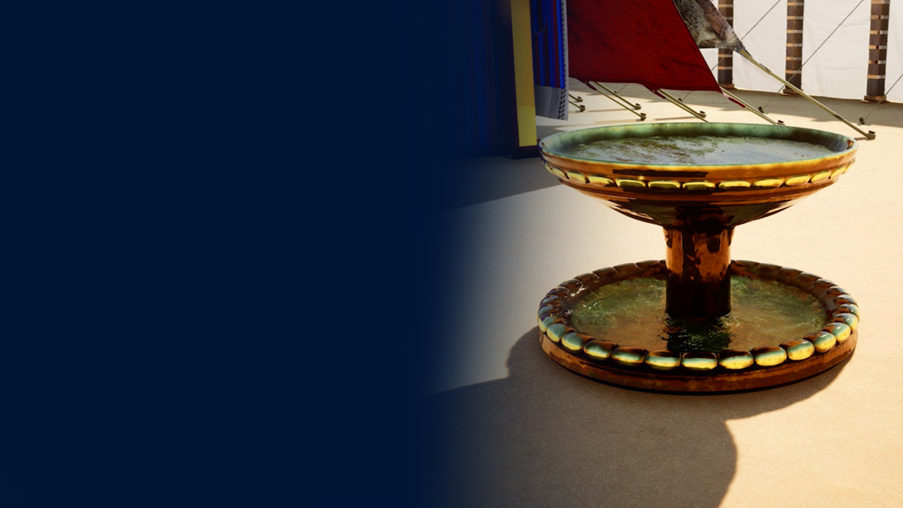
BRONZE LAVER – BASIN FOR WASHING (EXODUS 30:17–21)

Slide 14
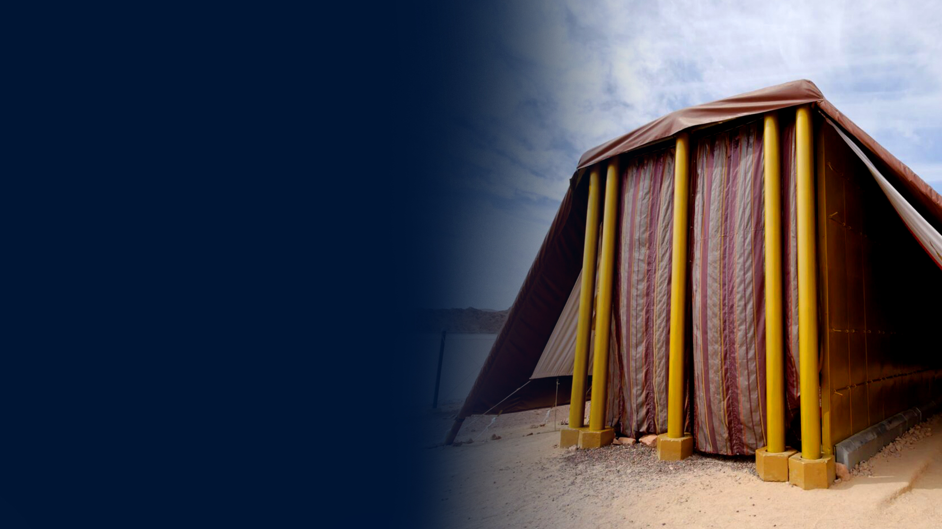
THE ENTRANCE CURTAIN

Slide 15
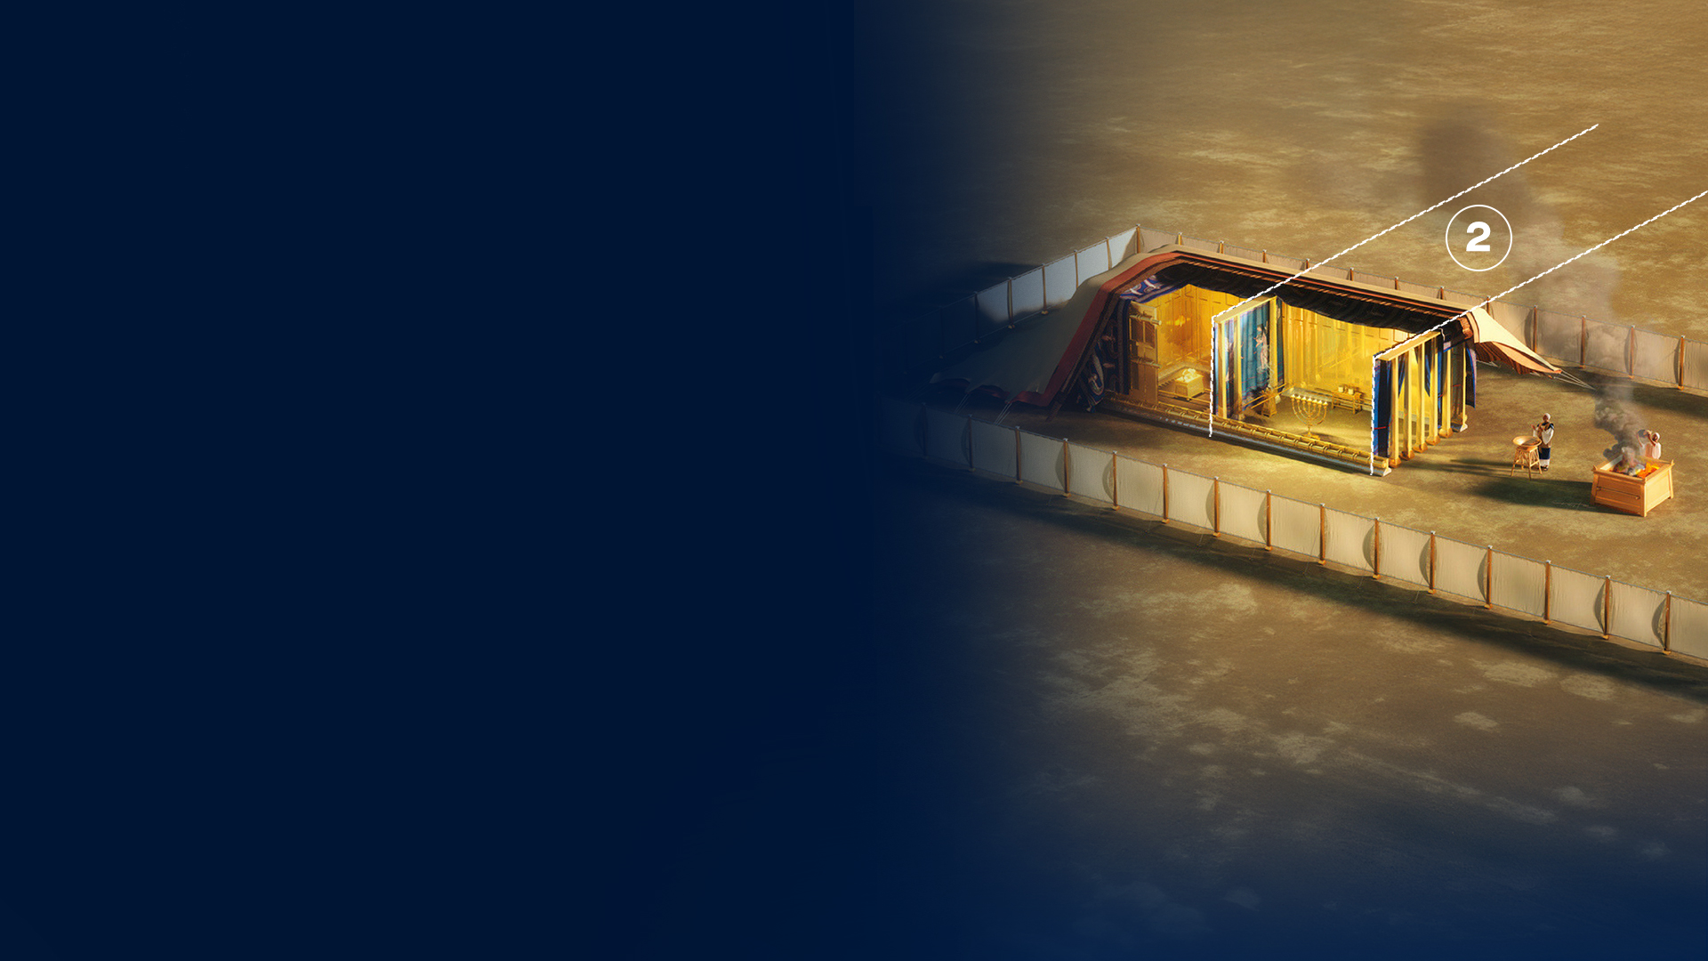
2. HOLY PLACE

Slide 16
GOLDEN LAMPSTAND (MENORAH) (EXODUS 25:31–40)

Slide 17
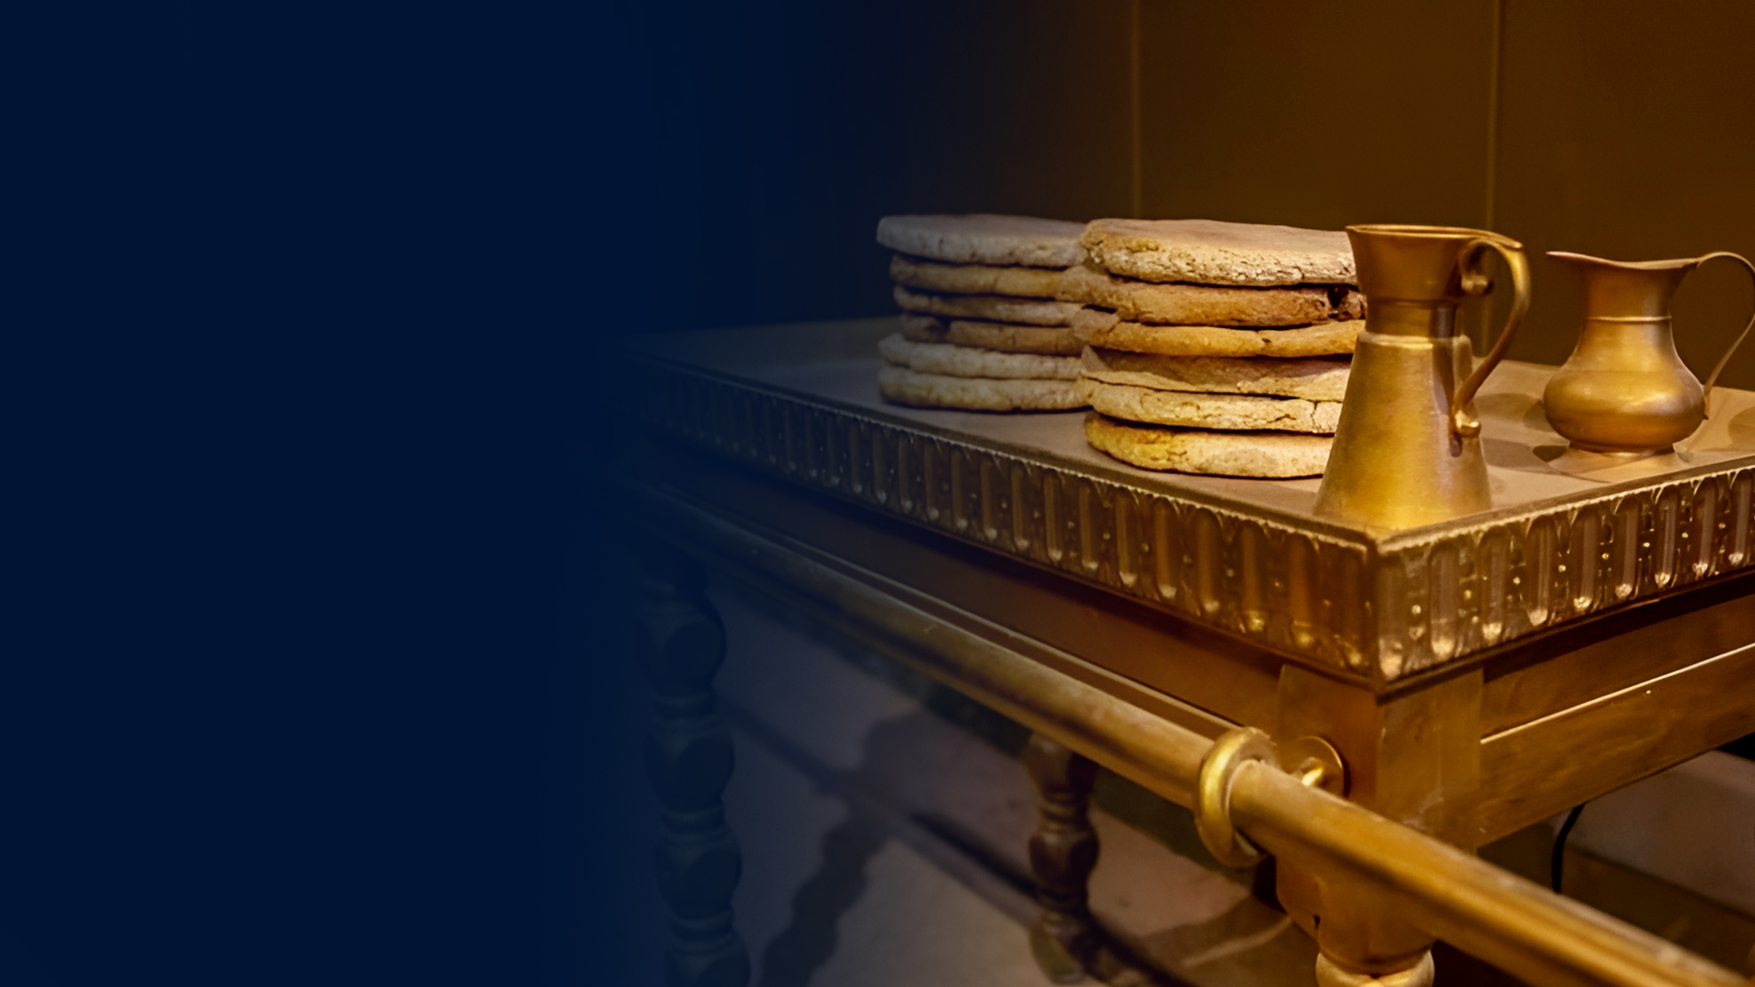
TABLE OF SHOWBREAD
(EXODUS 25:23–30)

Slide 18
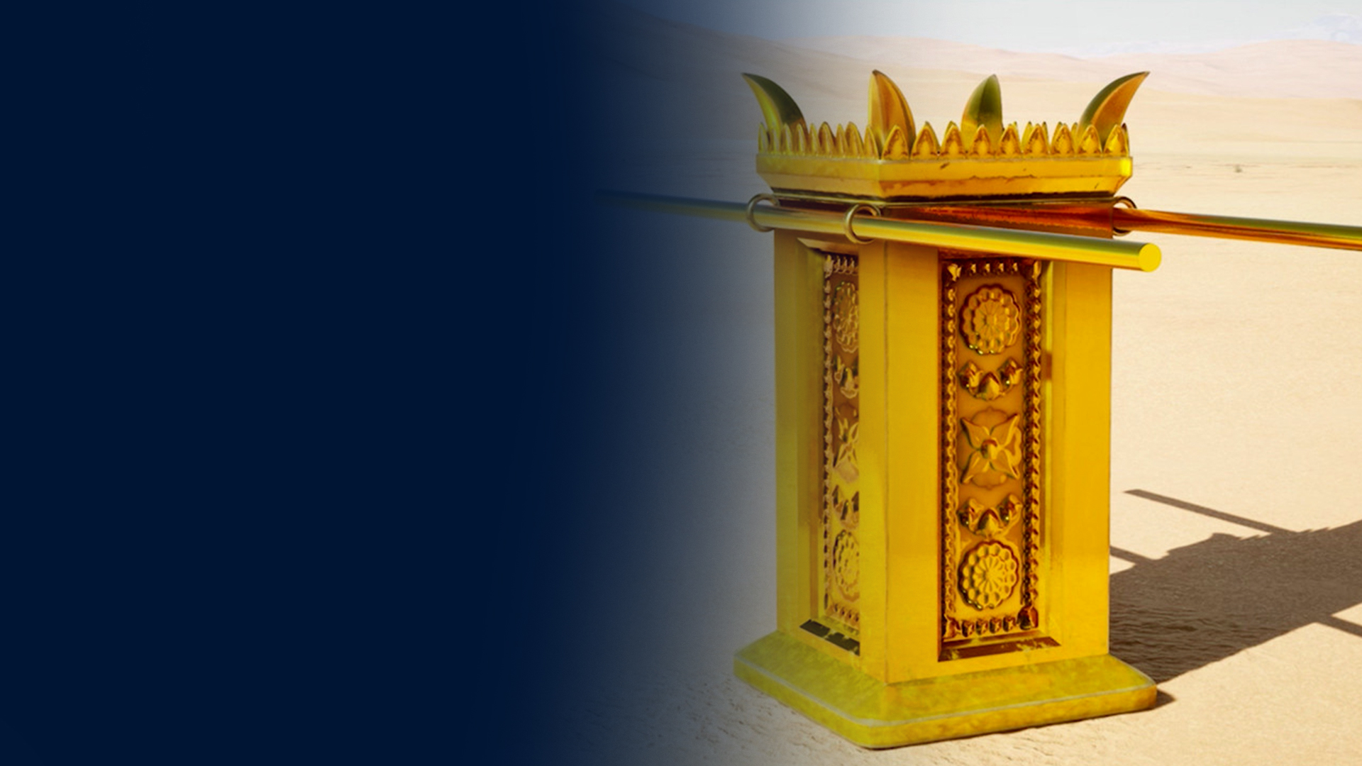
GOLDEN ALTAR OF INCENSE (EXODUS 30:1–10)

Slide 19
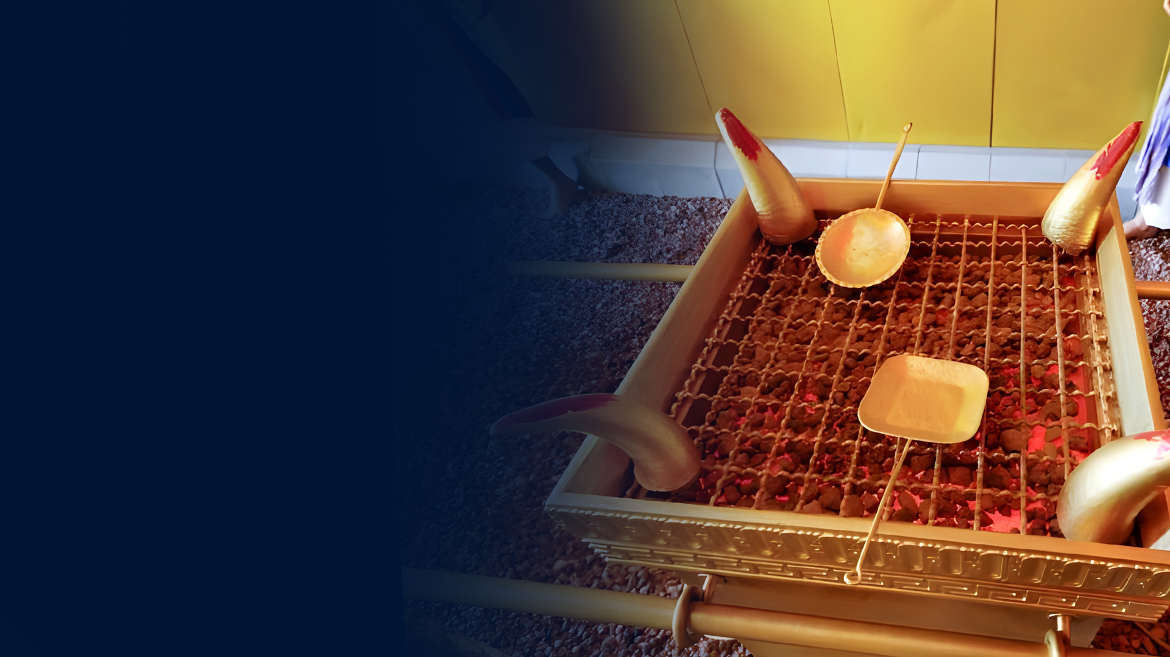
HORNS OF THE ALTAR

Slide 20
What did the horns symbolize?
1. Atonement and Substitution
2. Power, Strength, and Salvation
3. Refuge and Mercy
4. Atonement and Intercession

Slide 21
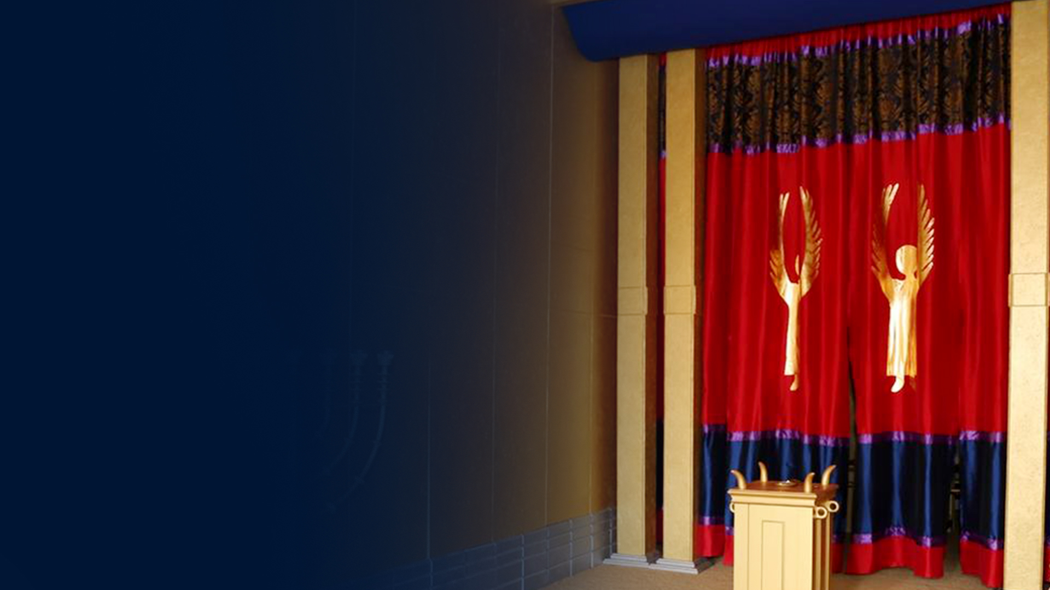
THE VEIL

Slide 22

3. MOST HOLY PLACE
(HOLY OF HOLIES)

Slide 23
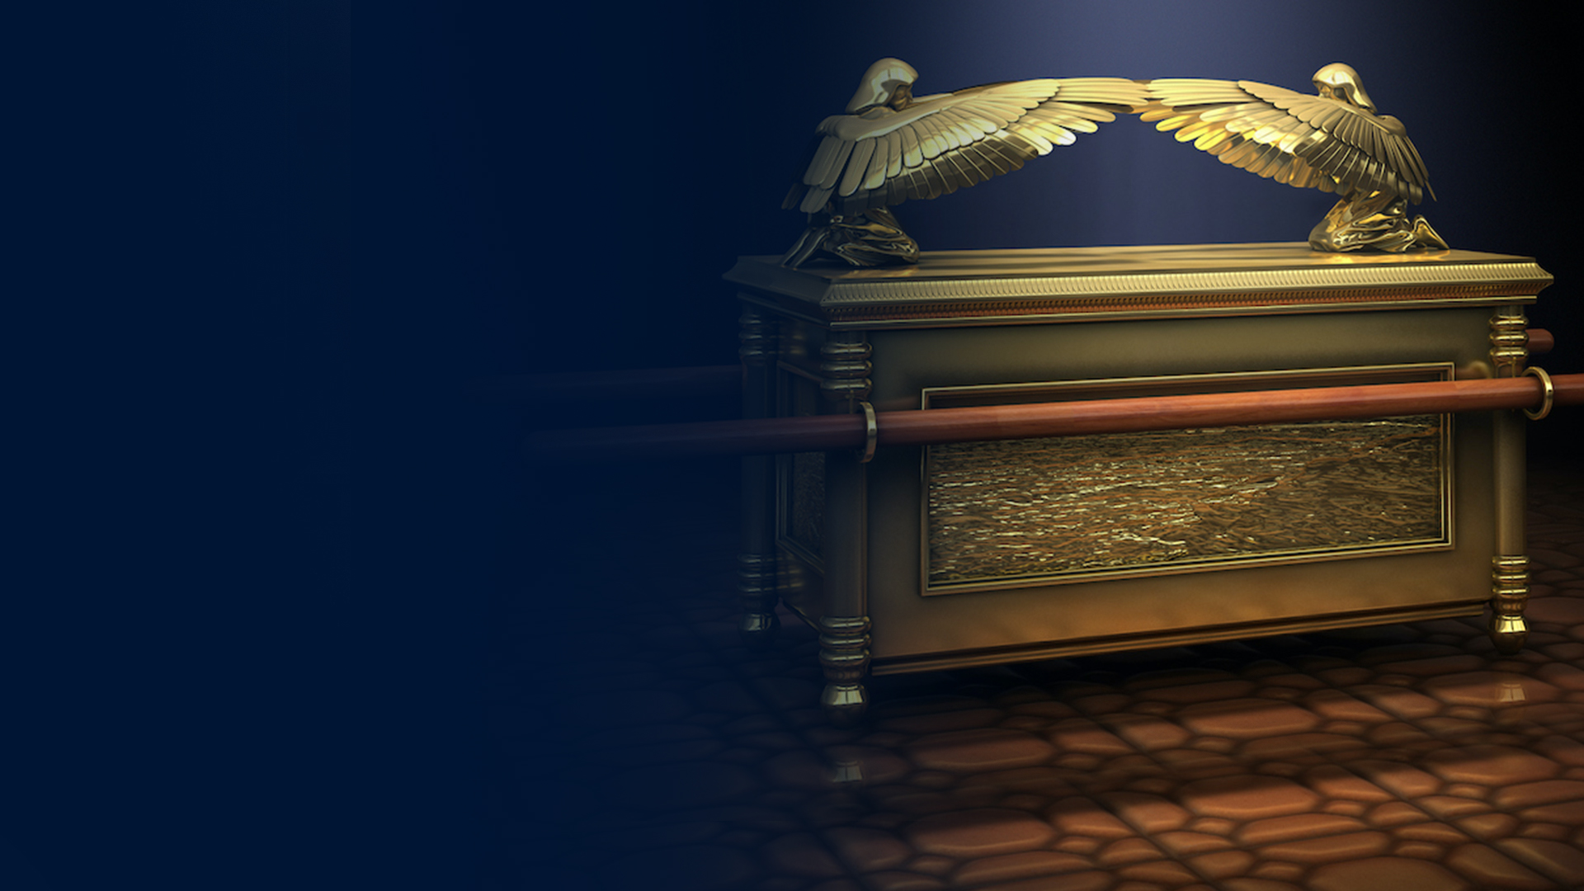
ARK OF THE COVENANT (EXODUS 25:10–22)

Slide 24
MERCY SEAT (ON THE ARK) (EXODUS 25:17–22)

Slide 25
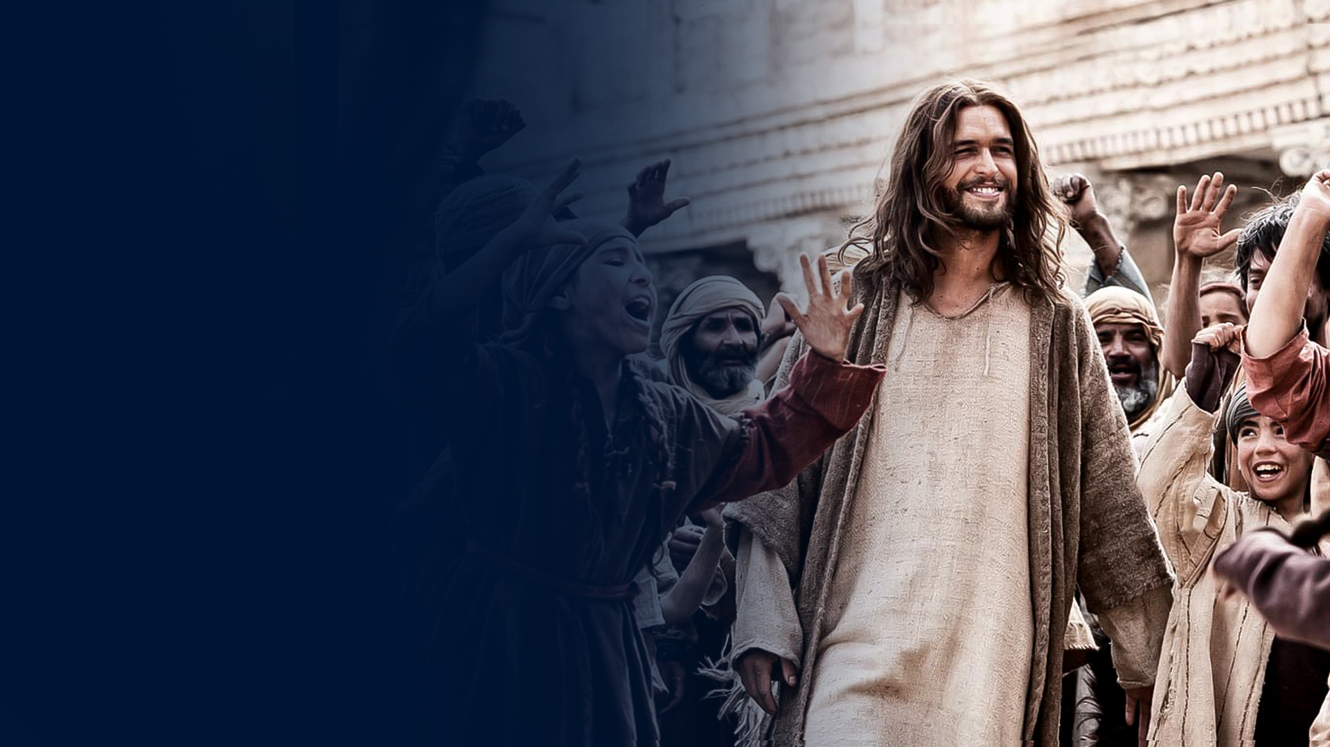
JESUS: THE TRUE TABERNACLE OF GOD AMONG MEN

Slide 26
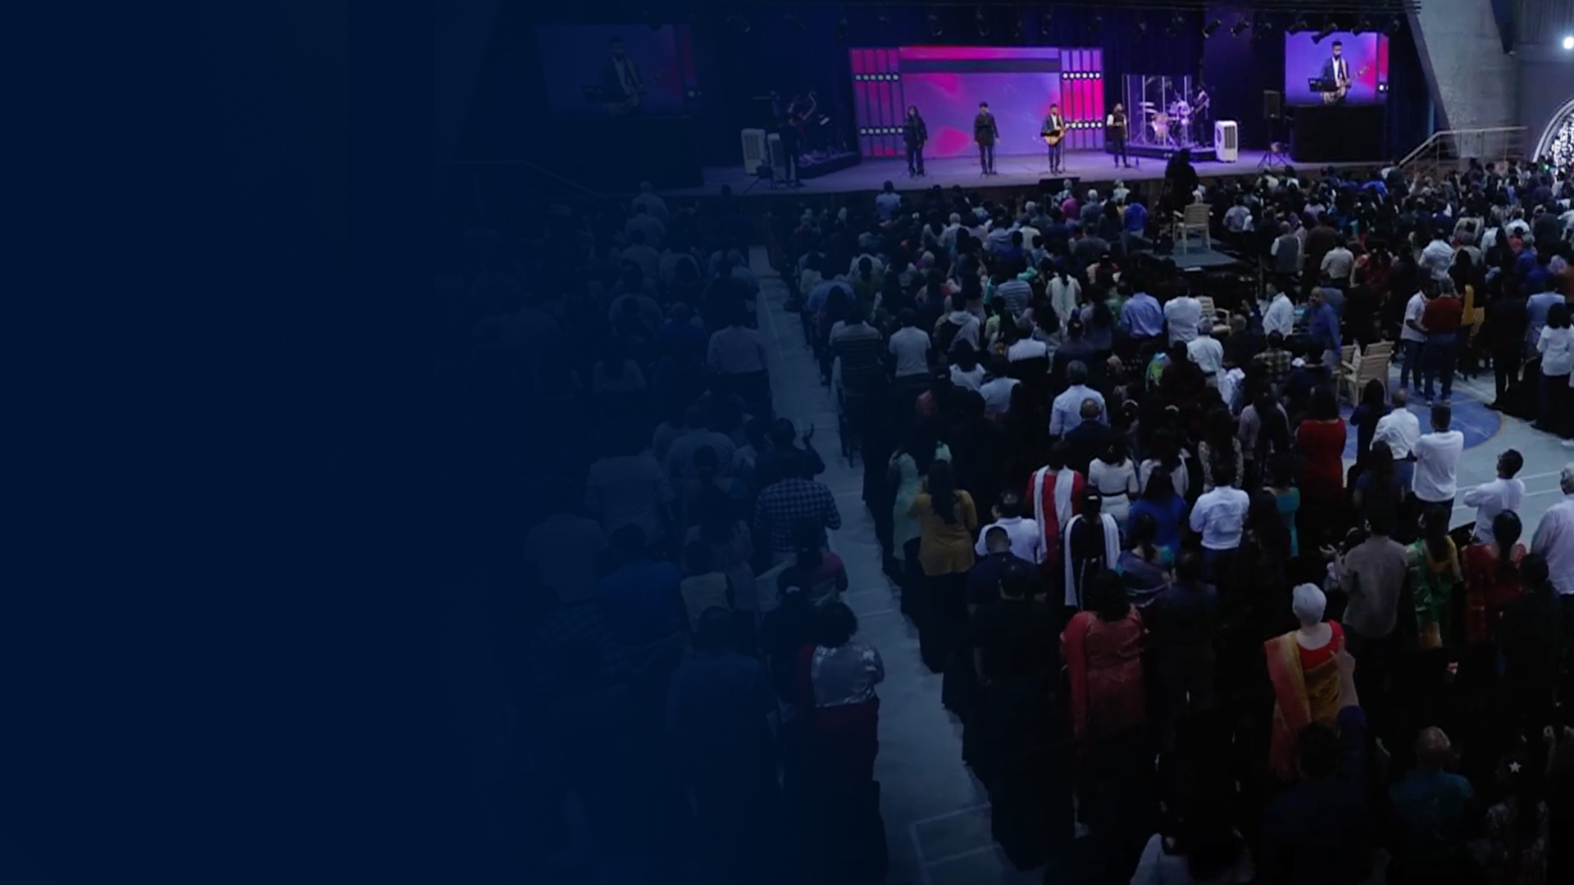
THE CHURCH:
THE LIVING TEMPLE

Slide 27
HOW TO APPLY THIS AS A NEW COVENANT HOLY AND ROYAL PRIEST

