Slide 1


Slide 2
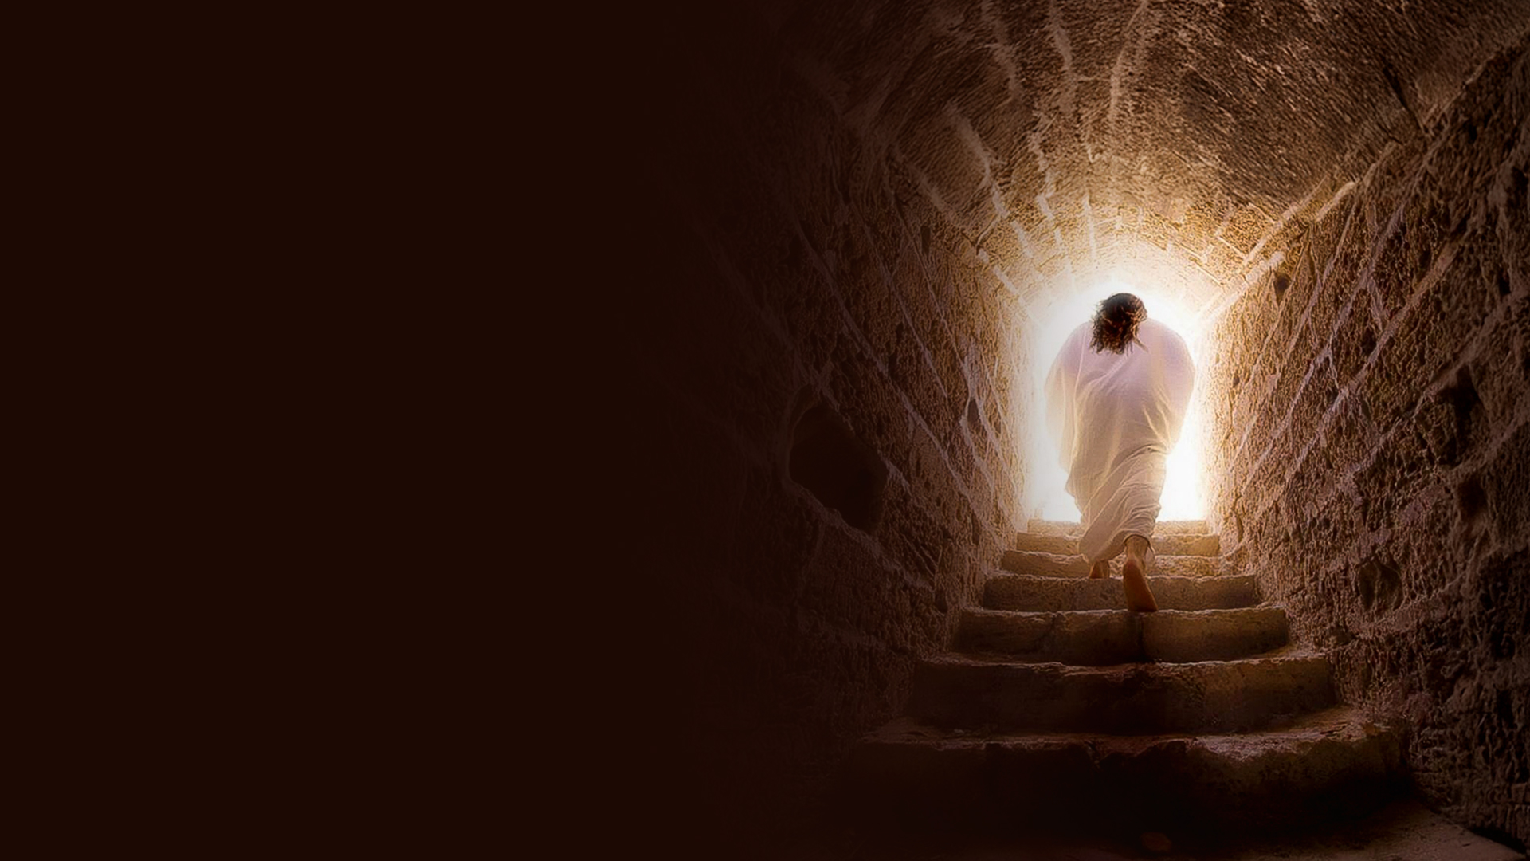
CHAPTER TWENTY:
THE RESURRECTED SAVIOR

Slide 3
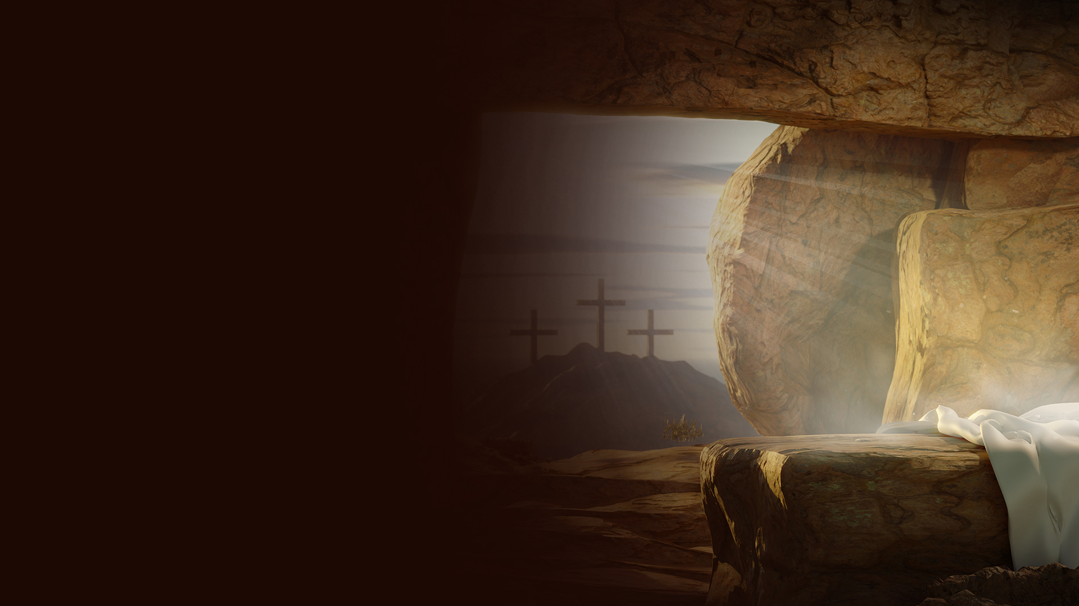
THE TOMB, THE LINEN CLOTHS, THE HANDKERCHIEF (JOHN 20:1-10)

Slide 4
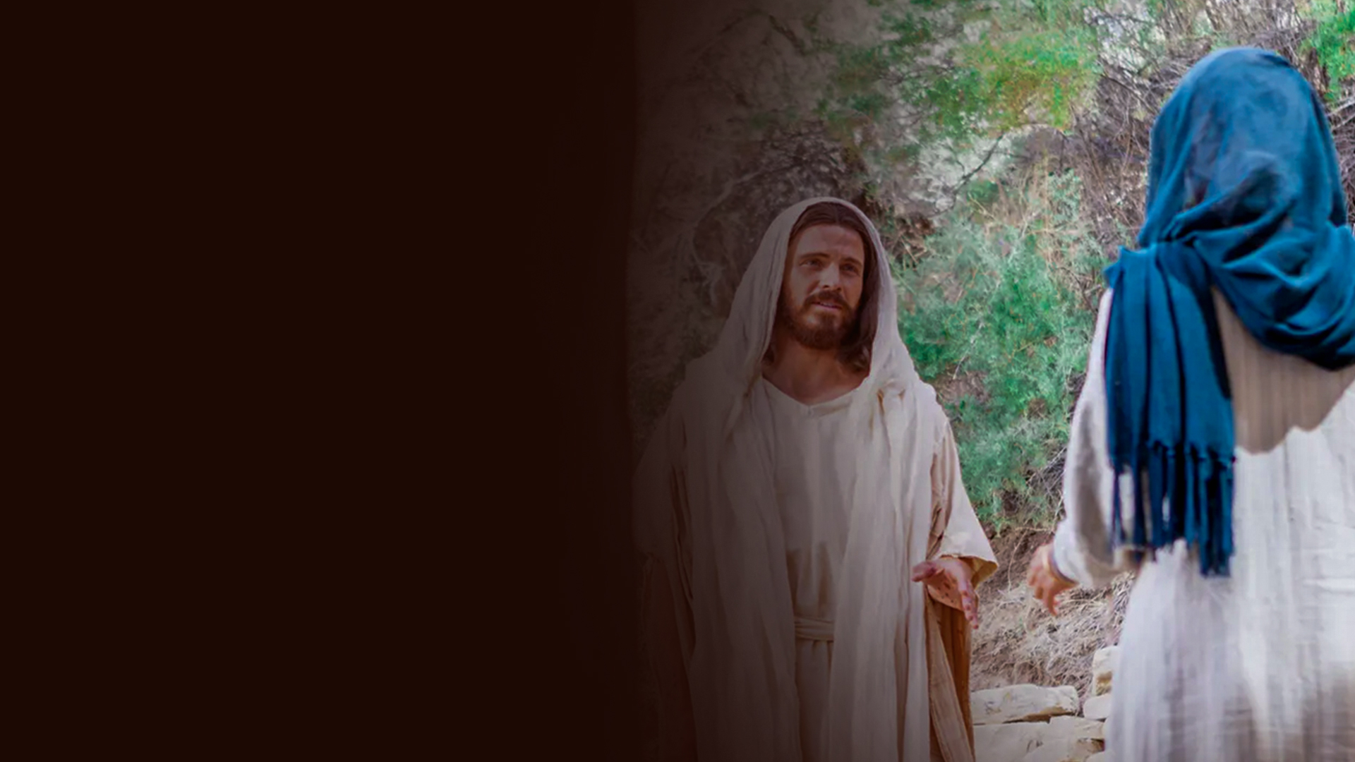
I SAW HIM! HE SPOKE TO ME! (JOHN 20:11-18)

Slide 5
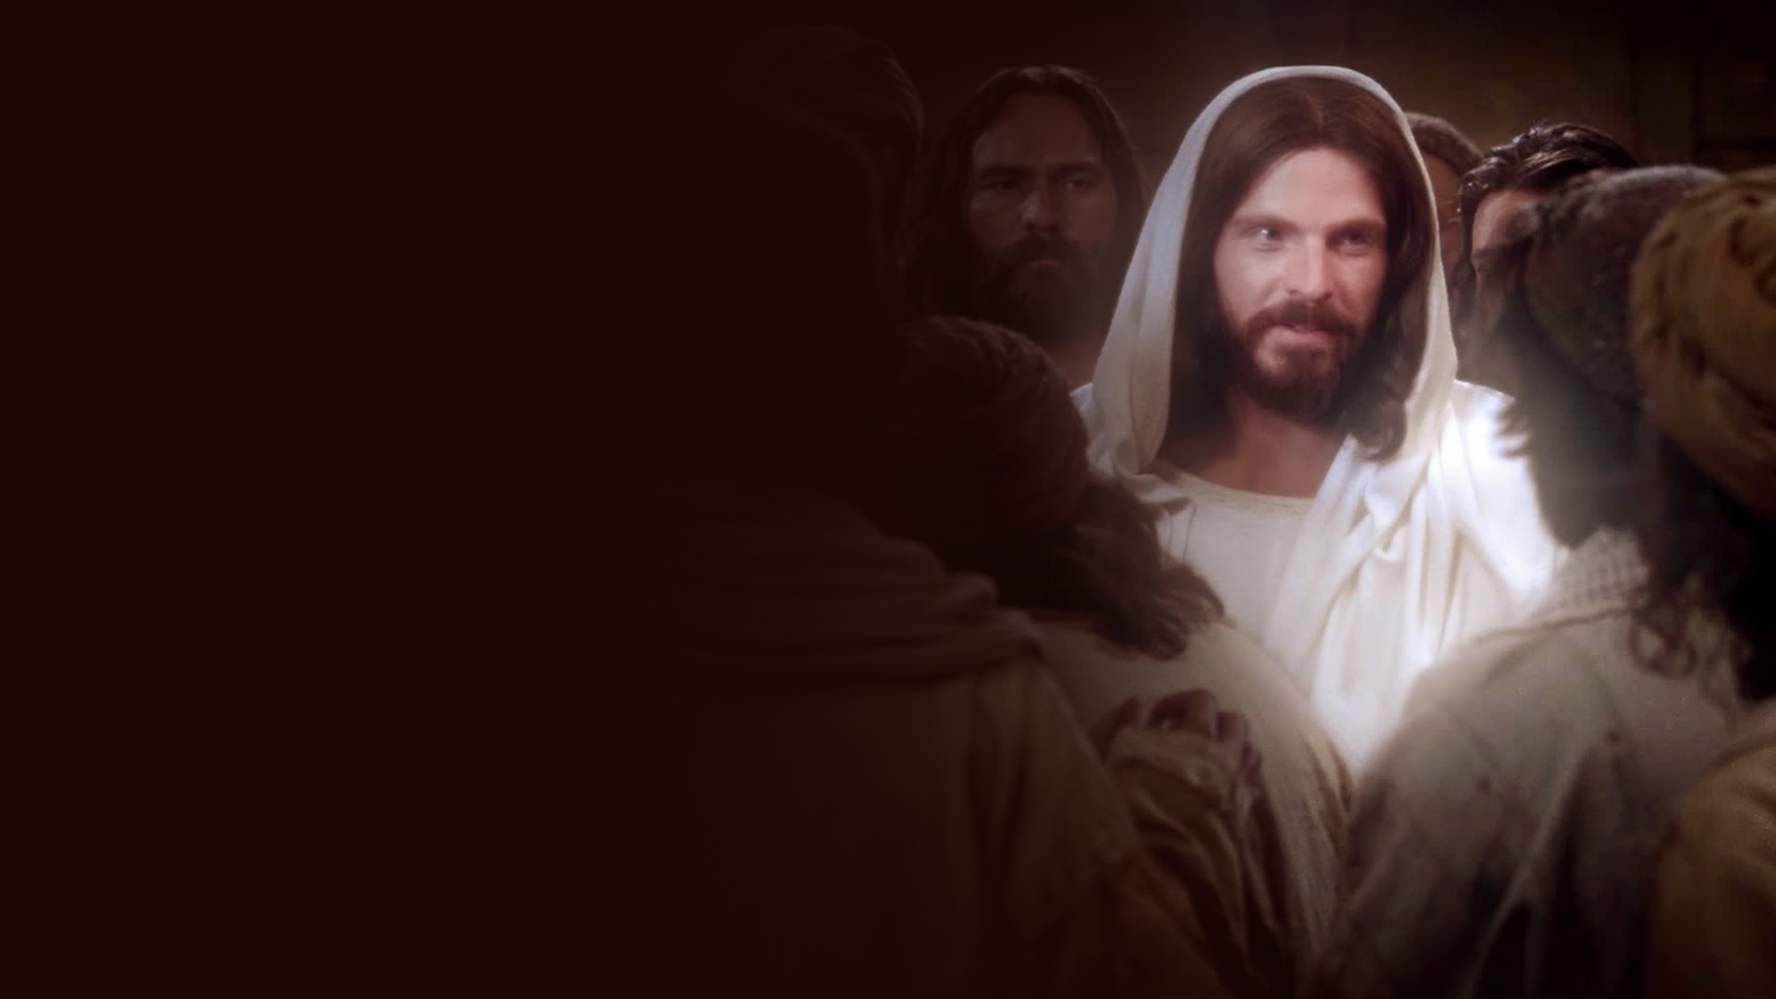
RECEIVE THE HOLY SPIRIT (JOHN 20:19-23)

Slide 6
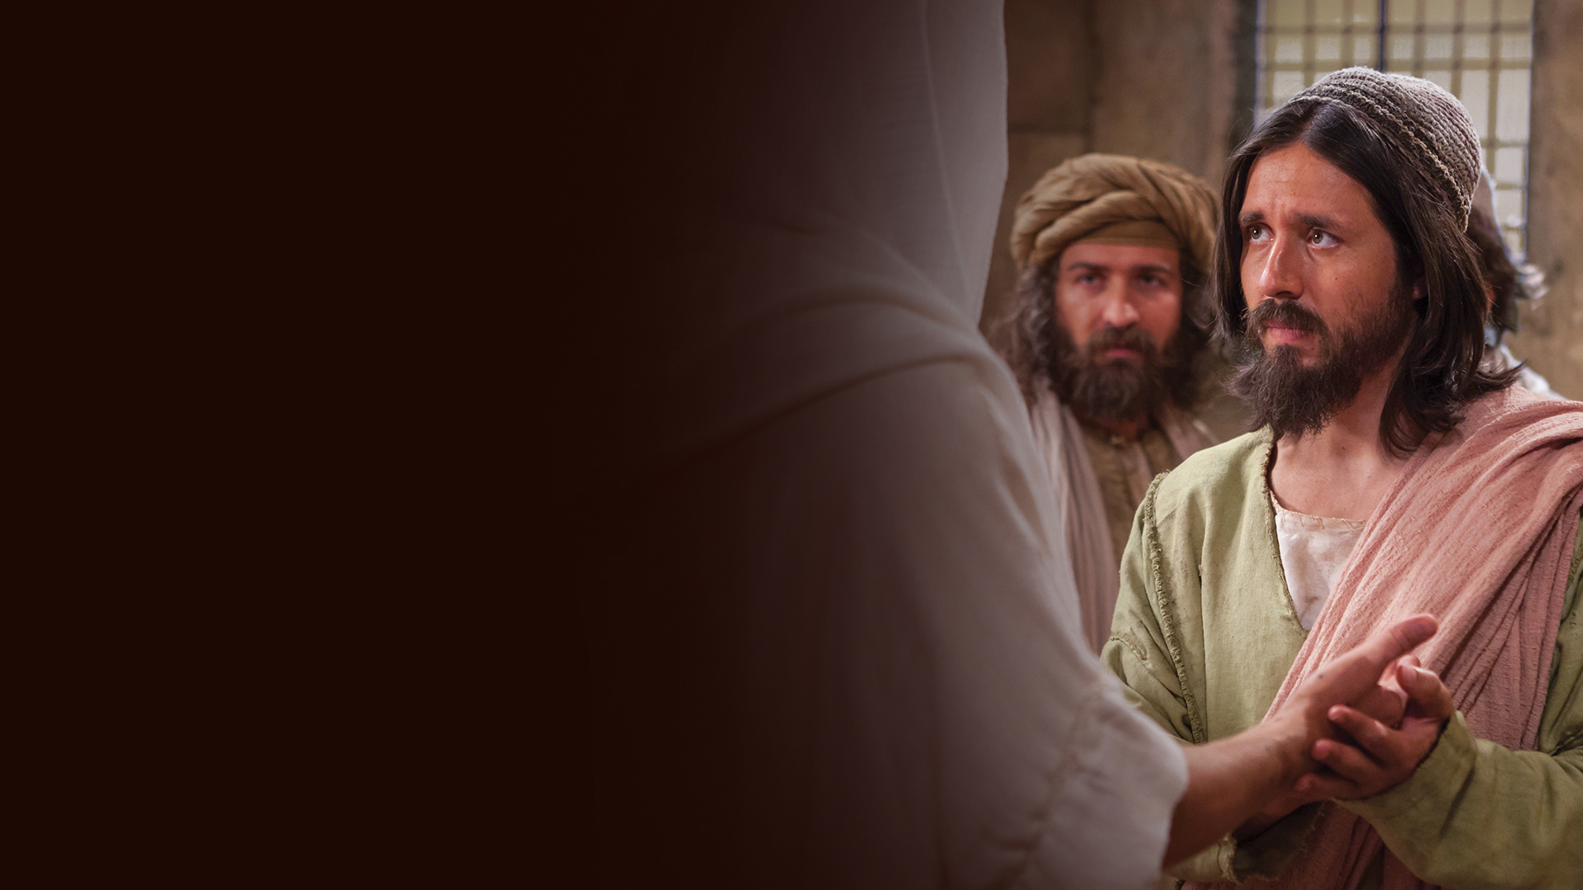
BLESSED ARE THOSE WHO HAVE NOT SEEN AND YET HAVE BELIEVED (JOHN 20:24-29)

Slide 7
THESE ARE WRITTEN THAT YOU MAY BELIEVE (JOHN 20:30-31)

Slide 8
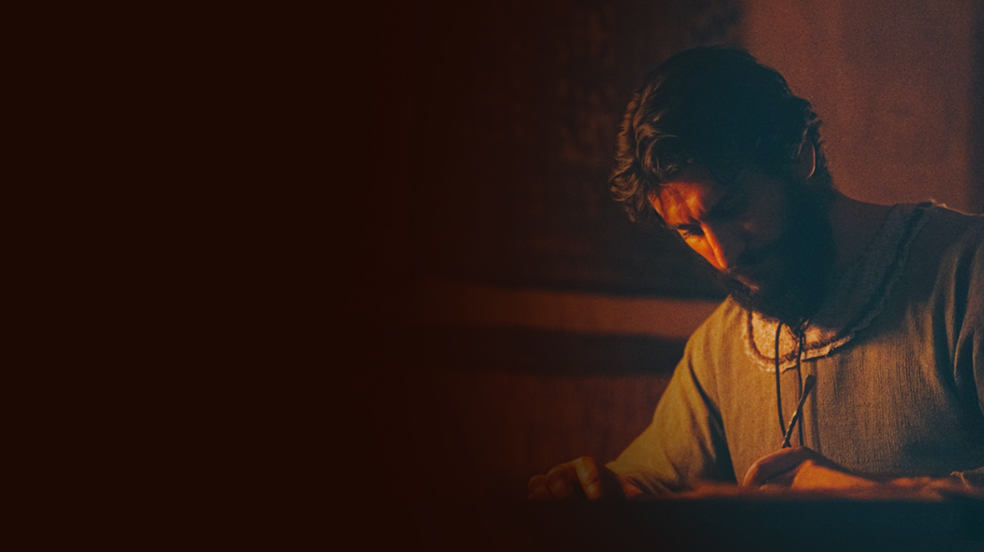
CHAPTER TWENTY-ONE: THAT YOU MAY BELIEVE

Slide 9
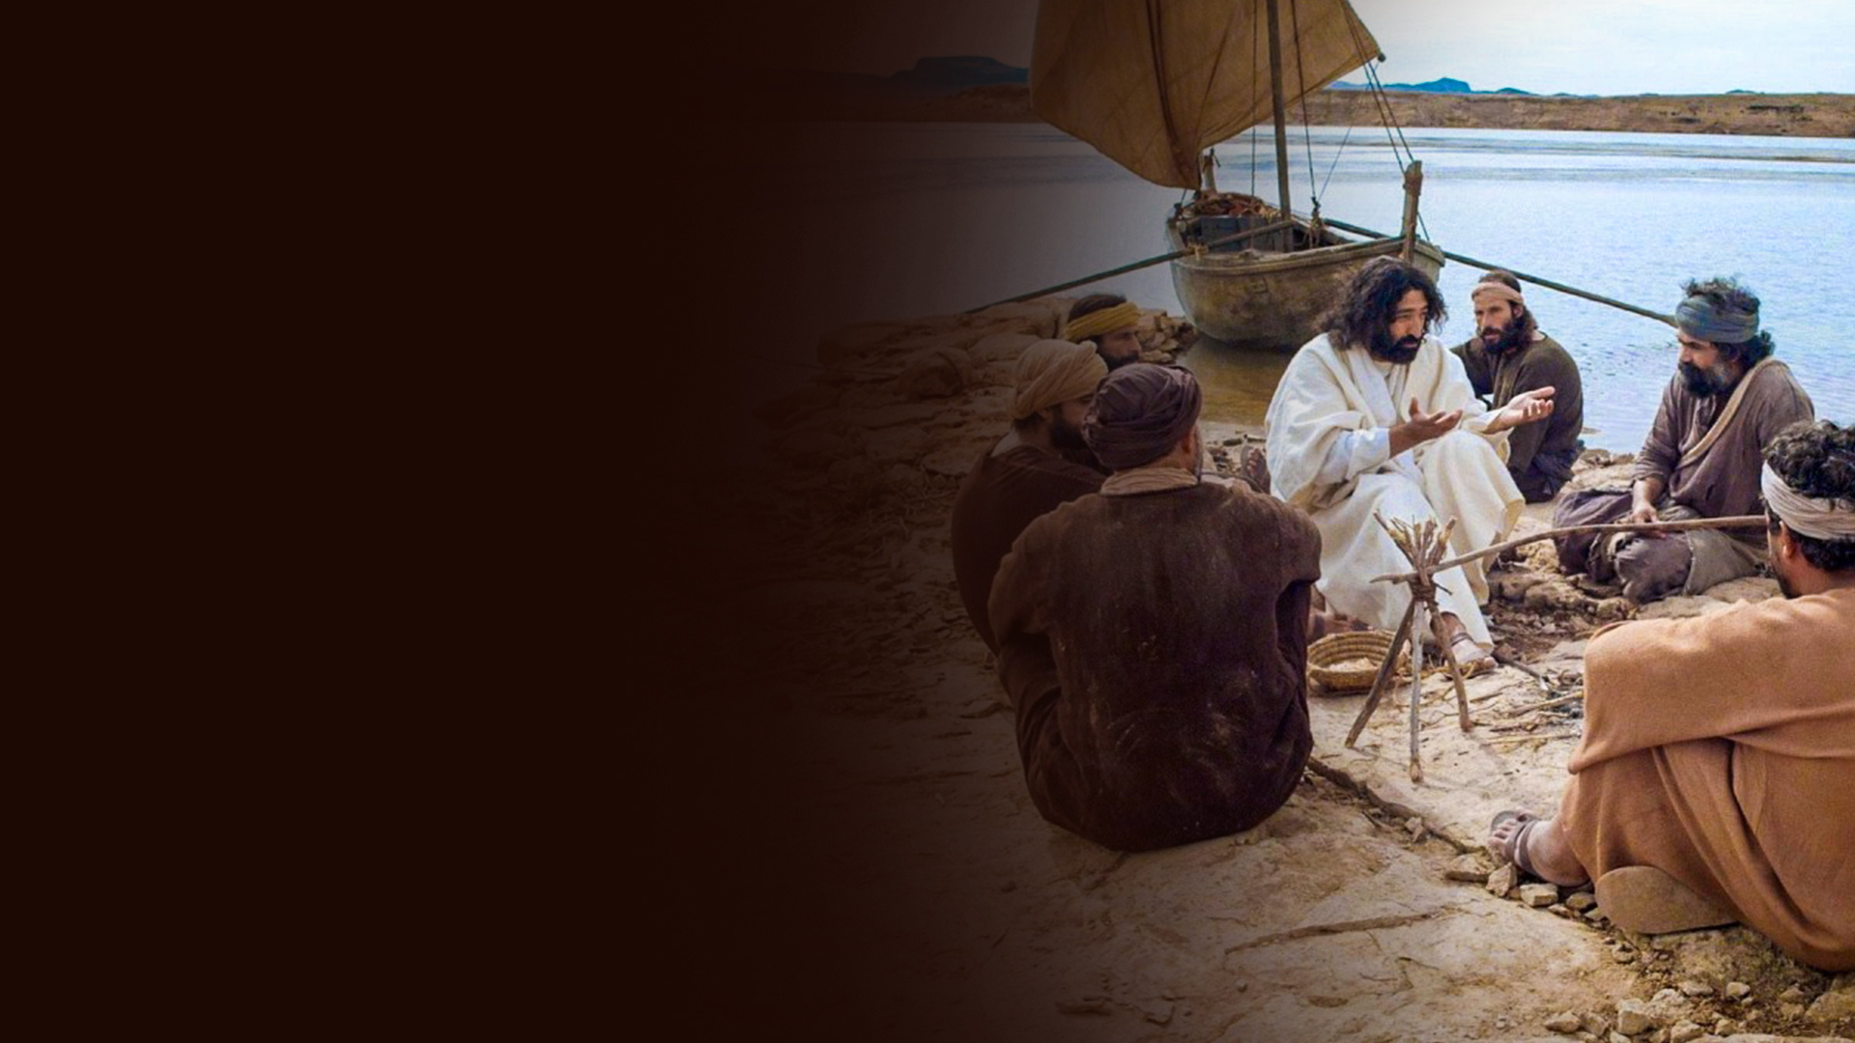
COME AND EAT BREAKFAST (JOHN 21:1-14)

Slide 10
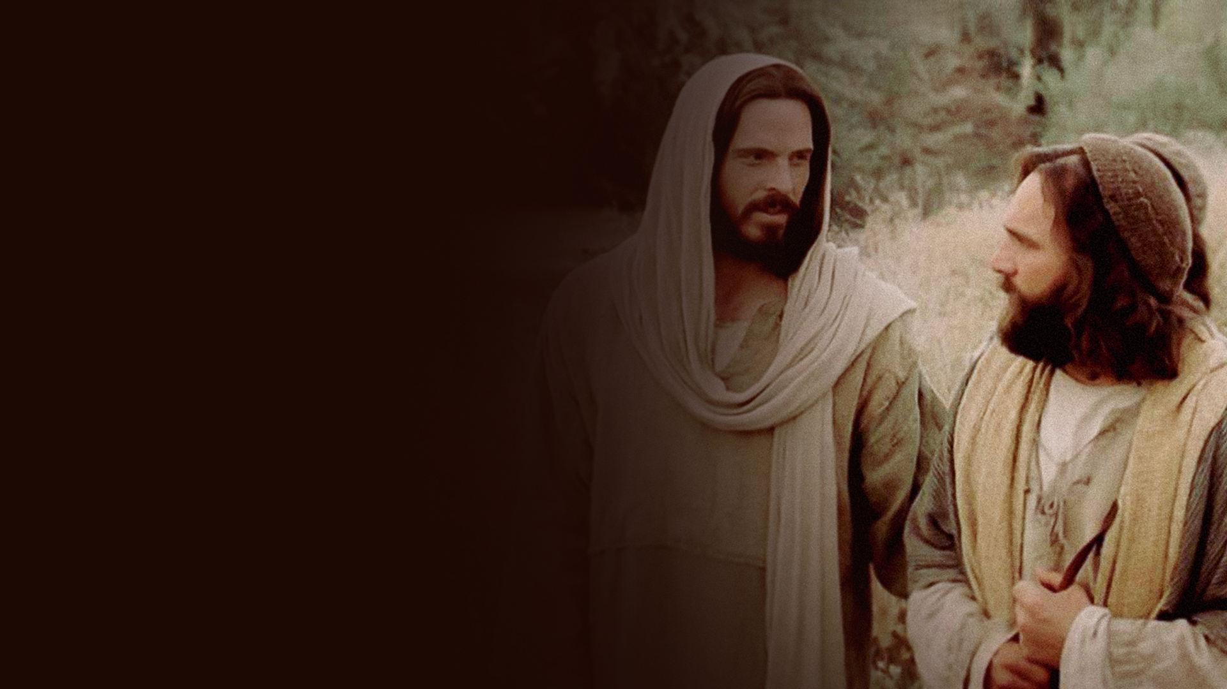
SIMON, TEND AND FEED MY SHEEP
(JOHN 21:15-19)

Slide 11
THE DISCIPLE WHOM JESUS LOVED WHO REPORTED THESE THINGS
(JOHN 21:20-25)

