Slide 1


Slide 2
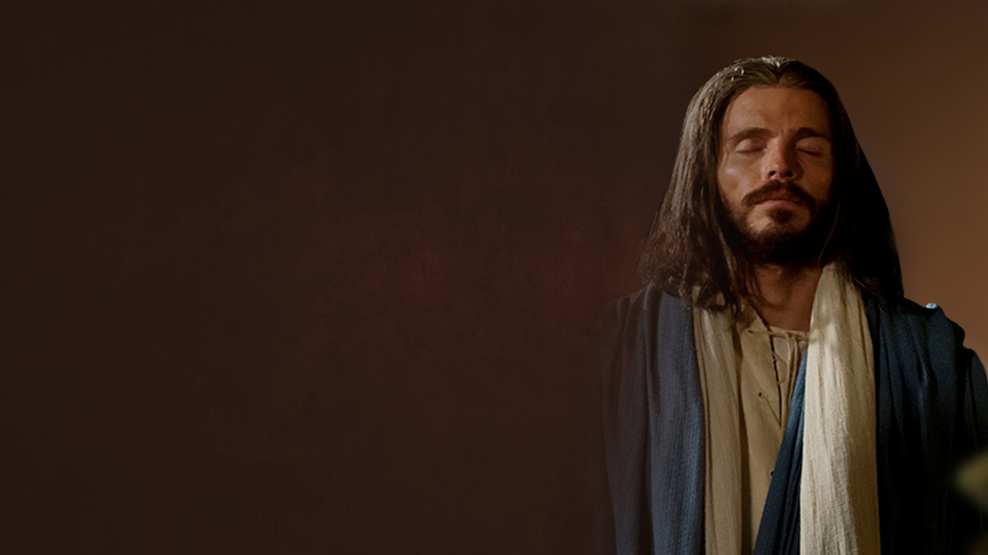
CHAPTER SEVENTEEN:
OUR GREAT HIGH PRIEST

Slide 3
GLORIFY ME WITH THE GLORY I HAD WITH YOU BEFORE THE WORLD WAS (JOHN 17:1-5)

Slide 4
KEEP THEM, SANCTIFY THEM (JOHN 17:6-19)

Slide 5
I PRAY FOR THOSE WHO WILL BELIEVE IN ME (JOHN 17:20-26)

Slide 6
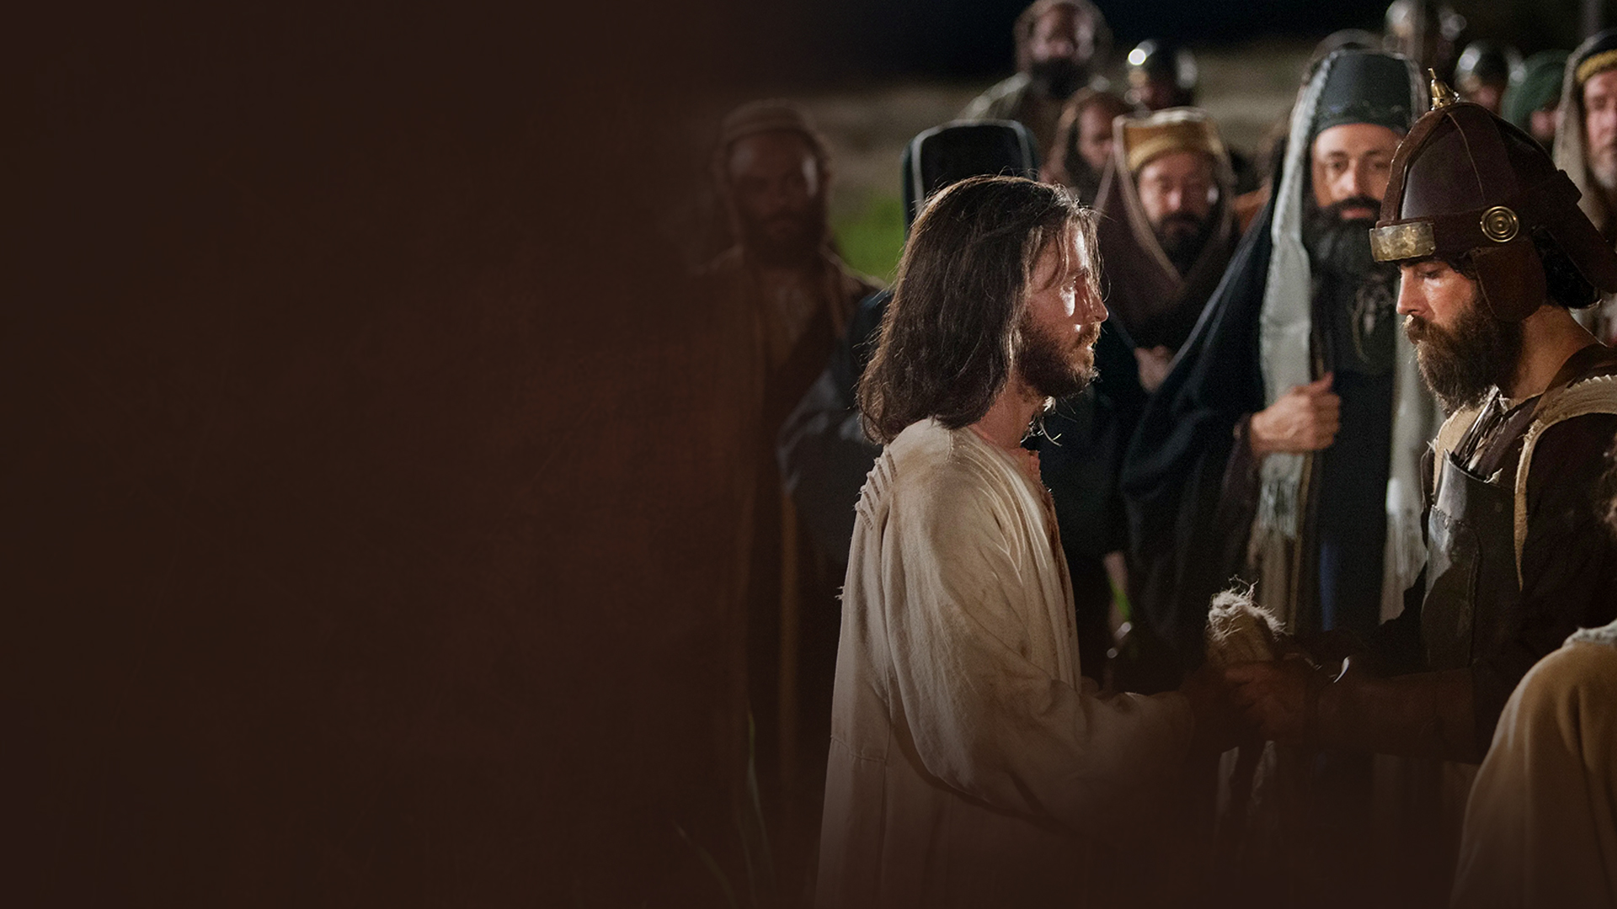
CHAPTER EIGHTEEN: I AM

Slide 7
I AM HE (JOHN 18:1-11)

Slide 8
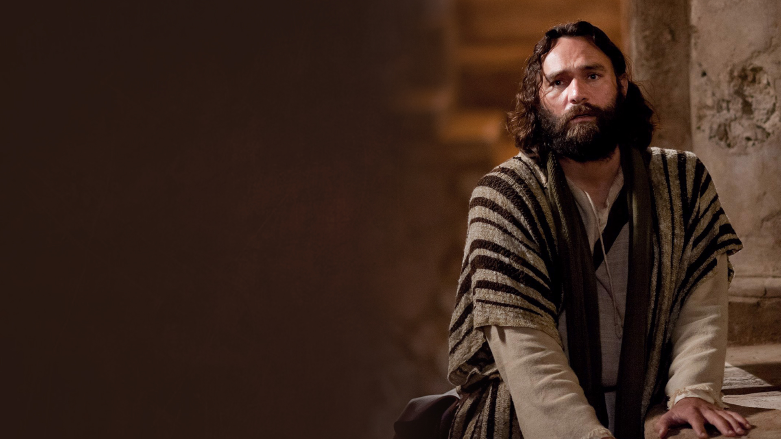
PETER FOLLOWED, BUT DENIED (JOHN 18:12-27)

Slide 9
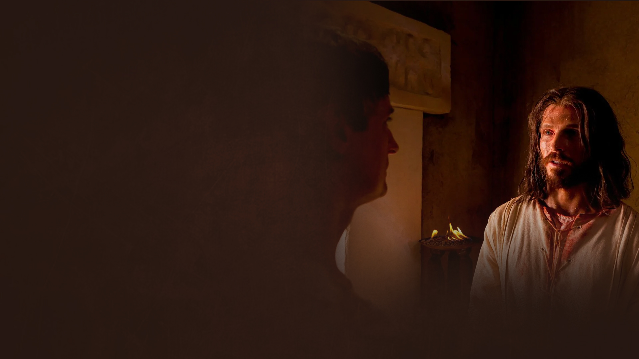
FOR THIS CAUSE I WAS BORN, FOR THIS CAUSE I HAVE COME (JOHN 18:28-40)

Slide 10
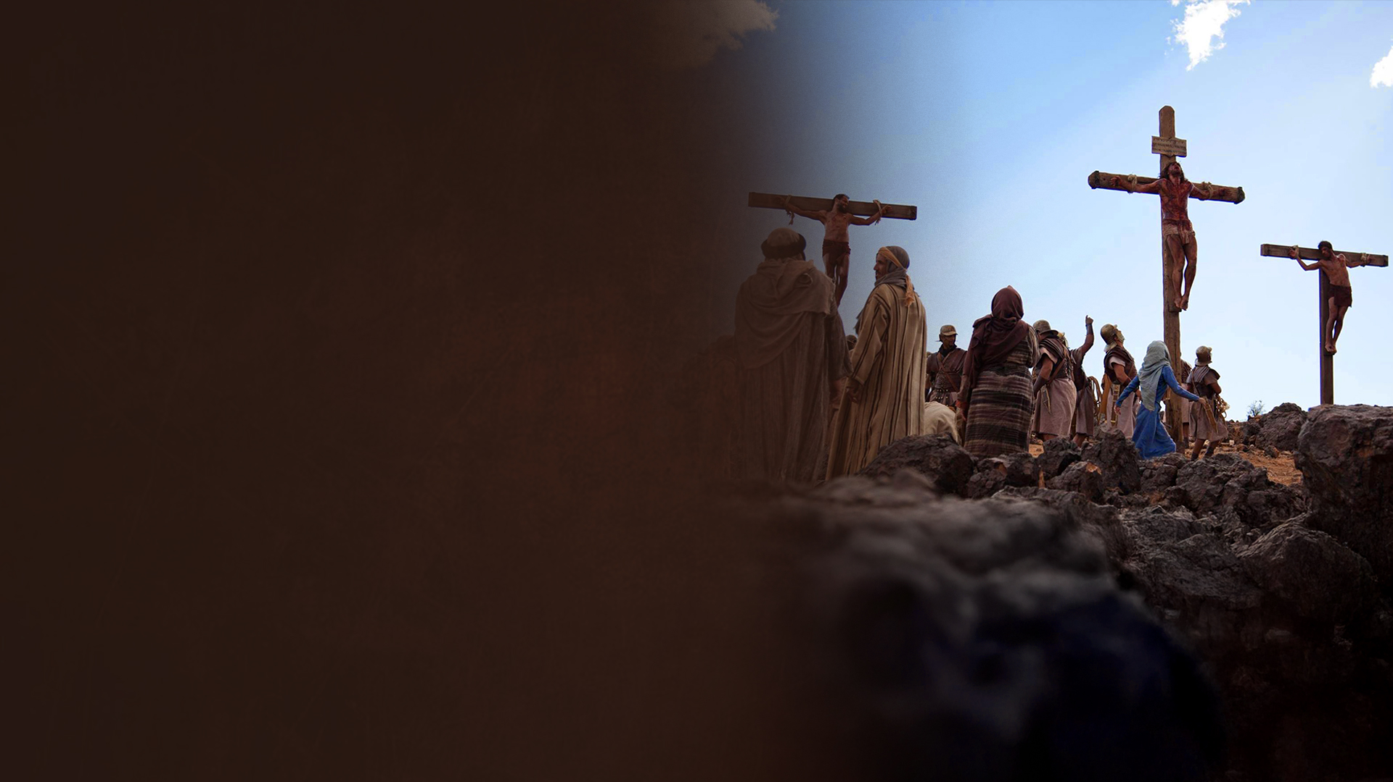
CHAPTER NINETEEN:
THE CRUCIFIED KING

Slide 11
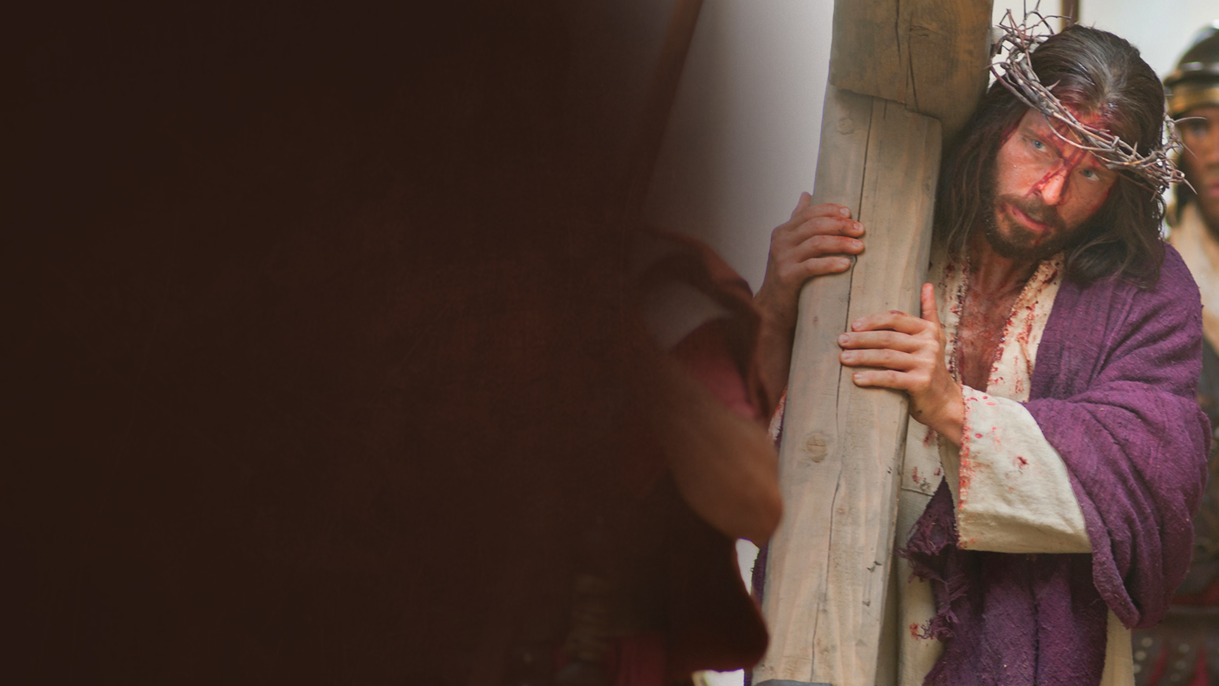
BEHOLD YOUR KING (JOHN 19:1-22)

Slide 12
THAT THE SCRIPTURE MIGHT BE FULFILLED (JOHN 19:23-42)

