Slide 1


Slide 2

CHAPTER FOURTEEN: THE COMFORTER

Slide 3
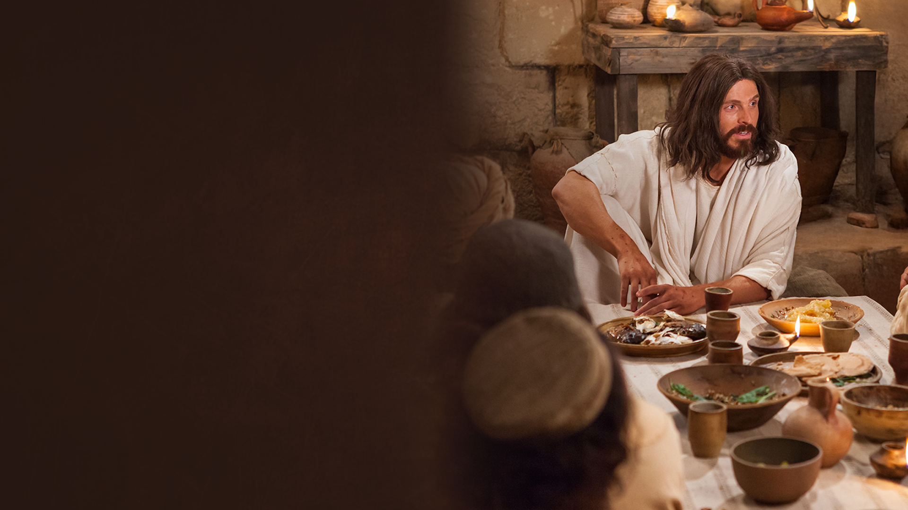
I AM THE WAY, AND THE TRUTH, AND THE LIFE (JOHN 14:1-9)

Slide 4
THE WORKS THAT I DO (JOHN 14:10-14)

Slide 5
ANOTHER HELPER 'ALLOS PARAKLETOS' (JOHN 14:15-19)

Slide 6
COMING REVELATION (JOHN 14:20-26)

Slide 7
I AM GOING TO THE FATHER (JOHN 14:27-31)

Slide 8

CHAPTER FIFTEEN:
THE TRUE VINE

Slide 9
I AM THE TRUE VINE (JOHN 15:1-8)

Slide 10
ABIDE IN MY LOVE (JOHN 15:9-17)

Slide 11
IF THE WORLD HATES YOU (JOHN 15:18-27)

Slide 12
CHAPTER SIXTEEN:
IN MY NAME

Slide 13
REMEMBER THAT I TOLD YOU (JOHN 16:1-6)

Slide 14
FOR YOUR ADVANTAGE
I GO AWAY (JOHN 16:7-15)

Slide 15
YOUR SORROW WILL TURN INTO JOY
(JOHN 16:16-24)

Slide 16
I HAVE OVERCOME THE WORLD (JOHN 16:25-33)

