Slide 1


Slide 2
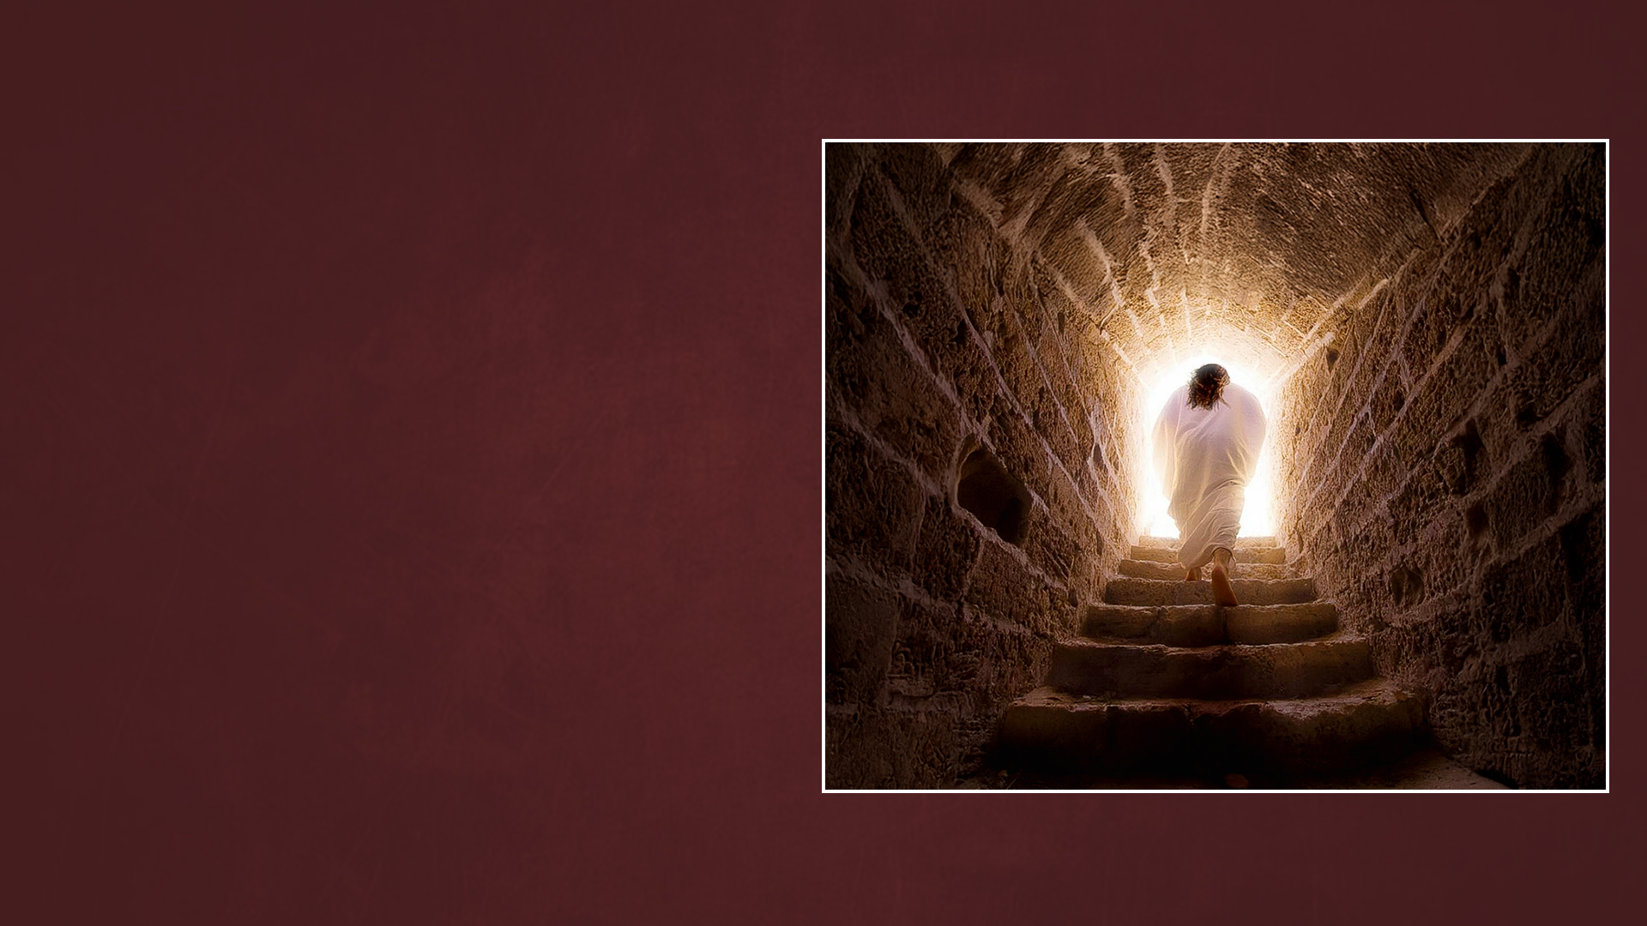
CHAPTER ELEVEN:
THE RESURRECTION AND THE LIFE

Slide 3
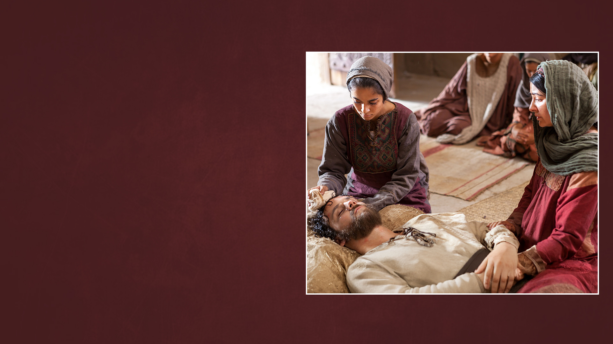
THIS SICKNESS
(JOHN 11:1-16)

Slide 4
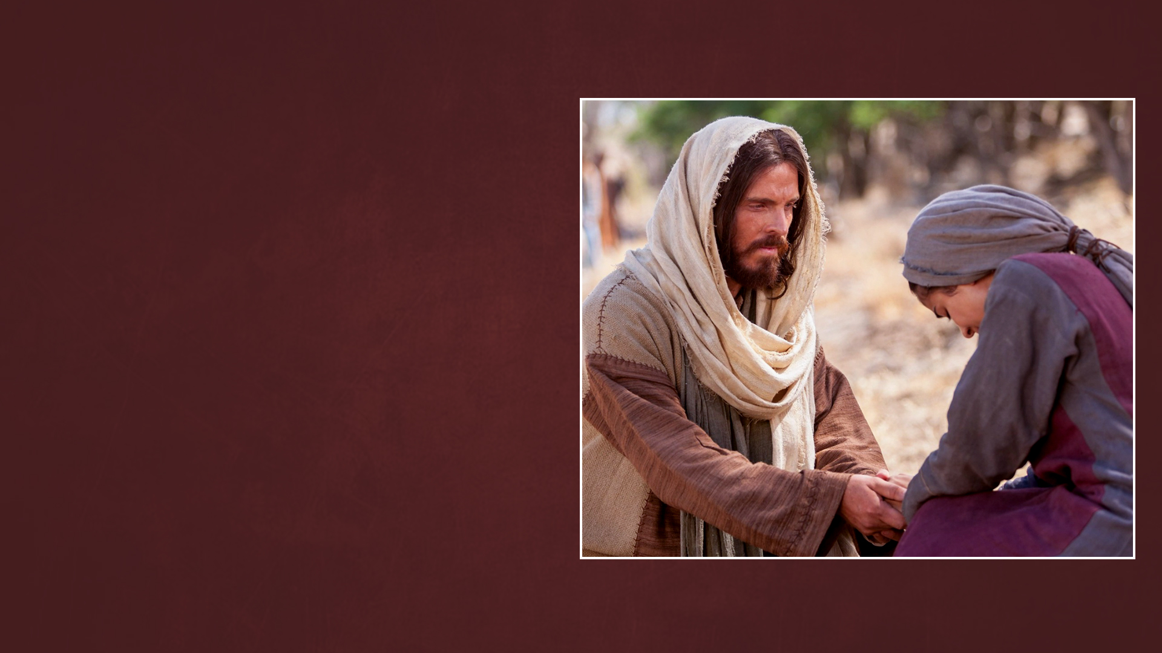
I AM THE RESURRECTION AND THE LIFE
(John 11:17-27)

Slide 5
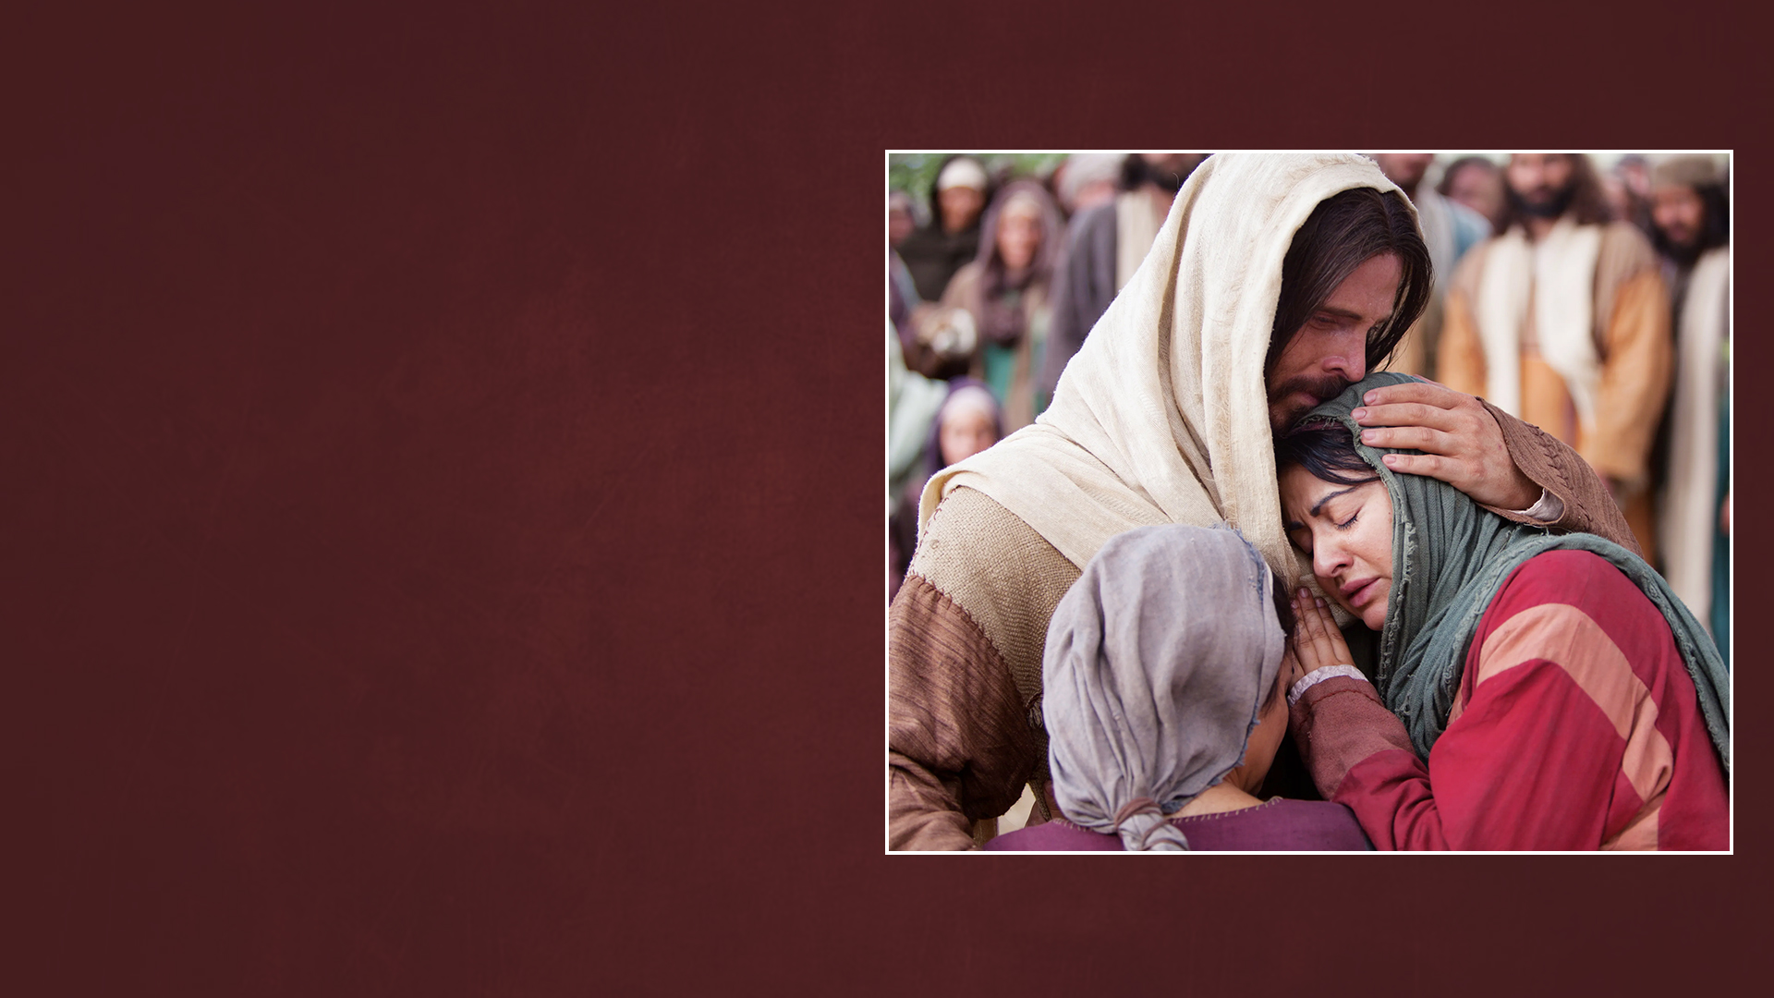
JESUS WEPT
(JOHN 11:28-37)

Slide 6
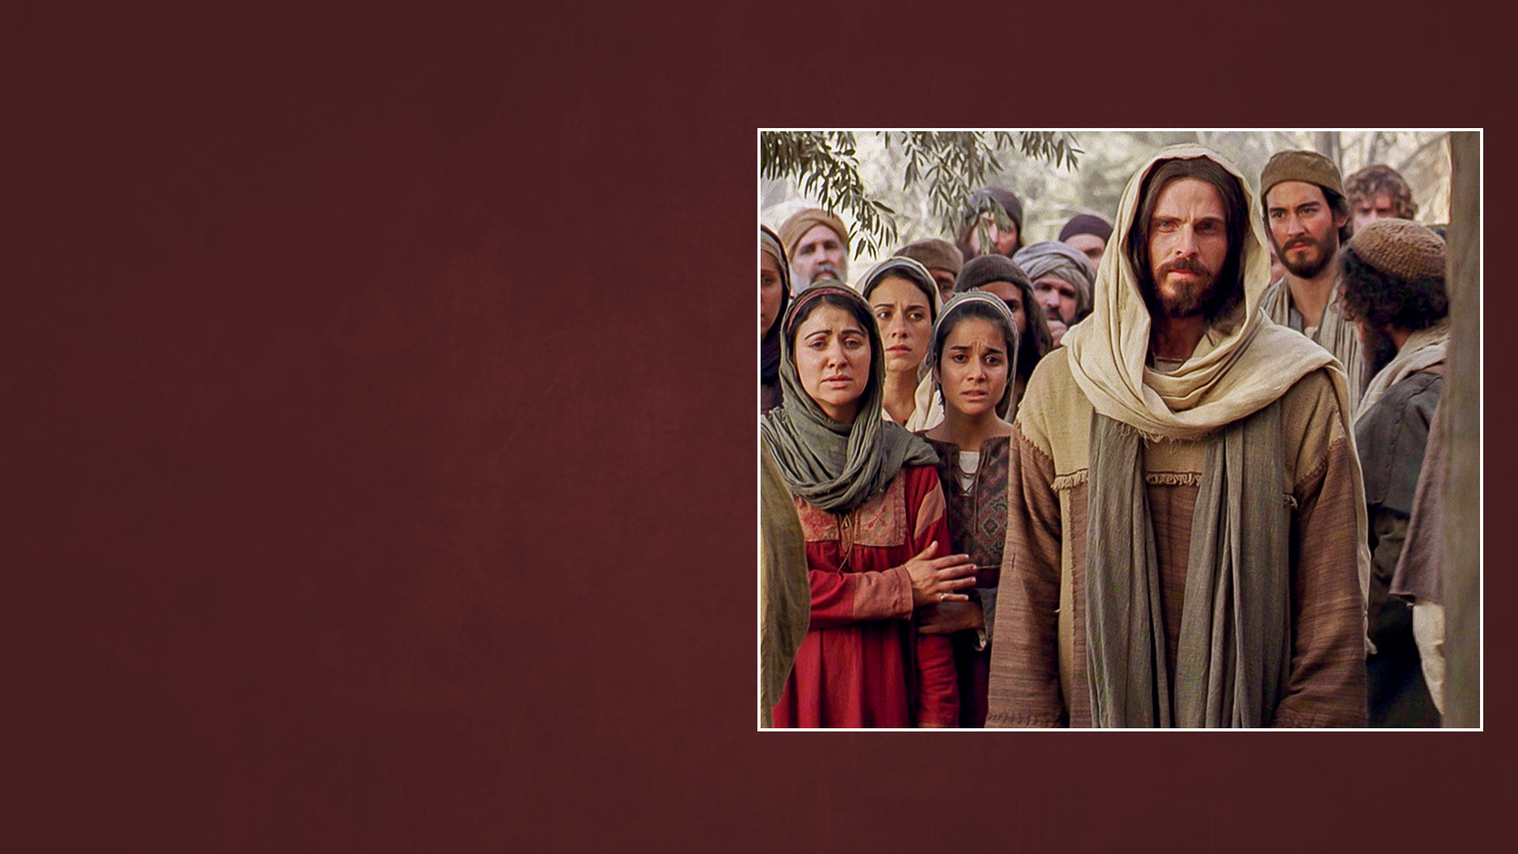
IF YOU BELIEVE YOU WILL SEE (JOHN 11:38-44)

Slide 7
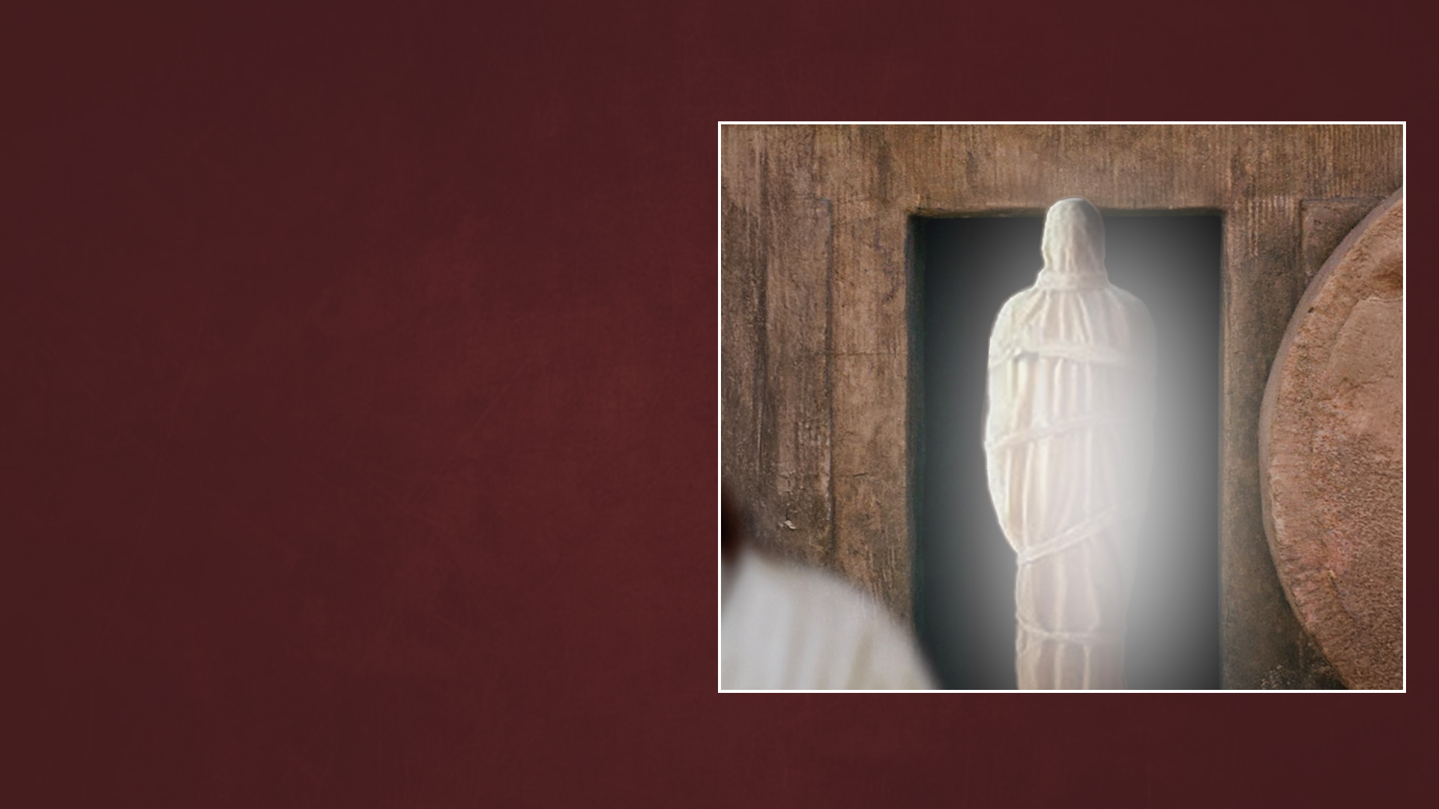
THIS MAN WORKS MANY SIGNS (JOHN 11:45-57)

Slide 8

CHAPTER TWELVE:
THE GRAIN OF WHEAT

Slide 9
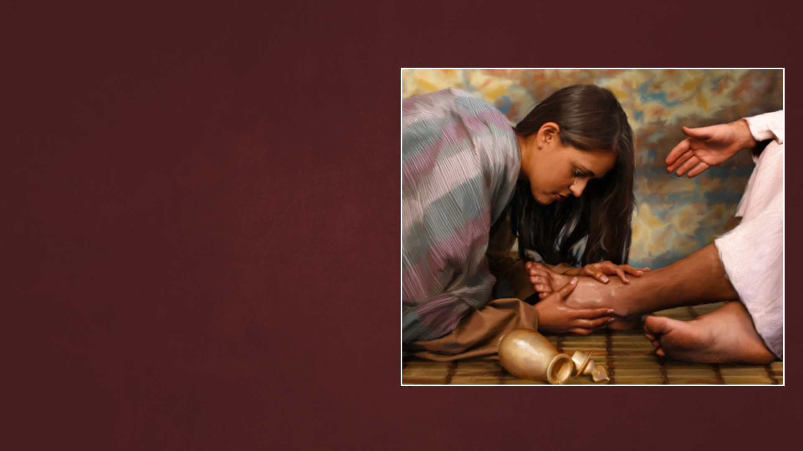
VERY COSTLY OIL
(JOHN 12:1-8)

Slide 10
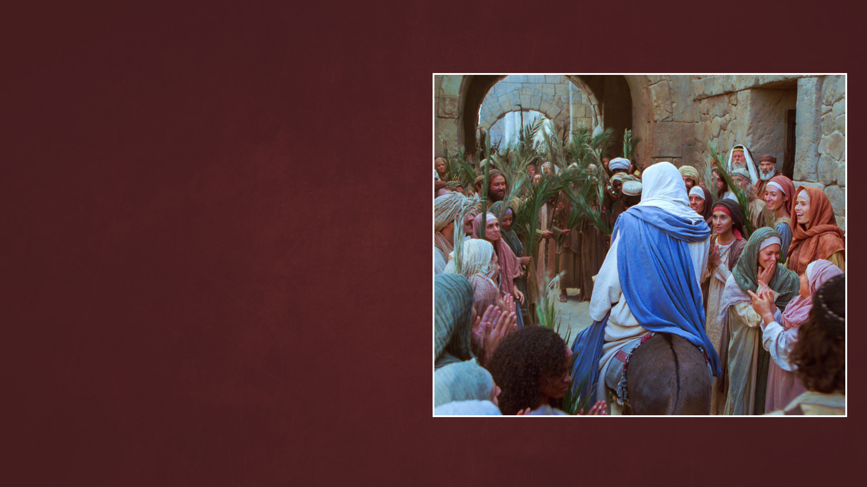
HOSANNA!
(JOHN 12:9-19)

Slide 11
A GRAIN OF WHEAT (JOHN 12:20-26)

Slide 12
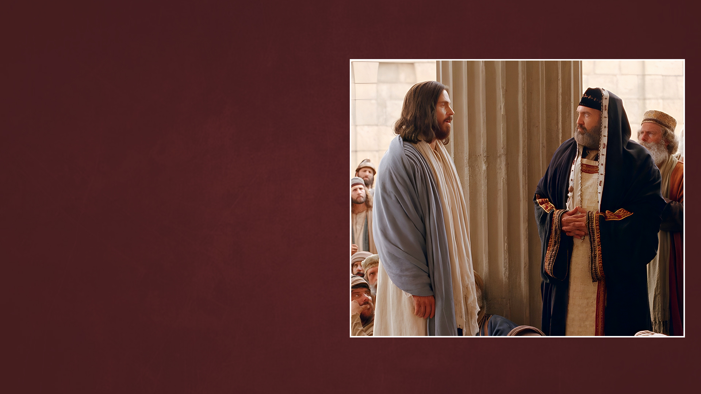
THE RULER OF THIS WORLD IS CAST OUT (JOHN 12:27-35)

Slide 13
HIS COMMAND IS EVERLASTING LIFE (JOHN 12:36-50)

Slide 14
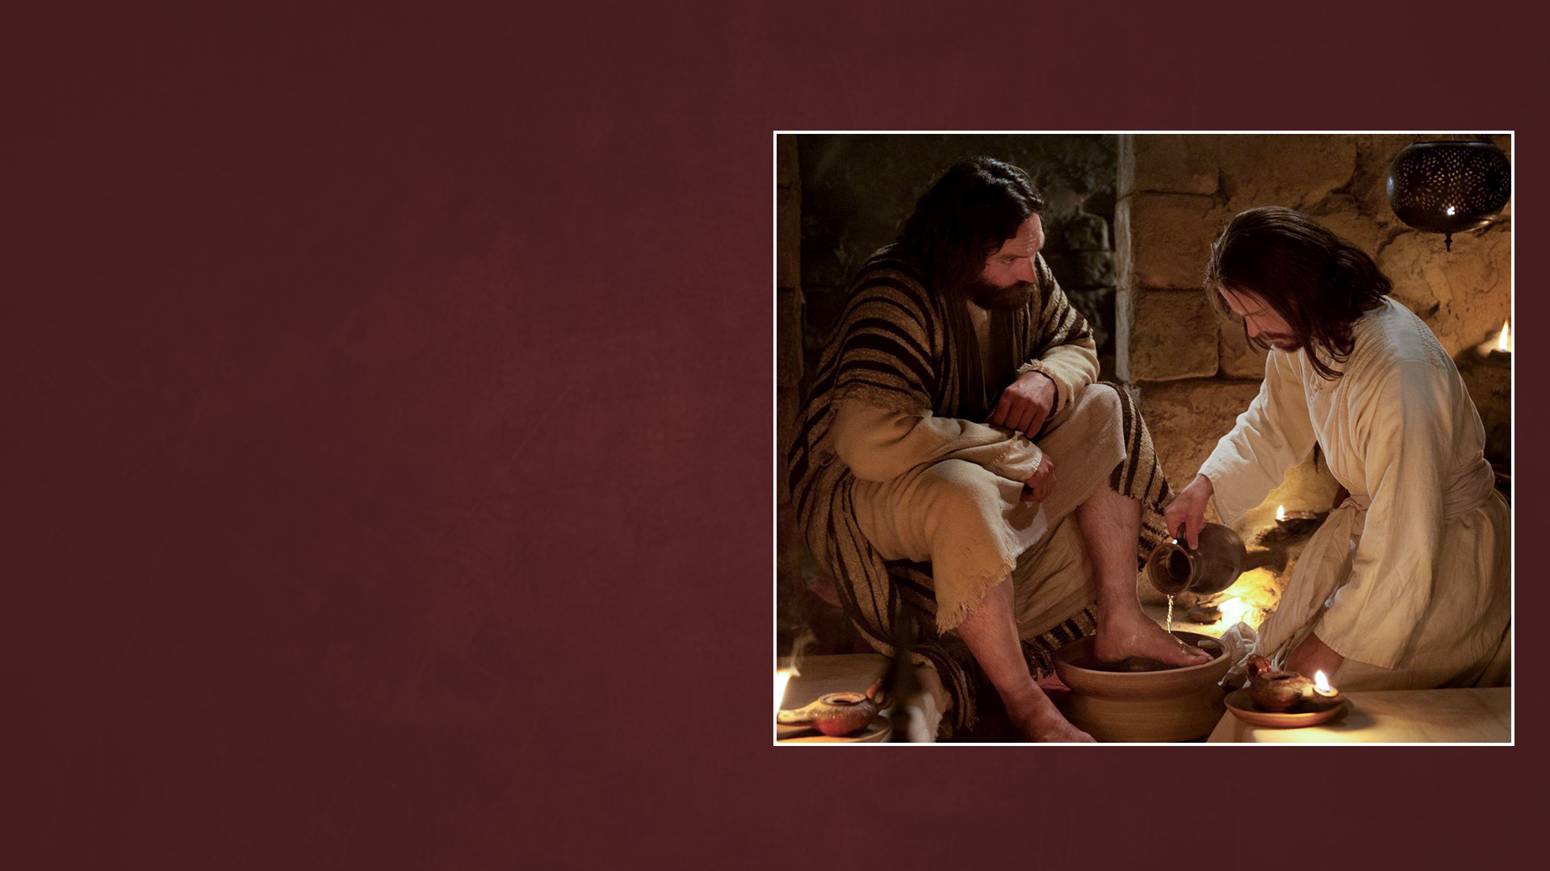
CHAPTER THIRTEEN:
THE SERVANT

Slide 15
I HAVE GIVEN YOU AN EXAMPLE
(JOHN 13:1-20)

Slide 16
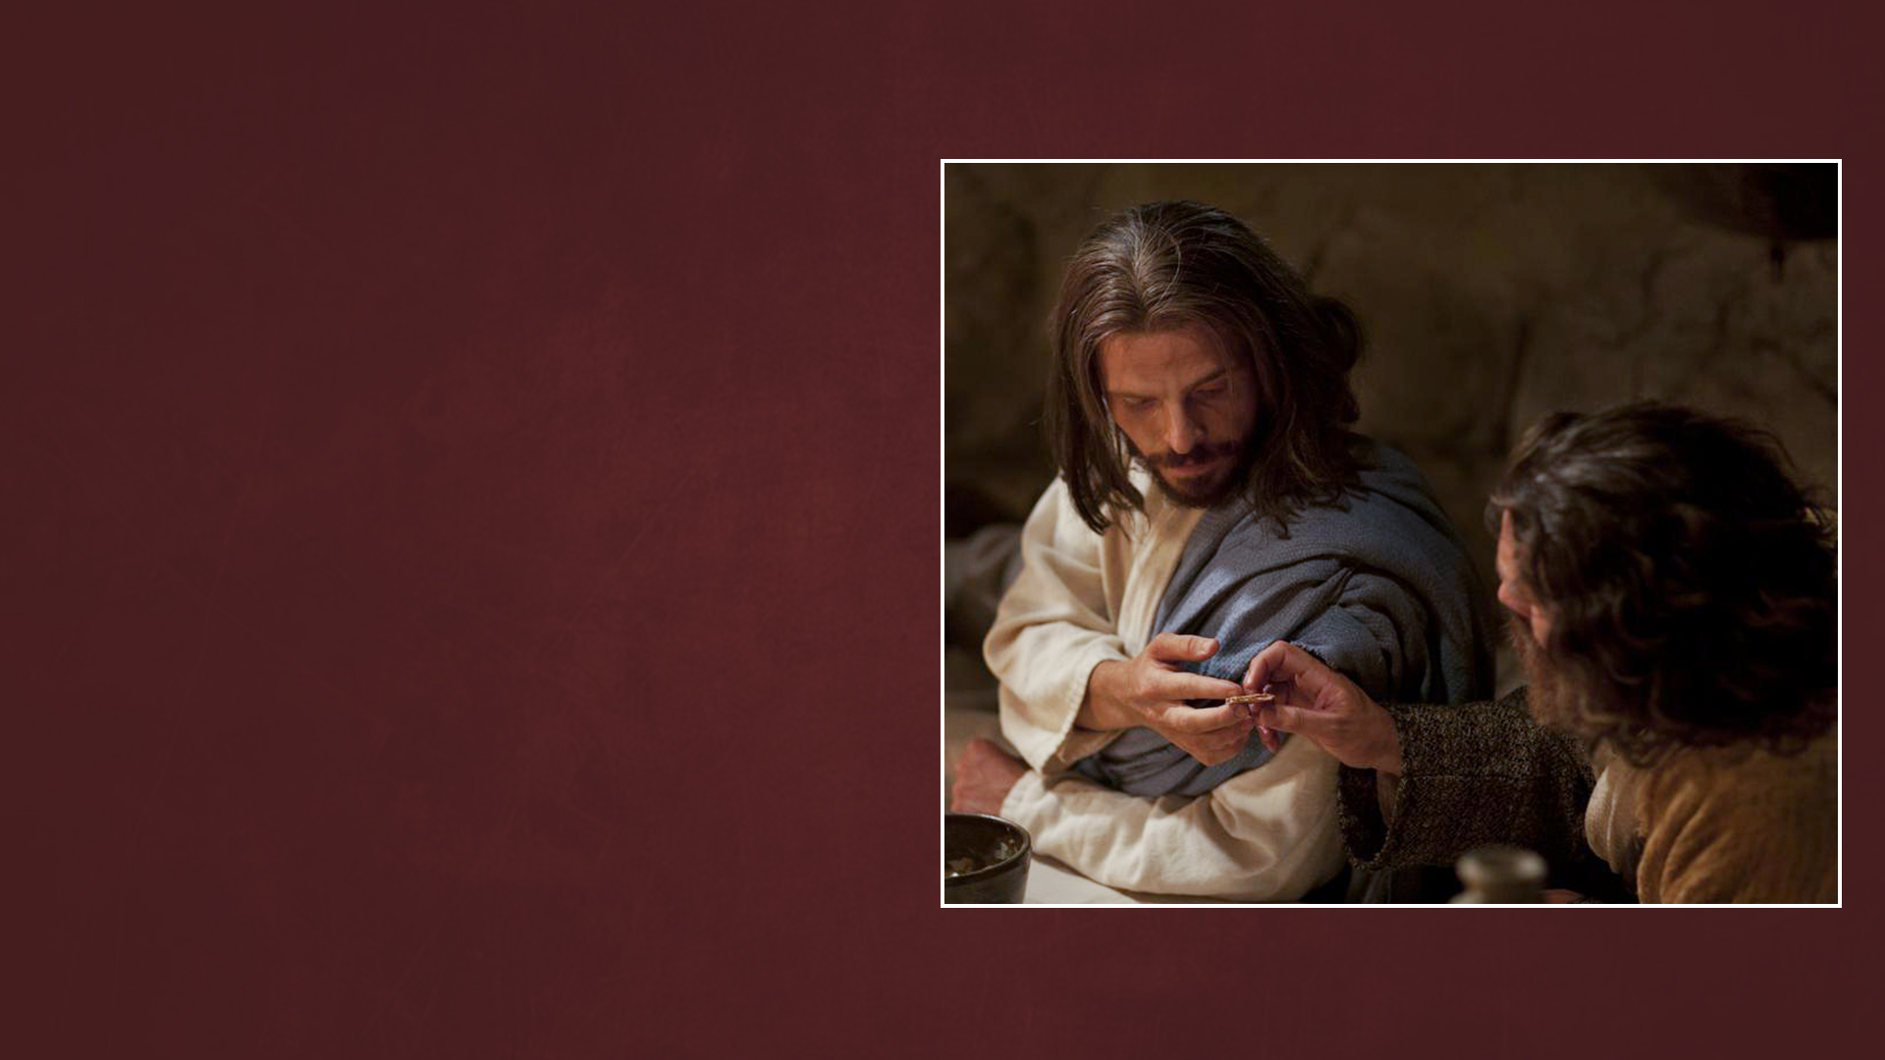
ONE OF YOU WILL BETRAY ME
(JOHN 13:21-30)

Slide 17
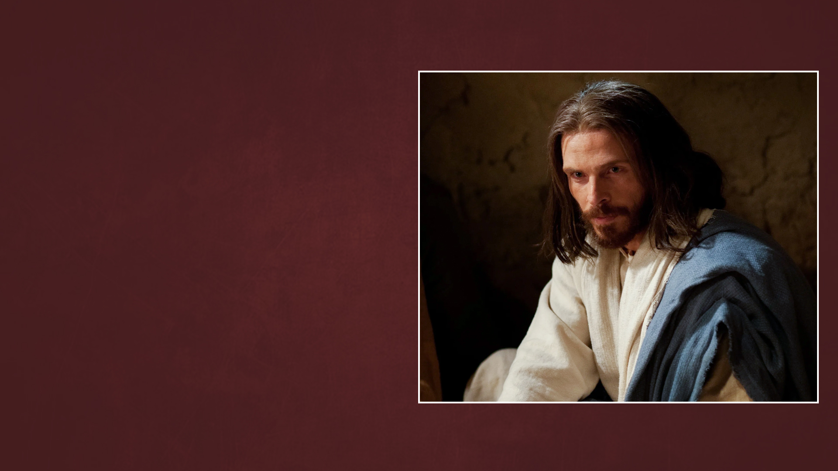
A NEW COMMANDMENT (JOHN 13:31-38)

