Slide 1


Slide 2
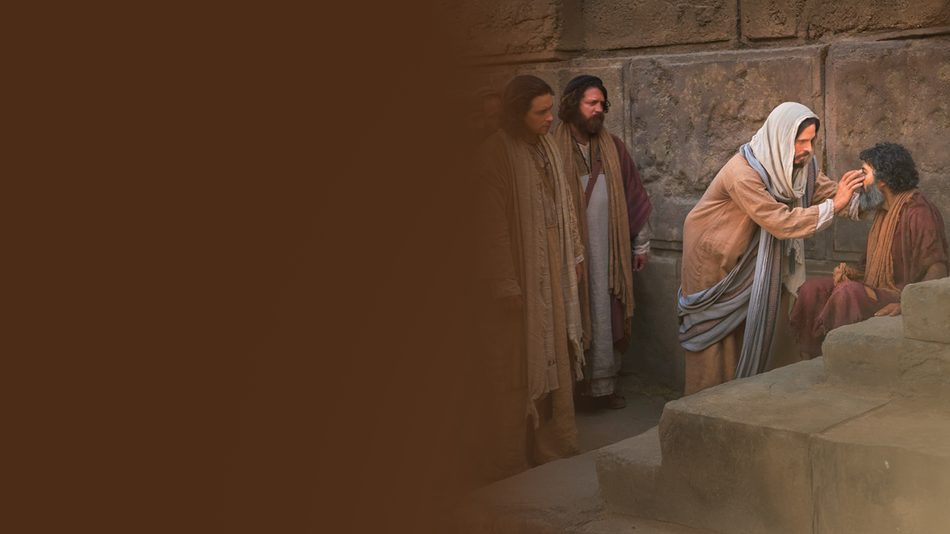
CHAPTER NINE:
DO THE WORKS

Slide 3
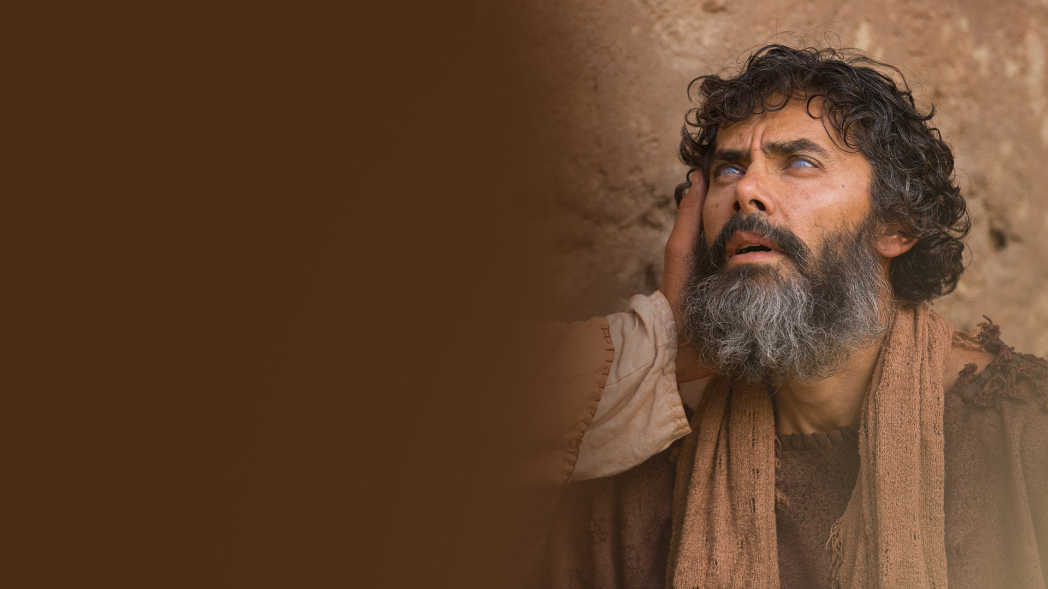
ONCE I WAS BLIND, BUT NOW I SEE! (JOHN 9:1-41)

Slide 4
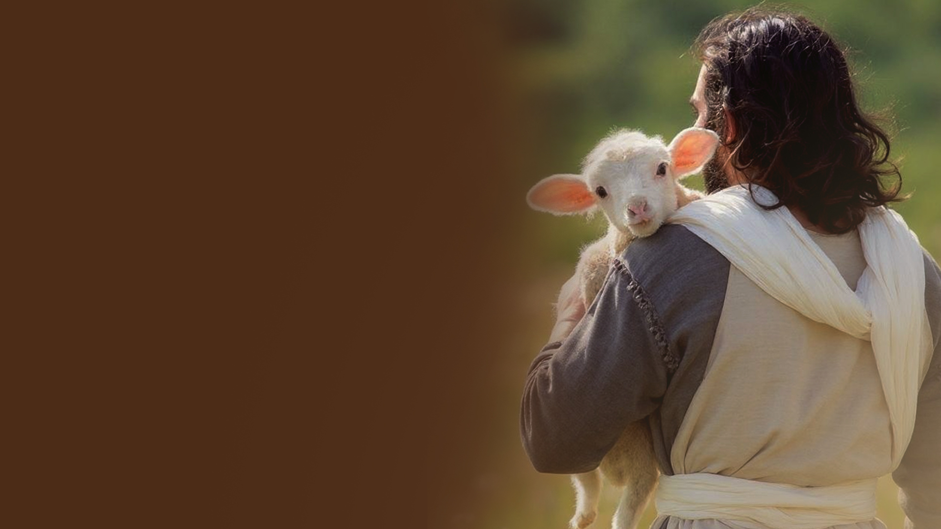
CHAPTER TEN:
THE GOOD SHEPHERD

Slide 5
I AM THE DOOR. I AM THE GOOD SHEPHERD.
(JOHN 10:1-16)

Slide 6
POWER TO LAY MY LIFE DOWN AND TO TAKE IT UP AGAIN (JOHN 10:17-21)

Slide 7
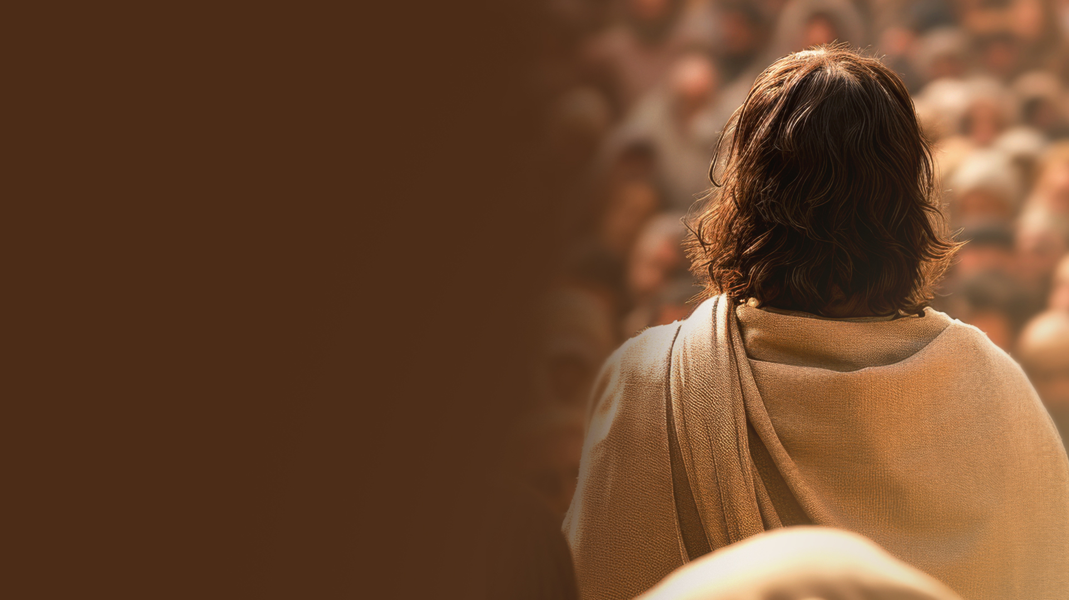
I AND THE FATHER ARE ONE (JOHN 10:22-42)

