Slide 1
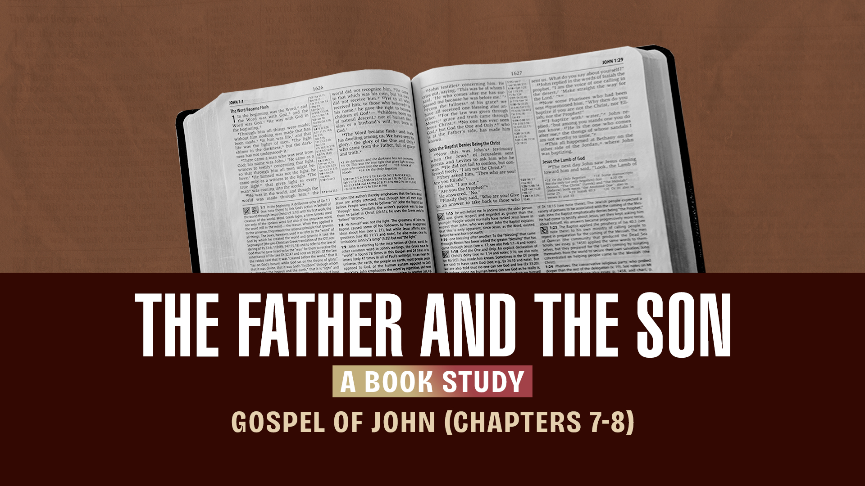

Slide 2
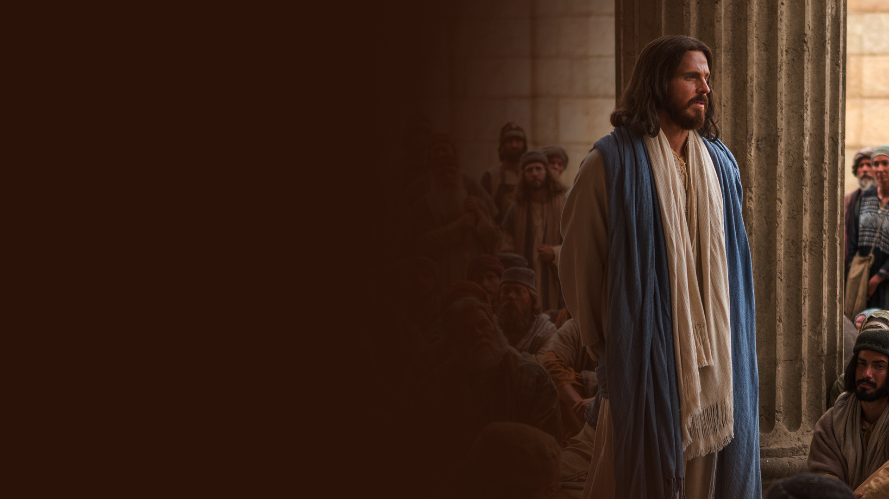
CHAPTER SEVEN:
RIVERS OF LIVING WATER

Slide 3
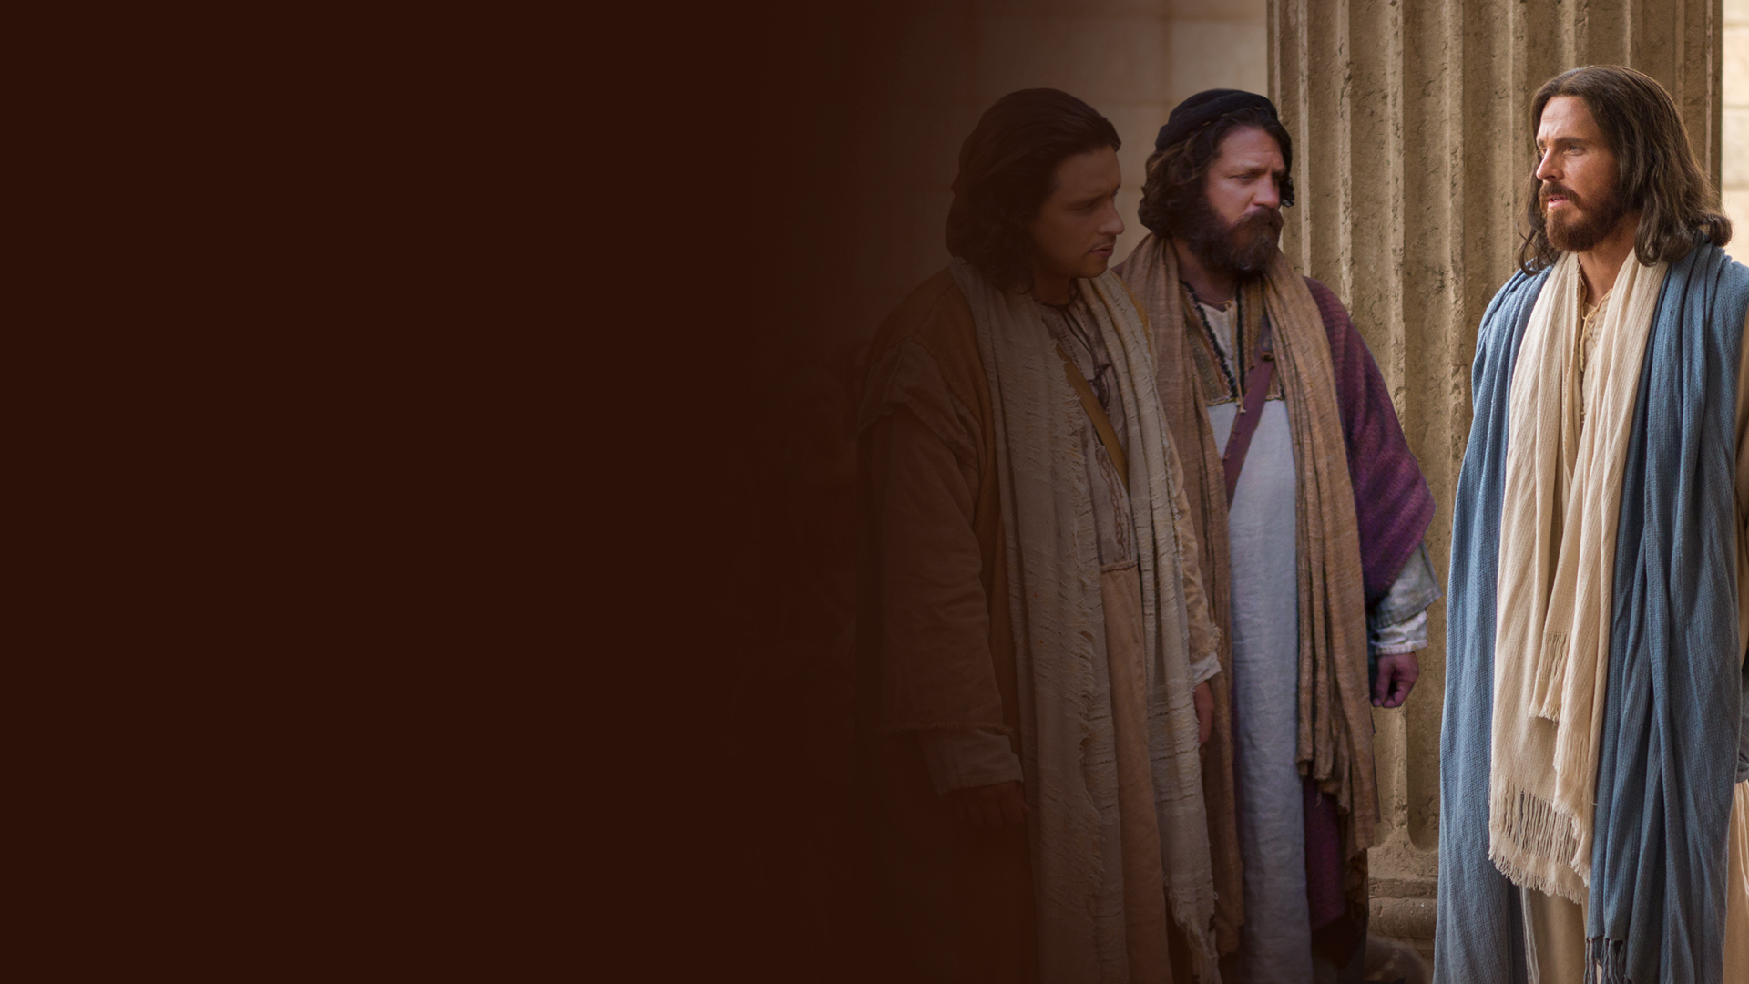
MY TIME HAS NOT YET COME (JOHN 7:1-10)

Slide 4
MY DOCTRINE IS NOT MINE (JOHN 7:11-24)

Slide 5
I KNOW HIM, FOR I AM FROM HIM, AND HE SENT ME (JOHN 7:25-31)

Slide 6
RIVERS OF LIVING WATER (JOHN 7:32-39)

Slide 7
NO MAN EVER SPOKE LIKE THIS MAN!
(JOHN 7:40-53)

Slide 8
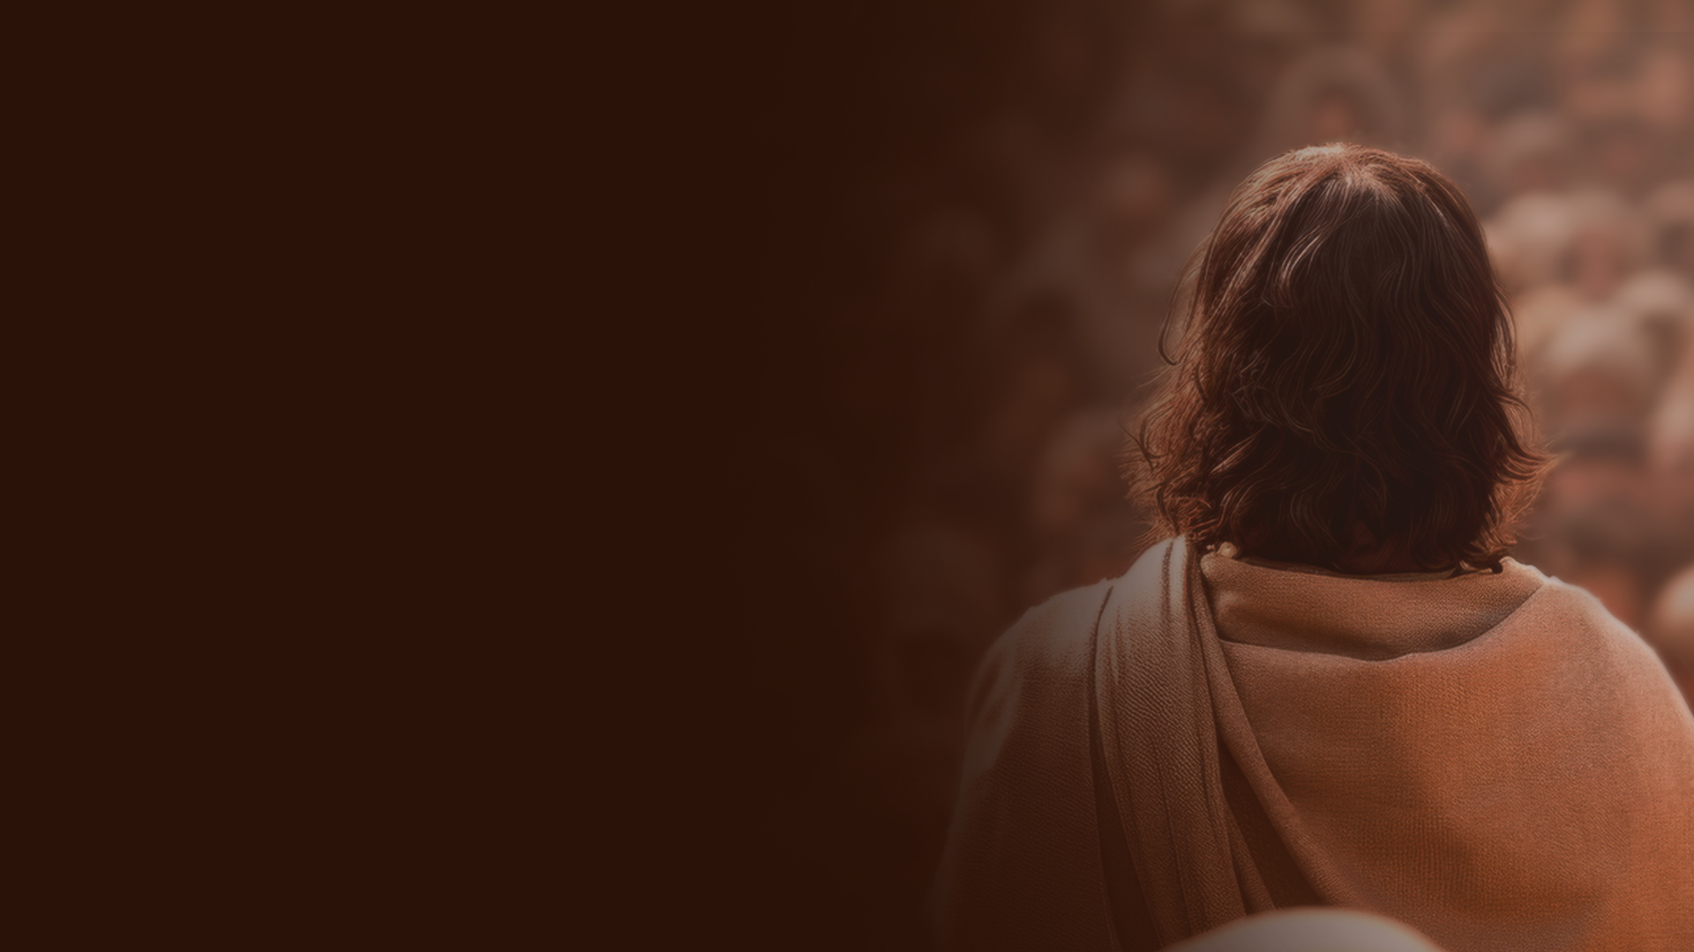
CHAPTER EIGHT:
THE FATHER AND THE SON

Slide 9
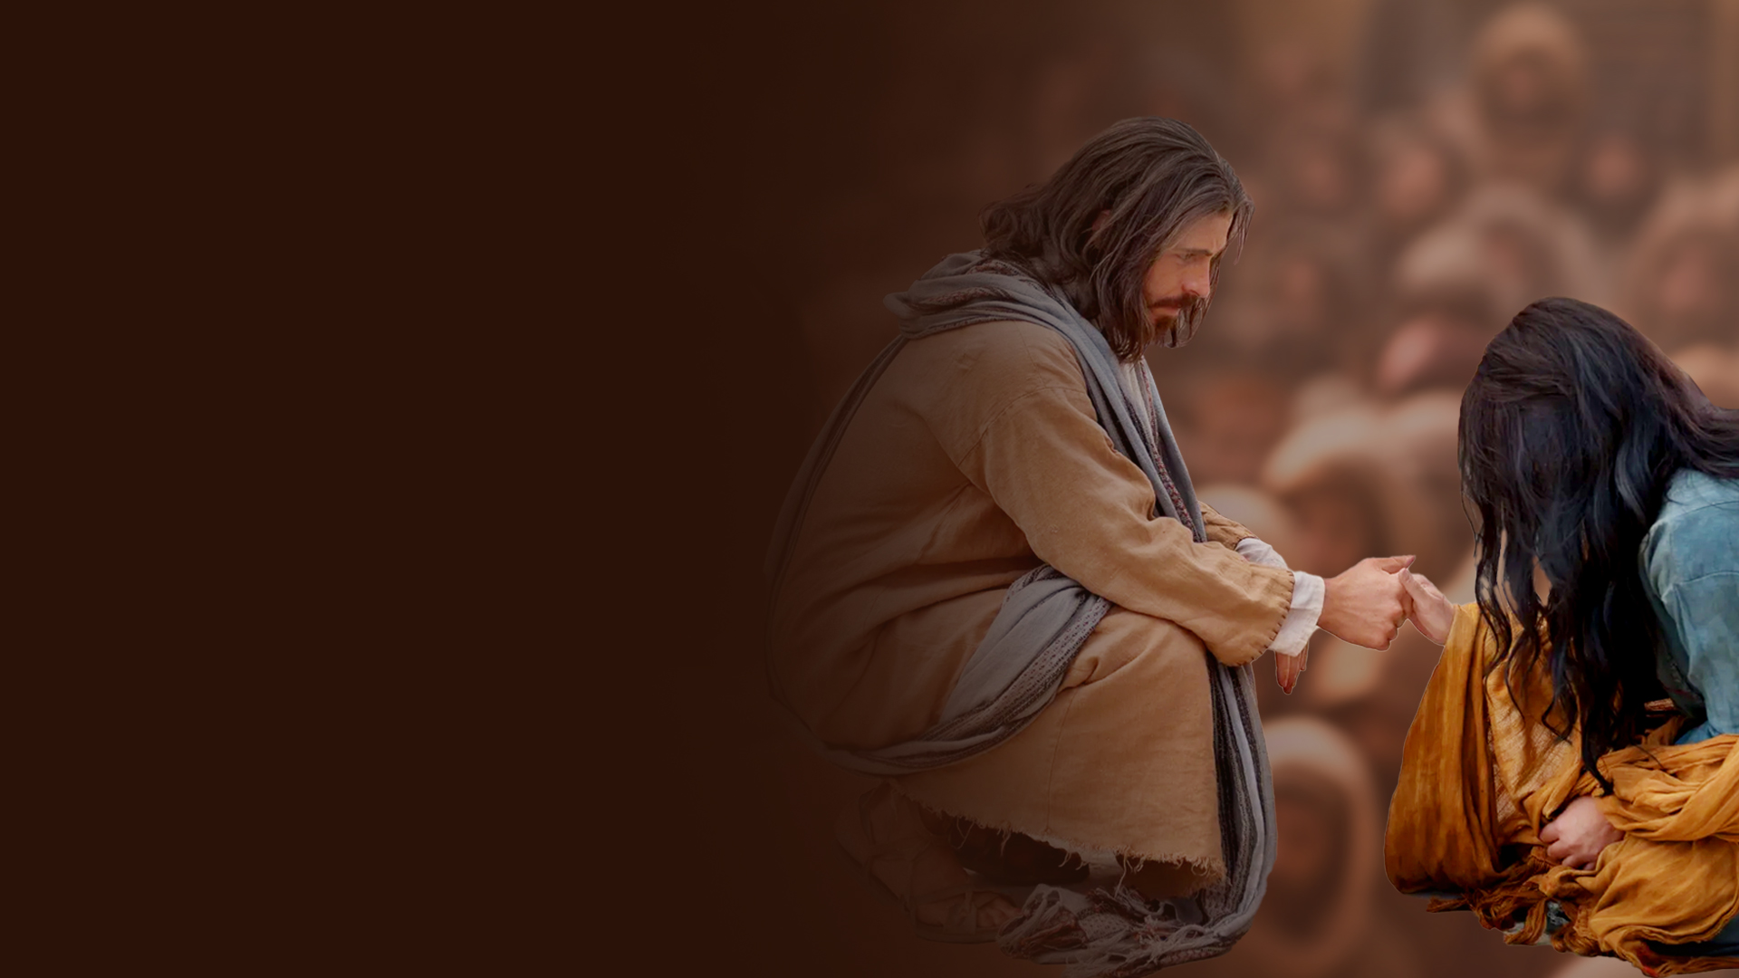
WOMAN, WHERE ARE YOUR ACCUSERS?
(JOHN 8:1-11)

Slide 10
I AM THE LIGHT OF THE WORLD (JOHN 8:12-20)

Slide 11
I ALWAYS DO THOSE THINGS THAT PLEASE HIM
(JOHN 8:21-30)

Slide 12
I SPEAK WHAT I HAVE SEEN WITH MY FATHER
(JOHN 8:31-38)

Slide 13
I PROCEEDED FORTH AND CAME FROM GOD
(JOHN 8:39-47)

Slide 14
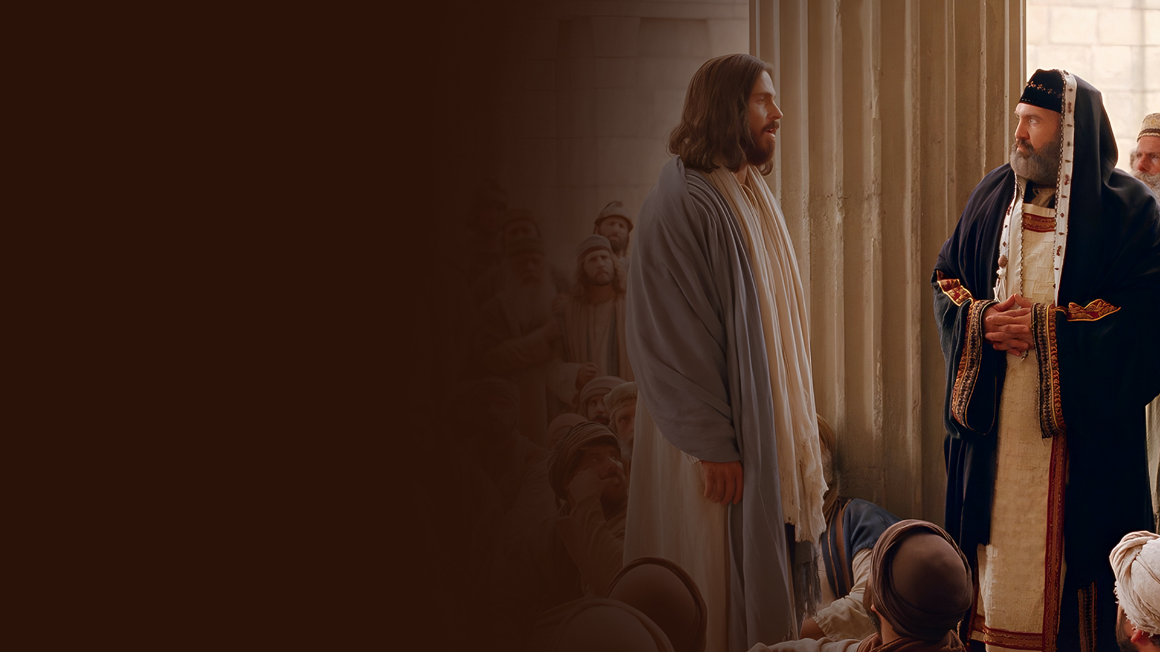
BEFORE ABRAHAM WAS, I AM (JOHN 8:48-59)

