Slide 1


Slide 2
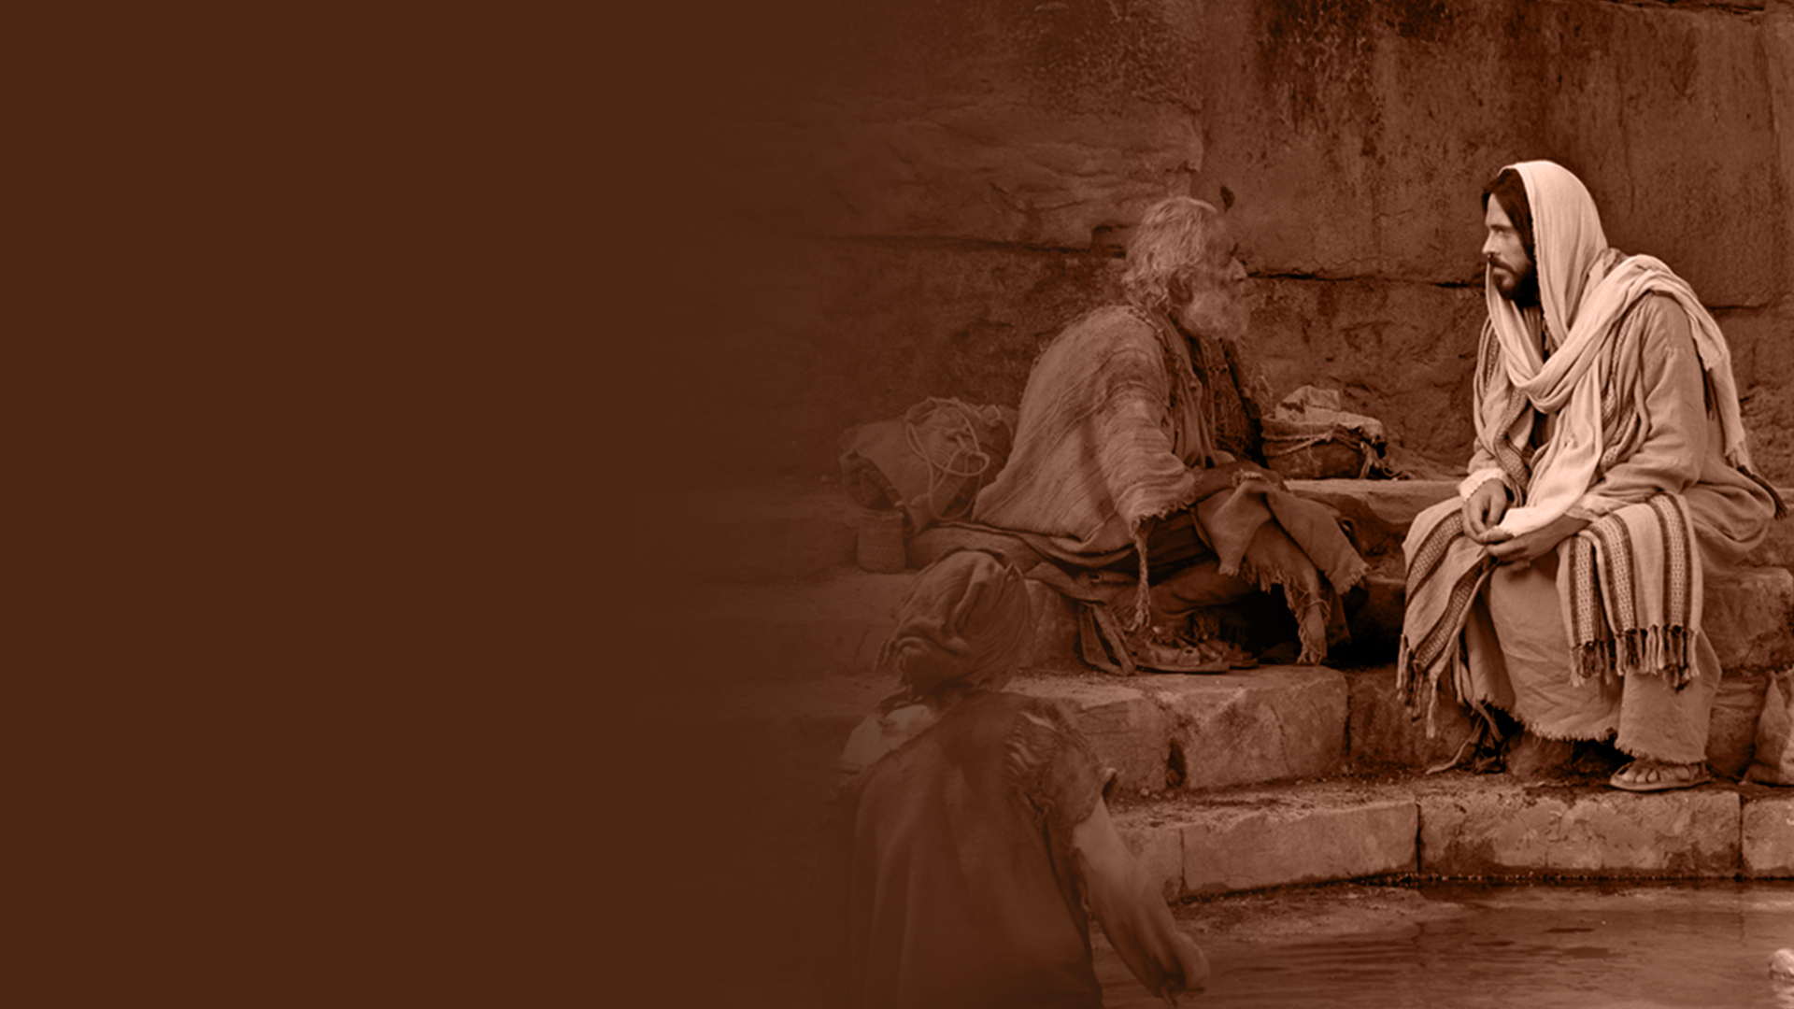
HEALING AT THE POOL OF BETHESDA (JOHN 5:1-15)

Slide 3
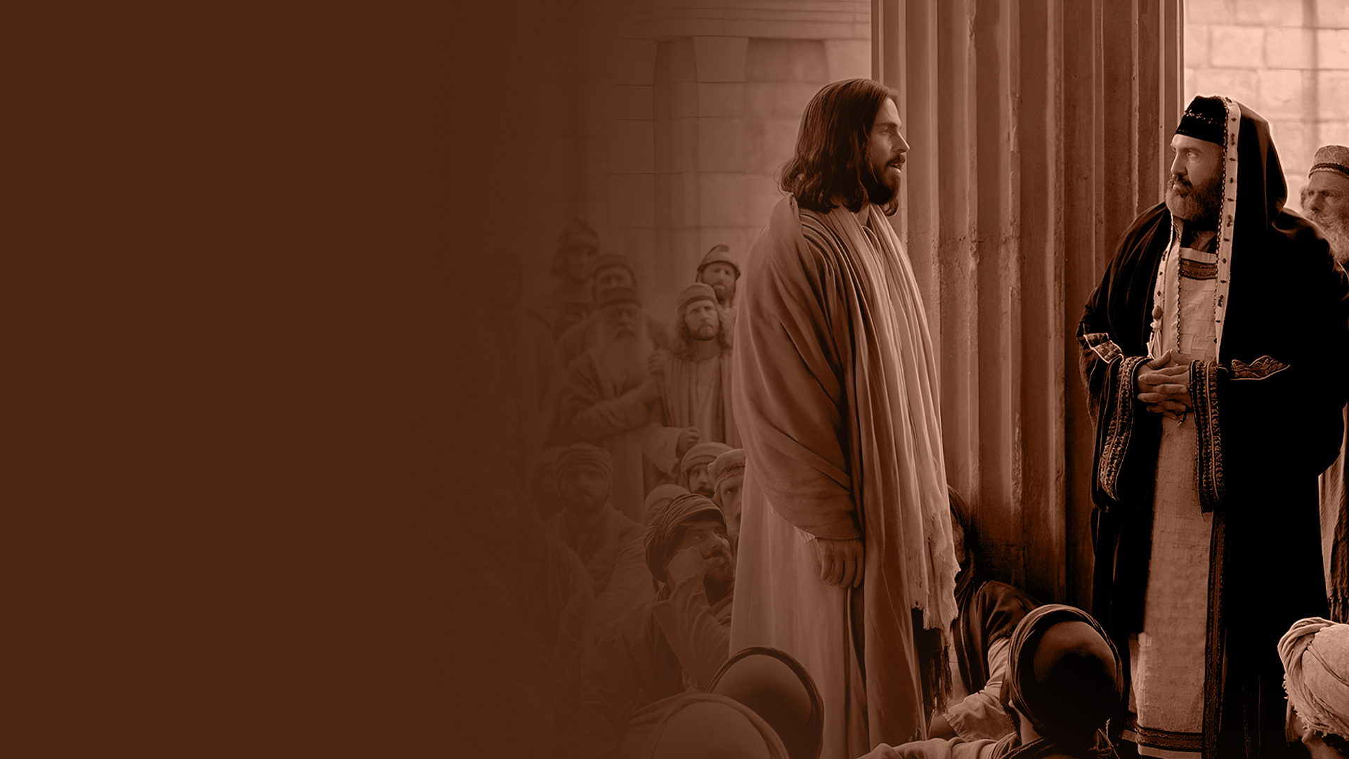
THE SON AND THE FATHER (JOHN 5:16-20)

Slide 4
HONOR THE SON JUST AS YOU HONOR THE FATHER (JOHN 5:21-29)

Slide 5
THE WORKS I DO BEAR WITNESS (JOHN 5:30-36)

Slide 6
THE FATHER HIMSELF BEARS WITNESS OF ME
(JOHN 5:37-47)

Slide 7
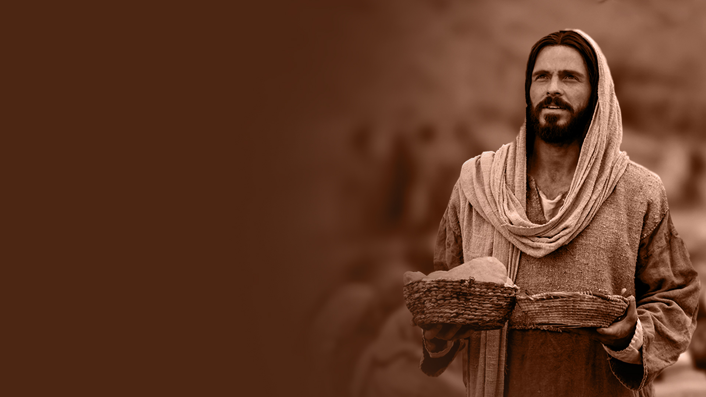
FEEDING THE FIVE THOUSAND (JOHN 6:1-15)

Slide 8
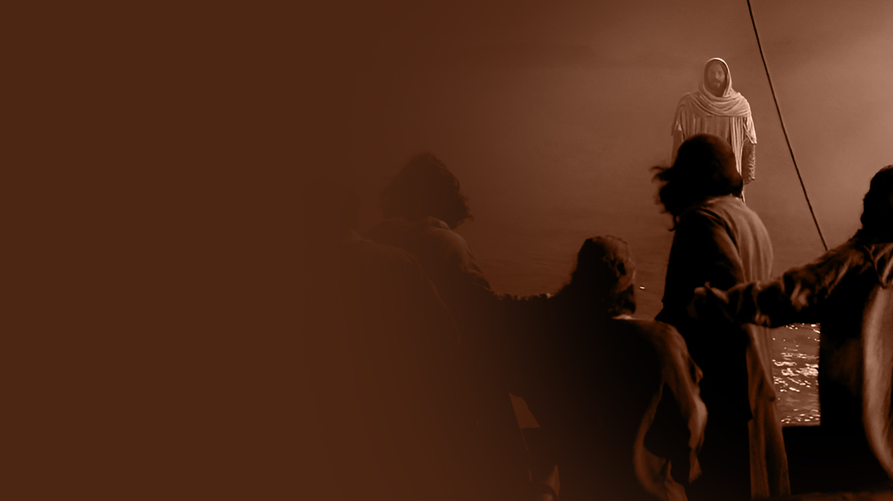
JESUS WALKS ON WATER
(JOHN 6:16-21)

Slide 9
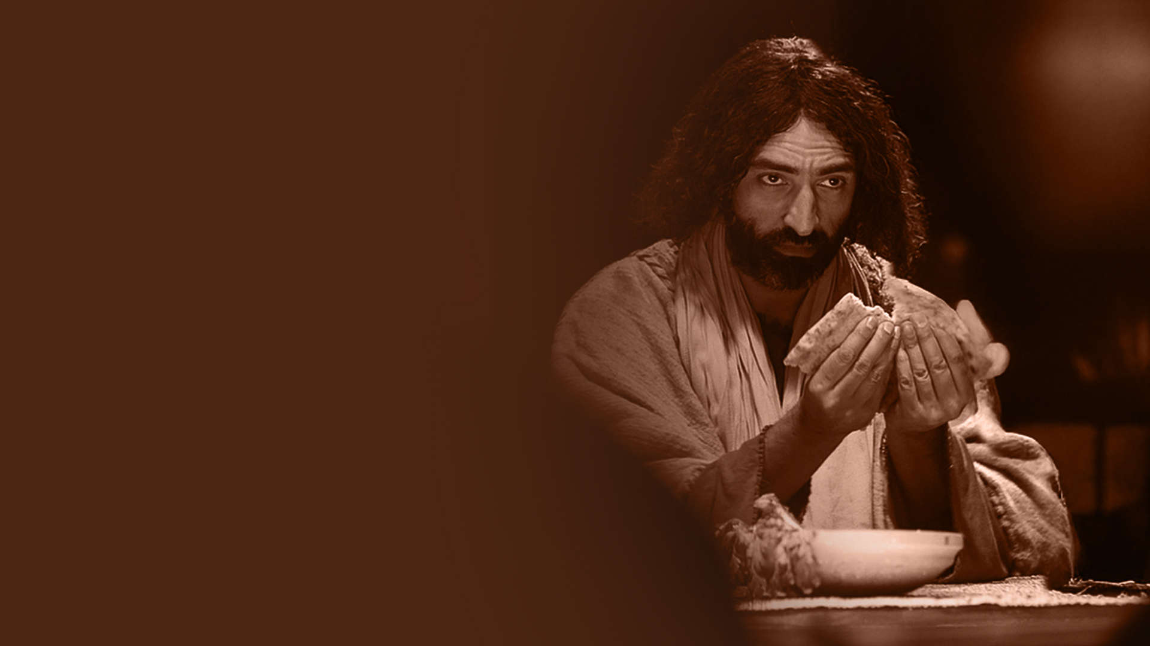
I AM THE BREAD OF LIFE
(JOHN 6:22-59)

Slide 10
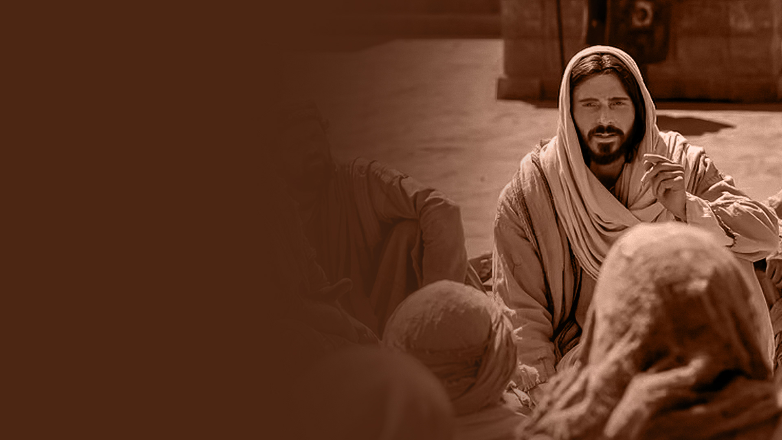
YOU HAVE THE WORDS OF ETERNAL LIFE (JOHN 6:60-71)

