Slide 2
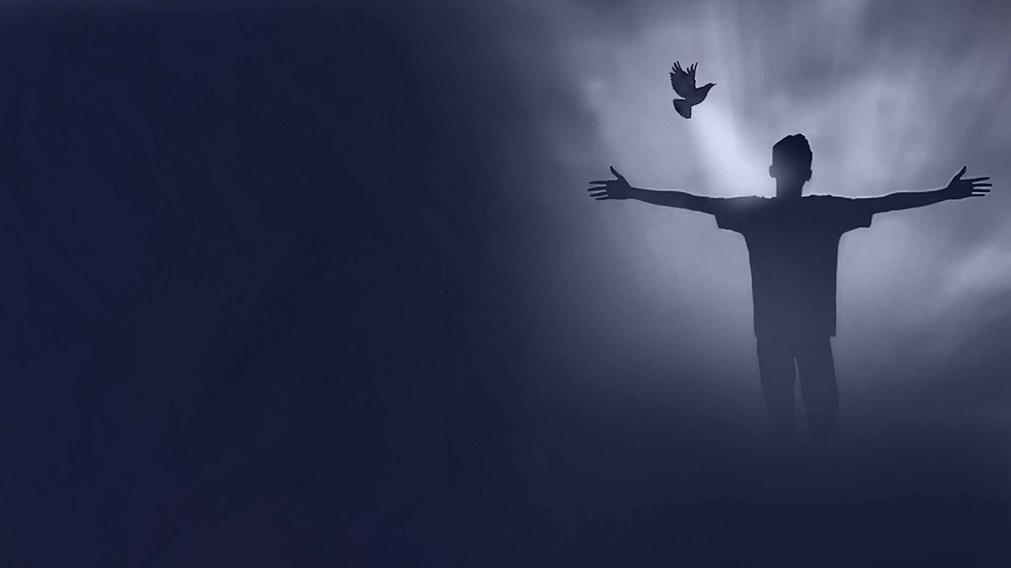
CHAPTER THREE:
BORN AGAIN

Slide 3
Unless one is born again (John 3:1-13)

Slide 4
God so loved the world (John 3:14-18)

Slide 5
Light and darkness
(John 3:19-21)

Slide 6
He must increase,
but I must decrease
(John 3:22-30)

Slide 7
He who comes from heaven (John 3:31-36)

Slide 8
CHAPTER FOUR:
THE MESSIAH

Slide 9
A Samaritan woman meets the Messiah
(John 4:1-26)

Slide 10
A city encounters the Messiah (John 4:27-42)

Slide 11
A nobleman meets Jesus at Cana of Galilee
(John 4:43-54)

