Slide 1


Slide 2
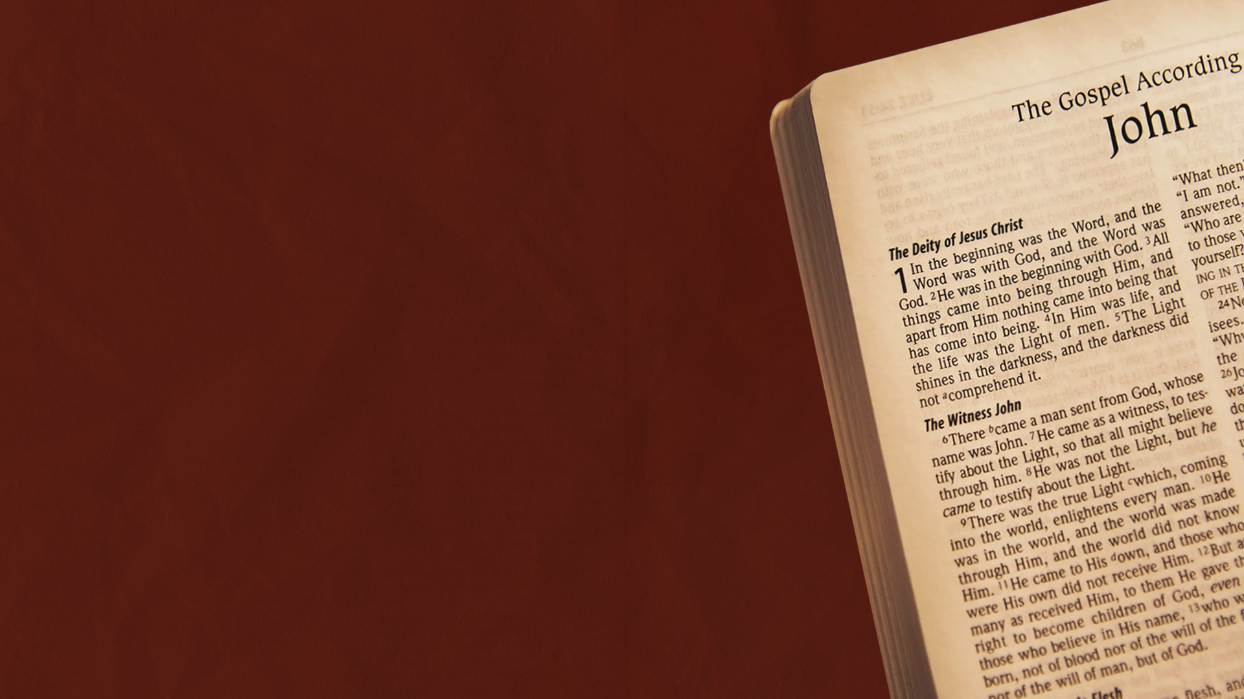
INTRODUCTION

Slide 3
Overview of the Gospel of John
When Was It Written?
By Whom Was It Written?
Where Was It Written?
To Whom Was It Written?
Under What Circumstances Was the Gospel Written?
How Was It Distributed?
How Was It Preserved?
Where Are the Manuscripts Preserved?

Slide 4
The Uniqueness of the Gospel of John

Slide 5
1. The Divinity of Christ
2. Unique Structure and Content
3. Signs Instead of “Miracles”
4. “I AM” Statements
5. Details of Individual Encounters

Slide 6
6. Keywords: “Believe,” “Eternal
Life”
7. Teaching on the Holy Spirit
8. The Crucifixion and Glorification
9. Distinct Vocabulary and
Symbolism
10. Post-Resurrection Appearance
to Thomas and Peter

Slide 7

CHAPTER ONE: THE ETERNAL INCARNATE WORD

Slide 8
The Eternal Word (1:1-5)

Slide 9
A Man Sent from God (1:6-8)

Slide 10
To Those Who Receive Him (1:9-13)

Slide 11
The Incarnate Word (1:14-18)

Slide 12
John, Who Are You? (1:19-23)

Slide 13
John, Why Do You Baptize? (1:24-28)

Slide 14
Behold! The Lamb of God (1:29-34)

Slide 15
The First to Follow Jesus (1:35-42)

Slide 16
Nathaniel Meets Jesus (1:43-51)

Slide 17
CHAPTER TWO: MANIFESTING HIS GLORY

Slide 18
A Wedding in Cana (2:1-11)

Slide 19
My Father’s House (2:12-17)

Slide 20
What Sign Do You Show Us? (2:18-22)

Slide 21
They Saw the Signs (2:23-25)

