Slide 2
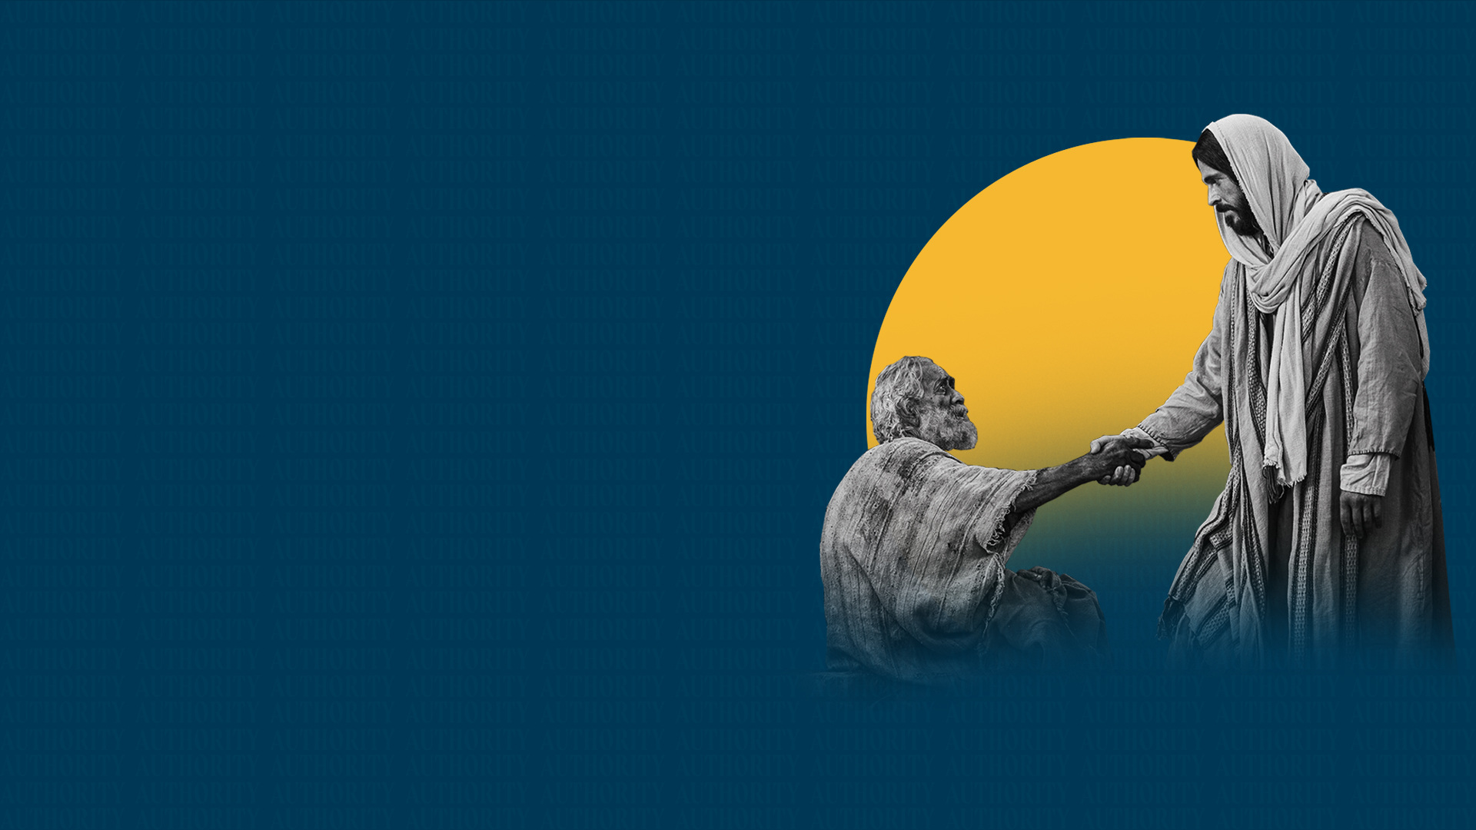
SPIRITUAL AUTHORITY

Slide 3
Example of the Traffic Police

Slide 4
THE LORD JESUS DEMONSTRATED AUTHORITY OVER NATURAL SITUATIONS, DEMONS, DISEASE, AND DEATH

Slide 5
He spoke to winds and waves, and they obeyed
He commanded sickness to leave, and it left
He commanded demons to leave, and they left
He commanded the dead to rise, and they did

Slide 6
THE LORD JESUS COMMISSIONED HIS DISCIPLES TO WALK IN AUTHORITY

Slide 7
The Twelve

Slide 8
Matthew 10:1
And when He had called His twelve disciples to Him, He gave them power over unclean spirits, to cast them out, and to heal all kinds of sickness and all kinds of disease.

Slide 9
Another Seventy

Slide 10
Luke 10:1,17-19
1 After these things the Lord appointed seventy others also, and sent them two by two before His face into every city and place where He Himself was about to go.
17 Then the seventy returned with joy, saying, "Lord, even the demons are subject to us in Your name."

Slide 11
Luke 10:1,17-19
18 And He said to them, "I saw Satan fall like lightning from heaven.
19 Behold, I give you the authority to trample on serpents and scorpions, and over all the power of the enemy, and nothing shall by any means hurt you.

Slide 12
The authority given to the early disciples continues on through the Church

Slide 13
AS BELIEVERS, WE HAVE SPIRITUAL AUTHORITY

Slide 14
Matthew 16:18,19
18 And I also say to you that you are Peter, and on this rock I will build My church, and the gates of Hades shall not prevail against it.
19 And I will give you the keys of the kingdom of heaven, and whatever you bind on earth will be bound in heaven, and whatever you loose on earth will be loosed in heaven.”

Slide 15
WE ARE SEATED IN A PLACE OF AUTHORITY

Slide 16
Ephesians 2:4-6
4 But God, who is rich in mercy, because of His great love with which He loved us,
5 even when we were dead in trespasses, made us alive together with Christ (by grace you have been saved),
6 and raised us up together, and made us sit together in the heavenly places in Christ Jesus,

Slide 17
WE HAVE BEEN GIVEN THE RIGHT TO USE THE NAME OF JESUS

Slide 18
Mark 16:17,18
17 And these signs will follow those who believe: In My name they will cast out demons; they will speak with new tongues;
18 they will take up serpents; and if they drink anything deadly, it will by no means hurt them; they will lay hands on the sick, and they will recover."

Slide 19
John 14:12-14
12 "Most assuredly, I say to you, he who believes in Me, the works that I do he will do also; and greater works than these he will do, because I go to My Father.
13 And whatever you ask in My name, that I will do, that the Father may be glorified in the Son.
14 If you ask anything in My name,
I will do it.

Slide 20
WE EXERCISE OUR AUTHORITY BY SPEAKING WORDS OF COMMAND IN THE NAME OF JESUS WITH FAITH IN OUR HEARTS

Slide 21
Faith is important when we exercise spiritual authority (Matthew 17:19-21)

Slide 22
SPEAK WITH AUTHORITY OVER SITUATIONS

Slide 23
Luke 8:24
And they came to Him and awoke Him, saying, "Master, Master, we are perishing!" Then He arose and rebuked the wind and the raging of the water. And they ceased, and there was a calm.

Slide 24
Follow the example of Jesus and speak to winds, waves, situations, etc

Slide 25
SPEAK WITH AUTHORITY OVER DEMONS AND DISEASE

Slide 26
Luke 4:35
But Jesus rebuked him, saying, "Be quiet, and come out of him!" And when the demon had thrown him in their midst, it came out of him and did not hurt him.

Slide 27
Luke 4:39
So He stood over her and rebuked the fever, and it left her. And immediately she arose and served them.

Slide 28
USE THE SWORD OF THE WORD AND DECLARE WHAT THE BLOOD HAS DONE FOR YOU

Slide 29
Ephesians 6:17
And take the helmet of salvation, and the sword of the Spirit, which is the word of God;

Slide 30
Revelation 12:11
And they overcame him by the blood of the Lamb and by the word of their testimony, and they did not love their lives to the death.

Slide 31
HAVE NO FEAR

Slide 32
Luke 10:19
Behold, I give you the authority to trample on serpents and scorpions, and over all the power of the enemy, and nothing shall by any means hurt you.

Slide 33
1 John 5:18
We know that whoever is born of God does not sin; but he who has been born of God keeps himself, and the wicked one does not touch him.

