Slide 2
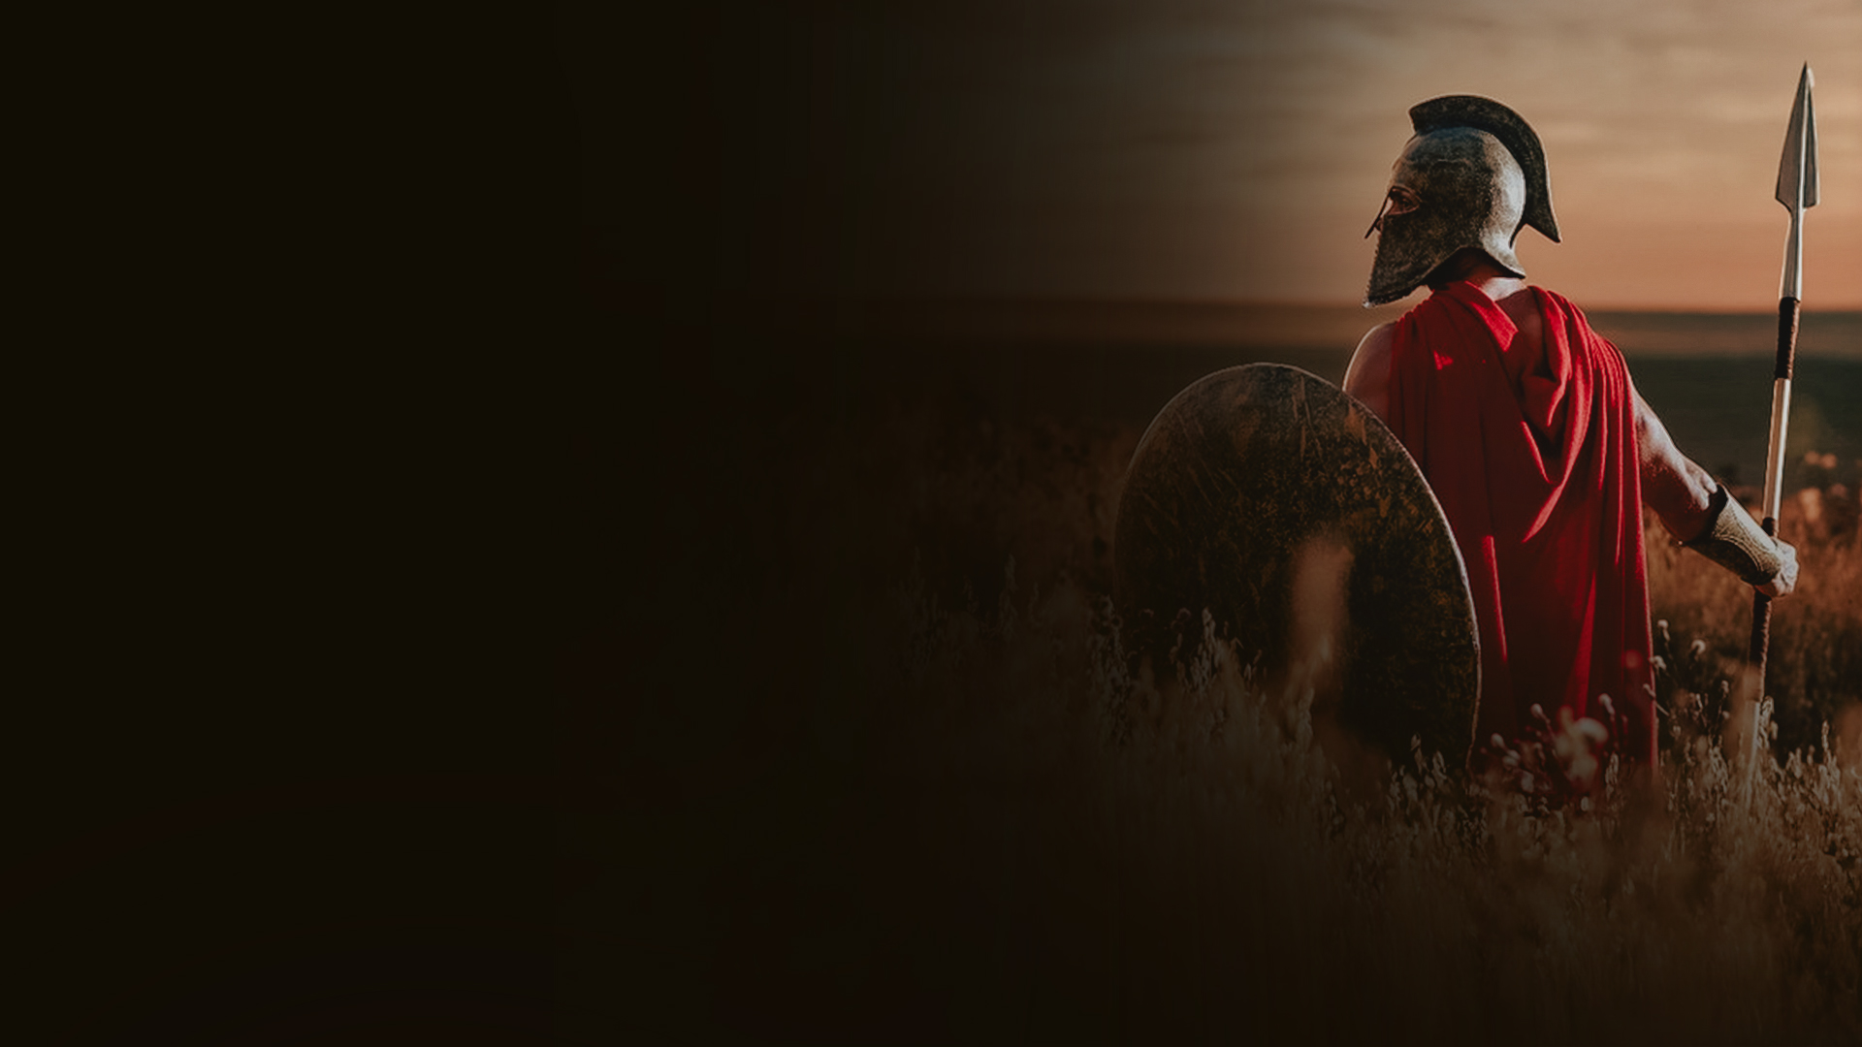
Ephesians 6:10-14
10 Finally, my brethren, be strong in the Lord and in the power of His might.
11 Put on the whole armor of God, that you may be able to stand against the wiles of the devil.
12 For we do not wrestle against flesh and blood, but against principalities, against powers, against the rulers of the darkness of this age, against spiritual hosts of wickedness in the heavenly places.

Slide 3
Ephesians 6:10-14
13 Therefore take up the whole armor of God, that you may be able to withstand in the evil day, and having done all, to stand.
14 Stand therefore, ...

Slide 4
1. BE STRONG IN THE LORD

Slide 5
2. PUT ON THE WHOLE ARMOR OF GOD (VS 11,13)

Slide 6
3. STAND AGAINST THE WILES OF THE DEVIL

Slide 7
4. WE WRESTLE AGAINST SPIRITUAL HOSTS OF WICKEDNESS

Slide 8
5. WITHSTAND IN THE EVIL DAY

Slide 9
6. HAVING DONE ALL TO STAND, STAND, AND KEEP STANDING!

